Slide 1
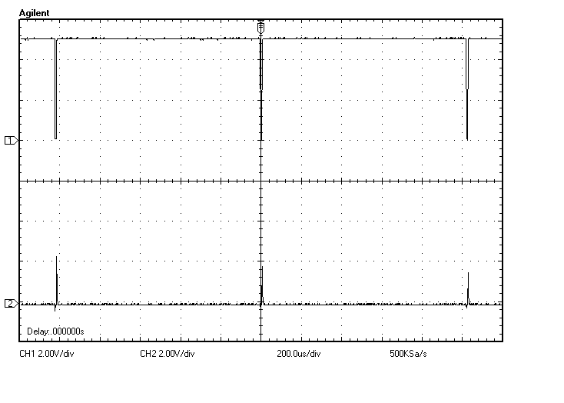
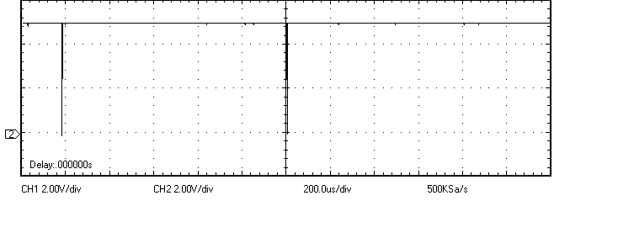
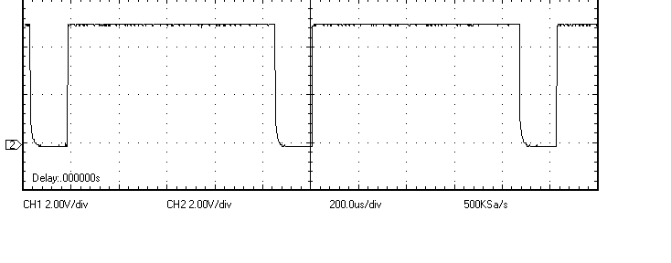
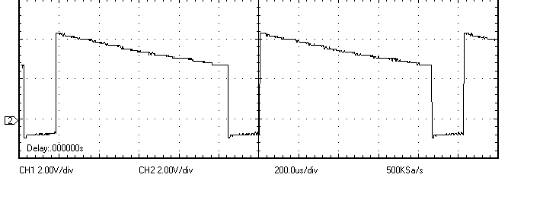
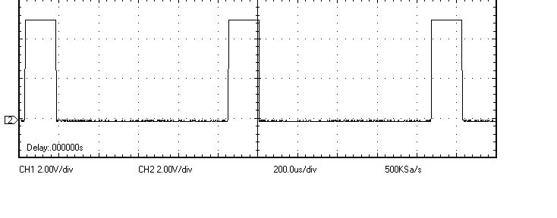
a
GND
200[μs/div]
2.00[V/div]
b
GND
k
GND
電圧 V[V]
l
GND
o
GND
q
GND
時刻 t [μs]

Slide 2
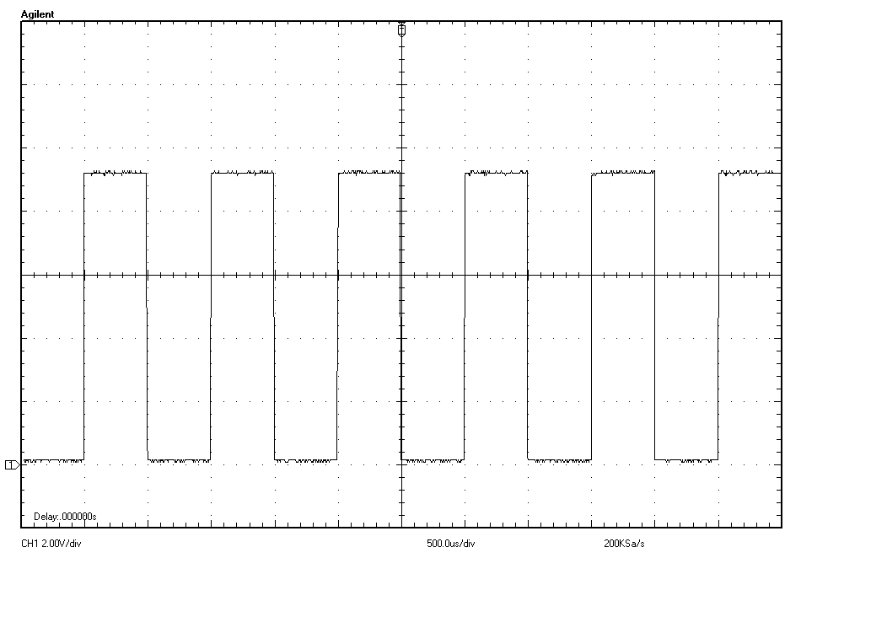
500[μs/div]
2.00[V/div]
GND

