Slide 1
DIGITAL CONCEPT ART II
4
PROP STUDIES
Midterm Presentation
2PROPS
2CHARACTERS
Midterm · Prop Design · Spring 2026

Slide 2
SUMMARY
2 Prop 2 CHARCTER
01
MILITARY LENSATIC
02
IWI TAVOR TAR-21
03
INDIAN MARCOS
04
CLASSROOM TEACHER

Slide 3
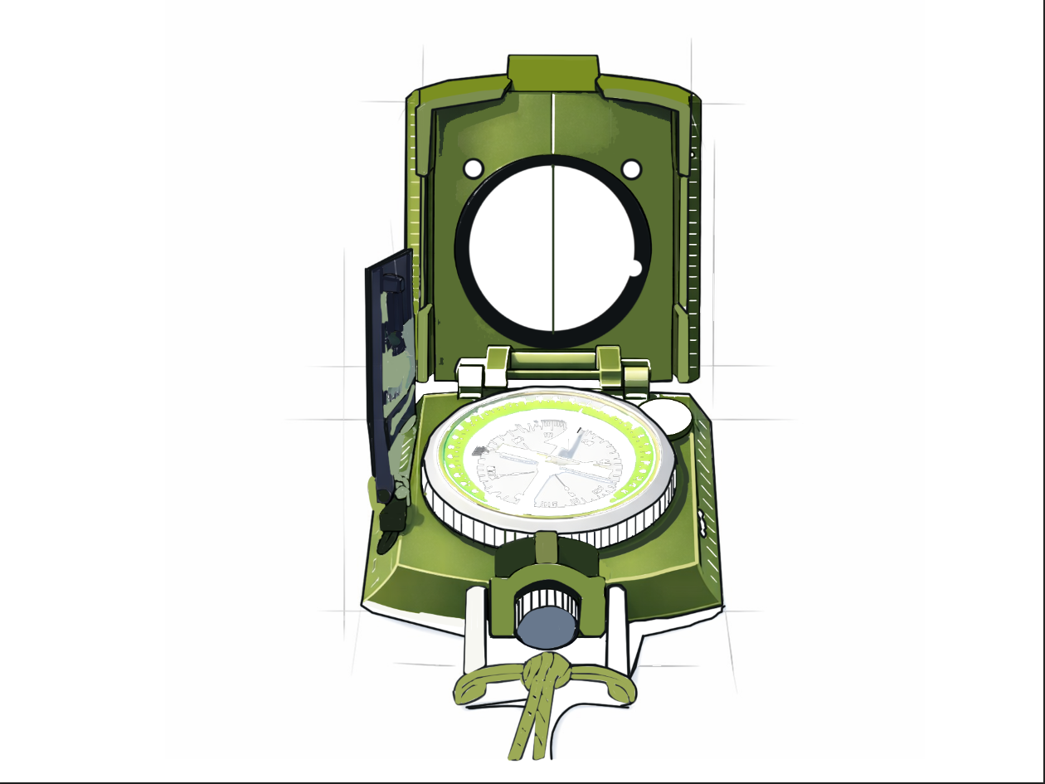
01
PROP
MILITARY LENSATIC
REAL-LIFE REFERENCE DETAILS
Scroll for full analysis →

Slide 4
01 · WEATHERED LANTERN · REAL-LIFE REFERENCE DETAILS
OVERVIEW
A rugged military-style lensatic compass used for navigation and land orientation. Commonly issued to soldiers, hikers, and surveyors. Built with a durable metal housing, a magnetic dial, and a sighting lens for precise directional readings.
DESIGN INSPIRATION
Real life Education
For Class Teacher
Forest Adventurers.
Game-Delta Force,Pubg Pc

Slide 5
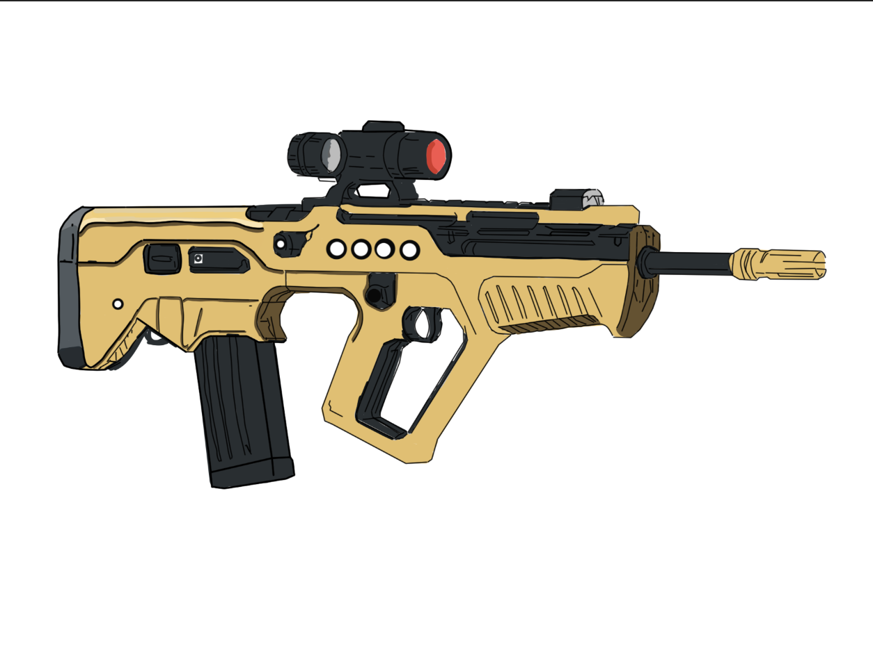
03
PROP
IWI TAVOR TAR-21
Scroll for full analysis →

Slide 6
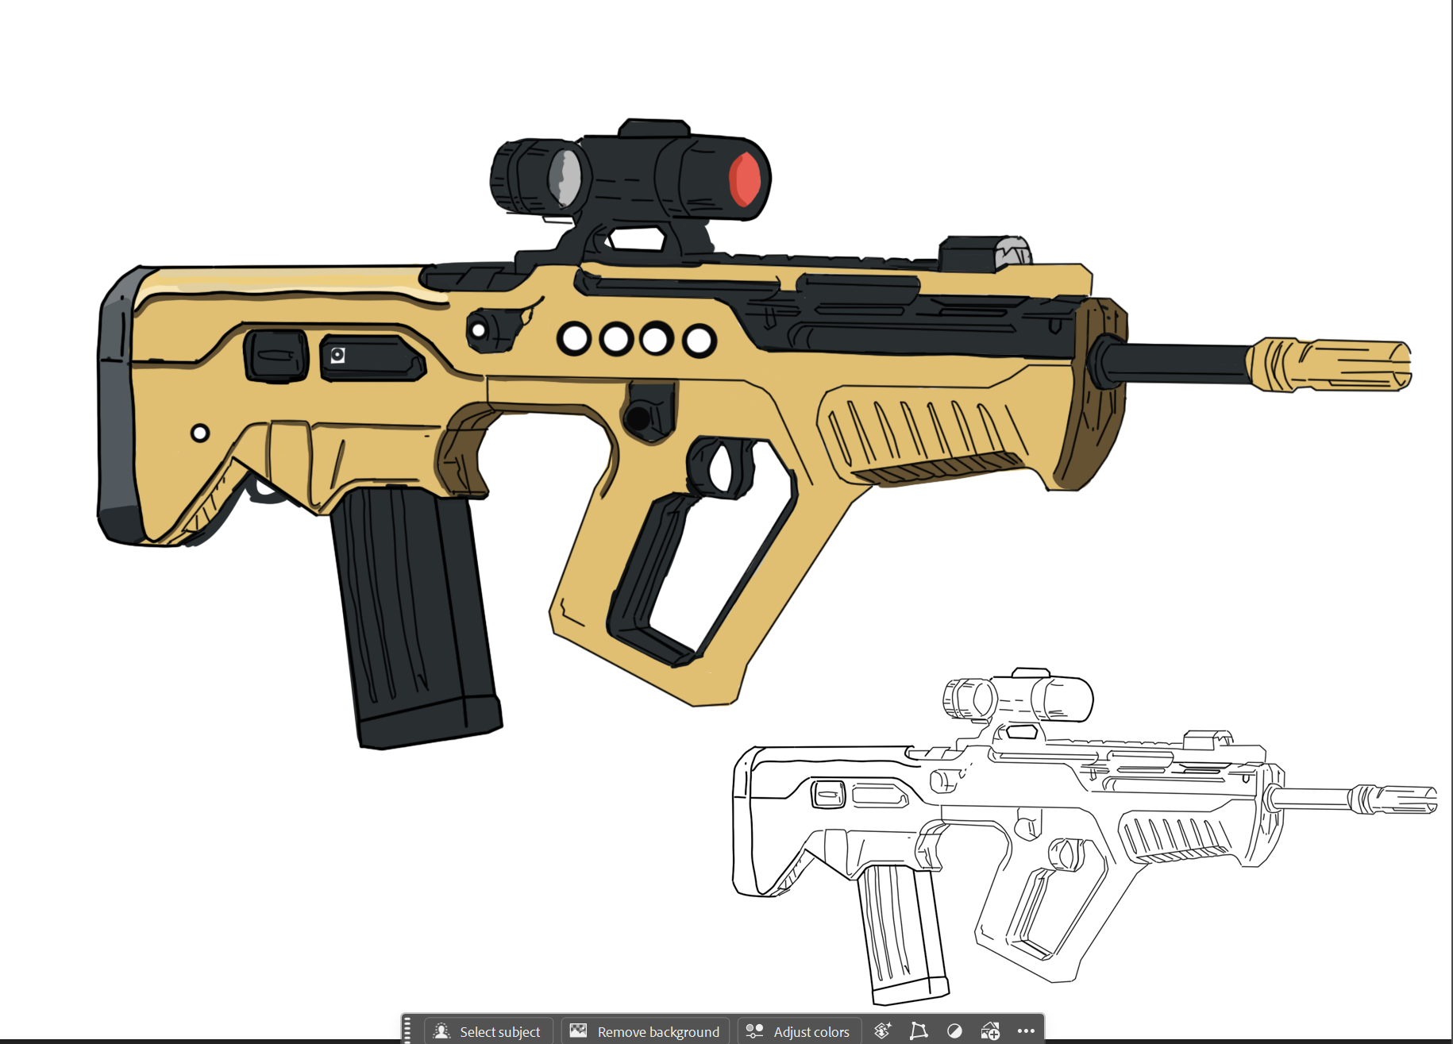

Slide 7
03 · MEDIEVAL SWORD · REAL-LIFE REFERENCE DETAILS
OVERVIEW
The Tavor TAR-21 is a modern bullpup-style assault rifle developed by Israel Weapon Industries. It is widely recognized for its compact form factor, reliability, and futuristic design. The rifle places the action and magazine behind the trigger, allowing a shorter overall length while maintaining a standard barrel length..
DESIGN INSPIRATION
Weapon use by Indian Marcos
Theme and Art design- Farlight 84

Slide 8
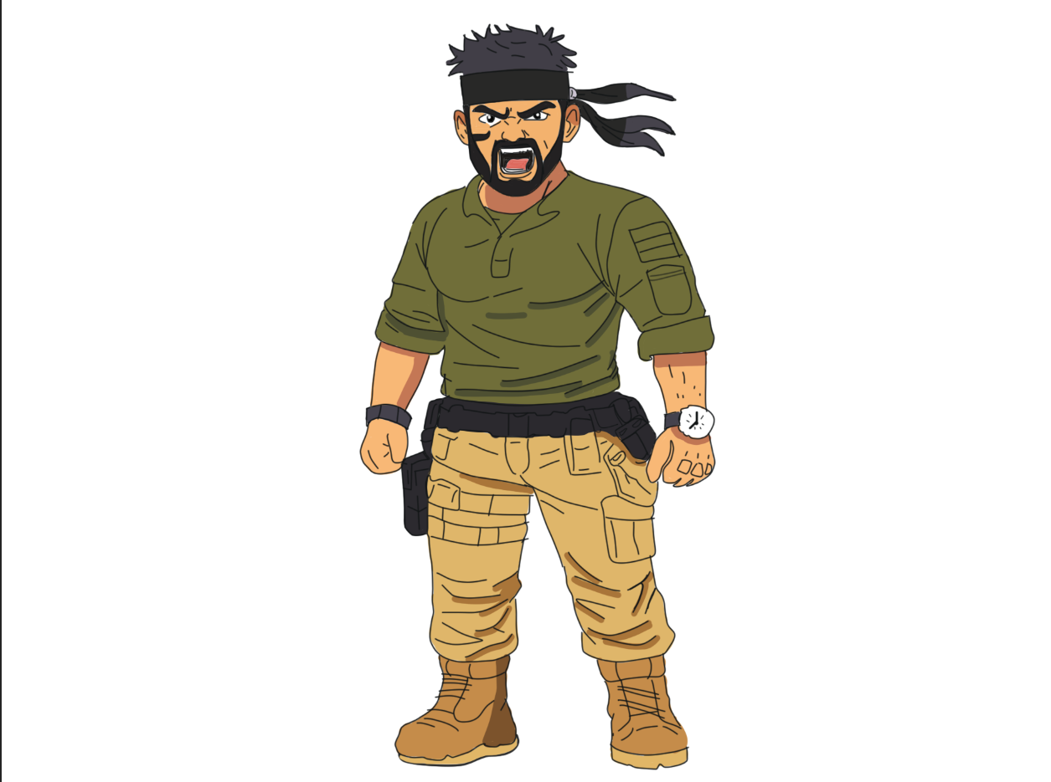
02
PROP
INDIAN MARCOS
Scroll for full analysis →

Slide 9
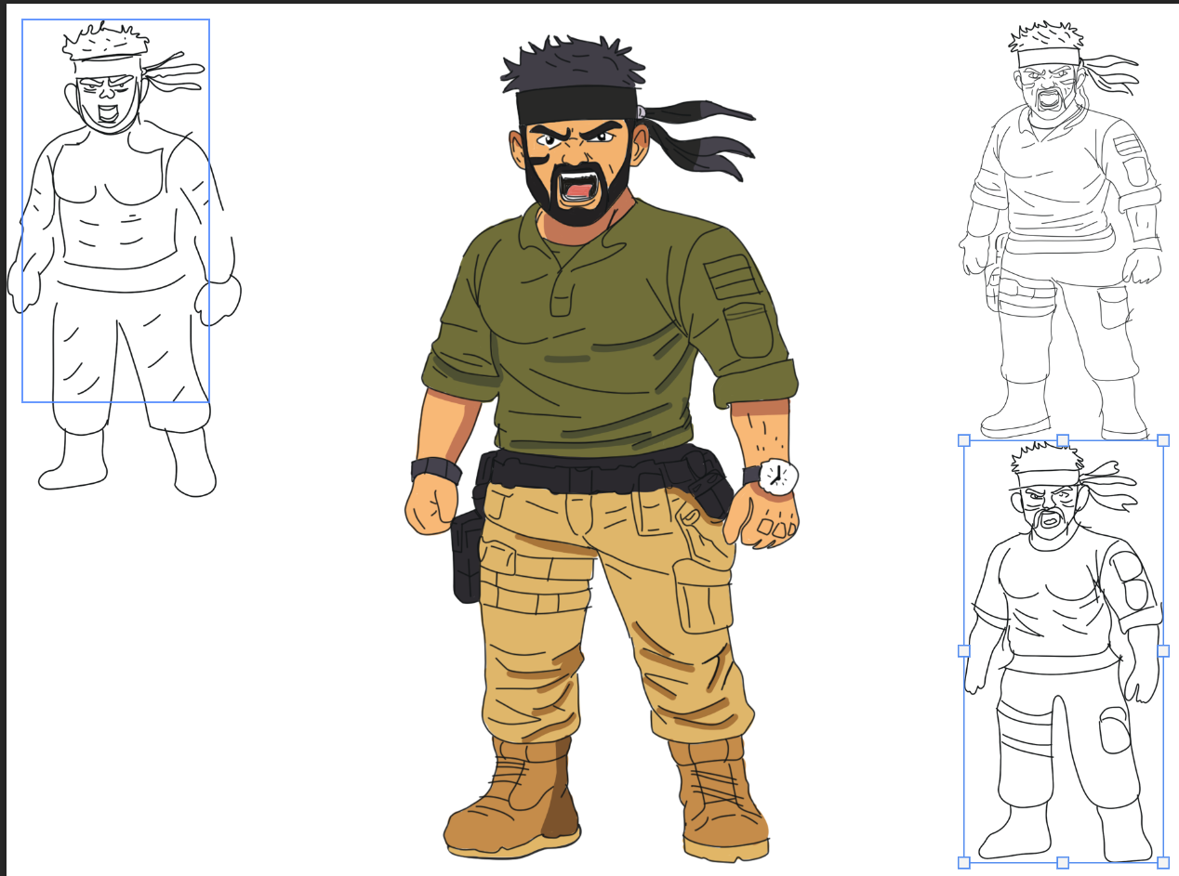

Slide 10
02 · LEATHER SATCHEL · REAL-LIFE REFERENCE DETAILS
OVERVIEW
A fully realized colored depiction of “Indian Marco,” an elite MARCOS commando. This version emphasizes realism through color balance, material contrast, and tactical authenticity while retaining a bold, stylized comic aesthetic. The character radiates intensity, authority, and battlefield readiness.
DESIGN INSPIRATION
Indian Marcos
Theme and Art Design –Farlight 84
Angry Emotion

Slide 11
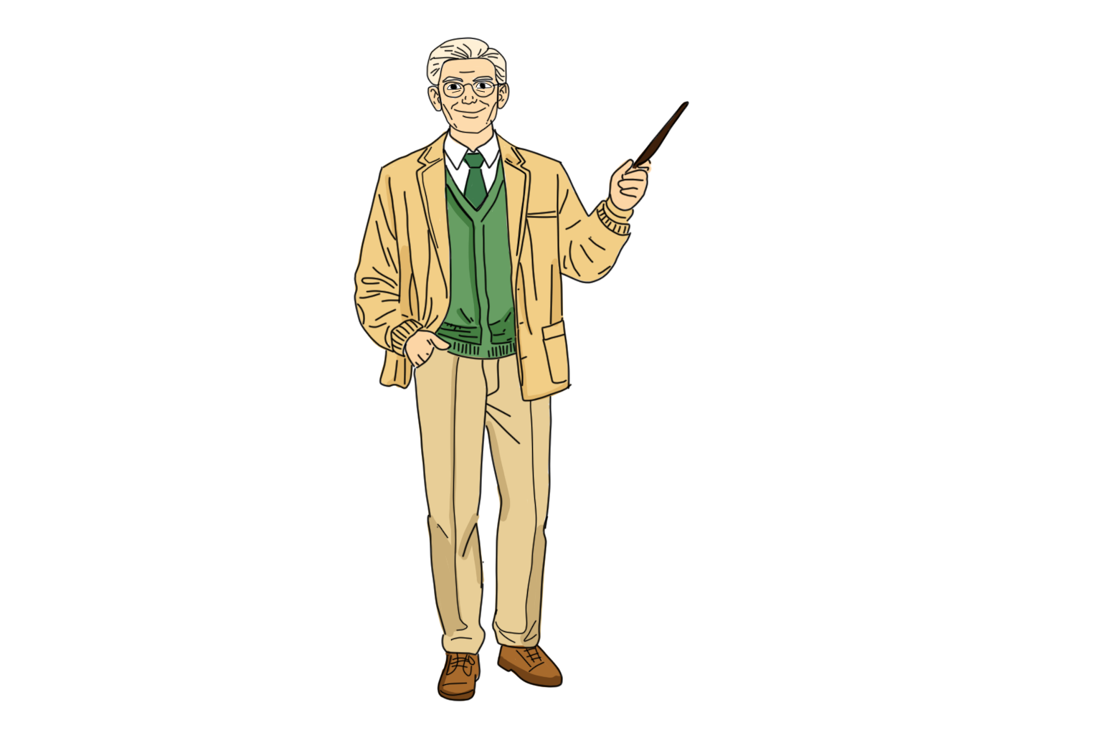
04
PROP
CLASSROOM TEACHER
Scroll for full analysis →

Slide 12
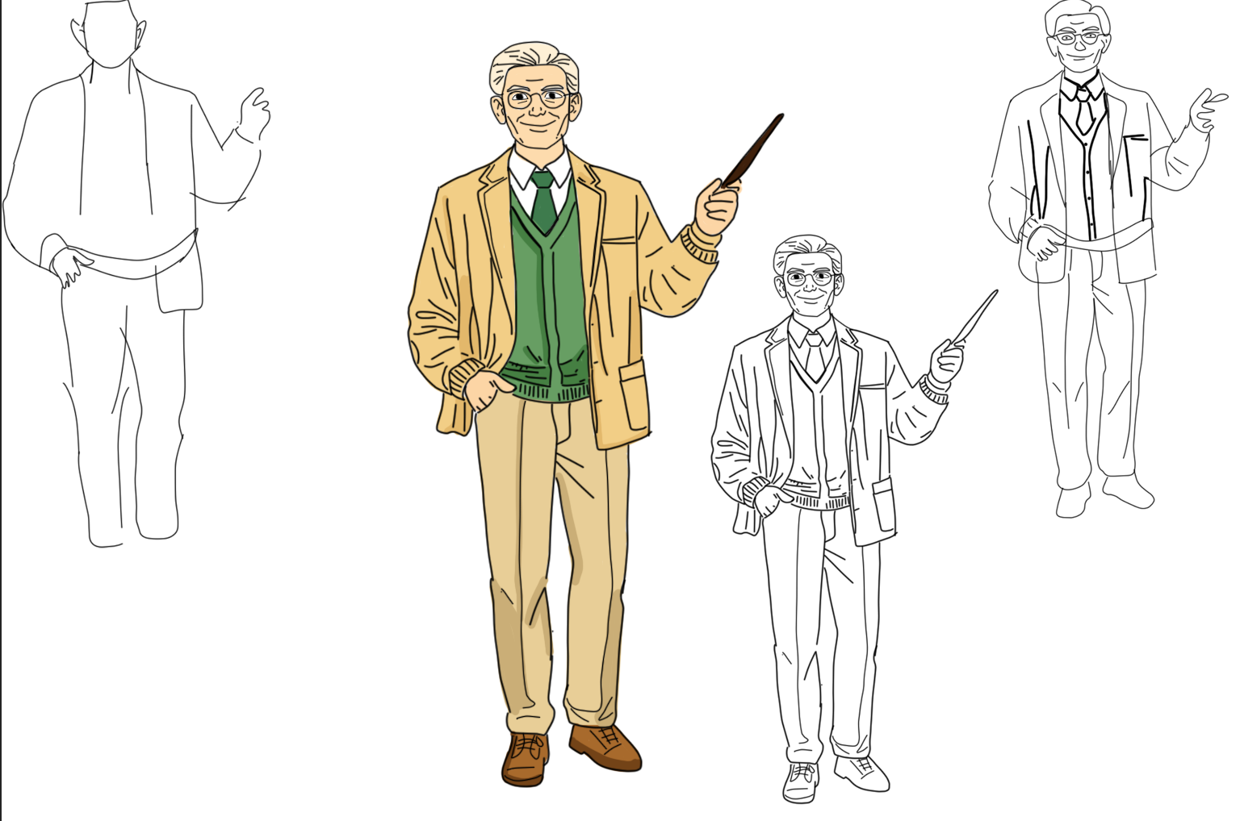

Slide 13
04 · VINTAGE COMPASS · REAL-LIFE REFERENCE DETAILS
OVERVIEW
A friendly, knowledgeable classroom teacher presenting a lesson with confidence and clarity. The character embodies approachability, intelligence, and calm authority—ideal for educational settings, explainer content, or academic-themed visuals.
DESIGN NOTES
Friendly Nature
Emotion – Happy
Best Profession

