Slide 1
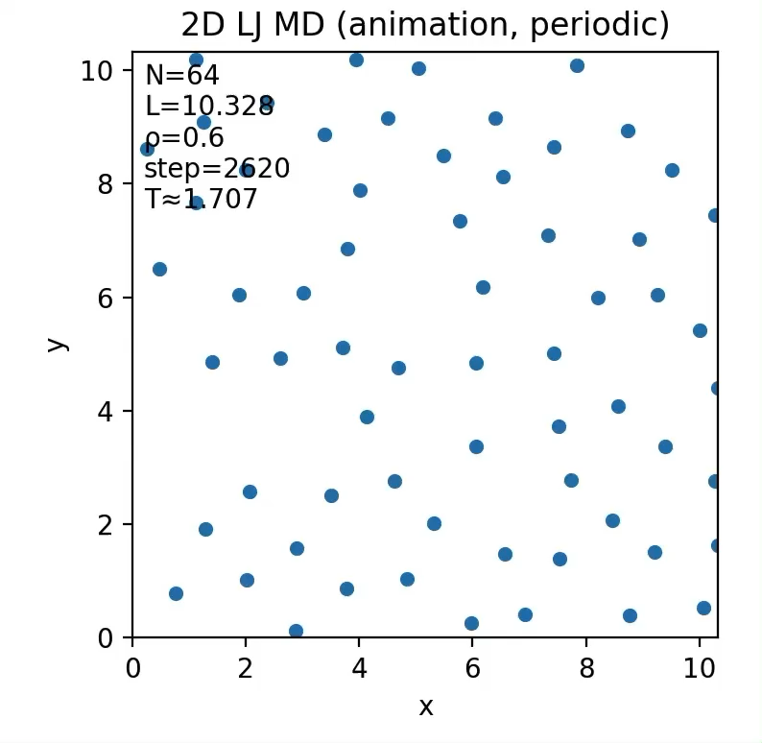
Monte Carlo Simulation | Hackathon Summary
Monte Carlo Simulation | Hackathon Summary
Monte Carlo Simulation
Model: 2D Lennard-Jones potential
Result: Molecular motion looked reasonable
Next goal: Verify implementation correctness
→ Calculate argon vapor pressure curve
CompPhysHack
CompPhysHack
1

Slide 2
Monte Carlo Simulation | Hackathon Summary
Monte Carlo Simulation | Hackathon Summary
Argon Vapor Pressure Curve
GEMC = Gibbs Ensemble MC (vapor–liquid coexistence)
Python implementation(too slow) → migrated to Rust → speedup!
Computation time comparison (no cutoff, no cell list)
Condition
Python (s)
Rust (s)
Speedup
N=20, T=114K
273.3
0.30
~910×
40000 steps
CompPhysHack
CompPhysHack
2

Slide 3
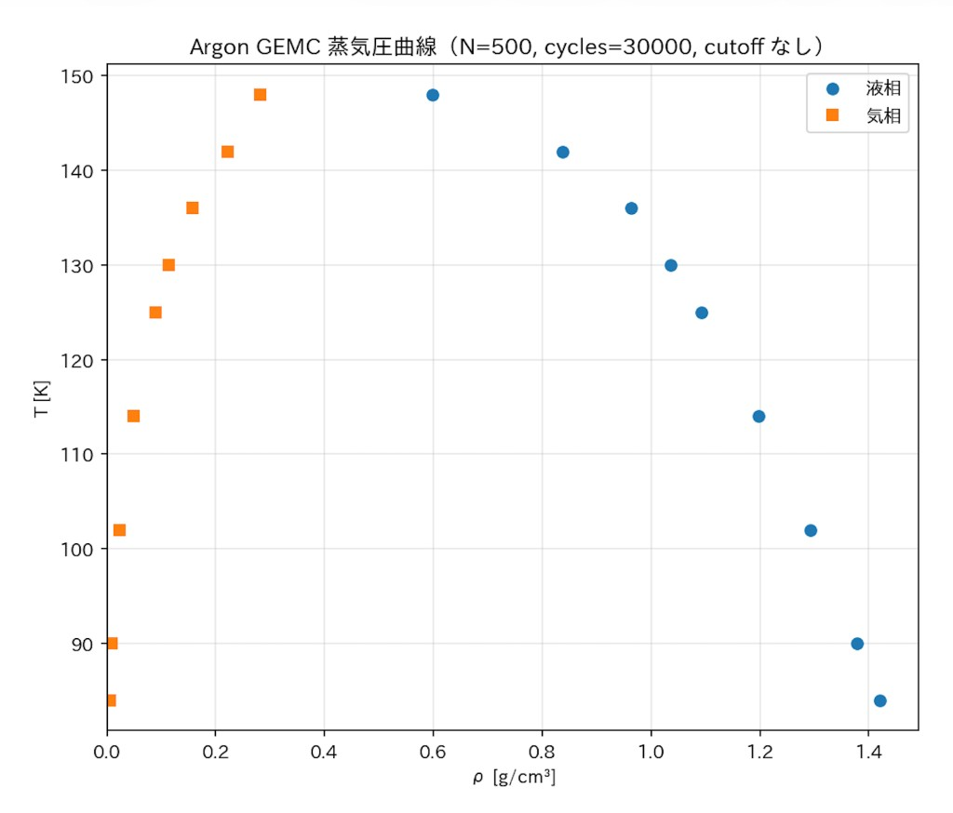
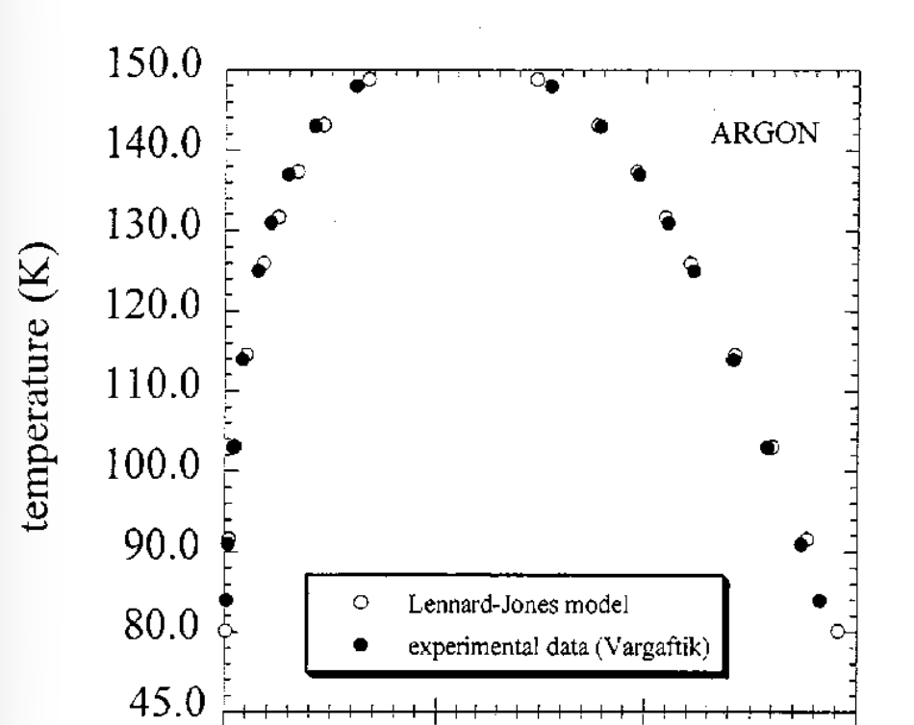
Monte Carlo Simulation | Hackathon Summary
Monte Carlo Simulation | Hackathon Summary
Argon Vapor Pressure Curve
Results agree well with prior studies
CompPhysHack
CompPhysHack
3

