Slide 1
Library Management System (A Microservices-based Application)
By- Aman Yadav

Slide 2
Library Management System
This Library Management System is designed using microservices architecture. It manages all essential library operations such as book inventory, member management, and admin functionalities.
Features:
• Users can search, borrow, and return books.
• Members can view their profiles and issued books.
• Admins can manage books, members, and overall system settings.
Tech Stack:
• Backend → Flask (Python)
• Frontend → Angular
• Databases → Separate DB per service
• Deployment → Docker & Docker Compose

Slide 3
Architecture Used – Microservices
Each service is independent and loosely coupled.
Services communicate via REST APIs through a central Gateway Service.
Each service has its own database, ensuring data isolation.
Advantages:
Scalability → Services can be scaled independently.
Fault Isolation → Failure in one service doesn’t affect others.
Faster Development → Teams can work on different services in parallel.

Slide 4
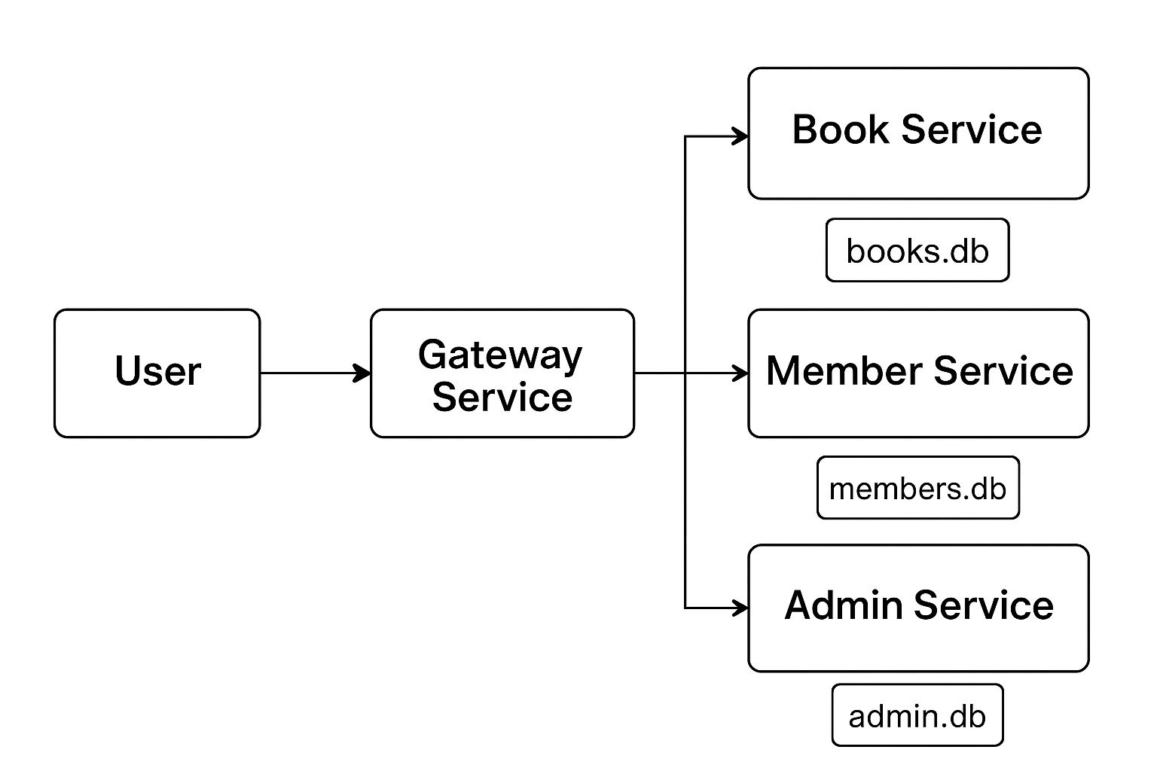
Architecture Diagram
User interacts via Gateway.
Gateway routes requests to:
Book Service → Handles books CRUD
Member Service → Manages users/members
Admin Service → Admin controls & authentication
Each service connects to its own database.

Slide 5
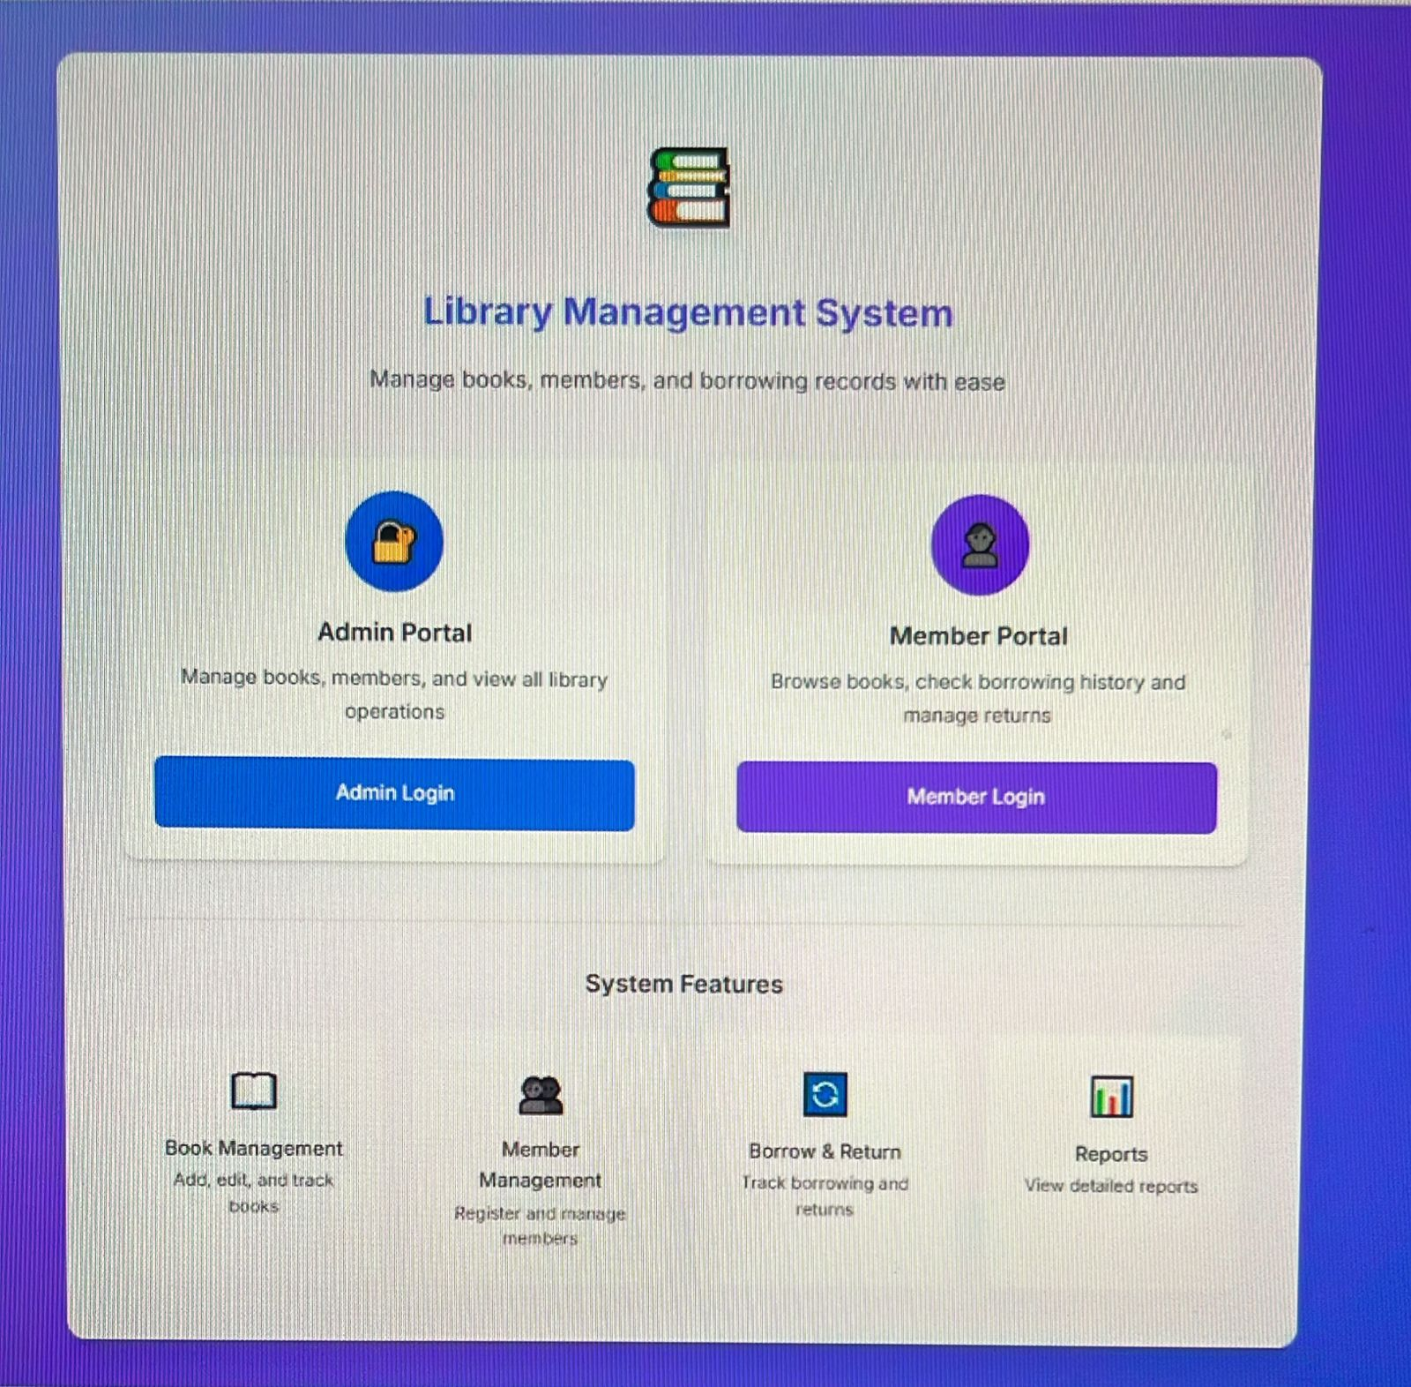
Service Overview & APIs
Book Service
• GET /books → List all books
• POST /books → Add new book
• PUT /books/{id} → Update book
• DELETE /books/{id} → Delete book
Member Service
• GET /members → List all members
• GET /members/{id} → Member by ID
• POST /members → Add new member
Admin Service
• POST /register → Register new admin
• POST /login → Authenticate admin

Slide 6
Containerization
Each microservice is packaged into a Docker container.
Containers created:
- Book Service Container
- Member Service Container
- Admin Service Container
- Gateway/Frontend Container
Benefits:
• Consistent across environments.
• Easy to update/scale services.
• Portable and lightweight.

Slide 7
Deployment - Docker Compose
• Multi-container setup managed via docker-compose.yml.
• One command starts everything:
docker-compose up
• If you want to force rebuild everything (ignoring cache), use:
docker-compose build --no-cache
Advantages:
• Simplifies multi-service management.
• Handles service dependencies automatically.
• Allows scaling specific services without affecting others.
After that, your services will be running at:
• http://localhost:5001 → Book Service
• http://localhost:5002 → Member Service
• http://localhost:5003 → Admin Service
• http://localhost:5000 → Gateway

Slide 8
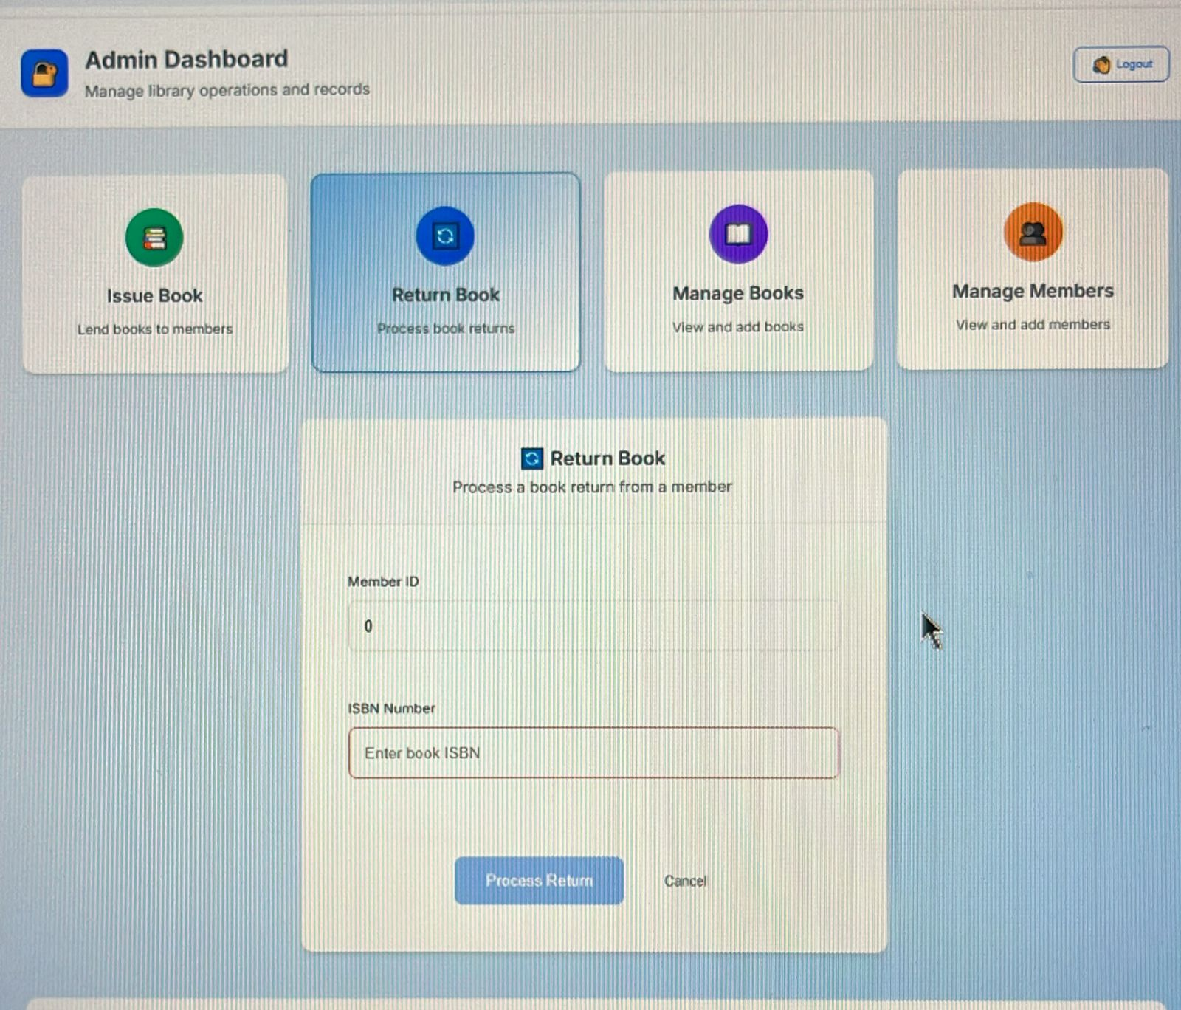
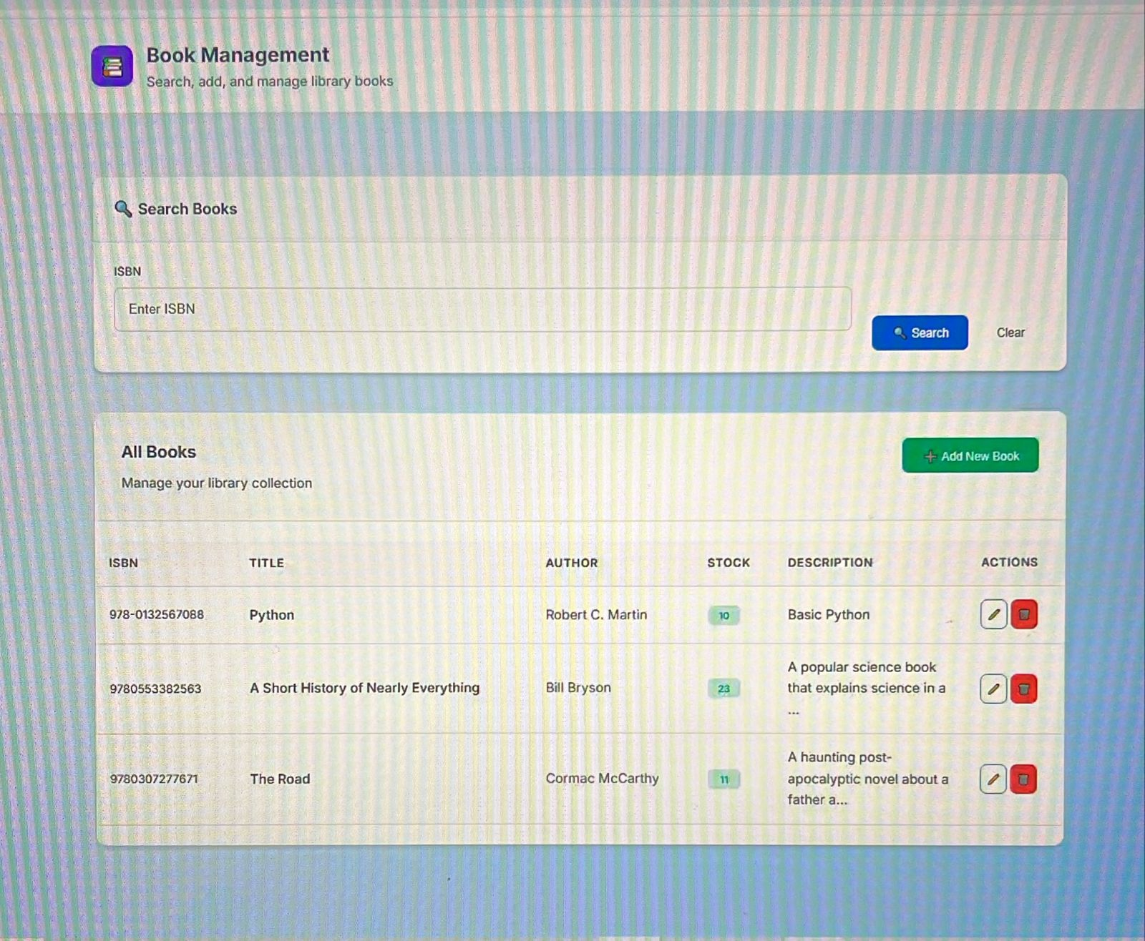
RESULTS

Slide 9
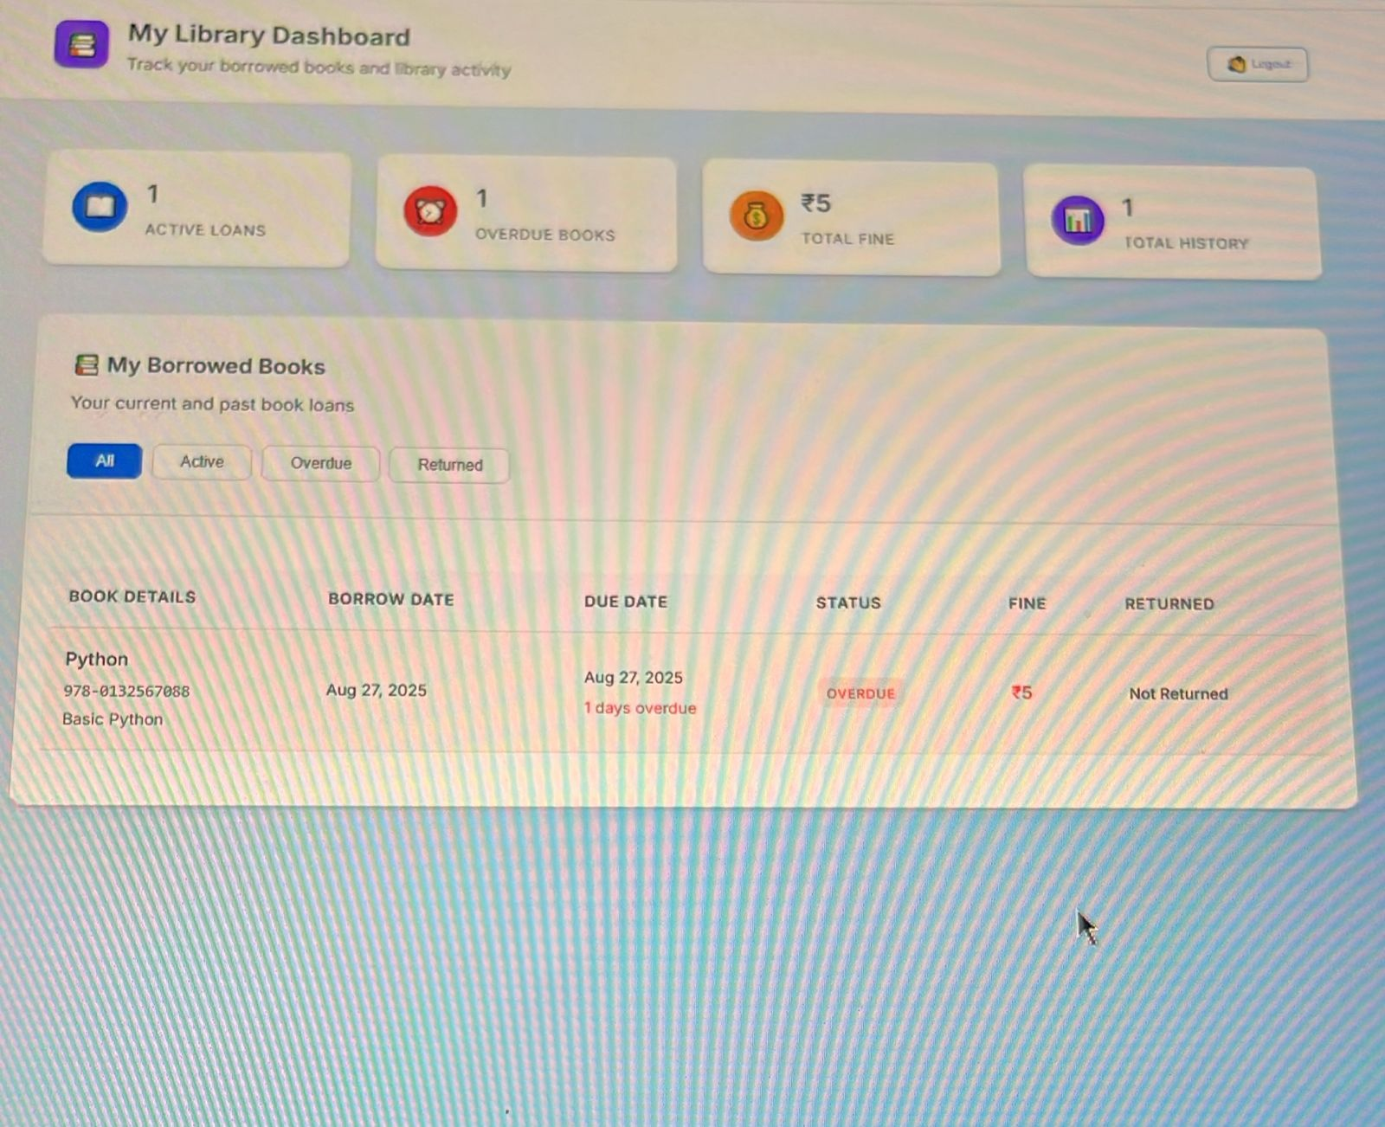
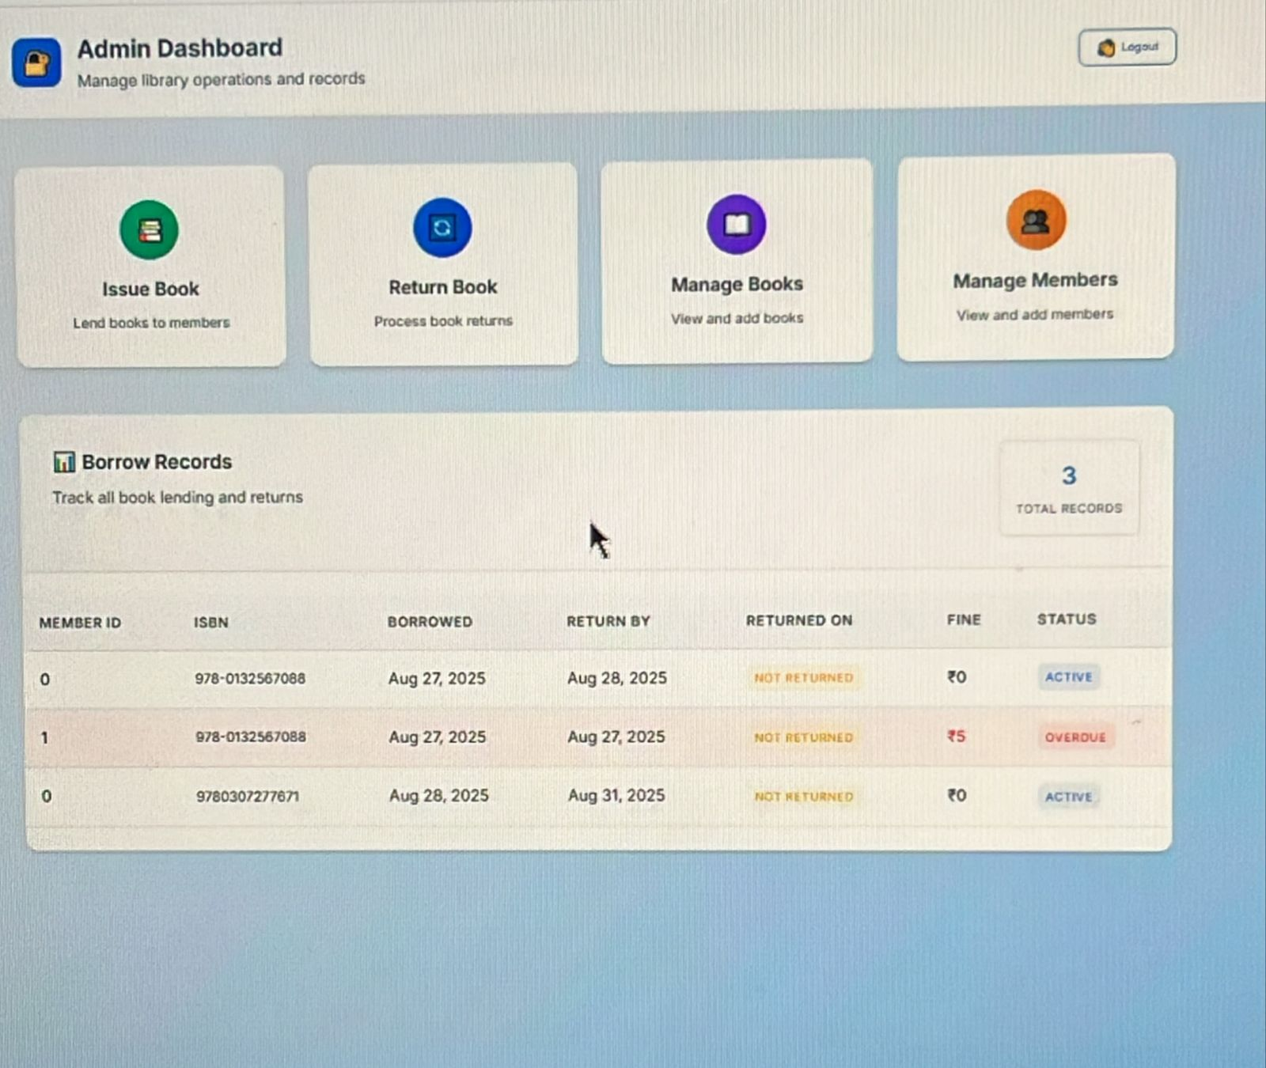
RESULTS

Slide 10
THANK YOU

