Slide 1
Introduction
Dr. Lavdie RADA
(lavdie.rada@bau.edu.tr)

Slide 2
Images-Digital Images
An image is a two-dimensional function f(x,y), where x and y are the spatial (plane) coordinates, and the value (amplitude) of f at any pair of coordinates (x,y) is called the intensity of the image at the given coordinates (x,y) .
An image is a projection of a 3D scene into a 2D projection plane.
If x,y and the amplitude values of f are finite and discrete quantities, we call the image a digital image. A digital image is composed of a finite number of elements called pixels. Each pixel has a particular location and value.

Slide 3
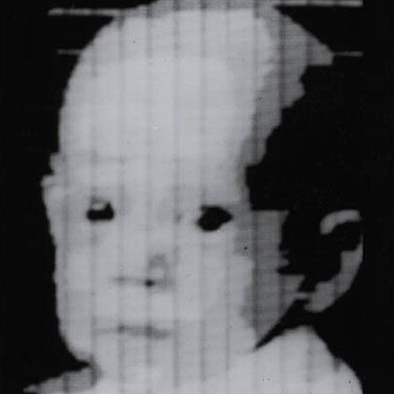
First Digital Photograph
© 2002 R. C. Gonzalez & R. E. Woods

Slide 4
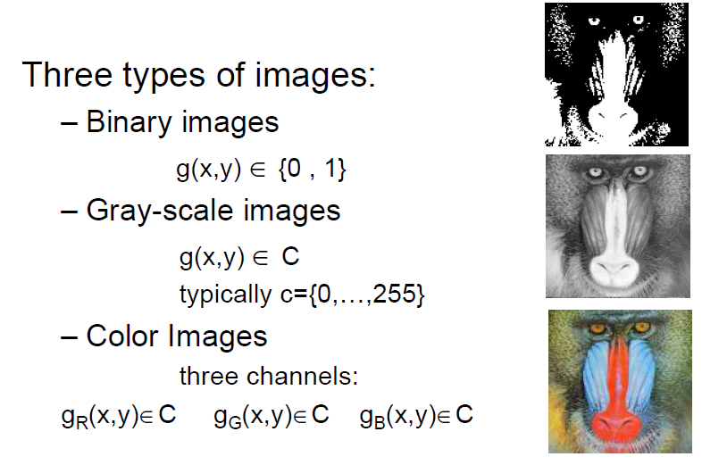
Image types

Slide 5
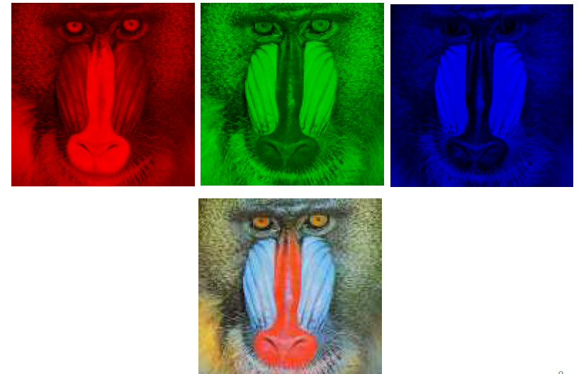
Color images

Slide 6
Aim: Use of computer algorithms to perform a series of actions on a given data and convert it into information.

Slide 7

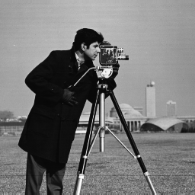
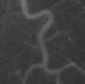
Pixel intensity values change between 0 (Black) and 255 (White)
I(1,1)=153
I(5:10,10:15)
ans =
157 155 154 154 158 162
158 152 153 159 156 157
156 155 156 155 157 158
157 157 159 161 156 163
161 156 161 160 155 158
161 160 160 158 161 158
I(172:177,80:85)
ans =
15 15 14 15 15 16
15 14 14 13 15 14
14 14 14 13 15 14
16 15 14 14 15 14
16 15 15 14 14 14
16 14 14 14 13 13

Slide 8
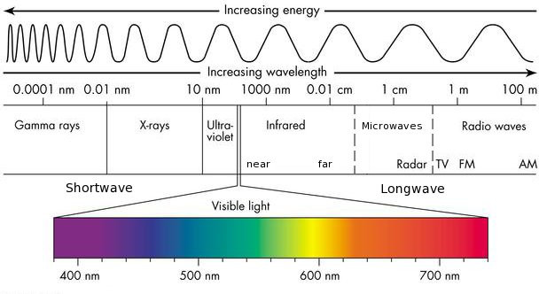
Sources of Digital Images
The principal source for the images is the electromagnetic (EM) energy spectrum.

Slide 9
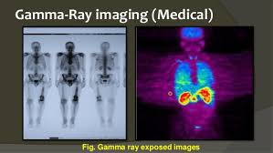
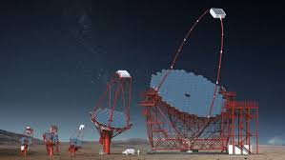
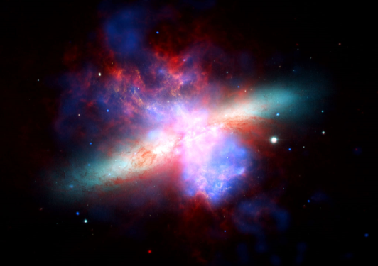
Gamma X-ray
Gamma-Ray imaging of
A starburst galaxy about 12 million light-years away
Gamma x-ray soaks through bones

Slide 10
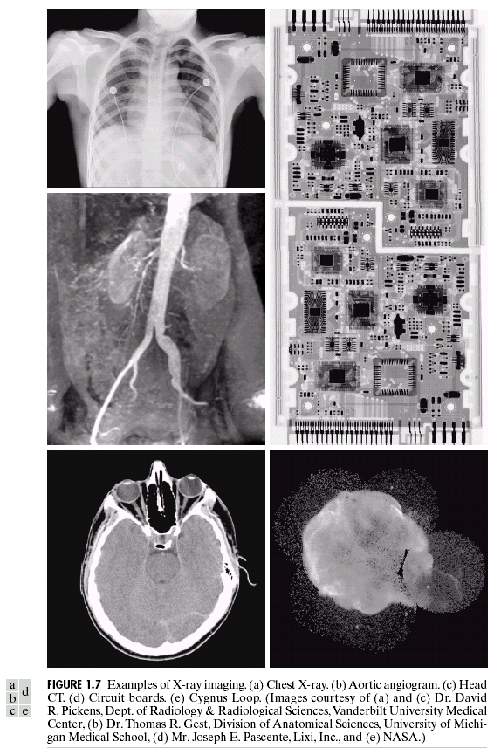
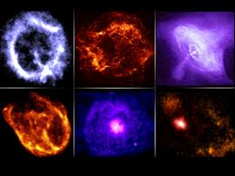
X-ray
X-ray images from the space
The Chandra X-Ray Observatory

Slide 11
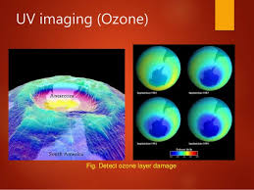
Detected Ozone Layer DAMAGE
Ultra Violet

Slide 12
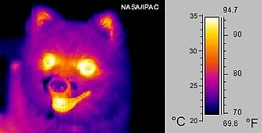
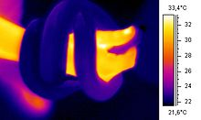
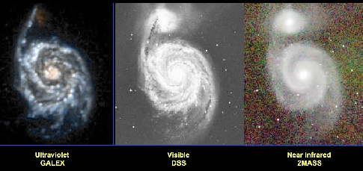
Infrared
infrared ("thermal") image Snake around the arm
Messier 51 in ultraviolet (GALEX), visible (DSS), and near infrared (2MASS). Courtesy of James Fanson.

Slide 13

Visible Lights Images

Slide 14
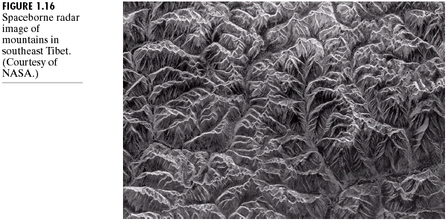
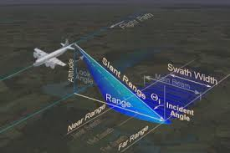
Synthetic Aperture Radar
System

Slide 15
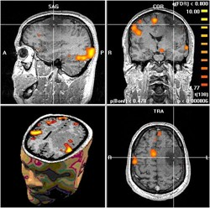
Radio Waves
MRI image slices from the brain

Slide 16
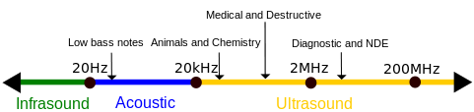
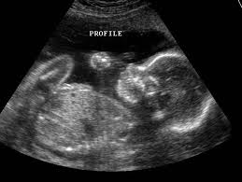
Electromagnetic (EM) energy spectrum is not the only source in order to produce images. Ultrasound Imaging is a sound cycle pressure with in a upper frequency of our hearing. It is considered as Nondestructive Evaluation(NDE).

Slide 17
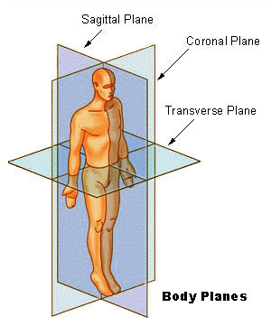
Anatomical Axes
Superior = head
Inferior = feet
Anterior = front
Posterior = back
Proximal = central
Distal = peripheral
Notes:
Diagram is public domain, from http://commons.wikimedia.org/wiki/File:BodyPlanes.jpg from http://training.seer.cancer.gov/module_anatomy/unit1_3_terminology2_planes.html

Slide 18
Medical image processing involves converting raw CT or MRI scan data into a format that can be used by special software. These 3D images are made up of tiny units called voxels (3D pixels). The images show different shades of gray, where lighter or darker areas represent different densities of body parts. For CT scans, this gray scale shows how much X-ray radiation was absorbed by the tissue. For MRI scans, the gray scale shows how the signals from proton particles behave in response to a magnetic field.

Slide 19
What a AI Student Can Do With A Given Medical Image?
Theoretical & practical skills in medical image analysis
Imaging modalities
Segmentation
Registration
Image understanding
Visualization
Established methods and current research
Focus on understanding & using algorithms

Slide 20
Why Is Medical Image Analysis Special?
Because of the patient
Computer Vision:
Good at detecting irregulars, e.g. on the factory floor
But no two patients are alike—everyone is “irregular”
Medicine is war
Radiology is primarily for reconnaissance
Surgeons are the marines
Life/death decisions made on insufficient information
Success measured by patient recovery
You’re not in “theory land” anymore

Slide 21
What Do I Mean by Analysis?
Different from “Image Processing”
Results in identification, measurement, &/or judgment
Produces numbers, words, & actions
Holy Grail: complete image understanding automated within a computer to perform diagnosis & control robotic intervention
Notes:
BUT, analysis often REQUIRES initial PROCESSING

Slide 22
What would be some examples given a x-Ray or CT image?

Slide 23
Segmentation
Labeling every voxel
Discrete vs. fuzzy
How good are such labels?
Gray matter (circuits) vs. white matter (cables).
Tremendous oversimplification
Requires a model

Slide 24
Registration
Image to Image
same vs. different imaging modality
same vs. different patient
topological variation
Image to Model
deformable models
Model to Model
matching graphs
Notes:
MODEL: landmarks, image primitives, features, etc.

Slide 25
Visualization
Visualization used to mean to picture in the mind.
Retina is a 2D device
Analysis needed to visualize surfaces
Doctors prefer slices to renderings
Visualization is required to reach visual cortex
Computers have an advantage over humans in 3D

Slide 26
The Practice of Automated Medical Image Analysis
A collection of recipes, a box of tools
Equations that function: crafting human thought.
ITK is a library, not a program.
Solutions:
Computer programs (fully- and semi-automated).
Very application-specific, no general solution.
Supervision / apprenticeship of machines

Slide 27
Image Processing And Machine Learning Comon And Differences

Slide 28
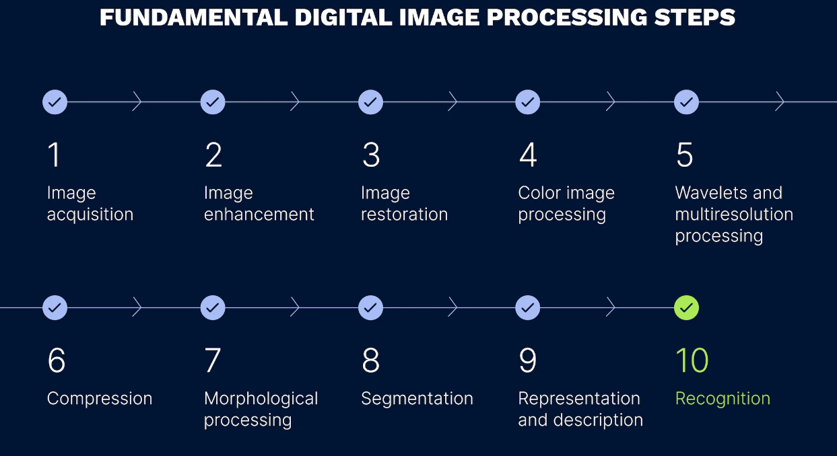

Slide 29
Medical image processing
Medical image processing is a way of studying patient data using 3D images like MRI and CT scans. This is an important part of modern medicine because it helps doctors and surgeons see detailed images of the inside of a patient's body

Slide 30
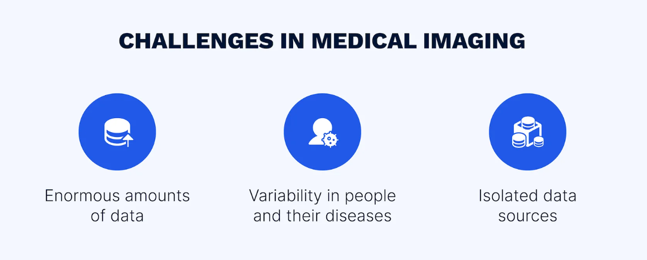

Slide 31
Clearer Images: Helps in better diagnosis by producing clearer images without noise.
Faster Processing: Simplifying the image makes processing quicker and more efficient.
Accurate Planning: Segmentation and CAD models help doctors plan surgeries or treatments with precision.
Physical Models: Exporting 3D models for printing helps doctors study physical structures before operations.

Slide 32
Case Study: Radiolance
What is Radiolance?
A platform that connects radiologists with diagnostic centers.
It helps medical facilities analyze MRI, CT scans, X-rays, and mammograms using expert radiologists.
Improves healthcare services by connecting patients and doctors, no matter the distance.
Technology Used:
AI-Powered Platform: Developed by the SDH team.
Web Application for Diagnostic Centers and Mobile Apps (iOS and Android) for radiologists.
Radiologists can remotely analyze medical images and provide official medical reports.
SDH's Contribution:
SDH specializes in healthcare software development.
Their software supports working with medical images, export options, combining implants, creating 3D models, and converting data into usable formats.
SDH ensures the software is flexible and up-to-date with the latest technology.

Slide 33
Practical implementation using python
1. Install Required Libraries
First, we need to install some Python libraries that will help us work with images:
NumPy: for handling arrays (images are essentially arrays of numbers).
OpenCV: for basic image processing.
Matplotlib: for displaying images.
Code:
pip install numpy opencv-python matplotlib

Slide 34
2. Import Libraries
Let’s start by importing the libraries we’ll use:
python
import cv2 # For image processing import numpy as np # For working with image arrays import matplotlib.pyplot as plt # For displaying images

Slide 35
3. Load a Medical Image
Let’s start by importing the libraries we’ll use:
python
import cv2 # For image processing import numpy as np # For working with image arrays import matplotlib.pyplot as plt # For displaying images

Slide 36
4. Apply Basic Image Processing
In real platforms like Radiolance, noise reduction and image enhancement are important. We will simulate this by applying a Gaussian Blur to reduce noise.
python
# Apply Gaussian Blur to reduce noise blurred_image = cv2.GaussianBlur(image, (5, 5), 0) # Display the blurred image plt.imshow(blurred_image, cmap='gray') plt.title("Blurred Medical Image (Noise Reduction)") plt.show()
cv2.GaussianBlur() applies a blur effect to smooth the image, reducing noise.

Slide 37
5. Simulate Image Segmentation
Segmentation is used to isolate areas of interest (like organs or tissues). In this simple case, we’ll use thresholding to highlight specific areas in the image.
Python
# Apply Thresholding to simulate segmentation _, segmented_image = cv2.threshold(blurred_image, 100, 255, cv2.THRESH_BINARY) # Display the segmented image plt.imshow(segmented_image, cmap='gray') plt.title("Segmented Medical Image") plt.show()
cv2.threshold() is used here to segment the image. It converts the image to black and white based on a threshold value (100). Pixels brighter than 100 become white (255), and the rest become black.

Slide 38
6. Add Additional Tools (Optional)
Just like Radiolance, we could also add measurement tools or filters. For example, we can apply an edge detection filter to identify boundaries in the image:
python
# Apply Edge Detection edges = cv2.Canny(segmented_image, 100, 200) # Display the edges plt.imshow(edges, cmap='gray') plt.title("Edges Detected in Medical Image") plt.show()
cv2.Canny() is used for detecting edges in the image, highlighting the boundaries of structures.

Slide 39
Step-by-Step Explanation:
Install Libraries: We install necessary libraries like opencv and numpy which are required for image processing.
Import Libraries: Libraries like OpenCV help us manipulate images, while Matplotlib helps display them.
Load a Medical Image: We load an image (like a CT scan or MRI) and convert it to grayscale, since medical images often use shades of gray
Apply Image Processing (Noise Reduction): We apply a blur to reduce noise. This makes it easier for doctors (and software) to focus on the important parts of the image.
Simulate Segmentation: We use thresholding to segment the image, which means separating the important parts of the image (like organs) from the rest.
Edge Detection: We add an edge detection filter to highlight boundaries, making it easier to identify different structures in the image.

Slide 40
Running the Program
You can run this program in Jupyter Notebook by following these steps:
Open Jupyter Notebook.
Copy each section of the code and run them in different cells.
You can also run this code in any IDE (like PyCharm or VS Code) as long as you have installed the required libraries.

Slide 41
Reference
https://medium.com/@sdhglobal/what-is-medical-image-processing-412d403cbfd0

