Slide 1
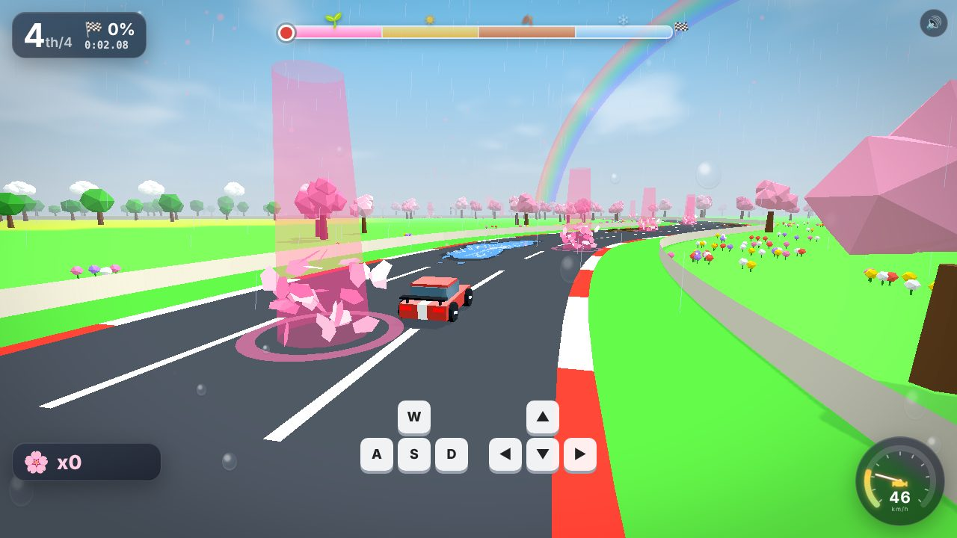
THUNDERHACKS 2026 · ALGOMA GAME JAM
Season Drift
One lap. Four seasons. Every season changes how you drive.
🌸
☀️
🍂
❄️
A browser racing game · solo vs bots, split screen, or two devices
Notes:
Hi, we built Season Drift: a racing game where one lap takes you through all four seasons, and every season changes the rules of driving, not just the scenery. It runs in any browser, solo against bots, two players on one screen, or on two devices.

Slide 2
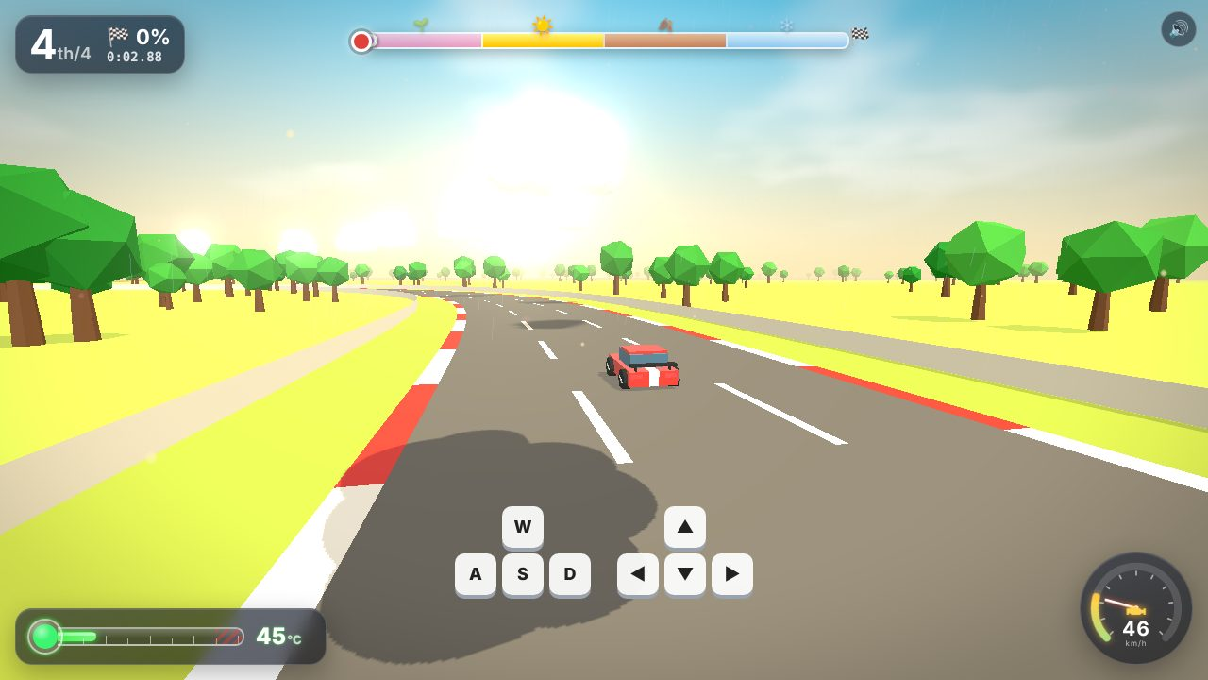
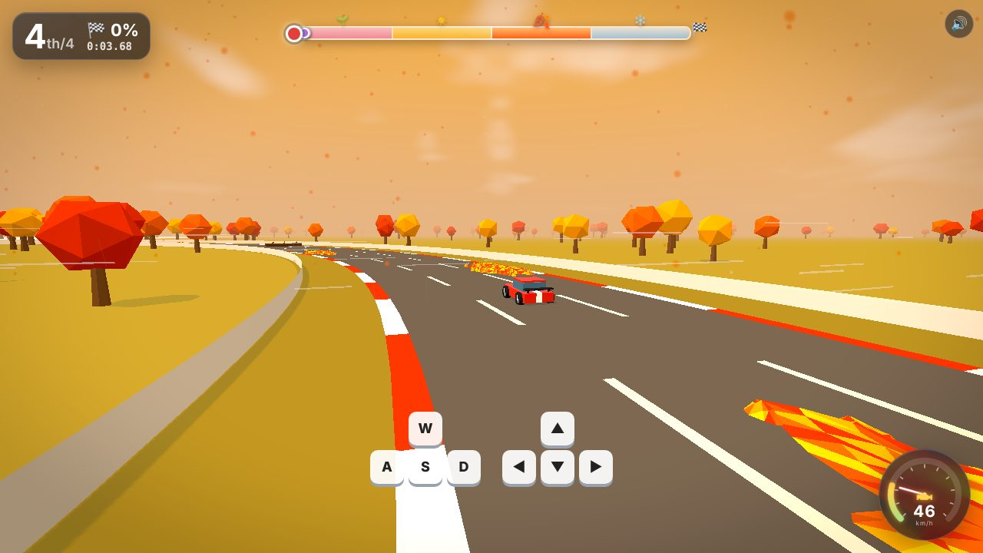
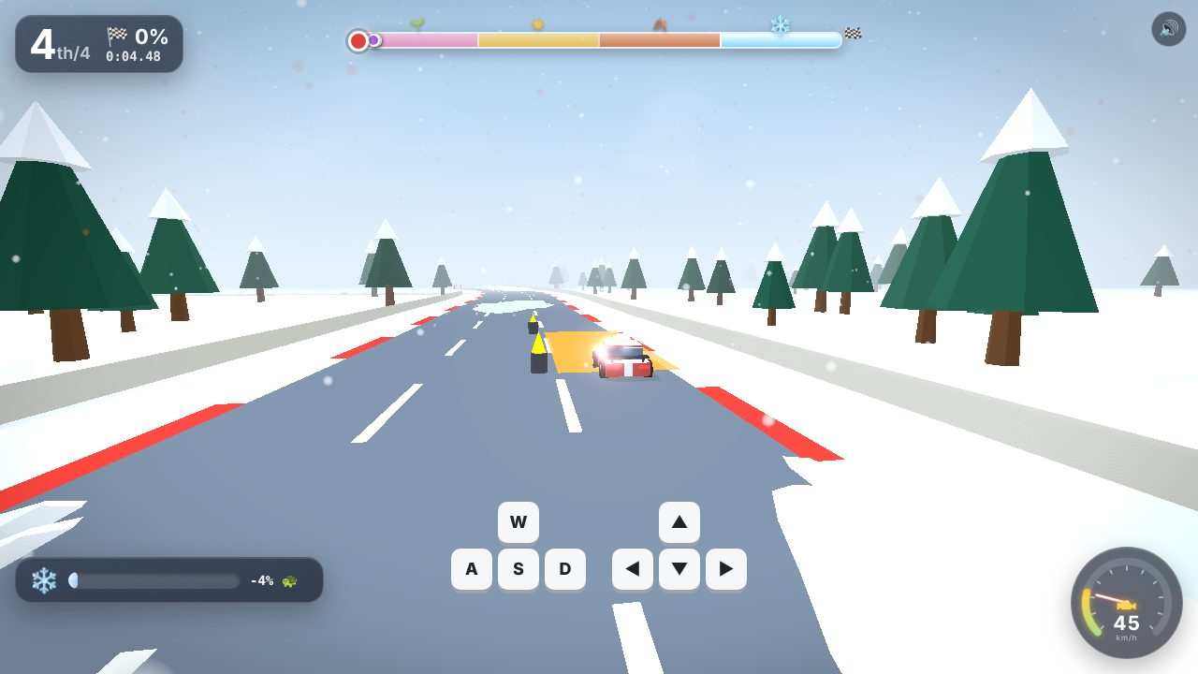
Each season rewrites one rule of driving
SPEED
HEAT
VISIBILITY
WEIGHT
🌸 Spring
☀️ Summer
🍂 Autumn
❄️ Winter
Petal Chain
Cloud Hopping
Leaf Kick
Snow Load
Weave through petal clusters in order. Every link adds top speed; miss one and the chain breaks.
The sun overheats your engine. Hop into a cloud’s shadow and brake to cool, or burst into flames.
Tear through leaf piles to blind the car behind you. Dodge the waves of blown leaves.
Snow piles on and slows you down. Stop on a heater pad to melt it, or risk the frozen-lake shortcut.
Notes:
Each season tests a different driving skill. Spring is about speed: thread the petal chain for a speed boost. Summer is about heat: the sun overheats your engine, so you hop between drifting cloud shadows and brake under them to cool down. Autumn is about visibility: rip through a leaf pile and the driver behind you gets a face full of leaves. Winter is about weight: snow piles on your car and slows you, so you have to stop on a heater pad to melt it, or gamble on the frozen-lake shortcut.

Slide 3
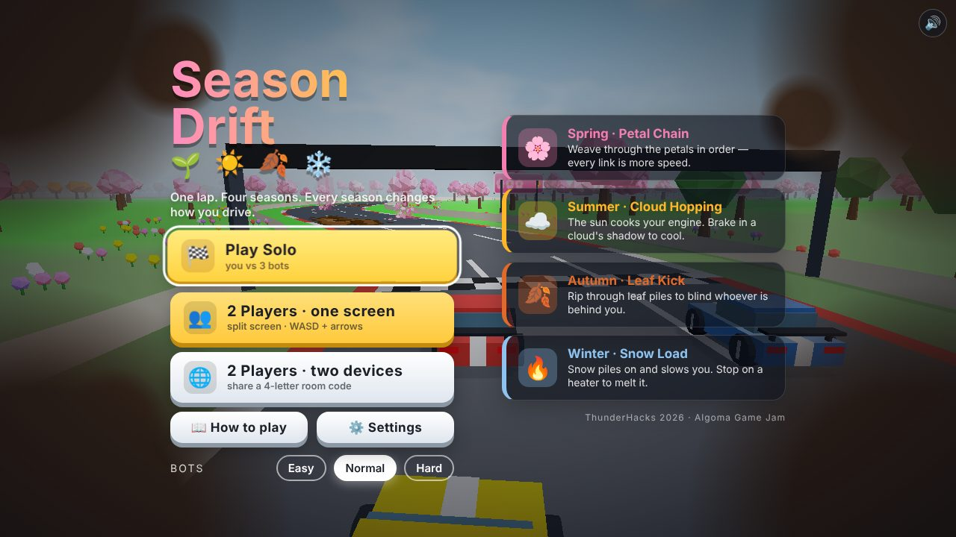
Seasons connect, and anyone can play
1 lap
3 ways
0 files
4 seasons, 4 rules, about two minutes a race
to play: vs bots, split screen, or two devices (phones too)
of art or audio: every model and every sound is made in code
🔁
Season change is part of the play
Your spring petal boost carries into summer: still faster, but your engine runs hotter.
🪧
Teaches without words
A picture sign before each season shows its rule: 🌸➜⚡, ☁️🛑➜❄️, 🍂➜🙈, 🔥🛑.
♿
Accessible
Remap keys for both players, colour-blind helpers, reduced flashes and shake, volume, difficulty.
Notes:
What makes it ours: the seasons are connected. If you build a long petal chain in spring, you carry that speed into summer, but your engine overheats faster, so it is a real trade-off. The game teaches itself with picture signs before each season, and it is built to be accessible: remappable keys for both players, colour-blind helpers, reduced flashes, and adjustable difficulty. Every model and every sound is generated in code; there are no asset files.

Slide 4
Pick it up and race: the theme is the gameplay
Theme
Every season changes a rule: speed, heat, visibility, weight
Gameplay & Fun
One-lap race with a clear goal; bots keep it close; 3 difficulties
Art & Audio
One low-poly style per season; live-synthesised music and effects
Playable Build
Runs in the browser, keyboard, gamepad or touch; recovers stuck cars
Play it
Originality
Brake into a moving cloud’s shadow; kick leaves into a rival’s face
github.com/Yamandangol/season-drift
npm install · npm run build · npm start
Made in code at ThunderHacks 2026: Three.js, TypeScript, Socket.IO, Web Audio
Notes:
To sum up against the brief: the seasons are the gameplay, there is a clear one-lap goal you understand in seconds, the art and audio share one style and were all made by us during the event, and the build runs in any browser. Please grab a controller or a keyboard and race us. Thank you!

