Slide 1
Customers Segmentation
Project by Sun Chetra

Slide 2
TABLE OF CONTENTS
01
Introduction
02
Analysis
03
Recommendation
Introduce about dataset that we use
Project
Process that need to go through
The Recommendation base on the Analysis

Slide 3
Dataset
There ae 8 columns with 541909 records:
InvoiceNo : Invoice code
StockCode : Product code
Description : Description of Product
Quantity : The quantities of product in each transaction
InvoiceDate : Date and time of the purchase
UnitPrice : the price per unit
CustomerID : Customer code
Country : Country that customer purchasing from

Slide 4
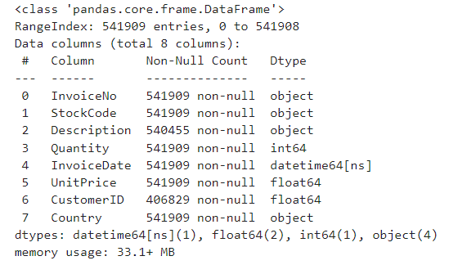
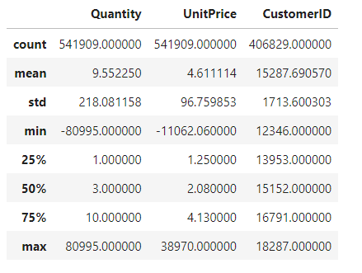
Data Exploration
Info
Describe
One Column is datetime
One Column is int
Two Columns are float
Four Columns are Object (text)
Statistics of numerical columns

Slide 5
Cleaning Data
Missing Value | 135080(25%) records are Missing
Duplicate | 5225(1%) records are Duplicate
Cancel order | 8872(2.21%) Total of cancel order

Slide 6
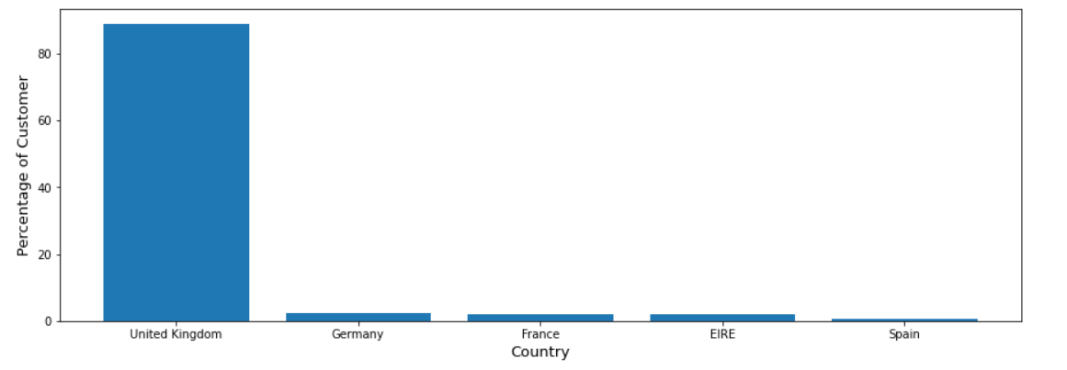
Filter Data by Country
Barplot show the most country that get purchase from and the result is UK .it show us
Above 80% of order come from United Kingdom.
We choose United Kingdom as the sample data

Slide 7
RFM Method
Recency : how recently a customer has transacted with a brand . Max InvoiceDate – Max InvoiceDate of each Customer
Frequency : how frequently they’ve engaged with a brand . Total of transaction (count InvoiceNo)
Monetary : how much money they’ve spent on a brand’s products and services. Sum of Total Amount for each customer

Slide 8
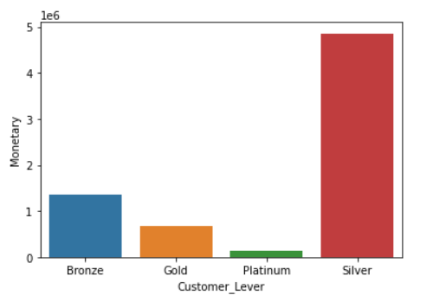
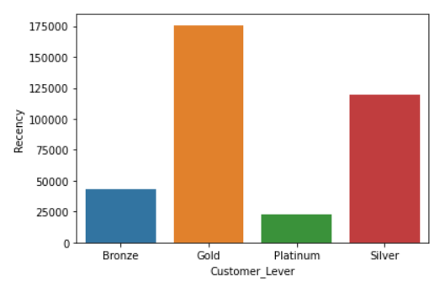
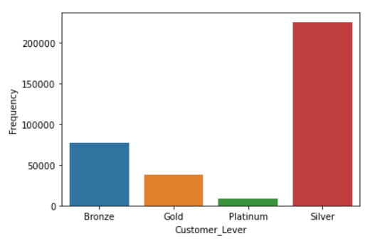
RFM Visualize
Monetary
Recency
Frequency
Platinum(1,1,1) = Best
Gold = very good
Silver = Good
Bronze(4,4,4) = not good

Slide 9
K-Mean Method
Cleaning Skewness : Manage the Skewness to Recency, Frequency and Monetary.
Scale : transform Mean and Standard Deviation have the same values in each R F M .
Cluster : Using K-Mean algorithm to cluster
Elbow Method : Find the optimize number for K-Mean

Slide 10
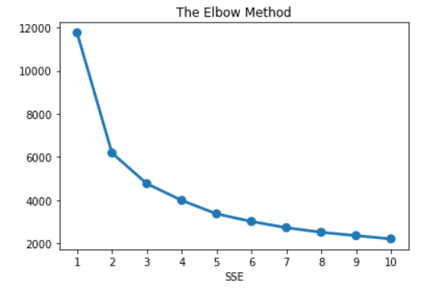
Elbow Method
We choose 3 for the K-Mean Model

Slide 11
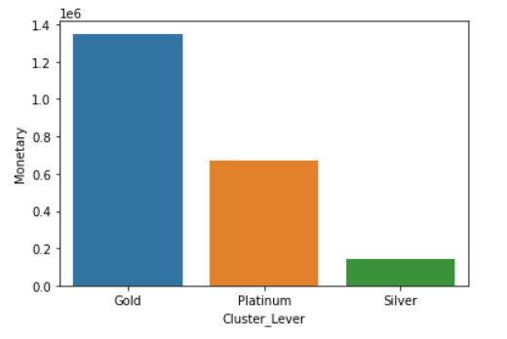
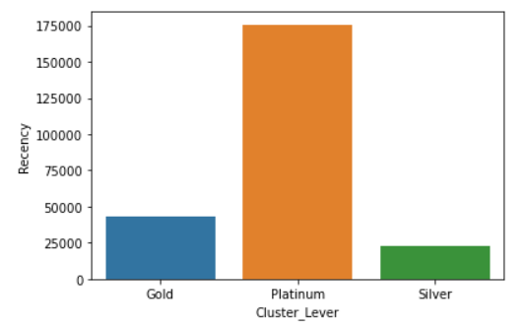
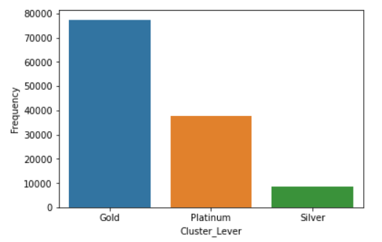
K-Mean Visualize
Monetary
Recency
Frequency

Slide 12
Recommendation
Platinum : is the best level of the Customer Segmentation in each RFM and K-Mean to deal with the this type of customer should use for Promotion ,service or other benefit for them to keep using our service . This strategy give the encourage tother customer level to upgrade their score .
Sliver(K-Mean) and Bronze(rfm) : is the low class of customer and type of this customers highly chance to churn ,to prevent this we should pay attention to the complaints or feedback ,give them more engagement to make them feel comfortable to use our product.

Slide 13
Thank you

