Slide 1
Supermarket analysis
Prepare by: Sun Chetra
Junior Data Scientist
E-mail: Chetra.Sun.datau@gmail.com

Slide 2
Table of contents
Introduction
Dataset
Analysis
Dashboard
cONCLUSION
REcommendation
Question time

Slide 3
Introduction
BUSINESS TASK
The Increasing of People shopping online due to world wild situation (codid19) and the number of competition is rising up everyday, make thing hardER for the Supermarket to compete
We will use the data to find insights to help the supermarket business increase sales

Slide 4
Introduction
INDUSTRY
RETAIL SECTOR

Slide 5
Introduction
BUSINESS QUESTION
Which city sells the most?
What product line that performing well of each month?
Is the Customer type really impact the sale performance?
What product line that generate the most and least revenue for the first quarter of the year?

Slide 6
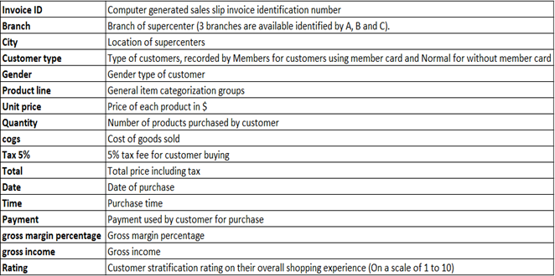
Dataset
The dataset get from Kaggle: https://www.kaggle.com/aungpyaeap/supermarket-sales
There are 17 columns in dataset and 3 month of time

Slide 7
CITY SALE PERFORMANCE
Analysis
110568.7065 $
106200.3705 $
106197.672 $

Slide 8
322,966.75 $
Analysis
Total Sale

Slide 9
Monthly Sale Activity
Analysis

Slide 10
Member vs Normal
Analysis

Slide 11
Sale Performance of Each Product
Analysis

Slide 12
cONCLUSION
This analysis has found a few factors that address the problem to Improving Sale Performance Through Effective Marketing Strategy .
The problem above is come up with the answer based on the analysis below :
Chicago really did the good job this Quarter
The most product have been sold in this quarter is Food and beverages and Health and beauty is the least sold product of the last 3 months
Member Customer type buy more than Normal Customer type

Slide 13
Recommentdation
The Marketing team should focus on the problem that have been found through dataset:
Member Customer type buy more than Normal Customer type that mean we need to focus on the strategy to make the normal customer subscription Supermarket offer for next month.
Food and beverages perform well in the first 3 month, Increase Food and beverages for the next month.
should have a strategy to promote Health and beauty to make more sale in the next quarter .
The Product need Local Promotion for the next month base on CITY SALE PERFORMANCE:
Chicago: Should do promotion for Home and Lifestyle
New York: Should do promotion for Health and beauty
San Francisco: Should do promotion for Food and beverage

Slide 14
Question Time

Slide 15
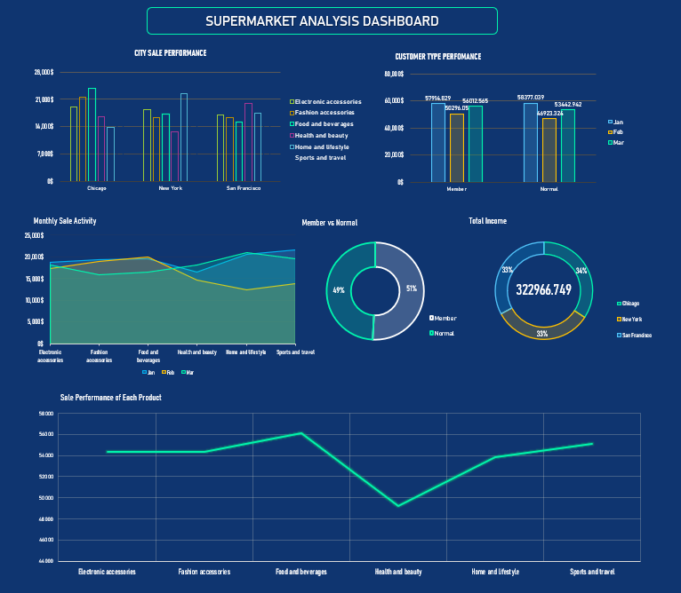
Dashboard

Slide 16
Thank you!

