Slide 1
Computer Network Programming
Introduction to the Socket Program in Linux
Computer Network Programming

Slide 2
Introduction
• A Simple Daytime Client
• A Simple Daytime Server
• Error handling: wrapper functions
• Types of Networking APIs
• BSD networking history
• Discover details of your local network
Computer Network Programming 2

Slide 3
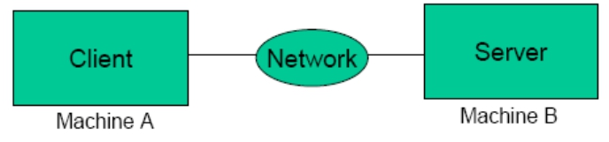
Client-Server Model
• Web browser and server
• FTP client and server
• Telnet client and server
Computer Network Programming 3

Slide 4
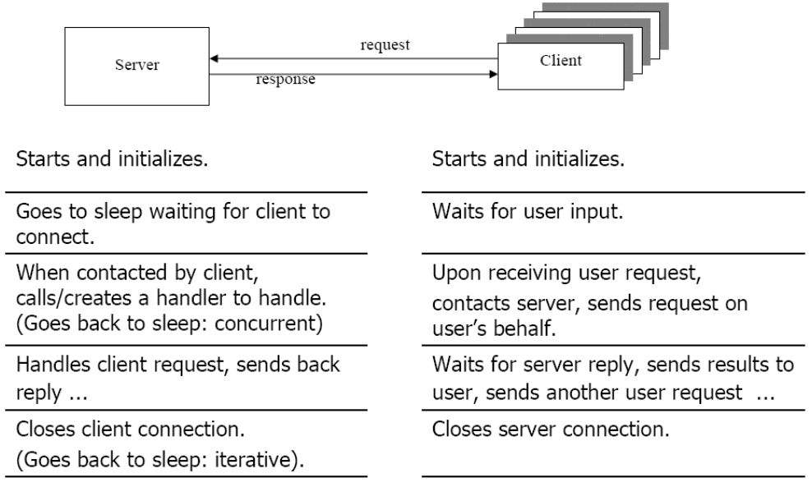
The Client/Server Model
Computer Network Programming
4

Slide 5
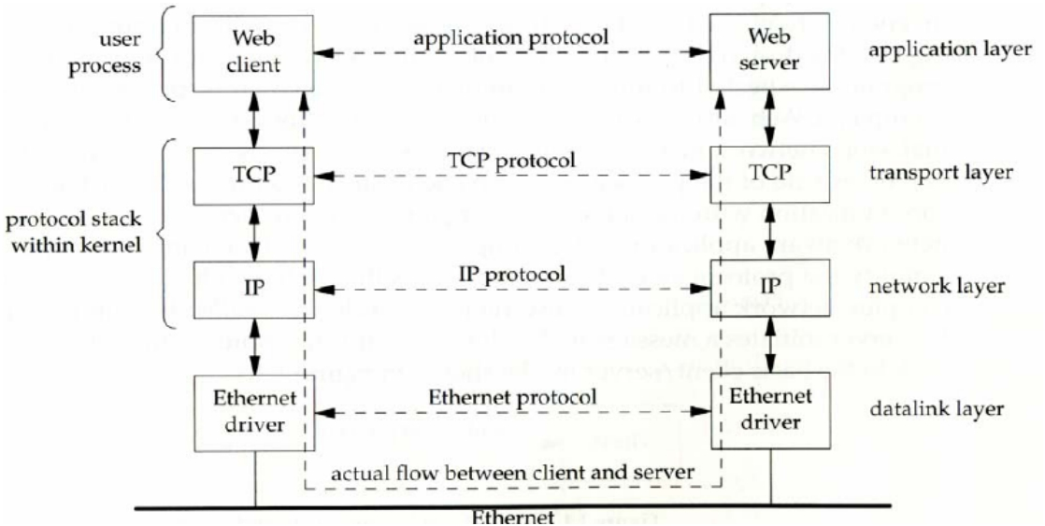
Client/Server on an LAN
Computer Network Programming
5

Slide 6
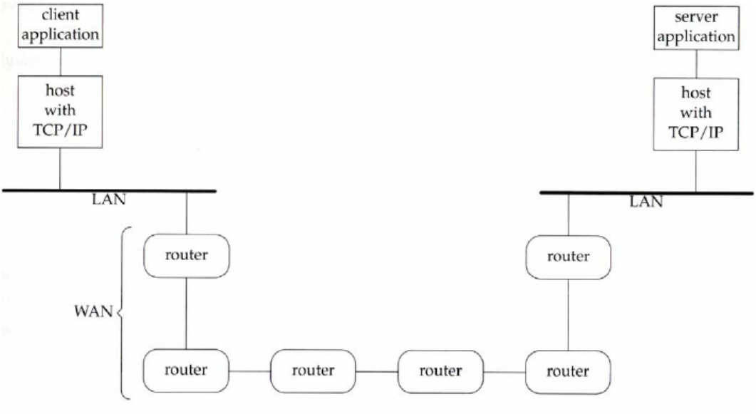
Client/Server via a WAN
Computer Network Programming
6

Slide 7
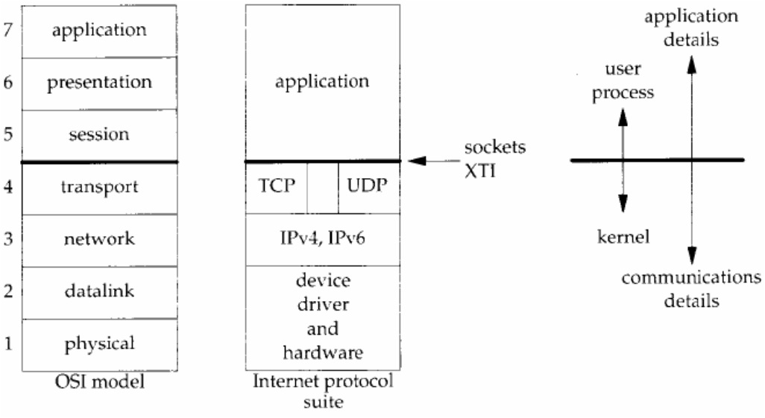
OSI vs. Internet Protocol Layers
Computer Network Programming
7

Slide 8
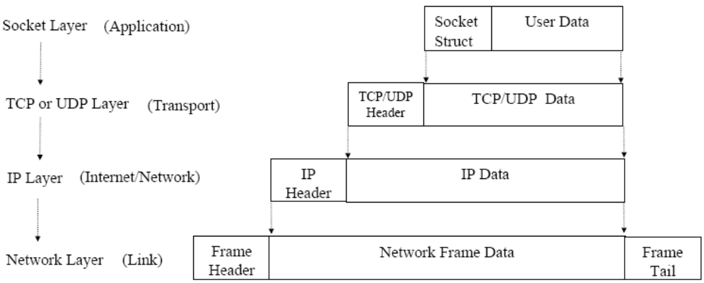
Protocol Data and Headers
Computer Network Programming
8

Slide 9
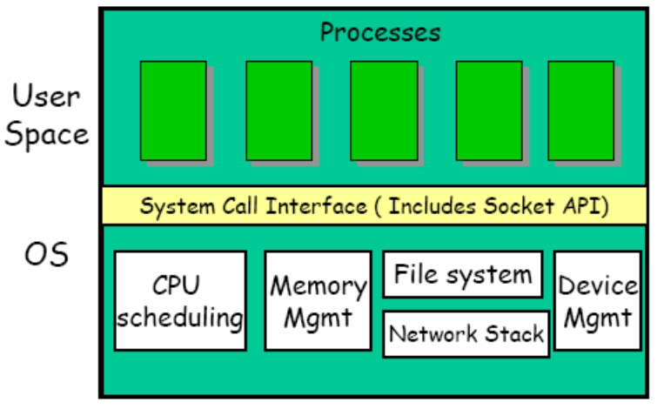
Socket API Location in OS
Computer Network Programming
9

Slide 10
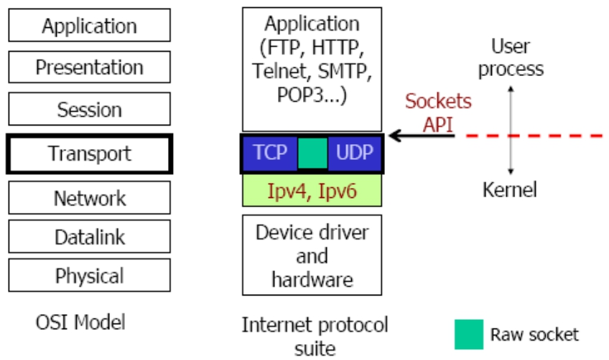
OSI and TCP/IP Model
Computer Network Programming
10

Slide 11
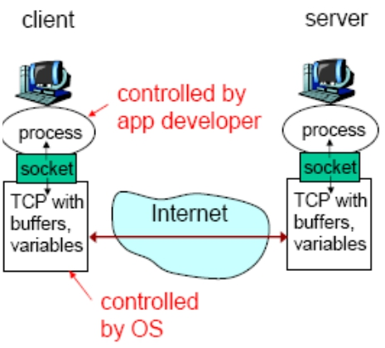
Sockets
• process sends/receives
messages to/from its socket
• socket analogous to door
– sending process shoves
message out door
– transport infrastructure brings message to the door at receiving process
Socket API: (1) choice of transport protocol;
(2) ability to fix many parameters
Computer Network Programming
11

Slide 12
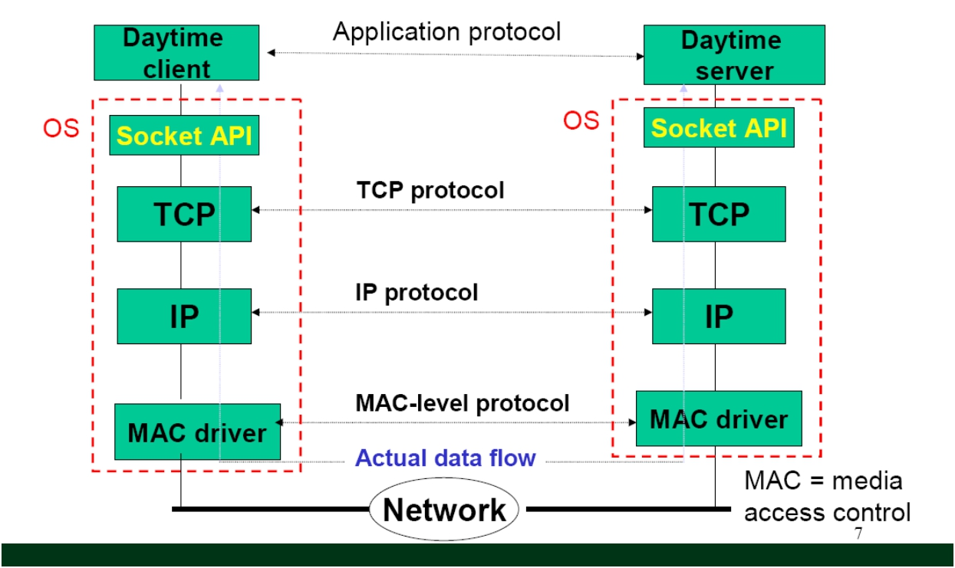
A Daytime client/server using socket API
Computer Network Programming
12

Slide 13
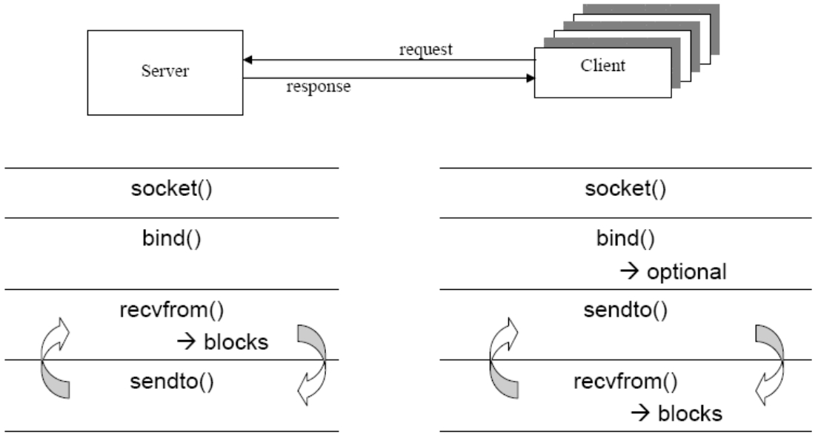
Connectionless: Functions Used
Computer Network Programming
13

Slide 14
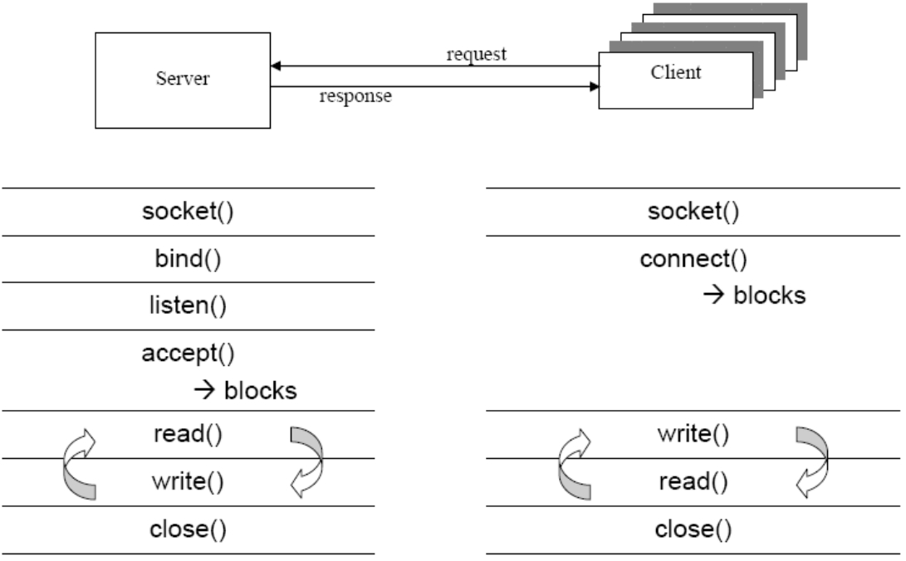
Connection-oriented:Functions Used
Computer Network Programming
14

Slide 15
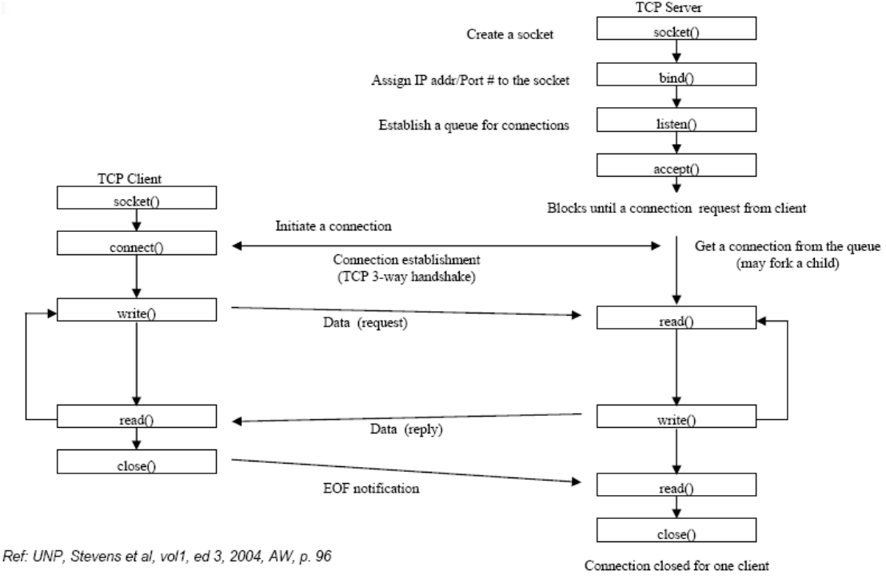
TCP Client/Server Socket
Functions
Computer Network Programming
15

Slide 16
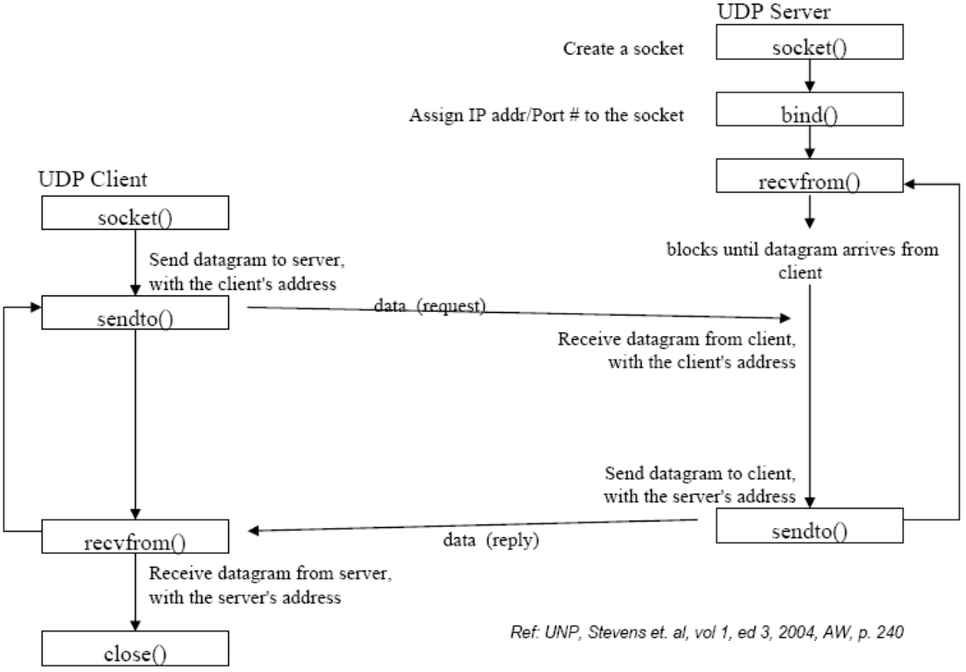
UDP Client/Server Socket
Functions
Computer Network Programming
16

Slide 17
Five Steps to Create a Simple Daytime
Client
1.Create TCP socket: get a file descriptor
2. Prepare server address structure: filling IP address and port
number
3. Connect to the server: bind the file descriptor with the remote
server
4. Read/write from/to server
5. Close socket
Computer Network Programming
17

Slide 18
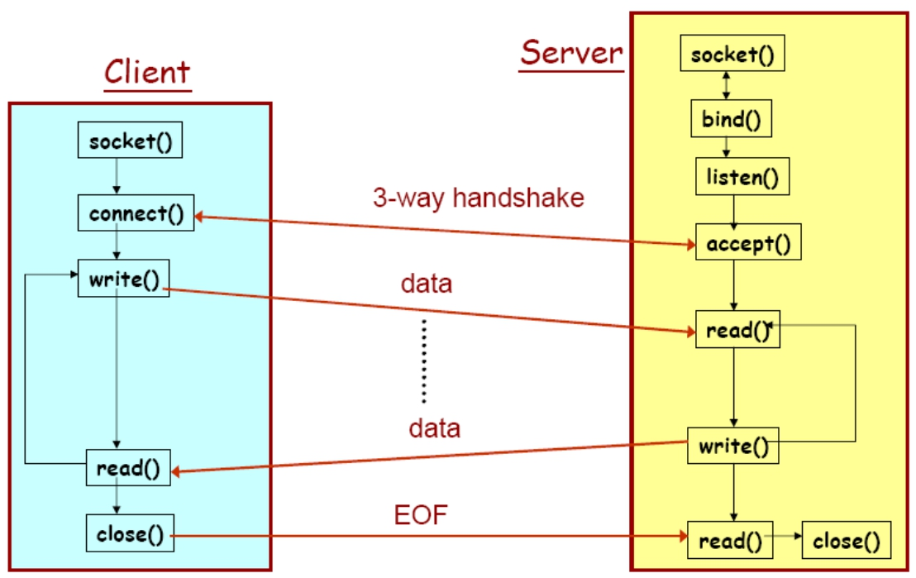
TCP client/server connection sequence
Computer Network Programming
18

Slide 19
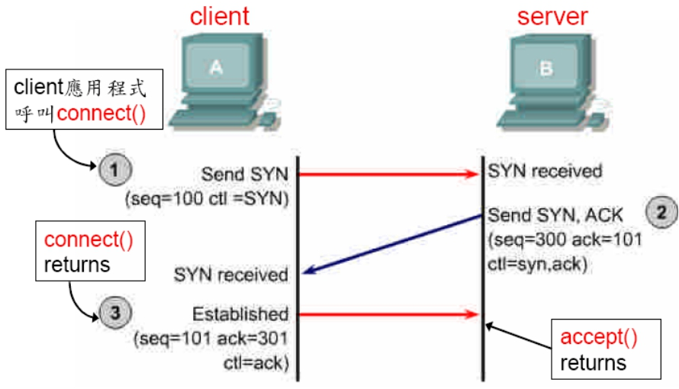
Three-Way Handshake of TCP
Computer Network Programming
19

Slide 20
intro/daytimetcpcli.c (1/2)
#include "unp.h"
int main(int argc, char **argv)
{
int sockfd, n;
char recvline[MAXLINE + 1];
struct sockaddr_in servaddr;
if (argc != 2)
err_quit("usage: a.out <IPaddress>");
if ( (sockfd = socket(AF_INET, SOCK_STREAM, 0)) < 0)
err_sys("socket error");
Computer Network Programming
20

Slide 21
Command-Line Arguments
int main(int argc, char *argv[])
• int argc
– Number of arguments passed
• char *argv[]
– Array of strings
– Has names of arguments in order
• argv[ 0 ] is first argument
• Example: $ mycopy input output
– argc: 3
– argv[ 0 ]: “mycopy"
– argv[ 1 ]: "input" – argv[ 2 ]: "output"
Computer Network Programming
21

Slide 22
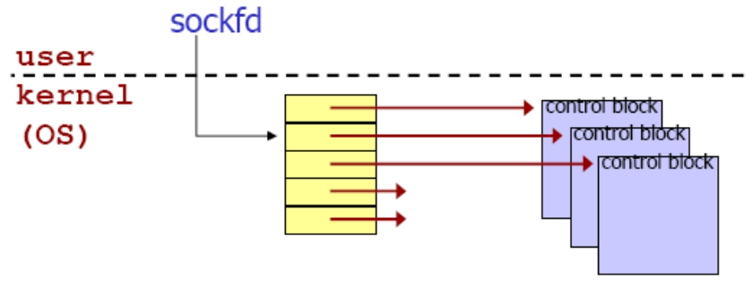
Step 1: Create A Socket
int sockfd;
…
sockfd = socket(AF_INET, SOCK_STREAM, 0);
• Call to the function socket() creates a transport control block (hidden in kernel), and returns a reference to it (integer used as index)
Computer Network Programming
22

Slide 23
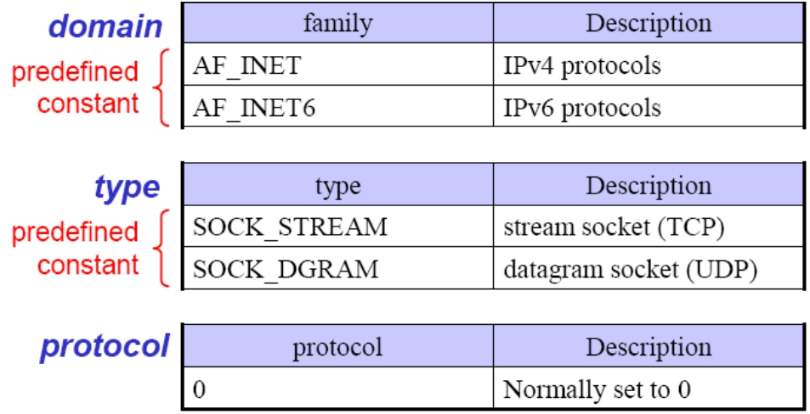
Parameters of the socket Call
int socket(int domain, int type, int protocol);
returns a socket descriptor (or negative value on errors)
Computer Network Programming
23

Slide 24
Socket functions
•
listenfd = Socket(AF_INET, SOCK_STREAM, 0); //建立TCP套接口
描述字
bzero(&servaddr, sizeof(servaddr)); //地址結構清零servaddr.sin_family = AF_INET; //IPv4協議servaddr.sin_addr.s_addr = htonl(INADDR_ANY); //內核指定地址servaddr.sin_port = htons(SERV_PORT); //總所諸知端口#9877
// 允許啟動一個監聽服務器並捆綁其眾所周知端口，即使以前建立的
將此端口用作它們的本地端口的連接仍存在。 Setsockopt(listenfd, SOL_SOCKET, SO_REUSEADDR, &on, sizeof(on));
Bind(listenfd, (SA *) &servaddr, sizeof(servaddr)); //綁定本機地址和
端口
Listen(listenfd, LISTENQ); //監聽
Computer Network Programming 24

Slide 25
 | intro/daytimetcpcli.c (2/2)
bzero(&servaddr, sizeof(servaddr)); servaddr.sin_family = AF_INET; servaddr.sin_port = htons(13); /* daytime if (inet_pton(AF_INET, argv[1], err_quit("inet_pton error for %s", if (connect(sockfd, (SA *) &servaddr, err_sys("connect error"); while ( (n = read(sockfd, recvline, recvline[n] = 0; /* null terminate */ if (fputs(recvline, stdout) == EOF) err_sys("fputs error"); } if (n <0 ) err_sys("read error"); exit(0); }
 | server */ &servaddr.sin_addr) <= 0) argv[1]); sizeof(servaddr)) < 0) MAXLINE)) > 0) {
Computer Network Programming 25

Slide 26
How to identify clients to accept,
and servers to contact?
•
Machine??
– by its IP address (e.g., 140.127.234.180)
•
Application/service/program??
– by (IP address and) port number
– standard applications have own, “well-known”port numbers
• SSH: 22
• Mail: 25
• Web: 80
• Look in /etc/services for more (for Unix OS)
Computer Network Programming 26

Slide 27
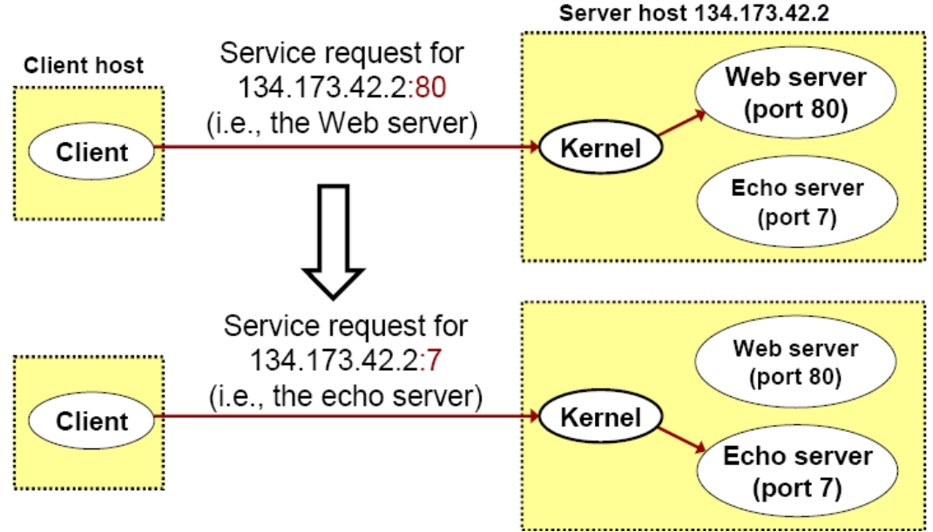
Using Ports to Identify Services
Computer Network Programming
27

Slide 28
Port Numbers
•
A (protocol) port is an abstraction used by TCP/UDP to distinguish applications on a given host
– A port is identified by a 16-bit integer known as the port number
•
Three ranges of port numbers : – Well-known ports
– Registered ports – Dynamic ports
Computer Network Programming 28

Slide 29
Well-known Ports
•
Port numbers ranging from 0 to 1,023
– A set of pre-assigned port numbers for specific uses
•
Port numbers are managed by ICANN.
– Short for the Internet Corporation for Assigned Names and Numbers (ICANN)
– Used to be controlled solely by IANA (Internet Assigned Numbers Authority)
Computer Network Programming 29

Slide 30
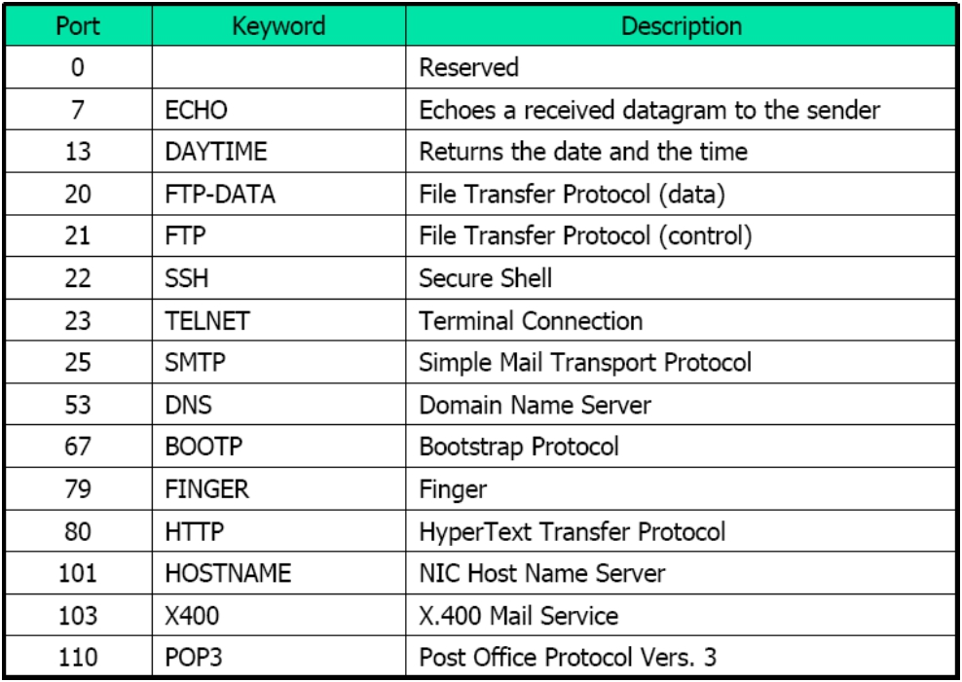
Some Well-known Ports
Computer Network Programming
30

Slide 31
Registered Ports
• Port numbers ranging from 1,024 to 49,151
•
Not assigned or controlled by ICANN; however their uses need to be registered via an ICANN-accredited registrar to prevent duplications
Computer Network Programming 31

Slide 32
Dynamic Ports
• Port numbers ranging from 49,152 to 65,535
•
Neither assigned or registered. They can be used by anyone – These are ephemeral ports
– Also known as private ports
Computer Network Programming 32

Slide 33
Specifying Server’s IP Address and Port
Number
• Filling in structure sockaddr_in
struct sockaddr_in {
unsigned short sin_family; /* address family (always AF_INET) */ unsigned short sin_port; /* port num in network byte order */ struct in_addr sin_addr; /* IP addr in network byte order */ unsigned char sin_zero[8]; /* pad to sizeof(struct sockaddr) */
};
Client程式須在此結構的欄位中填入server的IP address和port number
Computer Network Programming
33

Slide 34
Step 2-1: Clear the Structure
struct sockaddr_in servaddr;
…
bzero(&servaddr, sizeof(servaddr));
• bzero 從位址&servaddr 處開始將
sizeof(servaddr) 位元組的空間清為0
• 亦可使用標準庫存函式memset或其它方法
memset(&servaddr,0x0,sizeof(servaddr));
Computer Network Programming
34

Slide 35
Step 2-2: Set IP Addr And Port
servaddr.sin_family = AF_INET;
servaddr.sin_port = htons(13);/* port no=daytime server */
if (inet_pton(AF_INET, argv[1], &servaddr.sin_addr) <= 0)
err_quit("inet_pton error for %s", argv[1]);
• htons將整數轉為network byte order
• inet_pton將位址字串轉換為內部儲存格式 (傳回負值表轉換失敗)
Computer Network Programming
35

Slide 36
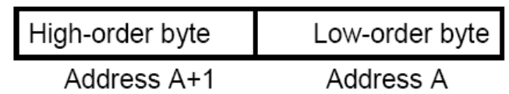
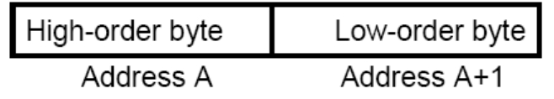
Network-byte ordering
•
Two ways to store 16-bit/32-bit integers – Little-endian byte order (e.g. Intel)
– Big-endian byte order (E.g. Sparc)
Computer Network Programming 36

Slide 37

Byte Order: IP address example
• IPv4 host address: represents a 32-bit address
– written on paper (”dotted decimal notation”):
129.240.71.213
– binary in bits: 10000001 11110000 01000111
10001011
– hexadecimal in bytes: 0x81 0xf0 0x47 0x8b
• Network byte order uses big-endian ordering
• Little-endian:
– one 4 byte int on x86, StrongARM, XScale, …:
• Big-endian:
– one 4 byte int on PowerPC, POWER, Sparc, …:
Computer Network Programming
37

Slide 38
Network-byte ordering (cont.)
• How do two machines with different byte-orders
communicate?
– Using network byte-order
– Network byte-order = big-endian order
• Conversion macros (<netinet/in.h>)
– uint16_t htons (uint16_t n) – uint32_t htonl (uint32_t n) – uint16_t ntohs (uint16_t n) – uint32_t ntohl (uint32_t n)
host to network conversion (s: short; l: long)
network to host conversion (s: short; l: long
Computer Network Programming 38

Slide 39
Function inet_pton()
• inet_pton() is new for IPv6 and may not exist yet (現在的Linux上沒問題).
• Oldest:
serveraddr.sin_addr.s_addr =
inet_addr(“129.240.65.193”);
• Newer:
inet_aton(“129.240.65.193”,
&serveraddr.sin_addr);
比inet_pton少一個參數(第一個AF_INET)
Computer Network Programming
39

Slide 40
Step 3: Connect to the Server
int connect(int sockfd,
struct sockaddr_in *serv_addr, int addrlen);
• used by TCP client only
• sockfd - socket descriptor (returned from socket())
• serv_addr: socket address, struct sockaddr_in is
used
• addrlen := sizeof(struct sockaddr_in)
• 傳回負值表連線建立失敗(如server不回應)
Computer Network Programming
40

Slide 41
Step 4: Read/Write from/to
Server
while ( (n = read(sockfd, recvline, MAXLINE)) > 0) {
recvline[n] = 0; /* null terminate */ if (fputs(recvline, stdout) == EOF)
err_sys("fputs error");
} if (n < 0)
err_sys("read error");
• 使用read讀取從server送過來的資料，並用fputs 輸出到螢幕上(client並沒有送資料到server)
Computer Network Programming
41

Slide 42
read Function
int read(int sockfd, char *buf, int maxlen);
• sockfd - socket descriptor (returned from socket())
• buf: buffer (in your program) to store received data
• maxlen: maximum number of bytes to receive
• Returns: # of bytes received (<=maxlen) if OK,
0 if connection has been gracefully closed, negative number on error
Computer Network Programming
42

Slide 43
關於使用read讀取資料
recvline
• 從server送過來的data是先放在位於kernel的socket receive buffer
• client應用程式呼叫read()將此buffer的資料取回放於自己程式的buffer recvline
• 如socket receive buffer中沒有資料，則read呼叫會被block (暫時無法return)
user process | application application buffer Read | data
Kernel | TCP Socket receive buffer IP Input queue datalink
Computer Network Programming 43

Slide 44
fputs 與err_sys
• fputs是C的標準庫存函數，功能是將字串str寫到
file pointer *stream中
int fputs( const char *str, FILE *stream );
• 成功傳回非負整數值；否則傳回EOF
• stdout: File pointer for standard output stream. Automatically opened when program execution begins.
• err_sys是作者自行定義的函數(需先include “unp.h”方可使用)
Computer Network Programming
44

Slide 45
Test the Program
• 從課程網頁下載原始程式檔
• 依課程網頁的說明解壓縮、設定、及編譯程式
• 若可出現類似下列執行結果即表示成功
本機
ws1 [unpv12e/intro]% ./daytimetcpcli 127.0.0.1 Mon Mar 5 15:36:27 2007
ws1 [unpv12e/intro]%
程式的output
Computer Network Programming
45

Slide 46
關於程式執行
• “./”表示執行目前這個目錄中的…
•
測試時本機必須有執行Daytime server。有些系統如Ubuntu預設沒有Daytime server，則必須先啟動Daytime server
• Daytime server的程式碼稍後介紹
Computer Network Programming 46

Slide 47
Error Handling: Wrappers
lib/wrapsock.c
/* include Socket */
int 大寫
Socket(int family, int type, int protocol)
{
將函數傳回值的檢查包裝在以大寫字母開頭的同名函數中
int n;
if ( (n = socket(family, type, protocol)) < 0)
err_sys("socket error");
return(n);
}/
* end Socket */
Computer Network Programming 47

Slide 48
intro/daytimetcpsrv.c (1/2)
#include"unp.h" #include<time.h> int
main(int argc, char **argv)
{
int listenfd, connfd;
struct sockaddr_in servaddr;
char buff[MAXLINE]; time_t ticks;
listenfd = Socket(AF_INET, SOCK_STREAM, 0);
Computer Network Programming
48

Slide 49
intro/daytimetcpsrv.c
bzero(&servaddr, sizeof(servaddr)); servaddr.sin_family= AF_INET; servaddr.sin_addr.s_addr = htonl(INADDR_ANY); servaddr.sin_port= htons(13); /* daytime server */
大寫
Bind(listenfd, (SA *) &servaddr, sizeof(servaddr));
大寫
Listen(listenfd, LISTENQ);
for ( ; ; ) { 大寫
connfd = Accept(listenfd, (SA *) NULL, NULL);
ticks = time(NULL);
snprintf(buff, sizeof(buff), "%.24s\r\n", ctime(&ticks));
Write(connfd, buff, strlen(buff));
Close(connfd);
} } 大寫
Computer Network Programming 49

Slide 50
bind Function
int bind(int sockfd, const struct sockaddr_in *name,
int namelen );
• sockfd: Descriptor identifying an unbound socket.
(returned by the socket function.)
• name: A pointer to a protocol-specific address
• namelen: Length of the value in the name
• parameter, in bytes.
• returns: 0 if OK, negative number on error
Computer Network Programming
50

Slide 51
listen Function
int listen(int sockfd, int backlog);
• sockfd: Descriptor identifying a bound socket.
(returned by the socket function.)
• backlog: how many connections we want to
queue
Computer Network Programming
51

Slide 52
Problems with the the Simple Server
• Protocol dependency on IPv4
•
Iterative server: no overlap of service times of different clients (一次只能服務一個client)
• Need for concurrent server: fork, prefork, or thread
• Need for daemon: background, unattached to a terminal
Computer Network Programming 52

Slide 53
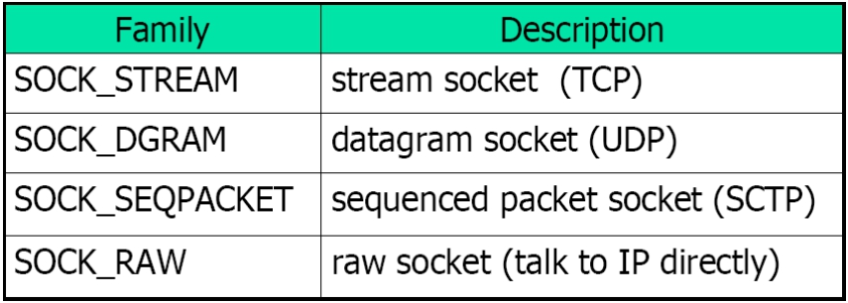
Types of Networking APIs
• TCP socket
• UDP socket
• raw socket over IP (bypass TCP/UDP)
•
datalink (bypass IP)
– BPF (BSD Packet Filter)
– DLPI (SVR4 Data Link Provider Interface)
Computer Network Programming 53

Slide 54
Some Relevant Socket System
Calls and Header Files
int socket(int family, int type, int protocol);
int bind(int sockfd, const struct sockaddr *addr, socklen_t addrlen); int listen(int sockfd, int backlog);
int accept(int sockfd, struct sockaddr *cliaddr, socklen_t *cliaddrlen);
int connect(int sockfd, struct sockaddr *servaddr, socklen_t *servaddrlen); ssize_t recvfrom(int sockfd, void *buff, size_t len, int flags,
struct sockaddr *from, socklen_t *fromlen);
ssize_t sendto(int sockfd, void *msg, size_t len, int flags,
struct sockaddr *to, socklen_t tolen); struct hostent gethostbyname(const char *name); int shutdown(int sockfd, int howto);
<sys/socket.h>
<netinet/in.h>
<netdb.h>
54
Computer Network Programming
54

