Slide 1
Chapter 3 Matrix Multiplication
黃國展

Slide 2
Sequential Matrix Multiplication

Slide 3
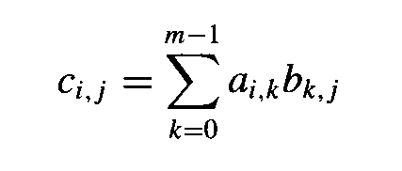
Iterative, Row-Oriented Algorithm
The product of an l × m matrix A and an m × n matrix B is an l × n matrix C whose elements are defined by

Slide 4
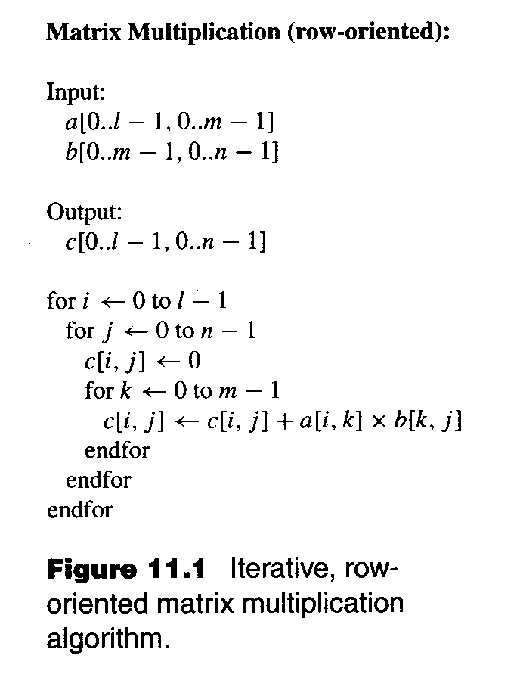

Slide 5
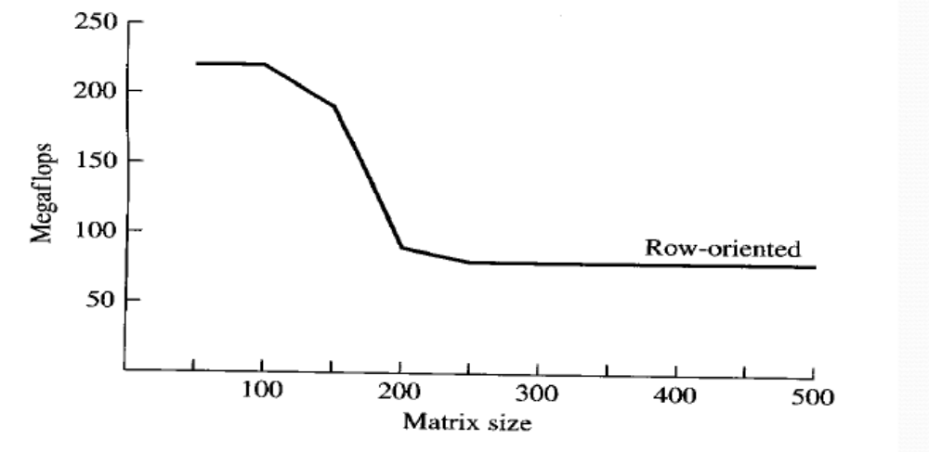

Slide 6
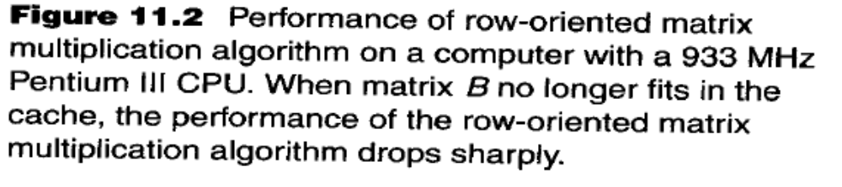

Slide 7
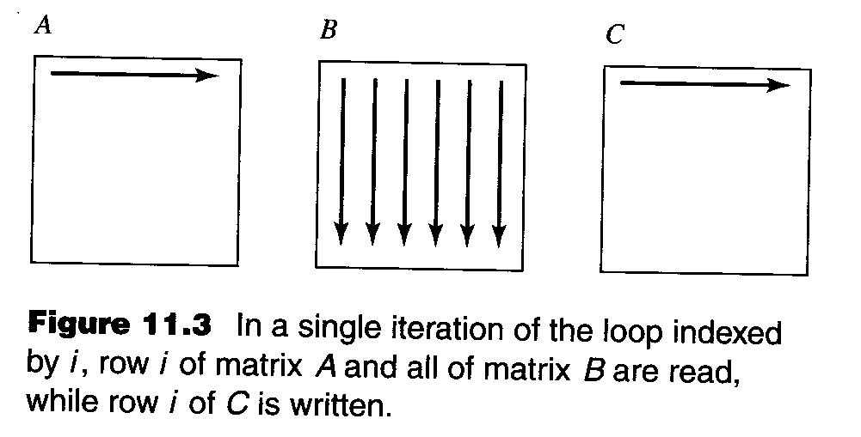

Slide 8
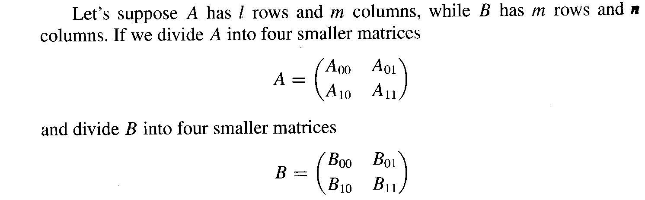
Recursive, Block-Oriented Algorithm

Slide 9
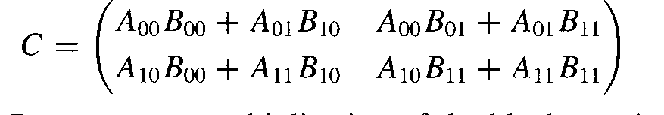
Recursive, Block-Oriented Algorithm
Our goal is to compute the matrix product C = AB. If matrix B is too large to fit into cache, we can divide it into four pieces and use the idea of block matrix multiplication to compute C.

Slide 10
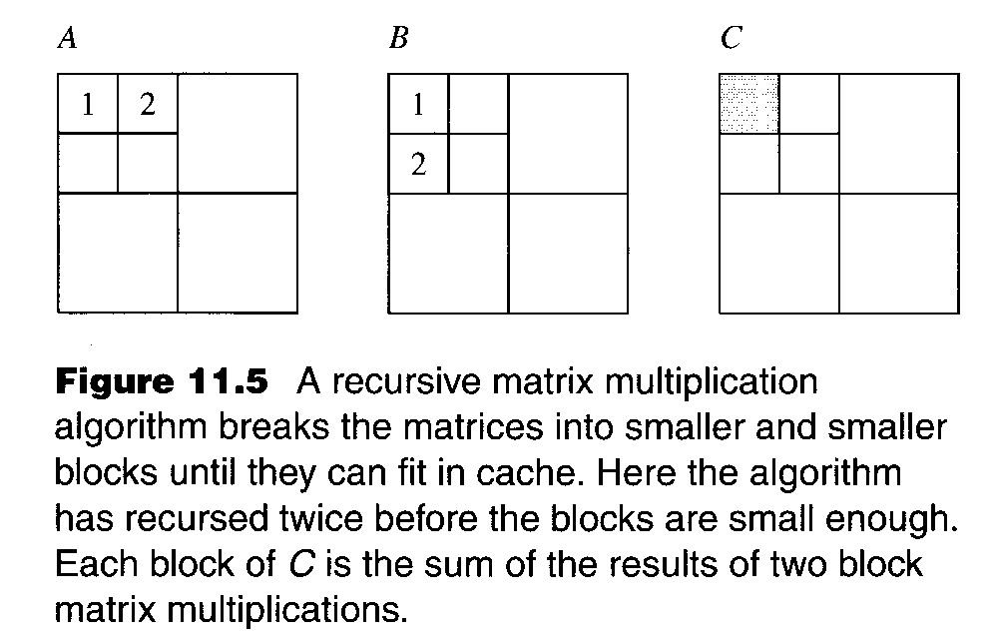

Slide 11
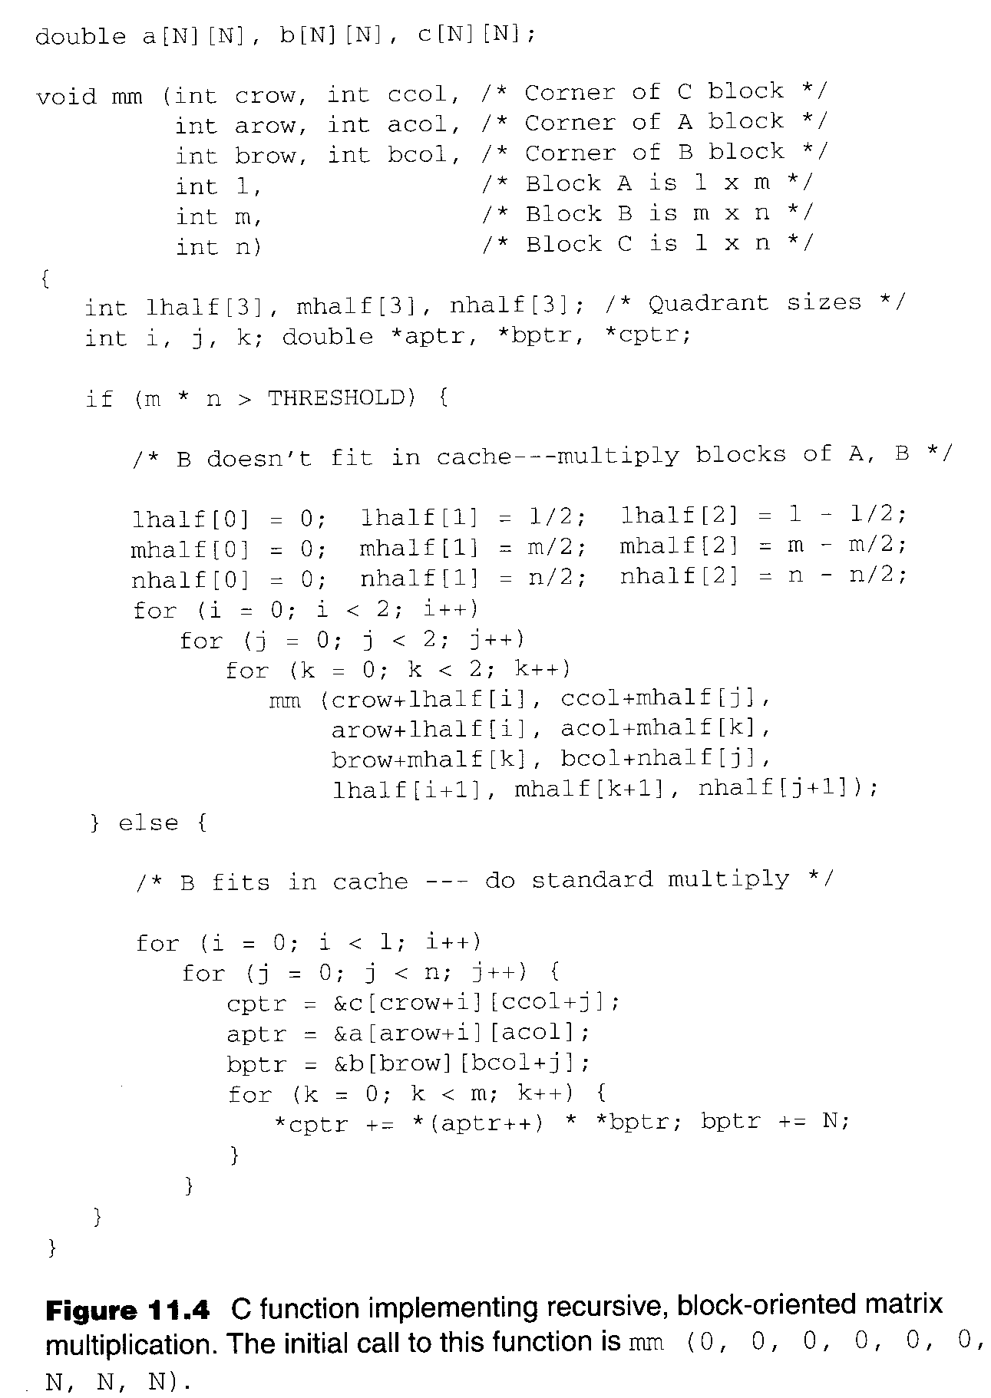

Slide 12
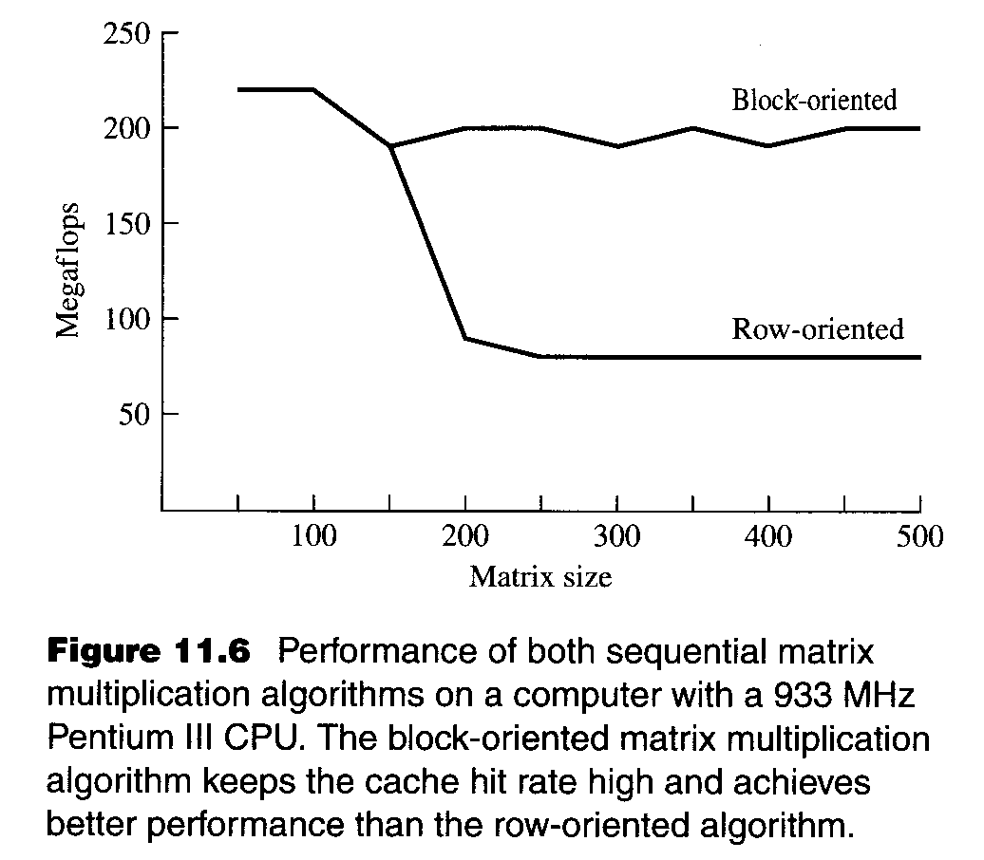

Slide 13
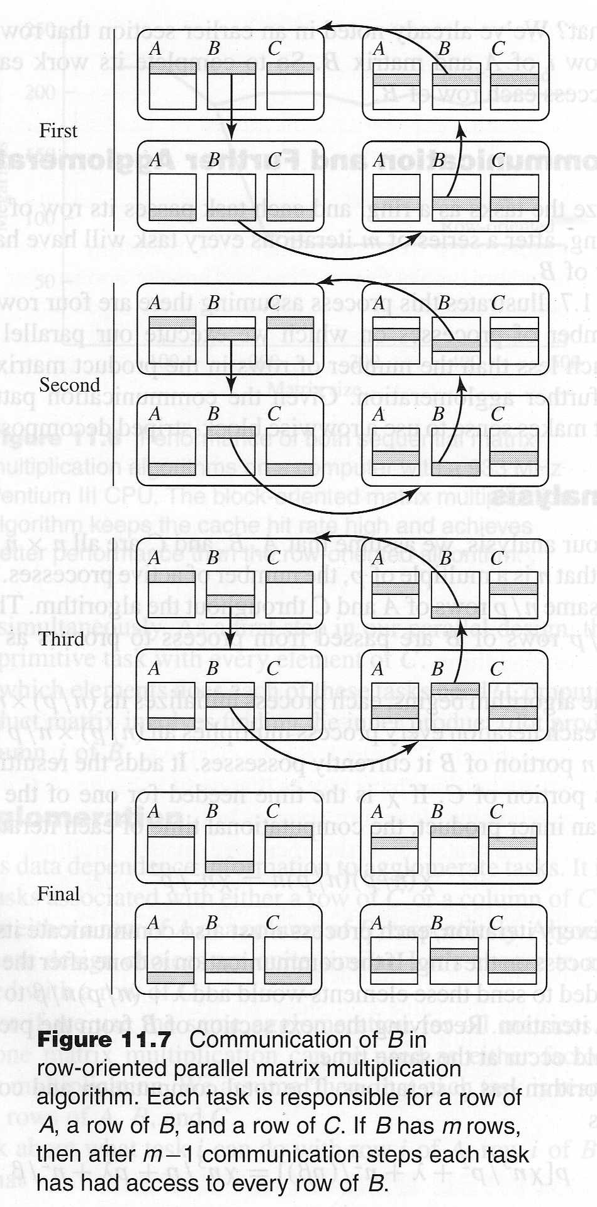
Rowwise Block-Striped Parallel Algorithm

Slide 14
Cannon’s Algorithm
A parallel algorithm based upon a checkerboard block decomposition of the matrices.

Slide 15
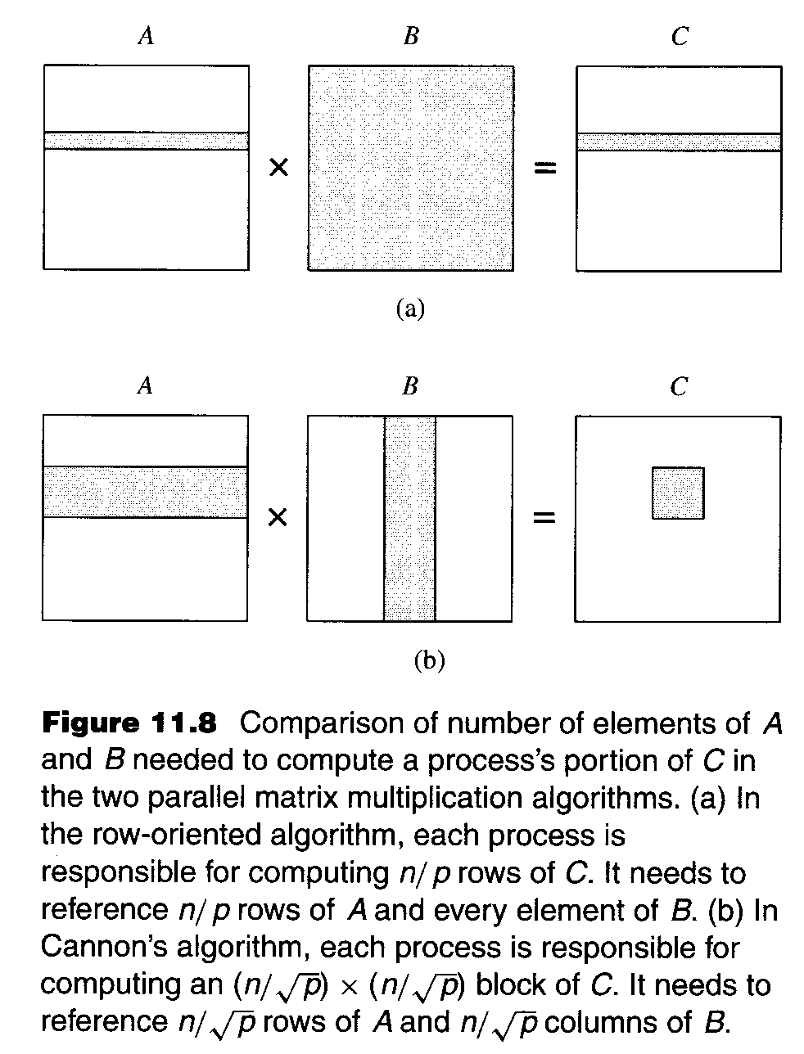

Slide 16
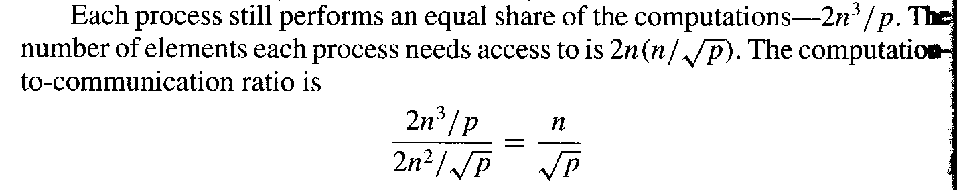
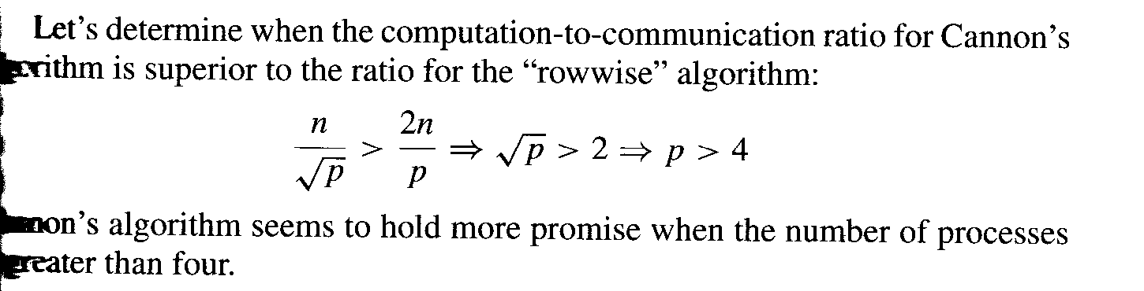

Slide 17
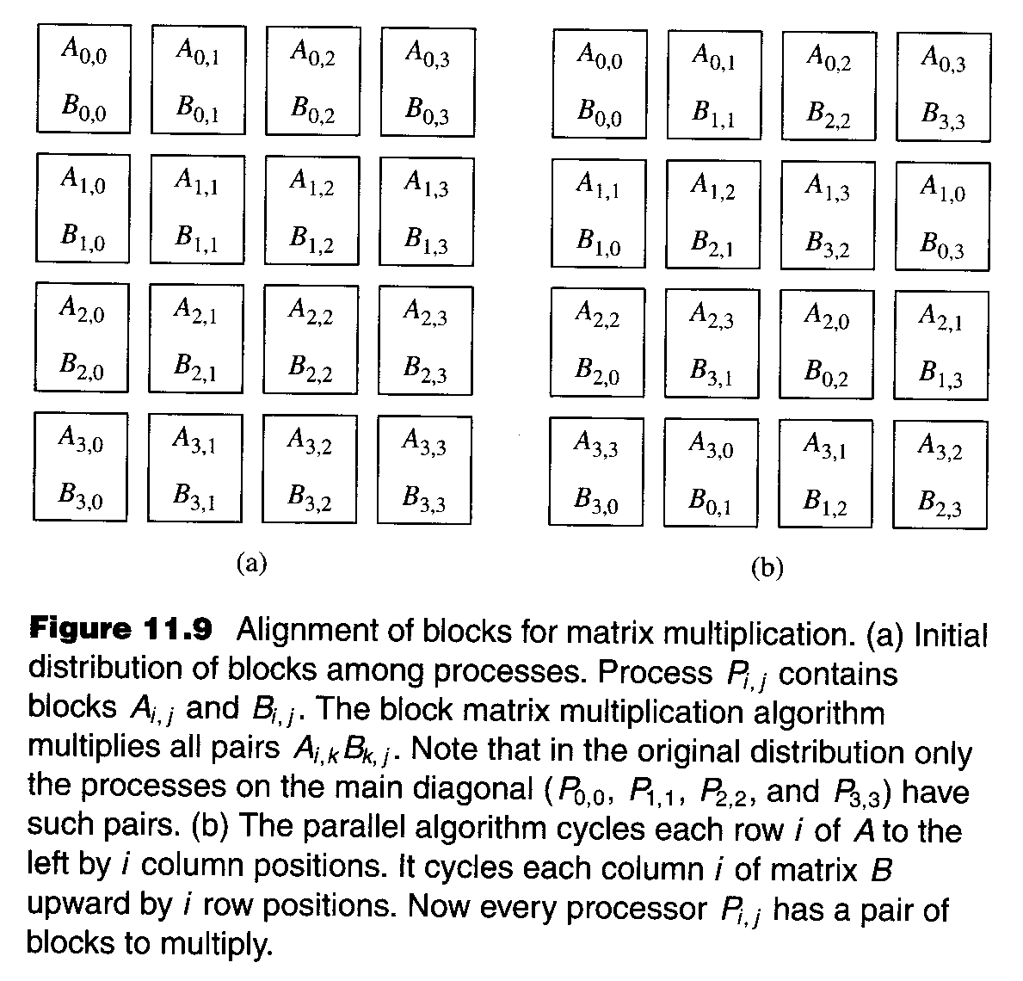

Slide 18
