Slide 1
Chapter 4 Nonograms
葉家郡、黃國展

Slide 2
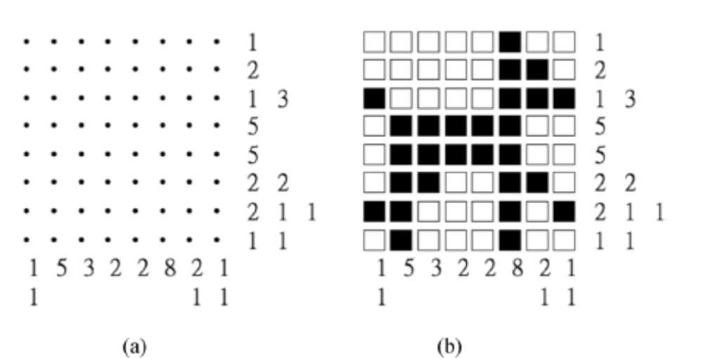
Introduction
https://en.wikipedia.org/wiki/Nonogram
http://www.puzzle-nonograms.com/

Slide 3
5x5 Nonogram Puzzle ID: 303,115
 | 2 | 2 | 2 2 | 1 1 | 3
3
4
1
3
1 1

Slide 4
10x10 Nonograms Puzzle ID: 6,479,127
 | 5 1 | 2 7 | 5 | 4 | 3 | 2 3 | 3 | 2 2 | 1 1 2 1 | 3 3
2
2 2
1 1 1 1
2 1 3
2
2 1
3 3
9
5 1
6 2

Slide 5
Nonogram Rules for TCGA Tournament
The input file consists of 1000 nonogram puzzles with size 25x25. Time limitation is 2 hours.
The rank is determined by the number of correctly solved puzzles.
If two groups have the same numbers of correctly solved puzzles, the rank is determined by the time for solving puzzles.
The puzzles are generated by boardgen.py.
  The ratio of black cell ranges from 0.5 to 0.35 in order. (This means that the difficulty of puzzles is roughly increasing in input order.)
  The random seed is determined by all participants.

Slide 6
Nonogram Rules for TCGA Tournament
Format of input and output
There is a symbol "$" before the puzzle number. The description/solution of the puzzle starts from the next line.
For 25x25 nonogram puzzles, there are 50 lines of clues (puzzle description). The former 25 are clues at the top end from up to down. The later 25 are clues at the left end from left to right.
The solutions are stored by 25x25 matrices. A "0" means to leave a cell blank while a "1" means to color a cell black.
All the numbers of clues and solutions are separated by TAB.

Slide 7
Nonogram Rules for TCGA Tournament
Solving
All of the programs will run on the same machine. Each program is only allowed to use single CPU core. The specification of machine will be announced after registration deadline.
Participants provide their executable programs.
Each program solves these puzzles in order (cannot skip).
For the puzzles with multiple solutions, the program only needs to generate 1 solution.
Each program needs to record total time to solve the puzzles.

Slide 8
CheckAns
Check whether the answer is correct or not.

Slide 9
An Efficient Approach
The general problem of determining whether a nonogram puzzle has a solution is NP-complete.
The following presents an efficient approach to solving nonogram puzzles.
It includes a fast dynamic programming (DP) method for line solving, whose time complexity in the worst case is O(kl) only, where the grid size is l×l and k is the average number of integers in one constraint, always smaller than l.
It also includes some fully probing (FP) methods to solve more pixels before running backtracking.
Most importantly, these FP methods provide useful guidance in choosing the next promising pixel to guess during backtracking.

Slide 10
LINE SOLVING AND PROPAGATION
Let Σ be the finite alphabet {0, 1}, and Σ^{l} be the set of all the strings over Σ of length l. For simplicity, let Σ* be the set of all the strings over Σ of all lengths. For simplicity of discussion, a pattern for strings is expressed in a regular expression notation. For example, both 0100111 and 001100 match pattern 0⁺1⁺0²1*.
Each line (either row or column) is given by a description, say D=<d₁, d₂, …, d_{r}>. Line S=s1s2…sl∈ Σ^{l} is said to be consistent with D, if r is the number of black segments in the line, and each d_{i} is the length of the ith black segment. More specifically, given description D, line S is consistent with D if S matches the following pattern: 0*1^{d1}0⁺1^{d2}0⁺…0⁺1^{dr}0*

Slide 11
LINE SOLVING AND PROPAGATION
Let σ(d) denote segment 0¹1^{d} of length d+1. Let 0S denote the concatenation of 0 and S . The above can be rewritten as follows for line consistency. Given D, S is consistent with D if 0S matches the following pattern: 0* σ(d₁) 0* σ(d₂) 0*…0* σ(d_{r}) 0*
In a line S=s₁s₂…s_{l}, let s_{i} be the symbol u if the i-th pixel has not yet been painted. Let Γ = Σ∪{u} be a finite alphabet, and Γ^{l} be the set of all the strings over Γ of length l. For a line S∈ Γ*, if some s_{i}=u, the i-th pixel s_{i} will need to be changed to either 0 or 1, but not vice versa. For a line S∈Σ*, no further changes are required.

Slide 12
LINE SOLVING AND PROPAGATION
String S’=s’₁s’₂…s’_{l}∈ Γ^{l} is said to be an assignment of another string S= s₁s₂…s_{l}∈ Γ^{l}, if the following three conditions hold: 1) if s_{i} is 0, then s’_{i} is 0; 2) if s_{i} is 1, then s’_{i} is 1; and 3) if s_{i} is u, then s’_{i} is one of 0, 1, or u. Let S→S’ denote the assignment relation between S and S’. For example, 0100, 0110, and 11u0 are assignments of u1u0, that is, u1u0→0100, u1u0→0110, and u1u0→11u0. An assignment S’ of S is also called a fix of S, if S’∈Σ*. For simplicity, let S→^{Σ}S’ denote S→S’ and S’∈Σ*.
String S∈Γ* is said to be fixable with respect to description D, if there exists some fix S’ with S→^{Σ}S’ such that S’ is consistent with D. For example, u1u0 is fixable with respect to D=<3>, since a fix 1110 (for u1u0→1110) is consistent with D.

Slide 13
LINE SOLVING AND PROPAGATION
String S∈Γ* is said to be partially fixable to string S’∈Γ* with respect to description D, if S’ is an assignment of S and S’ is fixable with respect to D.
The fixability problem is: given string S= s₁s₂…s_{l}∈ Γ^{l} and description D=<d₁, d₂, …, d_{k}>, verify whether S is fixable with respect to D. For simplicity, let us assume that s₁ is already 0 in the following. If s₁ is not 0, we simply add one 0 at the beginning of S.

Slide 14
LINE SOLVING AND PROPAGATION
For this fixability problem, we propose a DP method, which is to build a recurrence Fix(i,j) for all i >= 0 and j >= 0 as follows. Let S^{(i)} denote string s₁s₂…s_{i}, and D^{(j)} denote description <d₁, d₂, …, d_{j}>. Given S^{(i)} and D^{(j)}, Fix(i,j) verifies whether S^{(i)} is fixable with respect to D^{(j)}. In addition, let Fix0(i,j) indicate whether string S^{(i)} is fixable with respect to D^{(j)} in the case that s_{i} matches 0, and, similarly, let Fix1(i,j) indicate fixability for the case where s_{i} matches 1. The recurrences for Fix(i,j) are formulated in detail as follows:

Slide 15
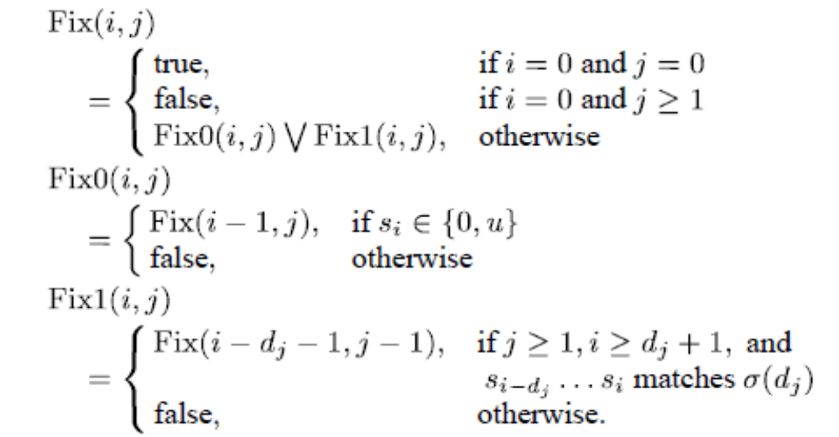
LINE SOLVING AND PROPAGATION

Slide 16
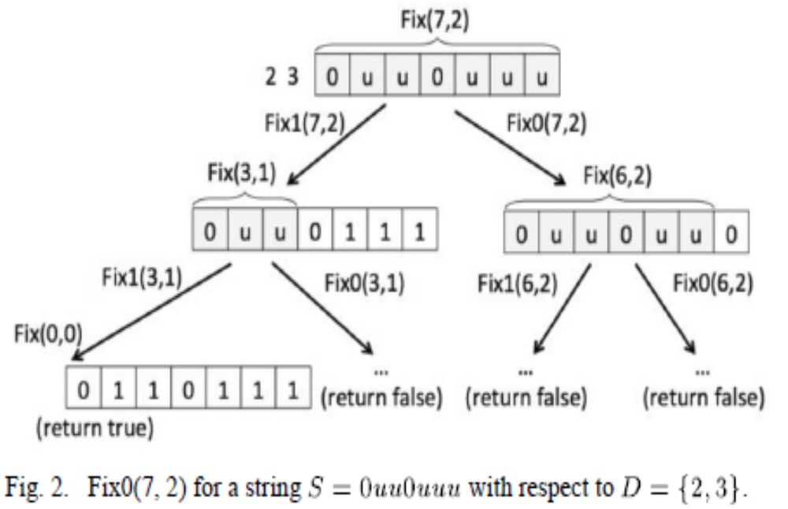
LINE SOLVING AND PROPAGATION

Slide 17
LINE SOLVING AND PROPAGATION
The solution to the fixability problem, therefore, is the value of Fix(l,k). To derive this value, we use the typical DP method by calculating a table with size l×k, where the table is a 2-D array of data returned from Fix(i,j) for all i,j. Since it takes only constant time to calculate each Fix(i,j), the time complexity for evaluating Fix(l,k) is clearly O(kl). In practice, the above method can be further improved by checking whether i ≥ Σ^{j}_{p=1}(d_{p}+1) in all Fix(i,j). If not, return false immediately. This is because the minimal length of strings fixable with respect to D^{(j)} is Σ^{j}_{p=1}(d_{p}+1).

Slide 18
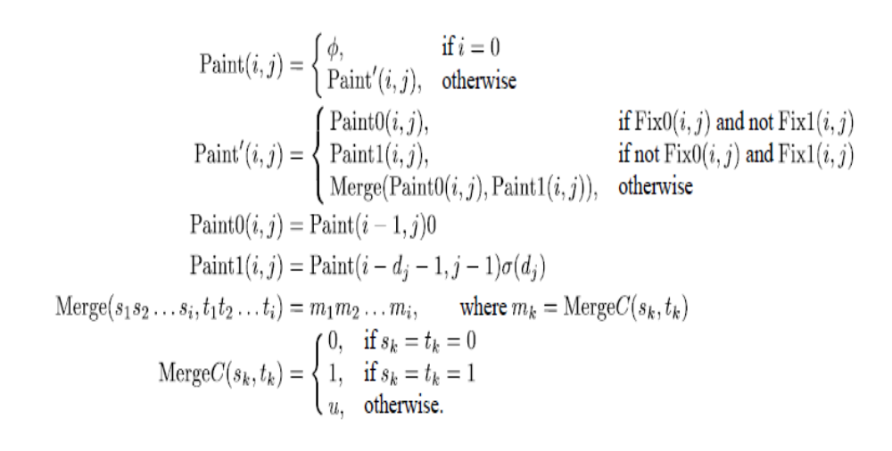
LINE SOLVING AND PROPAGATION
The line-solving problem is as follows: Given string S and description D, find the maximal painting S’ of S.

Slide 19
LINE SOLVING AND PROPAGATION
For deriving the maximal painting Paint(l,k), we also use DP to calculate a table with size l×k, where the table is a 2-D array of data returned from Paint(i,j) for all i,j. Since it takes O(i) or O(l) time to merge two strings, the time complexity for evaluating Paint(l,k) is O(kl²).
The propagation problem involves repeatedly painting pixels with values of u into 0 or 1 by applying line solving to all rows and all columns, until none of the pixels in the grid can be painted.

Slide 20
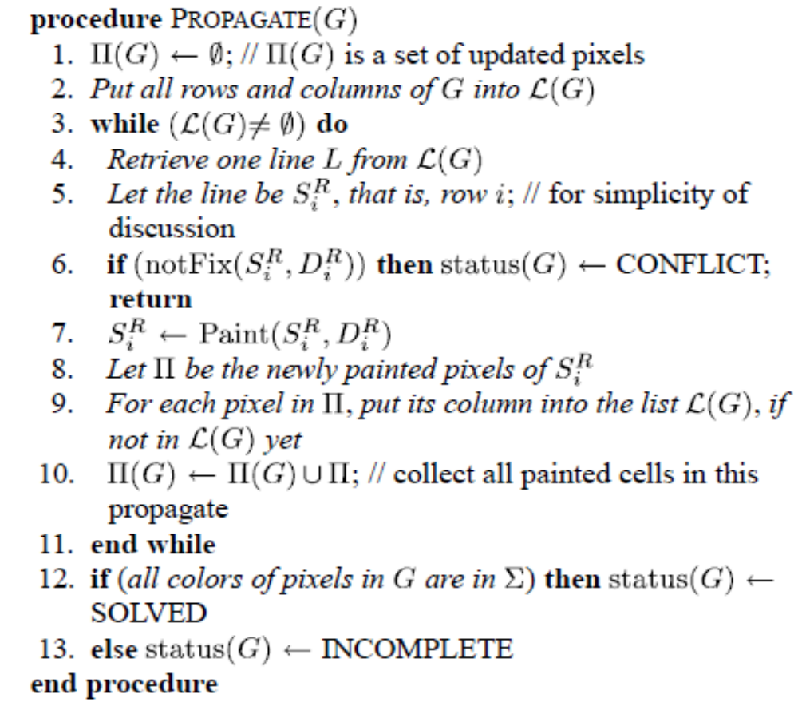
LINE SOLVING AND PROPAGATION

Slide 21
Fully Probing
When no more pixels are to be painted after PROPAGATE, a common method is to employ backtracking to search all possible solutions.
Yet another problem is which pixel to guess at in order to solve the puzzle more efficiently.
The following proposes an important technique, called fully probing (FP), to be used before running backtracking.
In FP, we attempt to guess a color on each pixel to see whether more pixels can be painted.
The FP method is different from backtracking in that the FP method is not recursive. That is, each pixel is only tested once, just enough to provide backtracking with more accurate guidance when choosing pixels to guess.

Slide 22
The First Fully Probing Method
The idea of FP is to make guesses for all unpainted pixels (with a value of ) in advance, and then perform propagation for each guess.
The first proposed FP method, named FP1, maintains pairs of grids (G_{p,0}, G_{p,1}) for all pixels p , where both G_{p,0} and G_{p,1} represent the painted grids after guessing p to be 0 and 1, respectively.

Slide 23
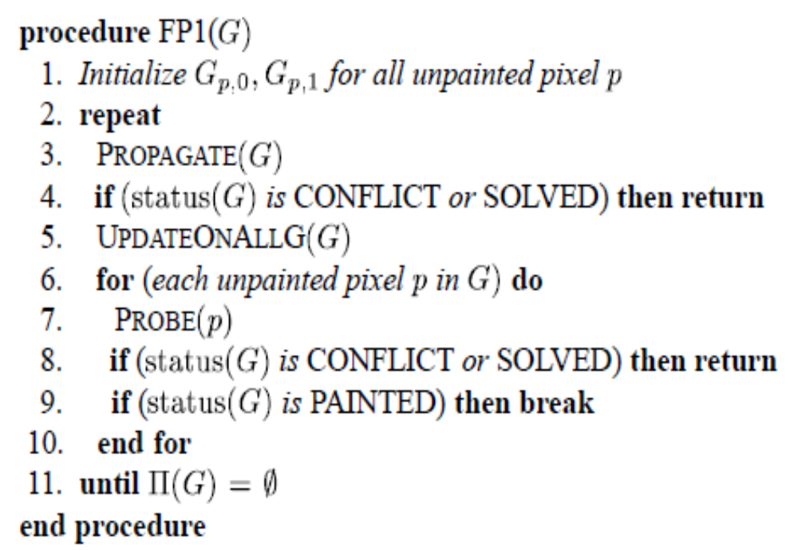
The First Fully Probing Method

Slide 24
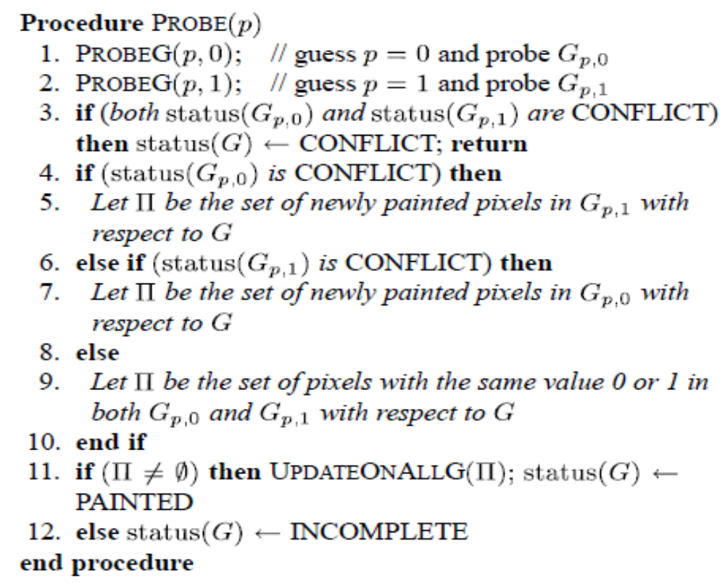
The First Fully Probing Method

Slide 25
The First Fully Probing Method
In the case where G is not yet complete, update all G_{p,0} and G_{p,1} from Π(G) using the procedure UPDATEONALLG, where Π(G) is the set of newly painted pixels in G by PROPAGATE. UPDATEONALLG updates the pixels in Π(G) from G to all G_{p,0} and G_{p,1}.
In the FP1 method, PROBEG(p,c) simply calls PROPAGATE(G_{p,c}).

Slide 26
The Second Method (FP2)
The major problem of FP1 is that it does not make use of the contrapositive, that is, an implication p_{a} → p_{b} implies the contrapositive ¬p_{b} → ¬ p_{a}.
In FP1, if we obtain p_{b} = 1 by performing PROBE on G_{pa,1}(assuming p_{a} =1 ), then this implies p_{a} → p_{b} , which implies its contrapositive ¬p_{b} → ¬ p_{a}. Then, the contrapositive implies p_{a} = 0 on G_{pb,0} (assuming p_{b} = 0).
Unfortunately, the FP1 method does not request to set (or paint) p_{a} = 0 on G_{pb,0} in this case.

Slide 27
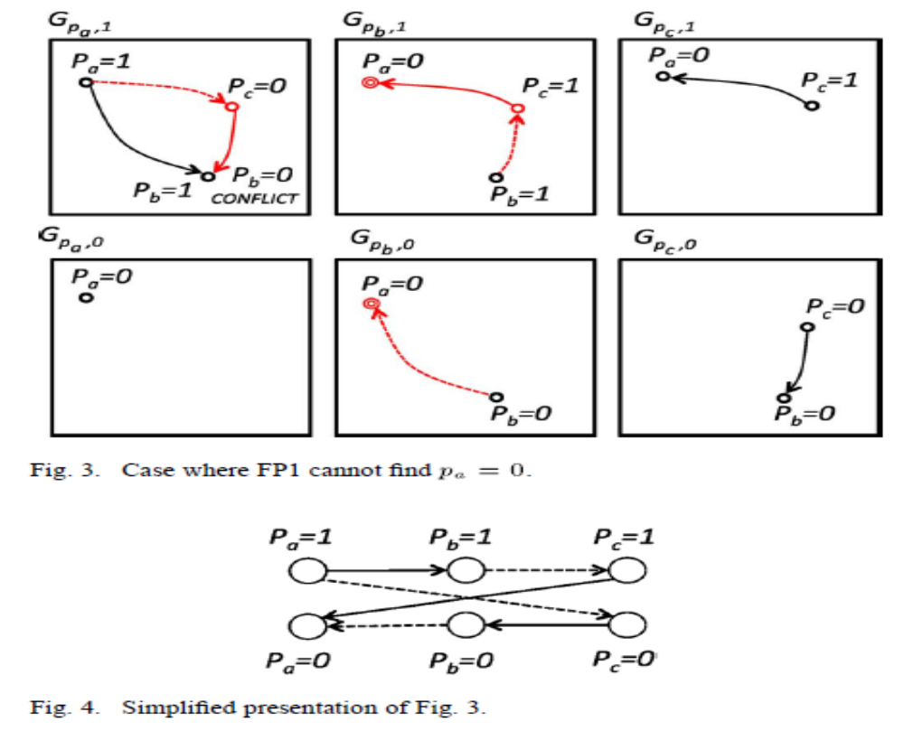
The Second Method (FP2)

Slide 28
The Second Method (FP2)
In FP2, all grids, say G_{p,0}, are associated with a list of pairs of pixels and their values, denoted by pclist(G), used to record the derived values for given pixels, mainly for the contrapositive.
When probing a grid, update the cells of the grid from the list before using PROPAGATE.

Slide 29
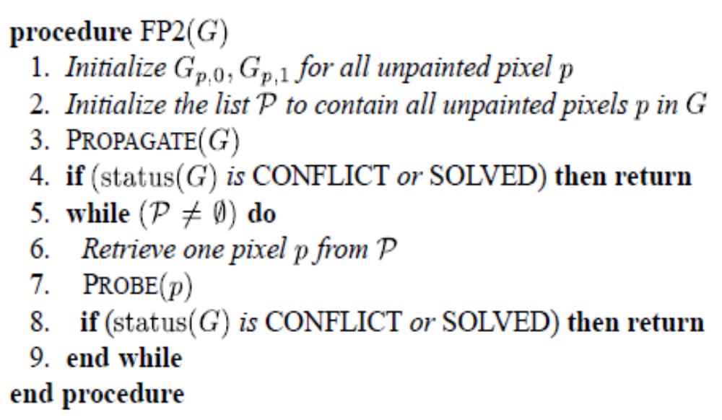
The Second Method (FP2)

Slide 30
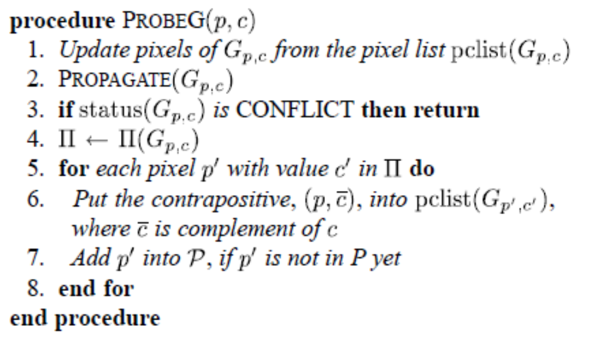
The Second Method (FP2)

Slide 31
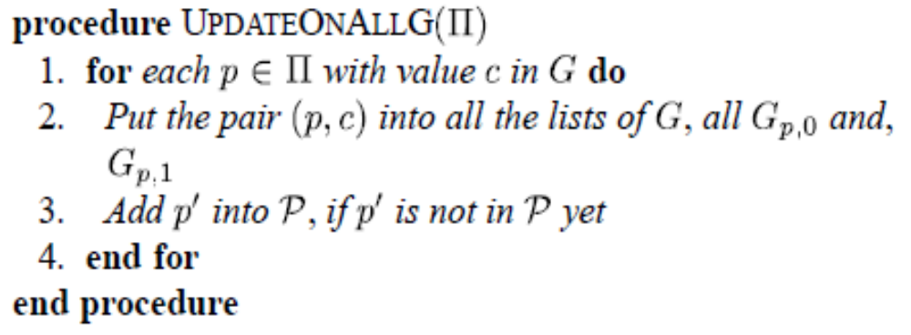
The Second Method (FP2)

Slide 32
Backtracking
In many puzzles, all pixels in the grids can be completely painted following an FP method: FP1, FP2, or FP3. However, if the grids are not completely painted, we still need to use the backtracking method to paint the whole grid.
In our backtracking method, first, we use an FP method to paint as many pixels as possible. If a conflict is not detected or a solution is not yet found in the grid, we use choose-pixel heuristics in a routine named CHOOSEPIXEL to choose the next pixel p to extend. After choosing p, we paint the value 0 to p, then recursively call the backtracking method. The process is repeated similarly for painting 1 on p.

Slide 33
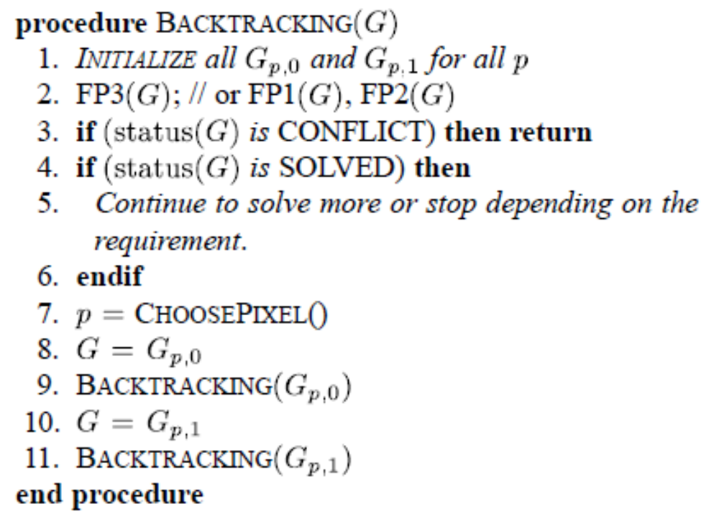
Backtracking

Slide 34
Backtracking
Regarding CHOOSEPIXEL, for example, we can choose the pixel p that maximizes m_{p,0} + m_{p,1}, where the value m_{p,c} denotes the number of extra pixels painted in G_{p,c}, not in G. In general, the larger m_{p,c} is, the better it is to extend on p. This is because extending on p with c generally results in more pixels painted. We tried many choose-pixel heuristics in the following experiments.

Slide 35
Experiments
In the experiments, we also supported caching for all lines, since the solving of identical lines is highly likely.
In the experiments, the various choose-pixel heuristics that were tried are listed as follows.

Slide 36
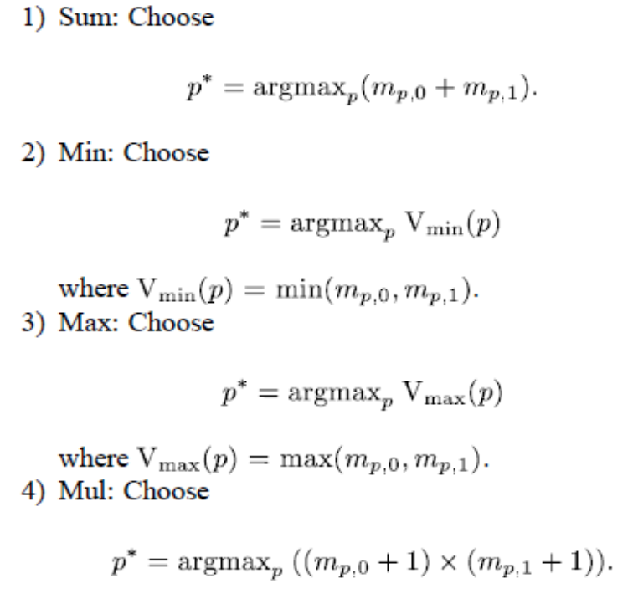
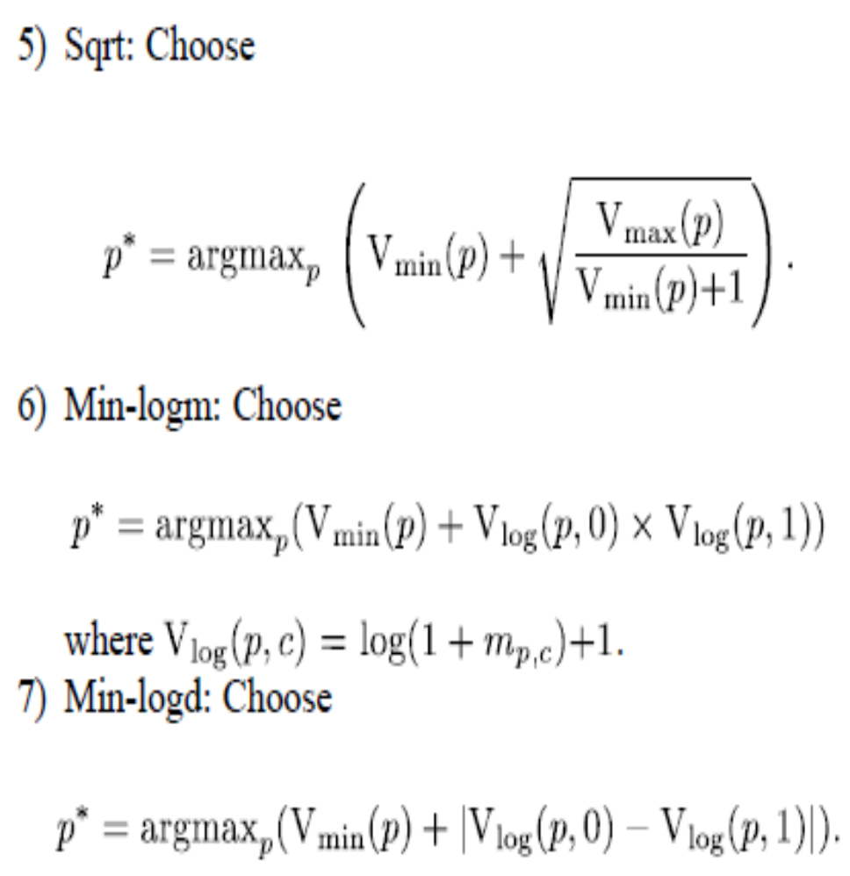
Experiments

Slide 37
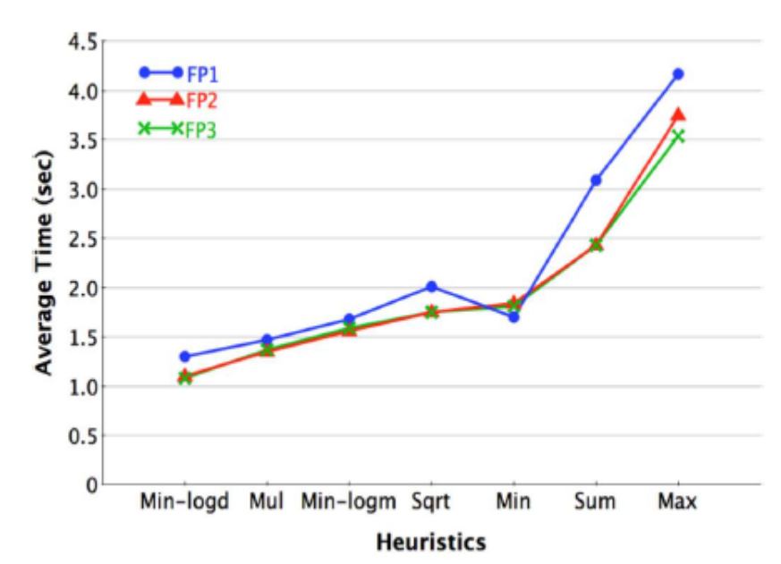
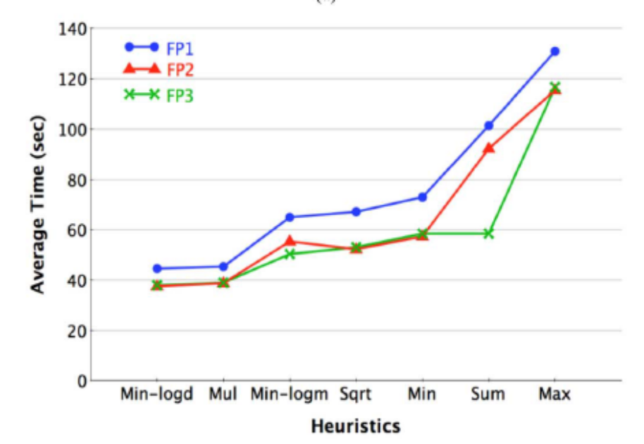
Experiments

Slide 38
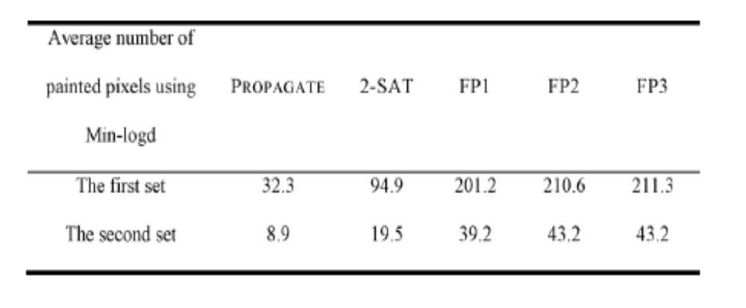
Experiments

