Slide 1
Chapter 5 Message Passing Programming
洪俊豪、劉曉青、黃國展

Slide 2
Message Passing Programming
Example: circuit satisfiability problem (figure 4.2)
MPI functions:
  MPI_Init
  MPI_Comm_rank
  MPI_Comm_size
  MPI_Reduce
  MPI_Finalize
  MPI_Barrier
  MPI_Wtime
  MPI_Wtick

Slide 3
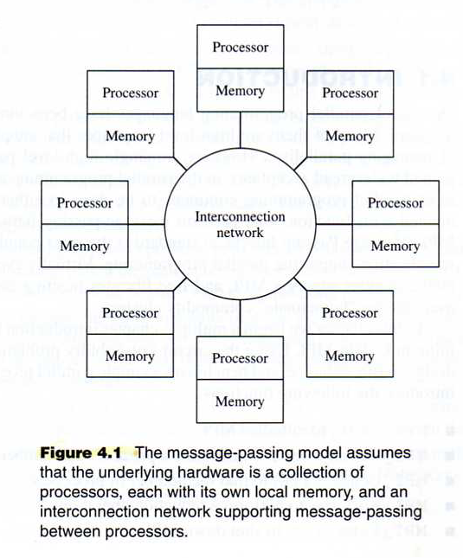

Slide 4
Circuit Satisfiability
For our initiation to MPI, we will implement a program that computes whether the circuit shown in Figure 4.2 is satisfiable. In other words, for what combinations of input values will the circuit output the value 1?
In Figure 4.2, this circuit has 16 inputs,labeled a-p, and every input can take on two values, 0 and 1, there are 2¹⁶ = 65536 combinations of inputs.

Slide 5
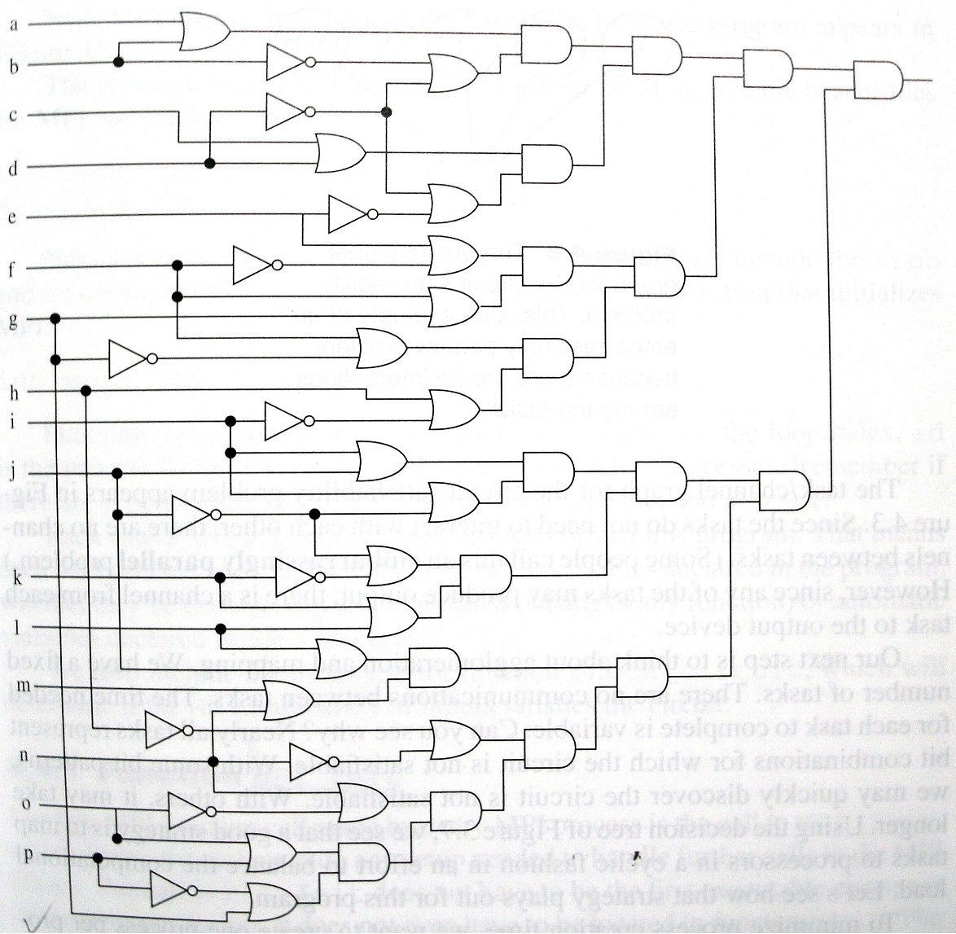
Figure 4.2

Slide 6
Circuit Satisfiability
One way to solve the problem is to try every combination of inputs. This can be implemented as a sequential version.
For parallel version, a data decomposition is natural for this application. We associate one task with each combination of inputs. If a task finds that its combination of inputs causes the circuit to return the value 1, it prints its combination. Since all of these tasks are independent, the satisfiability checks may be performed in parallel.

Slide 7
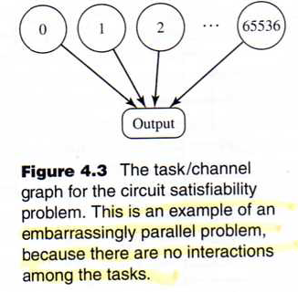

Slide 8
Cyclic (Interleaved) Allocation
To minimize process creation time, we want to create one process per processor.
So we have n pieces of work we want to allocate to p processes.
A cyclic (or interleaved) allocation assigns each process every pth piece of work in a round-robin fashion.

Slide 9
MPI_Init
int MPI_Init ( int *argc, char ***argv)
MPI_Init does not have to be the first executable statement.
The only requirement is that MPI_Init be called before any other MPI function.

Slide 10
MPI_Comm_rank
int MPI_Comm_rank (
  MPI_Comm comm,
    /* communicator */
  int *rank
    /* rank of calling process */
)
A communicator is an opague object that provides the environment for message passing among processes.
Function MPI_Comm_rank returns the rank of the calling process in a communicator.
MPI_COMM_WORLD

Slide 11
MPI_Comm_size
int MPI_Comm_size (
  MPI_Comm comm,
    /* communicator */
  int *size
    /*number of process in communicator*/
)
MPI_Comm_size return the number of processes in a communicator.

Slide 12
MPI_Finalize
int MPI_Finalize (void)
MPI_Finalize terminates the MPI execution environment. Every process must call this function before exiting.

Slide 13
MPI_Reduce
int MPI_Reduce (
  void *oprand,
    /* addr of 1st reduction element */
  void *result,
    /* addr of 1st reduction result */
  int count,
    /* reductions to perform */
  MPI_Datatype type,
    /* type of elements */
  MPI_Op operator,
    /* reduction operator */
  int root,
    /* process getting result (s) */
  MPI_Comm comm
)
A collective communication is a communication operation in which a group of processes works together to distribute or gather together a set of one or more values. Reduction is an example of an operation that requires collective communication in a message-passing environment.

Slide 14
MPI reduction operators
MPI_BAND Bitwise and
MPI_BOR Bitwise or
MPI_BXOR Bitwise xor
MPI_LAND Logical and
MPI_LOR Logical or
MPI_LXOR Logical xor
MPI_MAX Maximum
MPI_MAXLOC Max and location of maximum
MPI_MIN Minimum
MPI_MINLOC Min and location of minimum
MPI_PROD Product
MPI_SUM Sum

Slide 15
MPI_Wtime
double MPI_Wtime (void)
Function MPI_Wtime returns a double-precision floating-point number representing the number of seconds since some time in the past. The definition of “some time in the past” is guaranteed not to change during the life of a process. Hence the elapsed time of a block of code can be determined by calling MPI_Wtime before it and after it and computing the difference.

Slide 16
MPI_Wtick
double MPI_Wtick (void)
Function MPI_Wtick returns a double-precision floating-point number indicating the number of seconds between ticks of the clock used by function MPI_Wtime.

Slide 17
MPI_Barrier
int MPI_Barrier (
  MPI_Comm /* Communicator */
)
MPI_Barrier is a collective communication function that performs a barrier synchronization among all processes in the specified communicator.

Slide 18
MPI_Datatype
MPI_CHAR signed char
MPI_Double double
MPI_FLOAT float
MPI_INT int
MPI_LONG long
MPI_LONG_DOUBLE long double
MPI_SHORT short
MPI_UNSIGNED_CHAR unsigned char
MPI_UNSIGNED unsigned int
MPI_UNSIGNED_LONG unsigned long
MPI_UNSIGNED_SHORT unsigned short

Slide 19
Compiling and Running MPI Programs
mpicc –o sat1 sat1.c
mpirun –machinefile hosts –np 1 sat1
0)1010111110011001
0)0110111110011001
…
Process 0 is done

Slide 20
