Slide 1
Chapter 6 The Sieve of Eratosthenes
洪俊豪、劉曉青、黃國展

Slide 2
Example: The Sieve of Eratosthenes
MPI function:
  MPI_Bcast

Slide 3
The Sieve of Eratosthenes
Our goal is to develop a parallel version of the prime sieve invented by the Greek mathematician Eratosthenes.
You can find pseudo code for the Sieve of Eratosthenes in Figure 5.1.
An example of the sieve appears in Figure 5.2. In order to find primes up to 60, integer multiples of the primes 2,3,5, and 7 are marked as composite numbers. The next prime is 11. The square of its value is 121, which is greater than 60, causing an end to the sieving loop.

Slide 4
Figure 5.1
Create a list of natural numbers 2, 3, 4, …, n, none of which is marked.
Set k to 2, the first unmarked number on the list.
Repeat
  Mark all multiples of k between k² and n
  Find the smallest number greater than k that is unmarked, Set k to the new value.
  Until k² > n
The unmarked numbers are primes

Slide 5
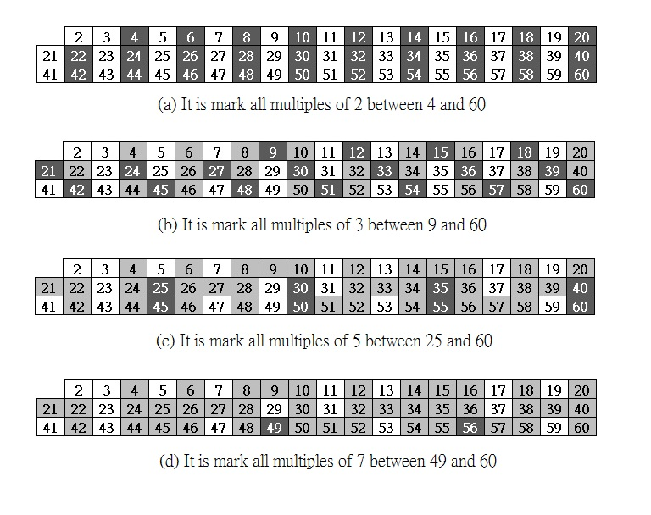
Figure 5.2

Slide 6
Source of Parallelism
Because the heart of the algorithm is marking elements of the array representing integers, it makes sense to do a domain decomposition, breaking the array into n-1 elements and associating a primitive task with each of these elements.
The key parallel computation is step 3a, where those elements representing multiples of a particular prime k are marked as composite.
  For the cell representing integer j, this computation is straightforward: if j mod k = 0, then j is a multiple of k and should be marked.

Slide 7
Source of Parallelism
If a primitive task represents each integer, then two communications are needed to perform step 3b each iteration of the repeat …. until loop.
  A reduction is needed each iteration in order to determine the new value of k,
  and then a broadcast is needed to inform all the tasks of the new value of k.

Slide 8
Interleaved Data Decomposition
Process 0 is responsible for the natural numbers 2, 2+p, 2+2p, …,
Process 1 is responsible for the natural numbers 3, 3+p, 3+2p, …,
where p is the number of processors.
An advantage of the interleaved decomposition is that given a particular array index I, it is easy to determine which process controls that index (process i mod p).

Slide 9
Interleaved Data Decomposition
A disadvantage of an interleaved decomposition for this problem is that it can lead to significant load imbalances among the processes.
  For example, if two processes are marking multiples of 2, process 0 marks (n-1)/2 elements while process 1 marks none.

Slide 10
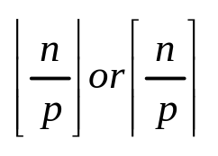

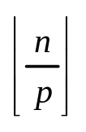
Block Data Decomposition
That means we divide the array into p contiguous blocks of roughly equal size.
  If the number of array elements n is a multiple of the number of processes p, the division is straightforward.
If n is not a multiple of p, then it is more complicated. What we need is a block allocation scheme that balances the workload by assigning to each process either
elements.
The first method begins by computing r = n mod p, then the first r processes should get a block of size and the remaining p-r processes should get a block of size .

Slide 11


Block Data Decomposition
There are two questions we typically need to be able to answer when developing algorithms based on a block allocation of data.
  What is the range of elements controlled by a particular process?
  Which process controls a particular element?
For the first scheme, the first element controlled by process i is , the last element controlled by process i is the element immediately before the first element controlled by process i+1:

Slide 12



Block Data Decomposition
The process controlling a particular array element j is
The second block allocation scheme we are considering does not concentrate all of the larger blocks among the smaller-numbered processes. The first element controlled by process i is , the last element controlled by process i is the element immediately before the first element controlled by process i+1: The process controlling a particular array element j is

Slide 13
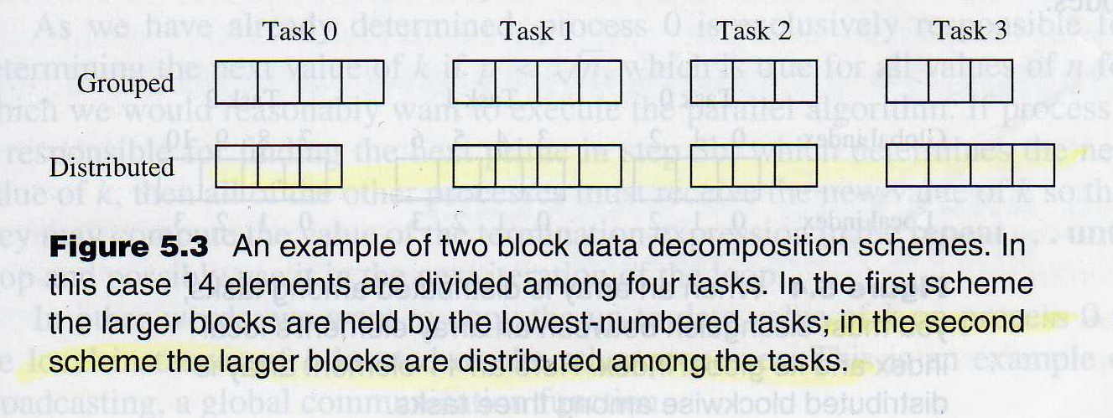
Block Data Decomposition

Slide 14
Block Data Decomposition
The second approach is superior because it requires fewer operations to perform the three most common block management computations, especially since integer division in C automatically rounds down the result. It is the block decomposition method we will use for the remainder of the book.

Slide 15
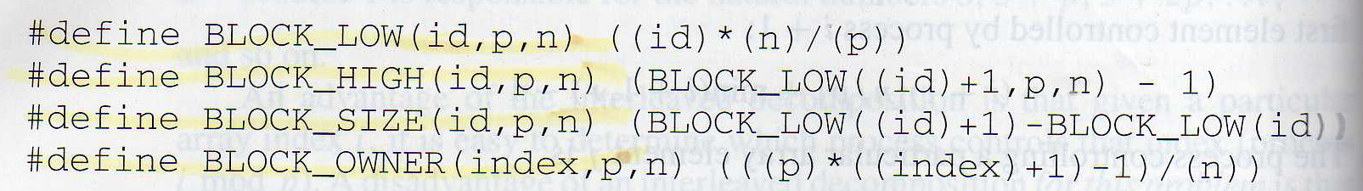
Block Decomposition Macros

Slide 16
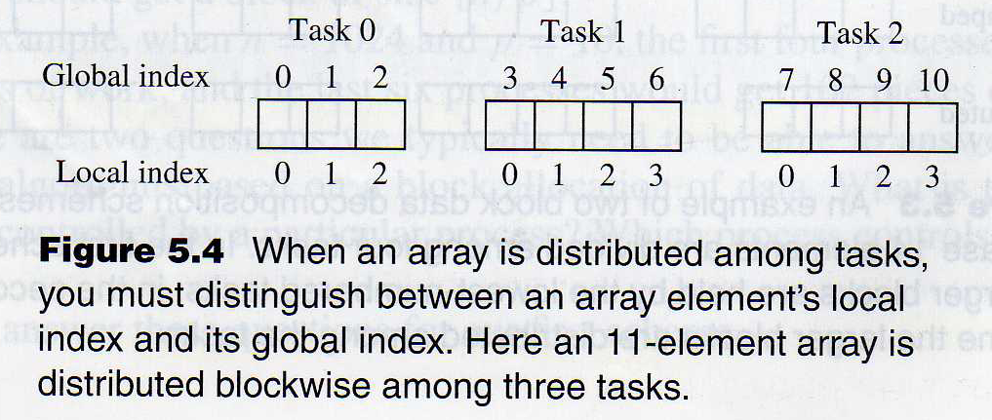
Local Index versus Global Index
When we decompose an array into pieces distributed among a set of tasks, we must remember to distinguish between the local index of an array element and its global index.

Slide 17
MPI_Bcast
int MPI_Bcast (
  void *buffer,
    /* addr of 1st broadcast element */
  int count,
    /* # elements to broadcast */
  MPI_Datatype type,
    /* type of elements to broadcast */
  int root,
    /* id of process doing broadcast */
  MPI_comm comm,
    /* communicator */
)

Slide 18
MPI_Bcast
Function MPI_Bcast is a collective communication operation allowing one process to broadcast a message to all other processes in a communicator. Parameter root is the rank of the process with the message to broadcast.
MPI_Bcast(&k, 1, MPI_INT, 0, MPI_COMM_WORLD)

Slide 19
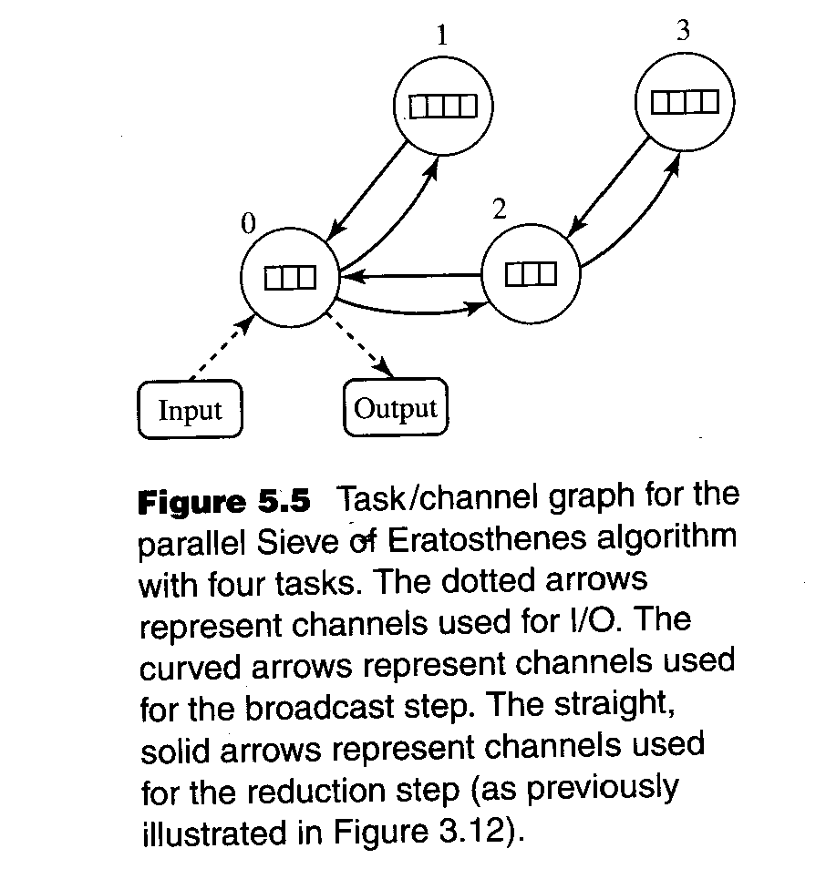

Slide 20
Improvements
Delete Even Integers
  Since 2 is the only even prime, there is little sense in setting aside half of the boolean values in the array for even numbers. Changing the sieve algorithm so that only odd integers are represented halves the amount of storage required and doubles the speed at which multiples of a particular prime are marked.

Slide 21
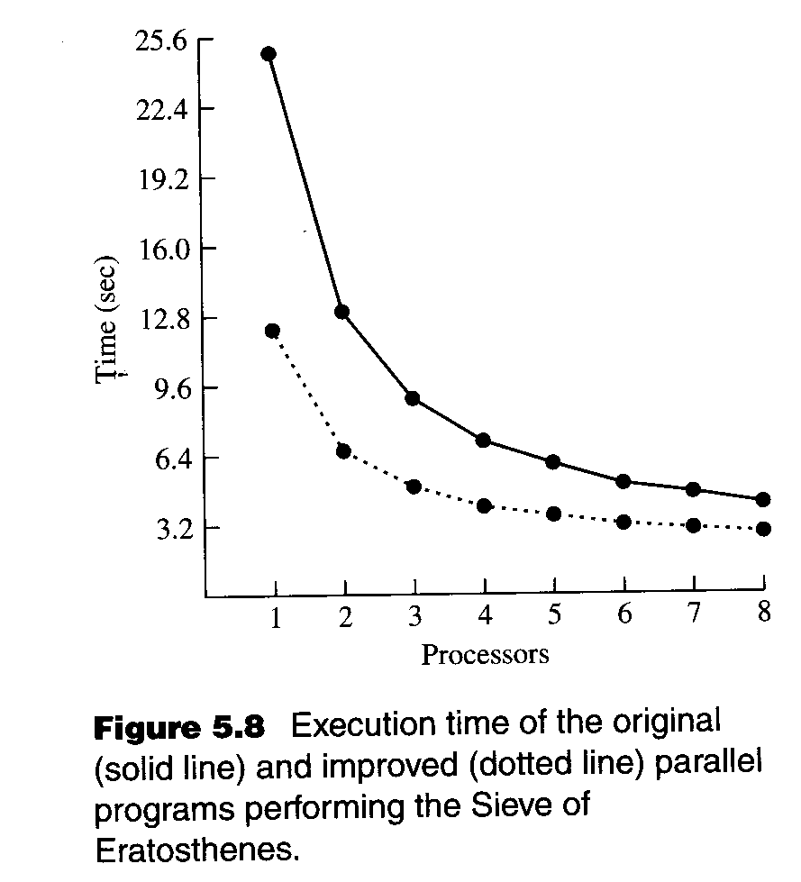
Improvements

Slide 22
Improvements
While our improved sieve runs twice as fast as our original program on one processor, it executes only slightly faster on eight processors.
  The computation time of the improved program is significantly lower than that of the original program, but the communication requirements are identical. As the number of processors increases, the relative importance of the communication component to overall execution time grows, shrinking the difference between the two programs.

