Slide 1
Chapter 9 Solving Linear Systems
(HPL)

Slide 2
問題
有5元和10元的硬幣共20個，總金額為140元，請問兩種硬幣各有幾個?

Slide 3
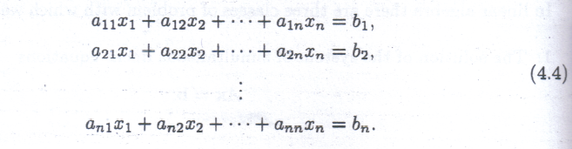
System of Simultaneous Linear Equations
Ax = b (4.3)
Written out in full, the system is

Slide 4
Gaussian Elimination
The solution of a linear system is invariant under the following operations:
  The addition of a multiple of one equation to another.
  A reordering of the equations (and, hence, the rows of A, provided that we simultaneously reorder the corresponding components of b)
The standard method of computing x is based on the use of Gaussian elimination. The basis of this method is to transform the original system (4.3) to
Ux = b’ , (4.5)
where U is an upper triangular matrix. The transformation of A to upper triangular form, known as forward elimination, employs only elementary operations of the forms (1) and (2) above.

Slide 5
Gaussian Elimination
Solving the upper triangular system (4.5) is easily achieved using backward substitution.

Slide 6
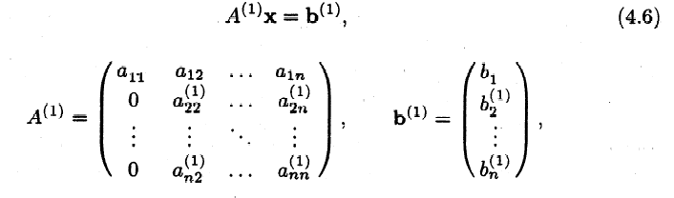
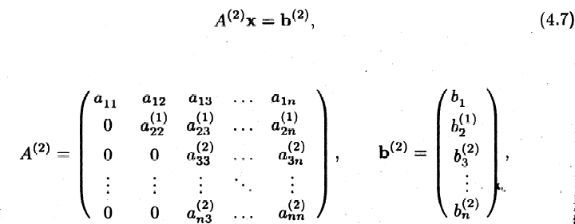
Forward Elimination

Slide 7
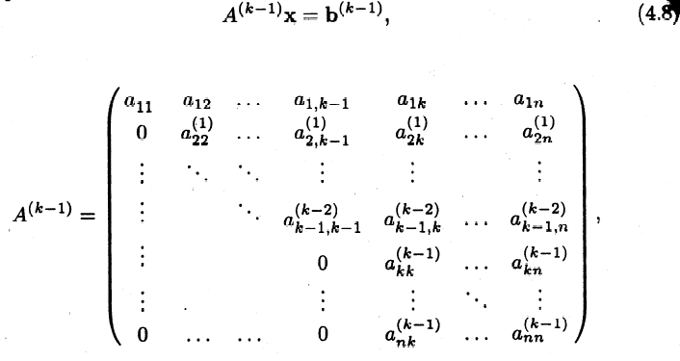
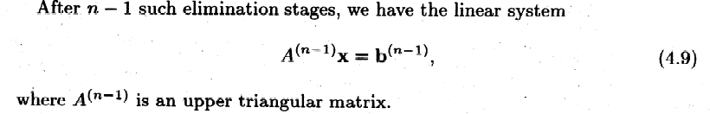
Forward Elimination
Thus, forward elimination is an O(n³) process on O(n²) data.

Slide 8
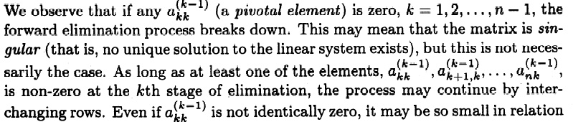
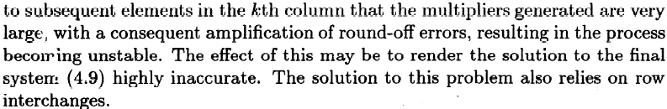
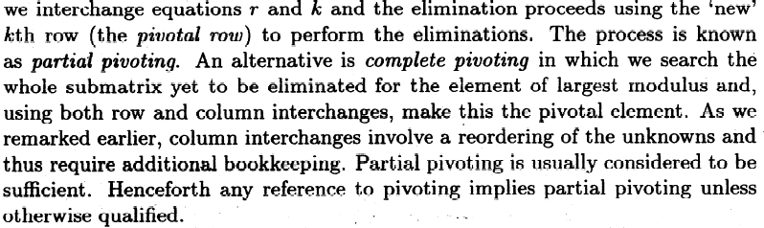
Partial pivoting

Slide 9
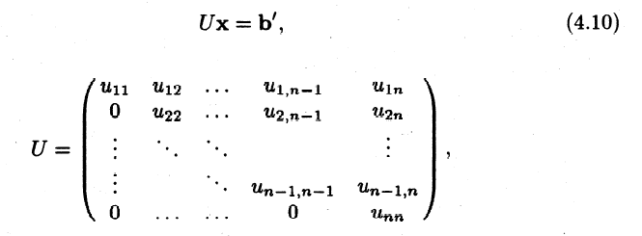
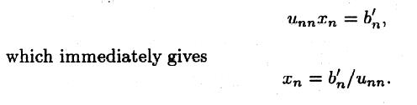
Backward Substitution

Slide 10
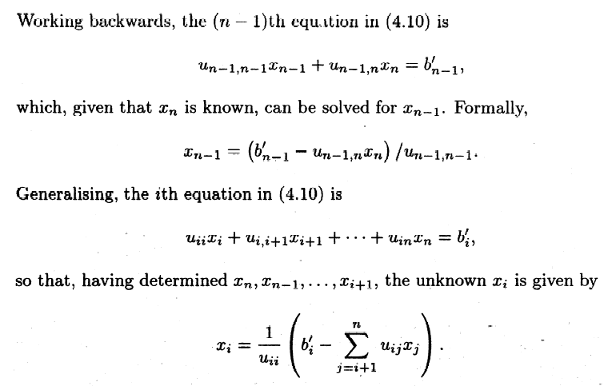
Backward Substitution
We refer to this process as backward substitution.

Slide 11
Backward Substitution
Backward substitution is an O(n2) process on O(n2) data, suggesting a compute/communication ratio of O(1) only. Thus, when attempting to derive a parallel algorithm for solving a system of linear equations based on Gaussian elimination followed by backward substitution, it is parallelisation of the elimination process which is likely to yield the most significant gains.

Slide 12
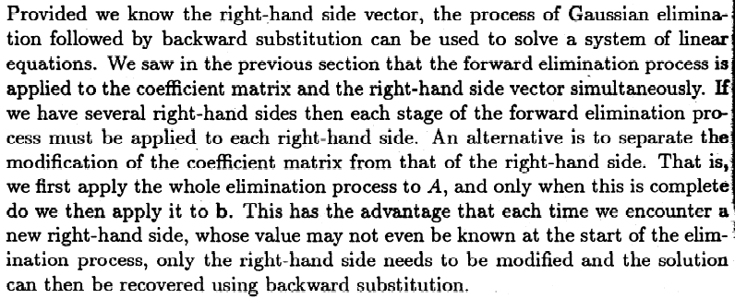
Matrix Factorisation

Slide 13
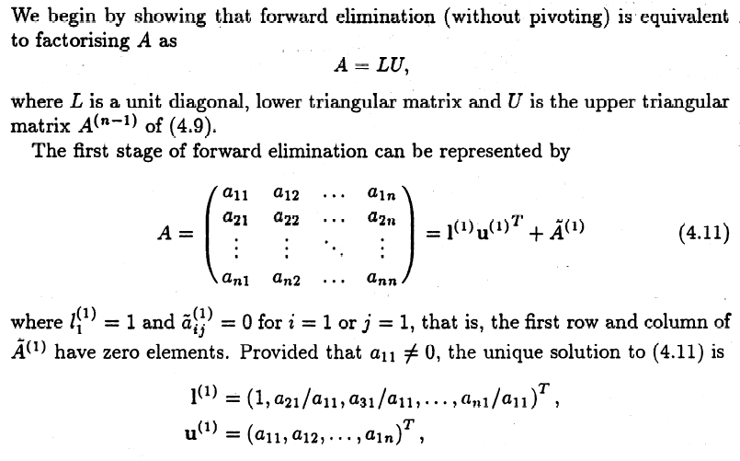
LU factorisation

Slide 14
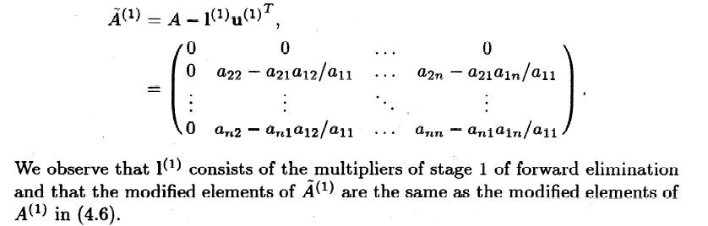
LU factorisation

Slide 15
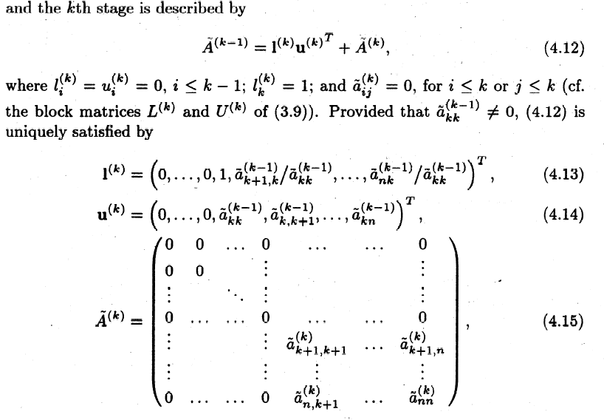
LU factorisation

Slide 16
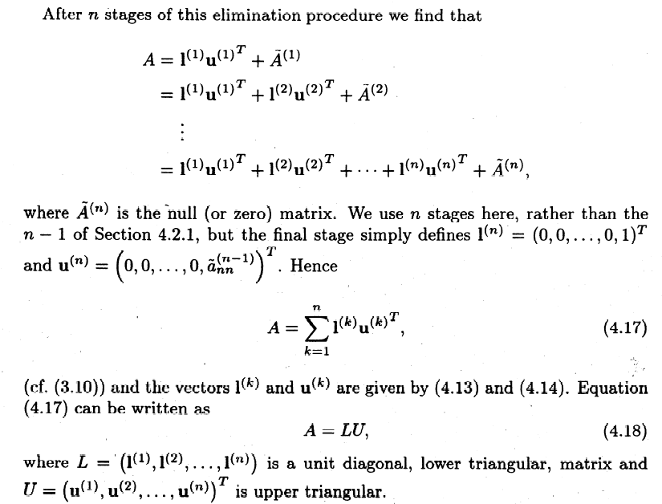
LU factorisation

Slide 17
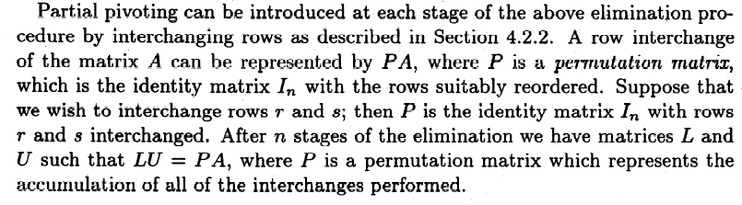
LU factorisation

Slide 18
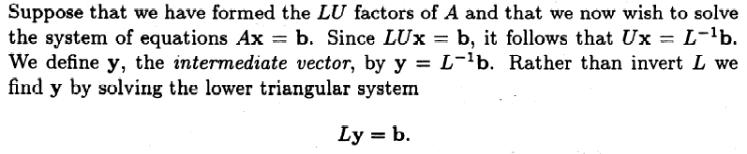
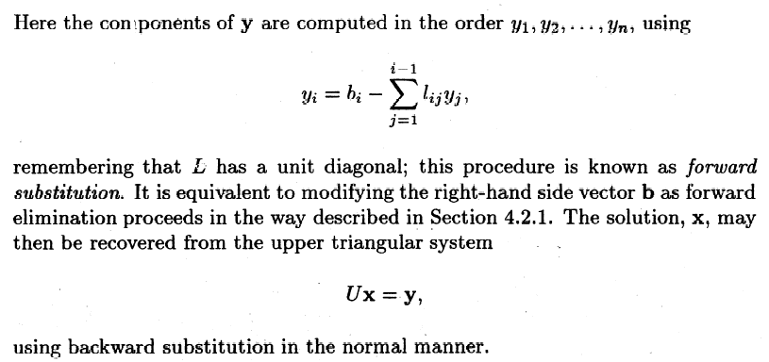
Forward and Backward Substitution

Slide 19
The BLAS
Basic Linear Algebra Subprograms
Level 1 BLAS
  Vector-vector operations involving O(n) operations on O(n) data (1979).
Level 2 BLAS
  Matrix-vector operations involving O(n²) operations on O(n²) data (1988)
Level 3 BLAS
  Matrix-matrix operations involving O(n³) operations on O(n²) data (1990)

