Slide 1
UVA10051 - Joseph's Cousin
ACS105111 呂易澄

Slide 2
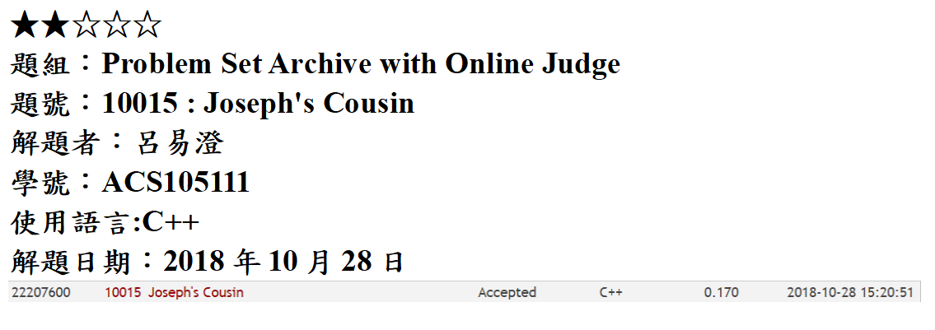

Slide 3
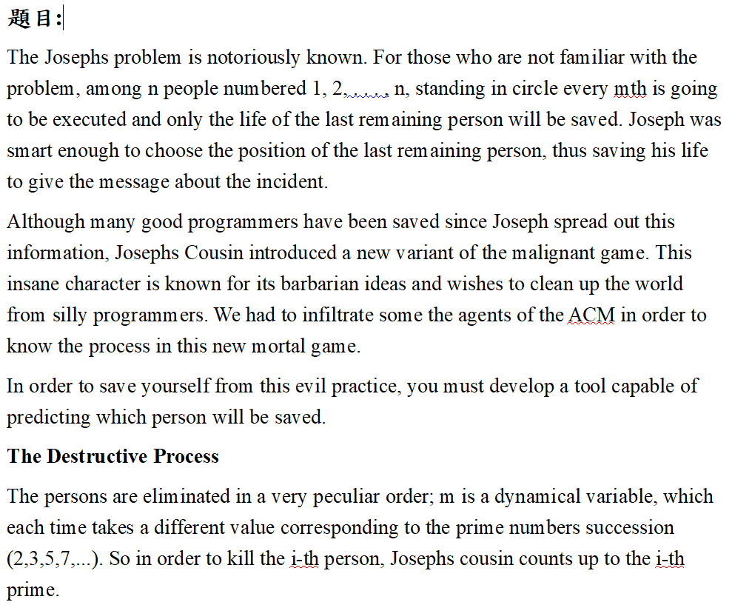

Slide 4



Slide 5
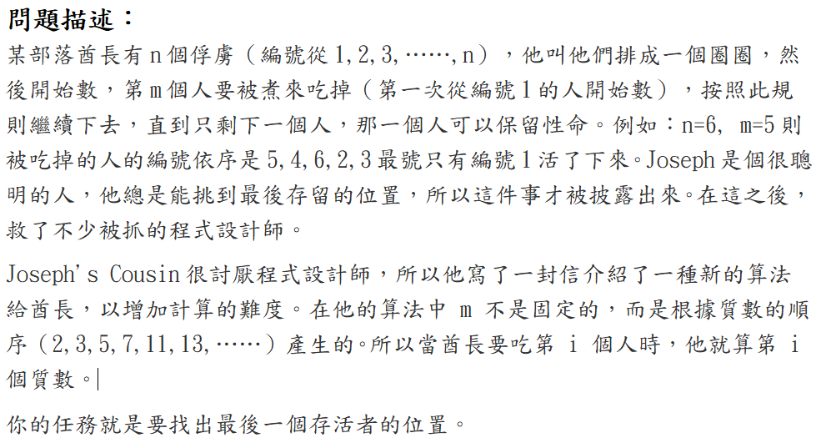

Slide 6
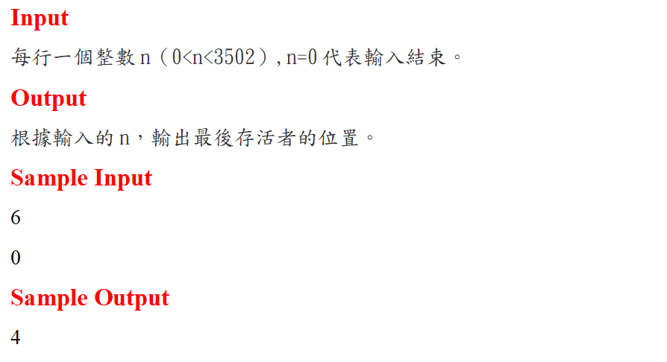

Slide 7
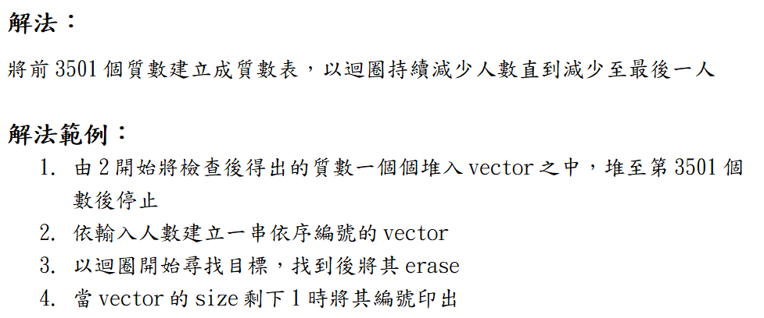

Slide 8


Slide 9
