Slide 1
MacroKeyTouchSensor
Jonas Gamao

Slide 2
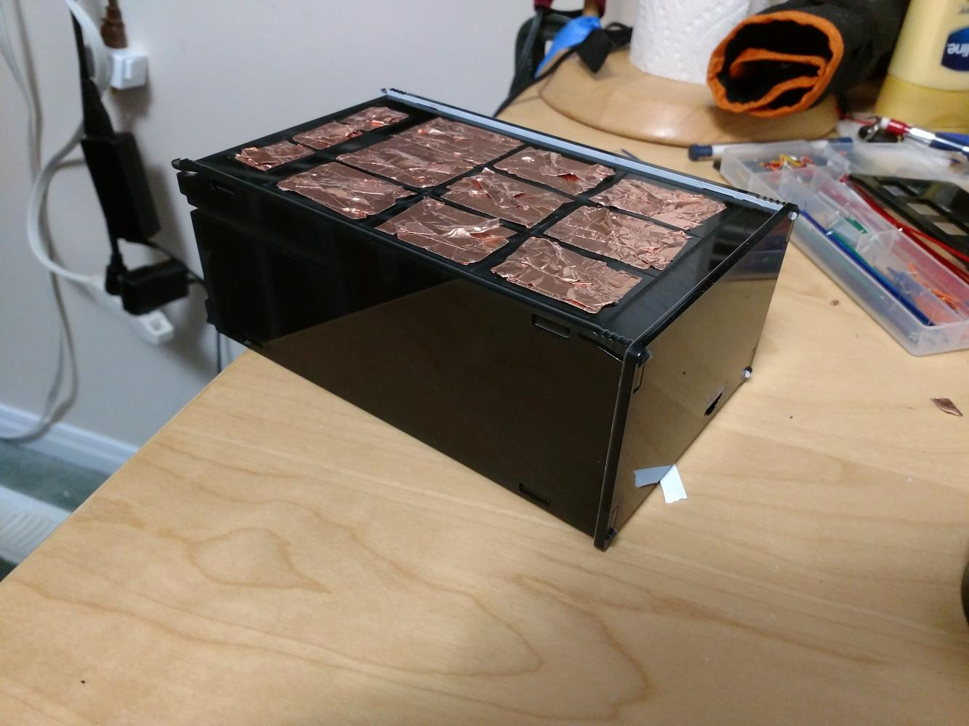
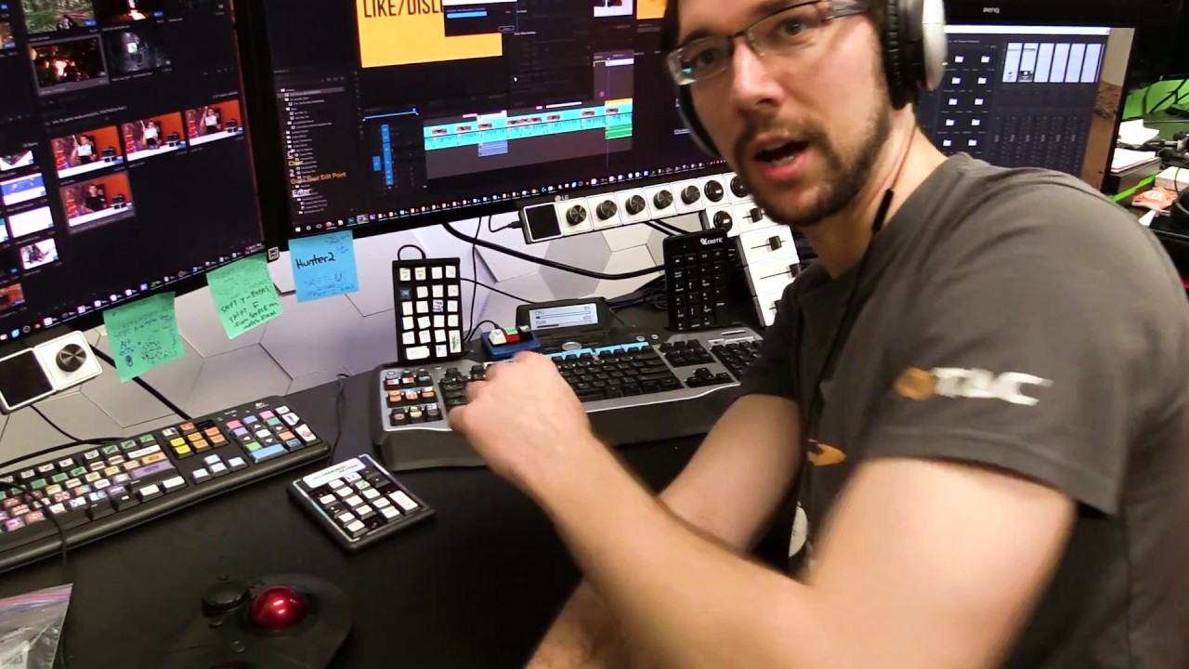
Introduction
A device that uses the MPR121 capacitive touch sensor as a “macro keyboard”
Uses the copper tape as conductive material to widen the touch target

Slide 3
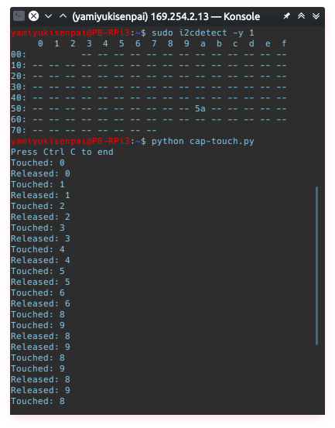
Testing
Used a basic test code found on MBTechWorks

Slide 4
Budget
Spent $149.46 on parts
  Bought everything this semester other than the parts kit
  MPR121 12-Key Capacitive Touch Sensor breakout
  Raspberry Pi 3 Model B
  32GB MicroSD card
  Copper tape
  Elegoo Electronics Kit
  Comes with a breadboard, M-F & M-M breadboard cables, etc.

Slide 5
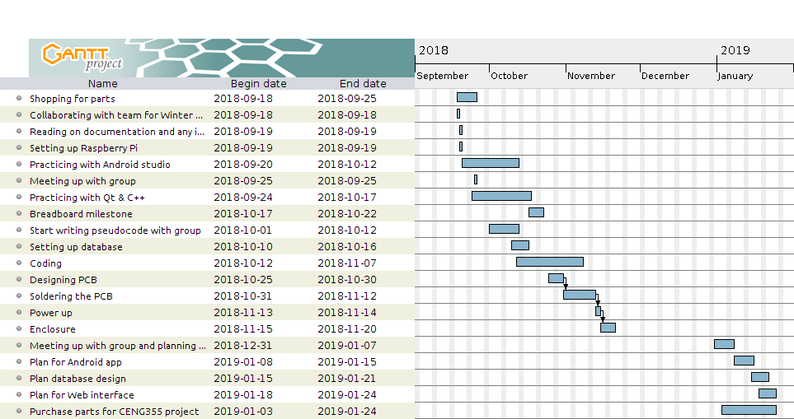
Schedule

Slide 6
Knowledge from Previous Courses
TECH 101 – Electronic Circuits
WRIT 120 – Technical Reading and Writing
CENG 200 – Unix Scripting
TECH

