Slide 1
The Next Analyst Challenge (2025)
Multinational Retail Sale Dataset (2016-2018)
Yamin Thiri Wai
Ton Duc Thang University

Slide 2
01
Analyze revenue and profit growth trends
Introduction
02
Understand regional contributions and sales channels
Objective
03
Identify key business opportunities

Slide 3
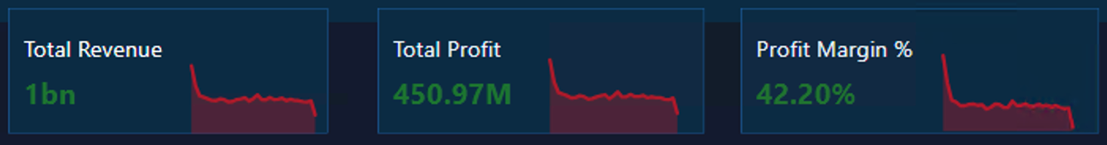
Key Metrics Overview
01
02
03
Total Revenue
Total Profit
Profit Margin
$1B
$450.97M
42.2%

Slide 4
Yearly Revenue Growth & Profit Margin
Revenue increased from $283M (2016) → $424M (2018).
Strong growth: +28% in 2017, +17% in 2018.
Profit margins remained stable at ~42% across all years.
Demonstrates scalable growth without margin erosion.

Slide 5
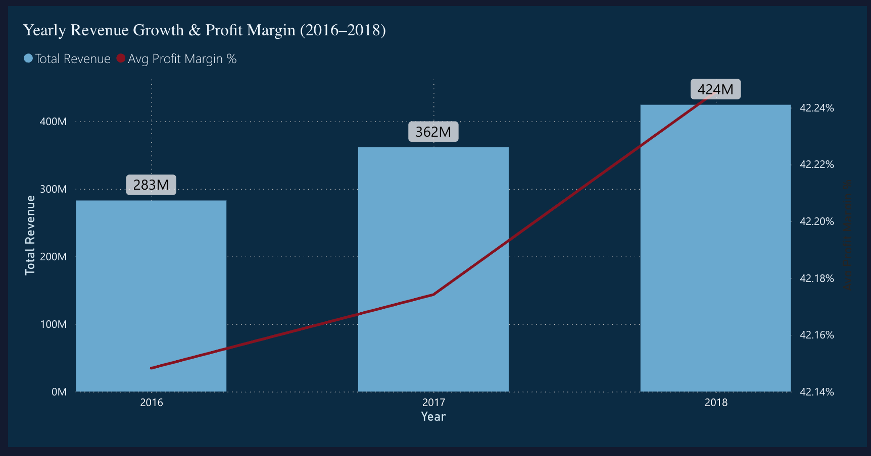
Yearly Revenue Growth & Profit Margin

Slide 6
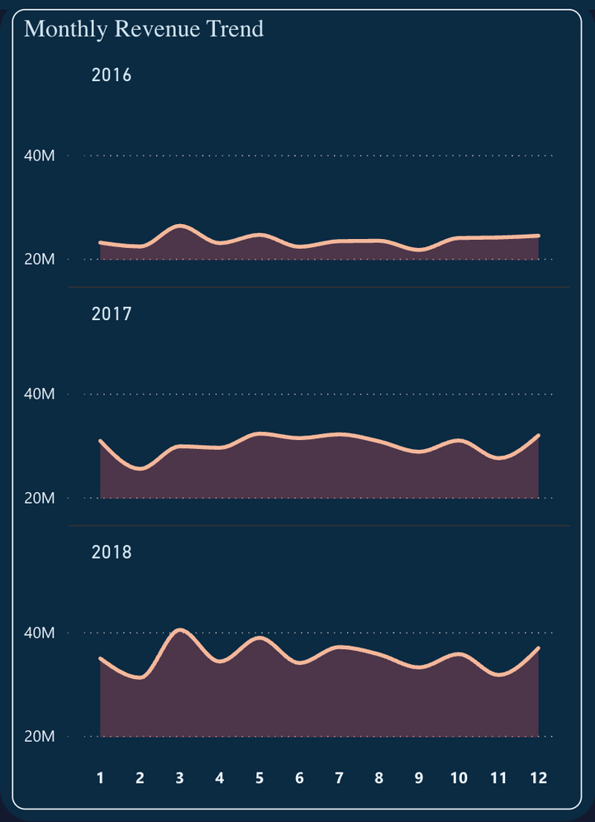
Monthly & Seasonal Trends
Revenue shows consistent month-on-month growth each year.
2016 monthly avg: $23M–26M, 2017: $27M–32M, 2018: $31M–40M.
2018 March peak: $40.5M, highest month in dataset.
Q1–Q2 (Jan–Jun) consistently outperform other quarters.
Seasonal spikes suggest stronger sales in early year, steady performance in H2.

Slide 7
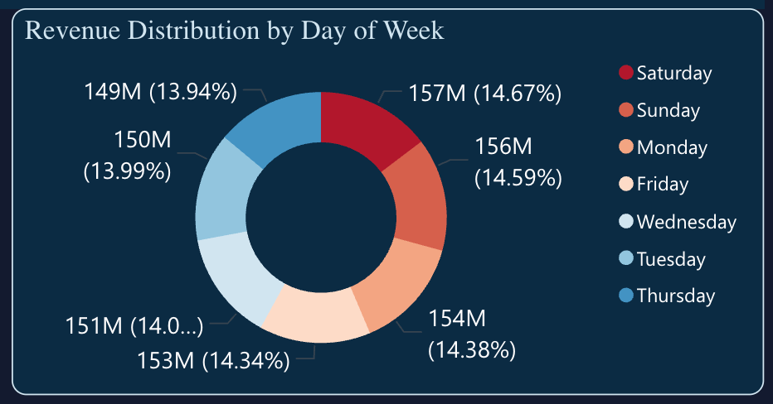
Monthly & Seasonal Trends
Saturday leads with highest revenue: $42.6M.
Close followers: Thursday ($41.6M) and Friday ($41.2M).
Lowest sales on Tuesday: $37.8M.
Weekends (Sat & Sun) together contribute ~19% higher than weekdays average.
Suggests weekend-focused promotions can capture peak buying behavior.

Slide 8
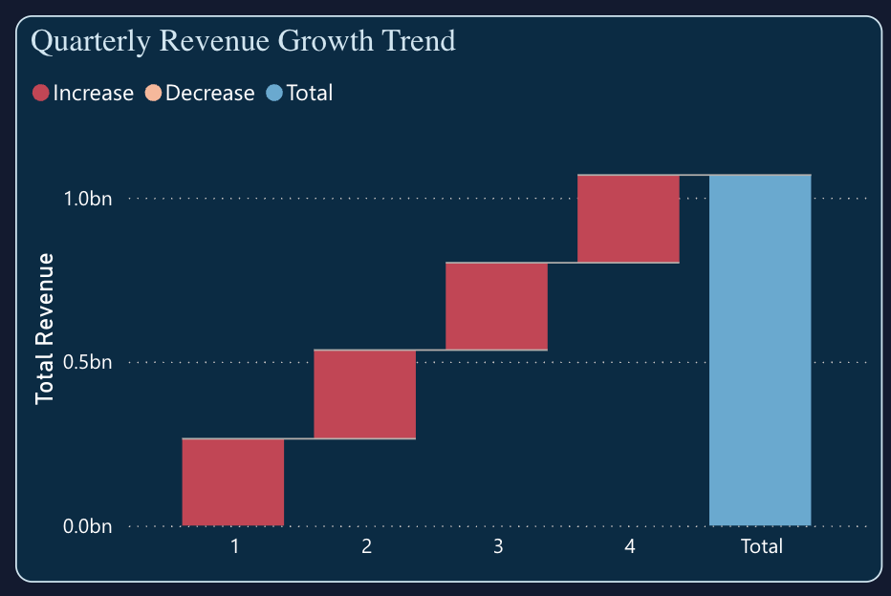
Monthly & Seasonal Trends
Revenue remains stable across quarters (~$68M–$72M each).
Q4 highest at $72.5M, slightly above Q1 ($71.8M).Q3 lowest at $68.5M.
Pattern shows balanced revenue distribution across the year.
Highlights opportunity to push more campaigns in Q1–Q2 (historically strongest in monthly trend).

Slide 9
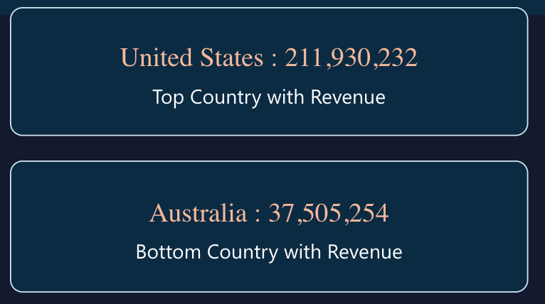
Regional & Country Insights
US highest revenue ($212M)
Australia lowest revenue ($37.5M)

Slide 10
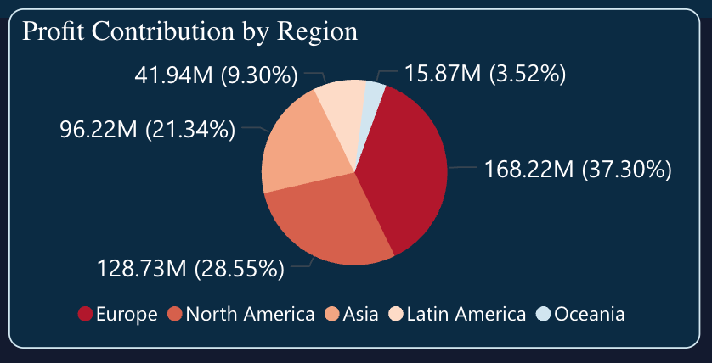
Regional & Country Insights
Europe leads with $168M profit (42% margin).
North America follows at $129M profit (42% margin).
Asia contributes $96M, solid third position.
Latin America ($42M) and Oceania ($16M) are smaller but maintain same margin.
Consistent 42% profit margin across all regions → profitability is balanced globally.

Slide 11
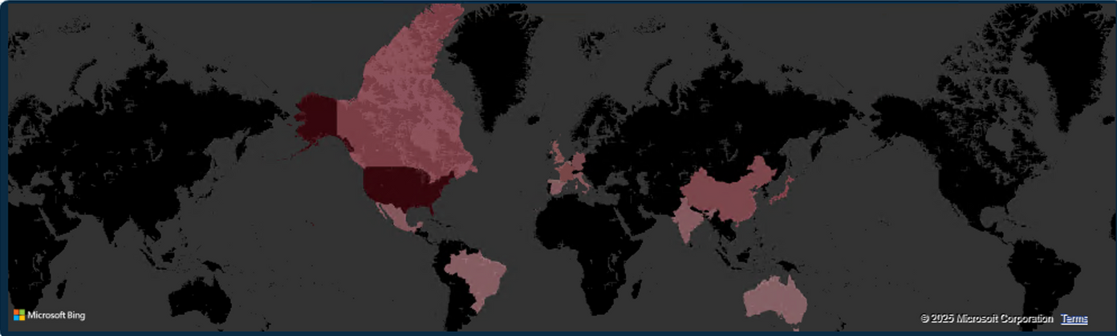
Regional & Country Insights
United States leads with $212M revenue.
Strong contributions from Japan ($99M), Canada ($93M), France ($86M), UK ($80M), China ($80M).
Australia lowest at $37.5M.
Regional dominance in North America, Europe, Asia; weaker in Latin America & Oceania.

Slide 12
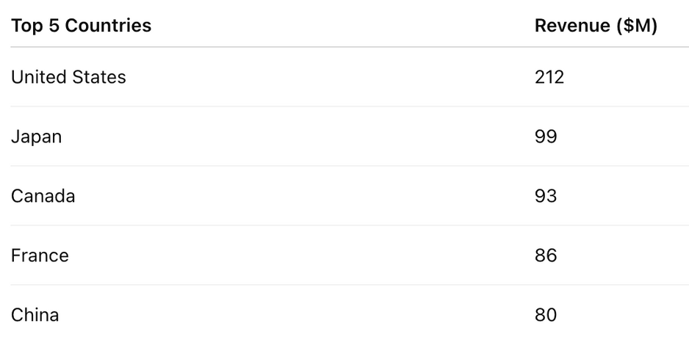
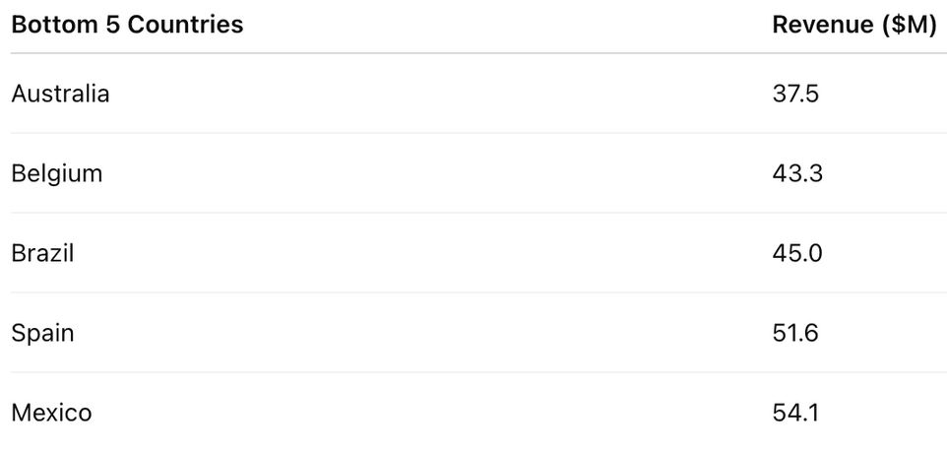
Regional & Country Insights

Slide 13
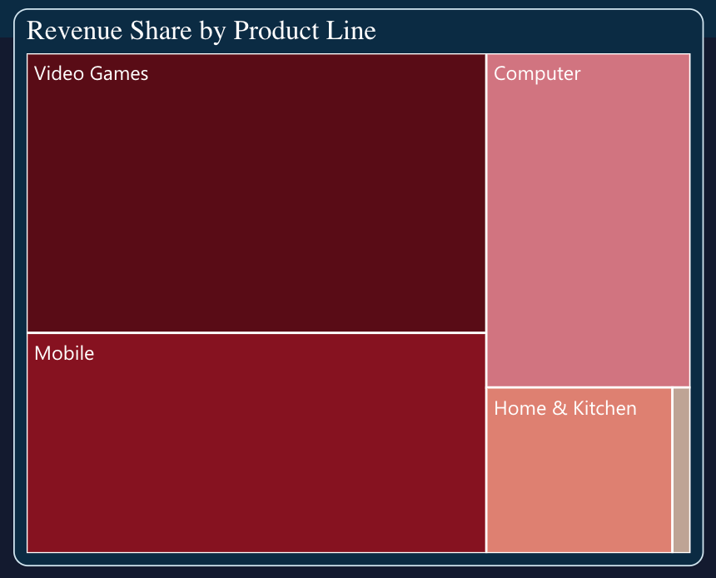
Product Line Performance
Video Games leads with $414M (39%) of total revenue.
Mobile close second at $326M (31%).
Computers contribute $220M (21%).
Home & Kitchen smaller at $99M (9%).
Books minimal at $9.5M (~1%).
Revenue is heavily concentrated in Gaming + Mobile (70%), showing core strengths.

Slide 14
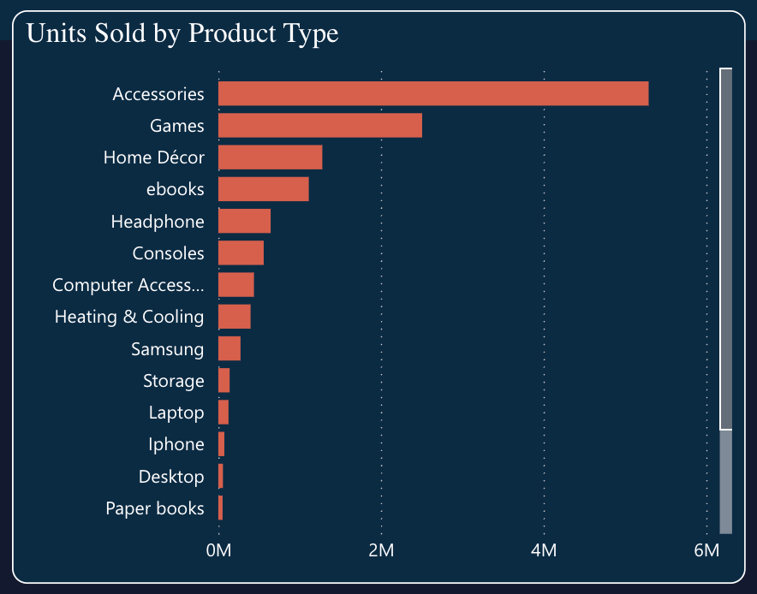
Product Line Performance
Accessories dominate with over 5.29M units, more than double the next category.
Games (2.5M) and Home Décor (1.28M) also perform strongly.
Categories like Paper Books, Screen, Home Improvement, Kitchen, and Bedding & Bath are niche, all under 55k units each.

Slide 15
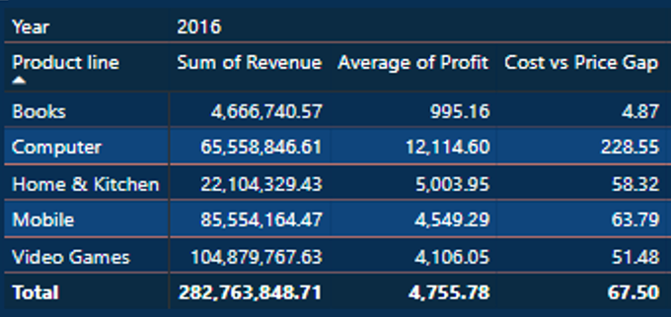
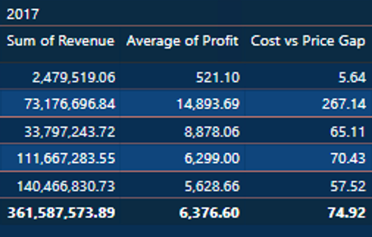
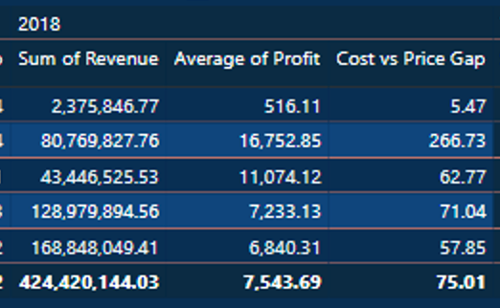
Product Line Performance
Video Games consistently lead, growing from $105M → $141M → $169M (total $414M).
Mobile strong second, rising from $86M → $112M → $129M (total $326M).
Computers show steady growth ($66M → $73M → $81M).
Home & Kitchen doubled from $22M (2016) → $43M (2018), showing fastest relative growth.
Books minimal, declining after 2016.
Profitability steady across categories, with average profit rising YoY.
Cost vs Price Gap widened, especially in Computers (biggest gap at ~267).

Slide 16
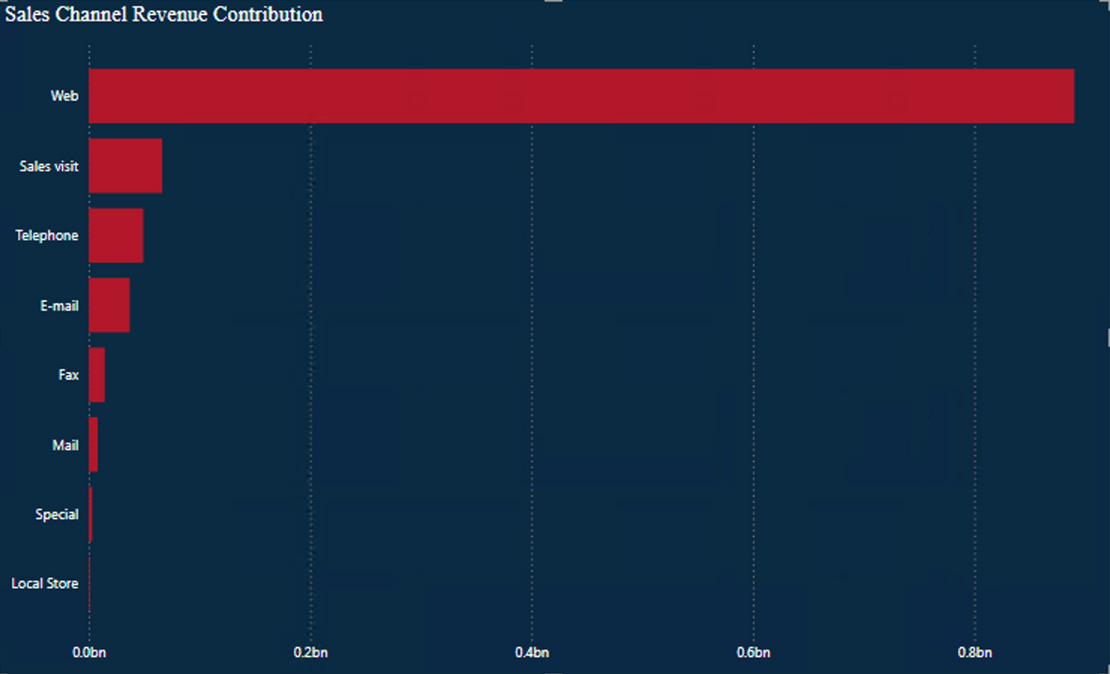
Sales Channels & Managers
Web → Main channel (~890M, majority share)
Sales visit → 66M (2nd highest)
Telephone & E-mail → Moderate (~49M & ~37M)
Fax, Mail, Special → Low contribution
Local Store → Negligible (~35K)

Slide 17
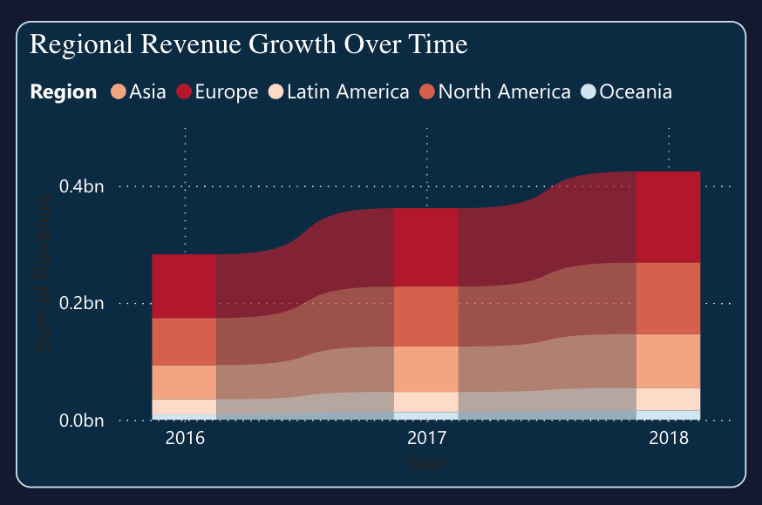
Sales Channels & Managers
Asia: Strong upward trend (58M → 93M)
Europe: Consistently highest revenue, rising (109M → 156M)
North America: Solid growth (80M → 122M)
Latin America: Steady increase (26M → 38M)
Oceania: Gradual rise (9M → 16M)

Slide 18
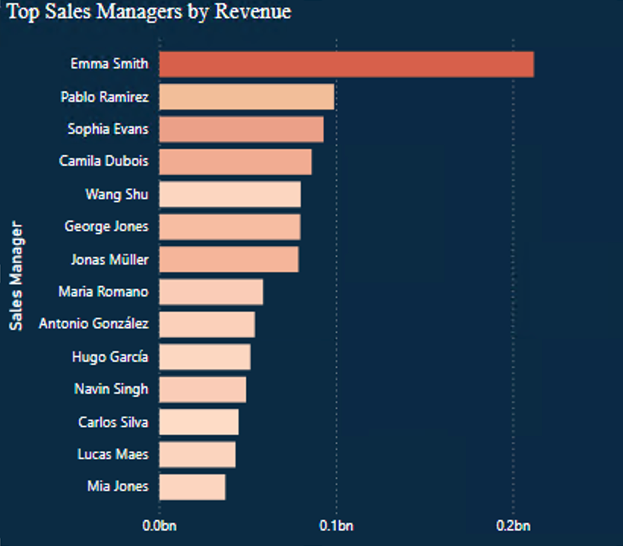
Sales Channels & Managers
Emma Smith leads significantly (212M)
Pablo Ramirez & Sophia Evans follow (~99M & 93M)
Camila Dubois, Wang Shu, George Jones, Jonas Müller contribute strongly (78M–86M)
Maria Romano – Lucas Maes generate moderate revenue (43M–59M)
Mia Jones closes the list with ~38M

Slide 19
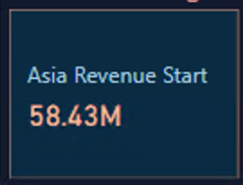
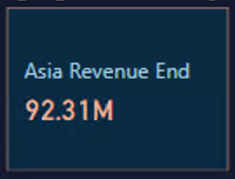
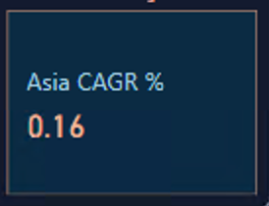
Start (2016): 58.4M
Regional Deep Dive: Asia
End (2018): 92.3M
CAGR: 16%

Slide 20
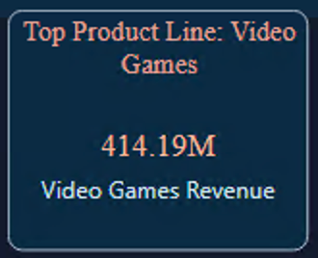
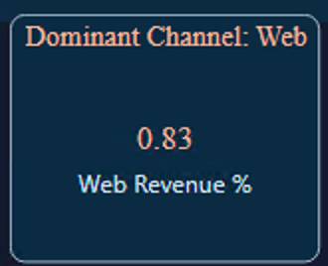
Video Games drive the highest sales, powered mainly by the Web channel

Slide 21
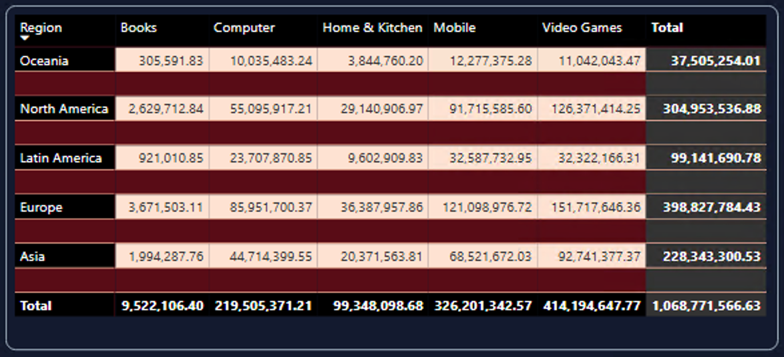
Regional Product Line Revenue Insights
Europe leads overall ($398.8M), with Video Games ($151.7M) as top product.
North America follows ($305M), strongly driven by Video Games ($126.4M).
Asia contributes $228.3M, with Video Games ($92.7M) as key driver.
Latin America: $99.1M, mainly Mobile ($32.6M) and Video Games ($32.3M).
Oceania: Smallest share ($37.5M), balanced across Mobile & Video Games.

Slide 22

Actionable Recommendations

Slide 23
Expand Asia & Latin America with Mobile + Gaming.
Diversify channels beyond Web → boost Telephone/E-mail sales.
Focus Q1–Q2 campaigns (historically strongest growth).
Weekend promos to capture peak sales behavior.

Slide 24
Closing
Revenue grew steadily across 2016–2018 (+28%, +17%).
Growth opportunities in Asia, LatAm, Gaming & Mobile.
Overreliance on Web → diversify channels.
Q1–Q2 and weekends are key sales windows.
Next Steps: Implement targeted campaigns and channel expansion.

Slide 25
Thank You!

