Slide 1
Cyclistic Rideshare Case Study
By: Yaminee Samrit
10-03-2022

Slide 2
Business Task
GOAL : To convert the Casual Riders into Annual Members.
WHY : To increase profits for Cyclistic Bikes.
HOW : By finding the trends in usage pattern by user and creating Marketing Campaign around it.

Slide 3
About DATA
From : Lyft Bikes and Scooters, LLC which operates the City of Chicago’s Divvy bicycle sharing service.
Duration : From Jan 2021 till Dec 2021

Slide 4
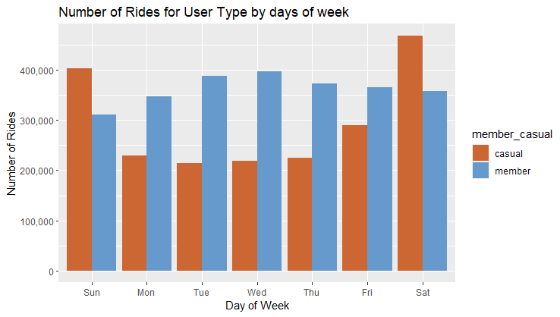
Analysis By Week
Number of rides for Casual riders in on higher side on weekends.
While it is on higher side for Annual members on weekdays.

Slide 5
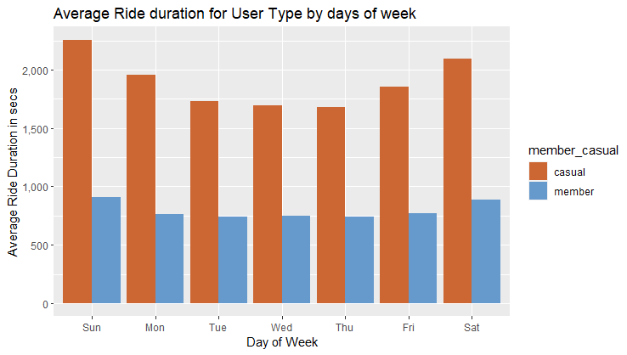
Analysis By Week
Average ride duration is on much higher side for Casual Riders as compared to Annual Members.
On weekends the Casual Riders use the services for more duration than on weekdays.

Slide 6
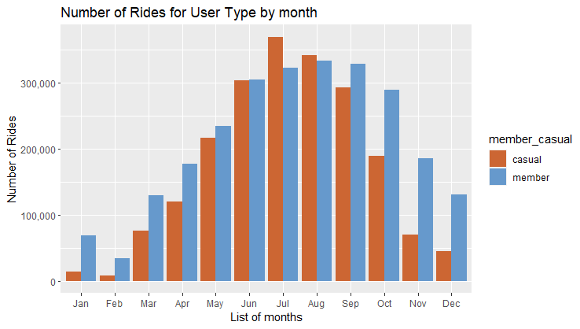
Analysis By Month
The fall in number of rides for the month of Jan, Feb, Nov and Dec might be because of winter season in Chicago.
For most of the months the number of rides are on higher side for Annual members as compared to Casual riders

Slide 7
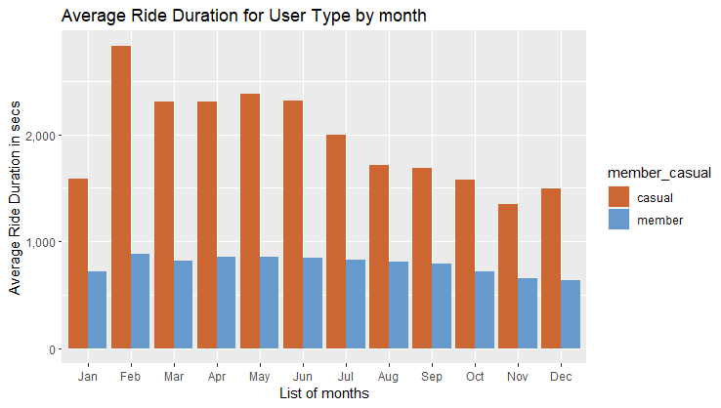
Analysis By Month
Average duration for Casual riders is on higher side as compared to Annual members.
Annual Members use the bikes for commuting to and from work hence we observe a steady pattern.
The peak in the month of Feb might be dur to winter weather and riders failing to drop the bikes at station.

Slide 8
Recommendation
Create an annual weekend pass and campaign it.
Make personalized email for Casual riders on how much hours they used the bike with money they paid. Later tell them how much they could have saved by taking annual membership.
Run the campaign during the month of April till July as the number of rides increases significantly during this time period.

Slide 9
Thank You !

