Slide 1

Smart Cam For Driver Fatigue and Depression Detection Through Enhanced Facial Behaviour Recognition
Batch number – 18
Jashti Yamini Y22CD054
Nagabru Mohana Pujitha L23CD201
Boddu Treveni Y22CD017
Guided by:
Mr. K. Sai Prasanth
Assistant Professor
Dept of CSD

Slide 2
Contents
Problem Statement
Abstract
Literature survey
Base Paper Execution
Existing Design Design
Proposed System
Proposed Design
Results
Conclusion
Future Work

Slide 3
Problem Statement
Driver fatigue, drowsiness, distraction, and reduced alertness are major causes of road accidents worldwide, often resulting from long driving hours, lack of sleep, stress, and poor lighting conditions. Existing safety systems primarily focus on vehicle performance and external factors, failing to monitor the driver’s physical and mental state in real time, which limits their effectiveness in preventing fatigue-related accidents. Therefore, there is a need for a non-intrusive driver monitoring system that continuously analyzes facial features such as eye closure duration, blinking frequency, yawning, head movement, and emotional state. The proposed system addresses this gap by providing real-time detection and alerts for unsafe conditions, thereby enhancing driver safety, reducing accident risk, and enabling adaptive monitoring for different individuals.

Slide 4
Abstract
Driver fatigue, drowsiness, and psychological conditions such as depression are major contributors to road accidents, yet many existing monitoring systems fail under real-world conditions such as low-light environments, occlusions from spectacles, and dynamic head movements. These limitations reduce the accuracy of behavioural cues like eye blinking, yawning, and facial expressions. To address these challenges, this project proposes a real-time driver state monitoring system based on a hybrid CNN–LSTM model, where the CNN extracts spatial facial features and the LSTM captures temporal behavioural patterns across video sequences. The system incorporates low-light enhancement to improve night-time performance and uses facial landmarks to analyze Eye Aspect Ratio (EAR), Mouth Aspect Ratio (MAR), and head pose for precise detection of drowsiness and depressive cues. By integrating multi-modal facial behaviour analysis with temporal deep learning, the proposed system provides reliable, early detection of risky driver states and delivers timely alerts to enhance safety in smart vehicle environments.

Slide 5
Literature Survey
Reference Title | Problem Addressed | Methodology Used | Advantages/Disadvantages
Real-Time Driver Drowsiness Detection Using Eye Blink Analysis | Detect driver fatigue through eye behavior | Haar Cascade used for eye detection and blink rate analysis based on threshold values | Simple and fast implementation; accuracy affected by lighting conditions and head movements
Vision-Based Driver Fatigue Detection System | Monitoring driver alertness using facial cues | Face and eye detection using Haar features followed by eye state analysis | Non-intrusive and cost-effective; sensitive to camera angle variations
Driver Drowsiness Detection Using Convolutional Neural Networks | Accurate eye state classification | CNN trained on eye image datasets to classify eyes as open or closed | High classification accuracy; requires large labeled datasets

Slide 6
Reference Title | Problem Addressed | Methodology Used | Advantages/Disadvantages
Yawning Detection for Driver Fatigue Monitoring | Use yawning as an indicator of drowsiness | Mouth region extraction and image-based yawning classification | Effective secondary fatigue cue; false positives during speaking
Hybrid CNN–SVM Based Image Classification | Improve robustness of visual classification | CNN used for feature extraction and SVM for final classification | Better generalization and accuracy; increased computational complexity

Slide 7
Existing System
The base paper implements a vision-based driver drowsiness detection system using image datasets. In the offline phase, labeled eye images are used to train a Convolutional Neural Network (CNN) for feature extraction, followed by a Support Vector Machine (SVM) for classifying eye states as open or closed. A separate image dataset containing yawning and non-yawning mouth images is used to train the yawning detection model.
During video execution, video frames are captured using a webcam. Haar Cascade classifiers are applied to detect the driver’s face and eye regions. The extracted eye regions are classified using the trained CNN–SVM model, while yawning is identified through mouth region analysis. Temporal counters are maintained to track prolonged eye closure and repeated yawning events. Based on predefined thresholds, the system determines driver drowsiness and generates an alert.

Slide 8
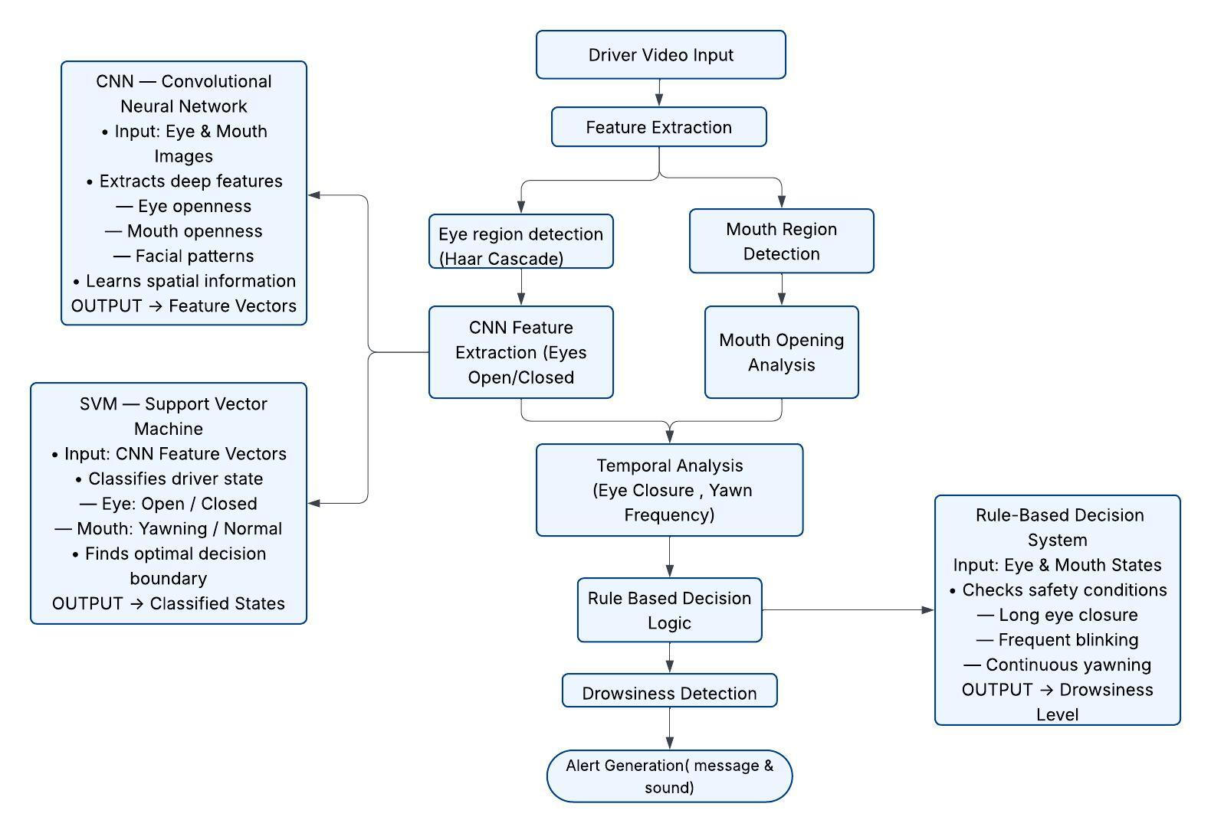
Existing Design

Slide 9
Proposed System
The proposed system focuses on real-time driver safety by analyzing facial features captured through a live camera. Initially, facial features such as Eye Aspect Ratio (EAR), Mouth Aspect Ratio (MAR), blink count, yawning count, eye closure duration, and head direction are extracted from live video frames. These features are stored in a structured dataset collected from multiple individuals, creating a custom driver feature database.
During live driver monitoring, the system continuously extracts facial features and compares them with the stored dataset to identify the driver. Based on the extracted features, deep learning models such as CNN combined LSTM are used to classify the driver’s condition into normal, drowsy, fatigued, or high-risk states. If unsafe conditions are detected—such as eye closure for more than 10 seconds, excessive blinking, or frequent yawning—the system generates real-time visual and audio alerts. This approach ensures early detection of driver fatigue and enhances overall road safety.

Slide 10
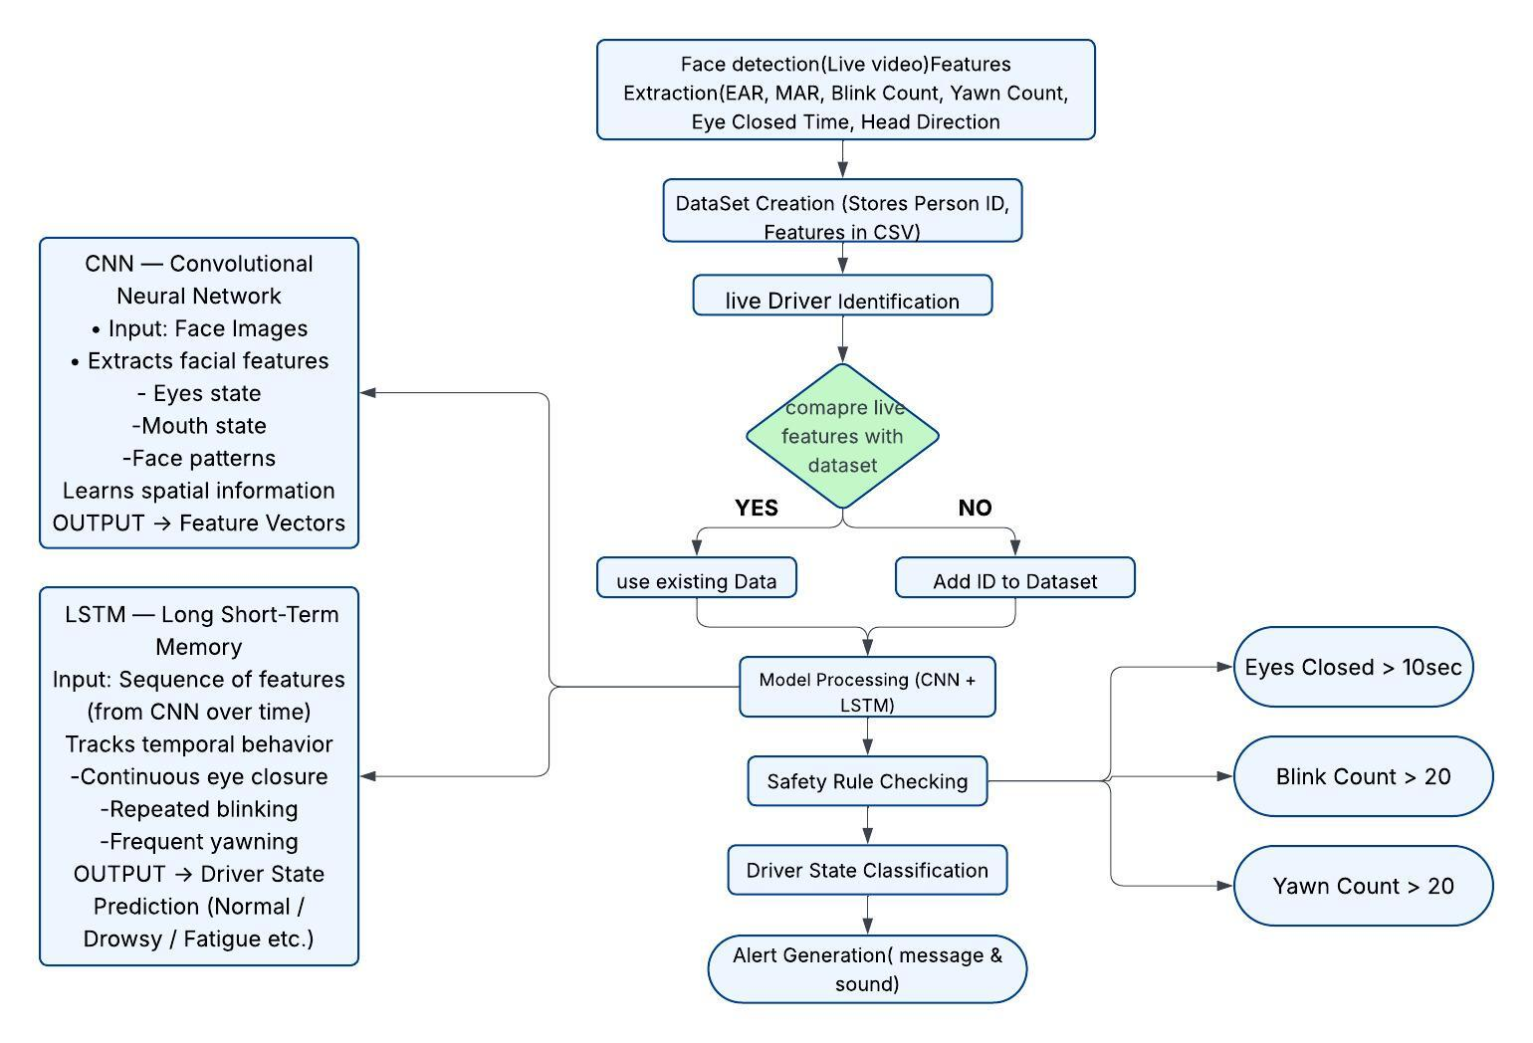

Proposed Design

Slide 11
Methodology
The methodology consists of the following steps:
Capture real-time video of the driver
Detect face and facial landmarks
Extract features such as EAR, MAR, head pose, and eye closure time
Store features in dataset
Compare live data with stored dataset
Analyze behavior using machine learning and Deep Learning models
Determine driver condition
Generate alerts if necessary

Slide 12
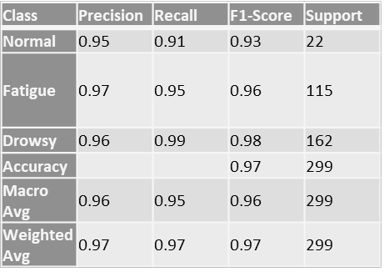
Results
The proposed system was evaluated using standard classification metrics across three driver states: Normal, Fatigue, and Drowsy. The system achieved an overall accuracy of 97%, demonstrating strong performance in real-time driver monitoring. Class-wise evaluation shows that the Normal state achieved a precision of 0.95, recall of 0.91, and F1-score of 0.93, while the Fatigue state recorded 0.97 precision, 0.95 recall, and 0.96 F1-score. The highest performance was observed in the Drowsy state, with a precision of 0.96, recall of 0.99, and F1-score of 0.98. The macro and weighted average scores further confirm the model’s balanced and consistent performance, indicating low false positives and false negatives across all classes. Overall, the results validate that the system effectively detects driver fatigue and drowsiness with high reliability in real-time scenarios.

Slide 13
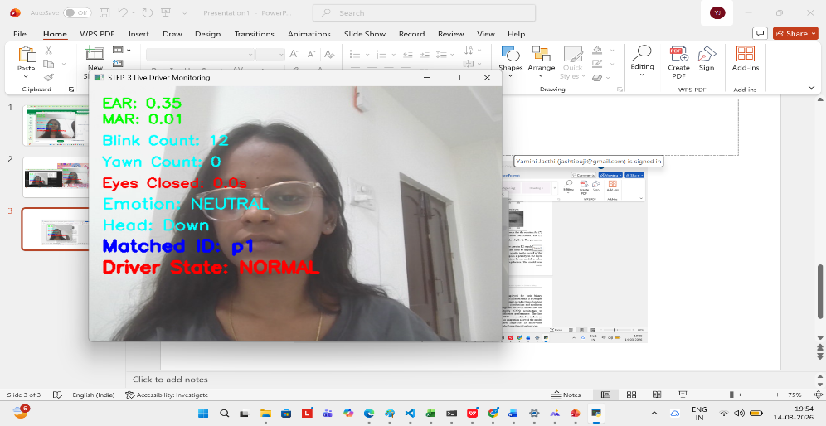

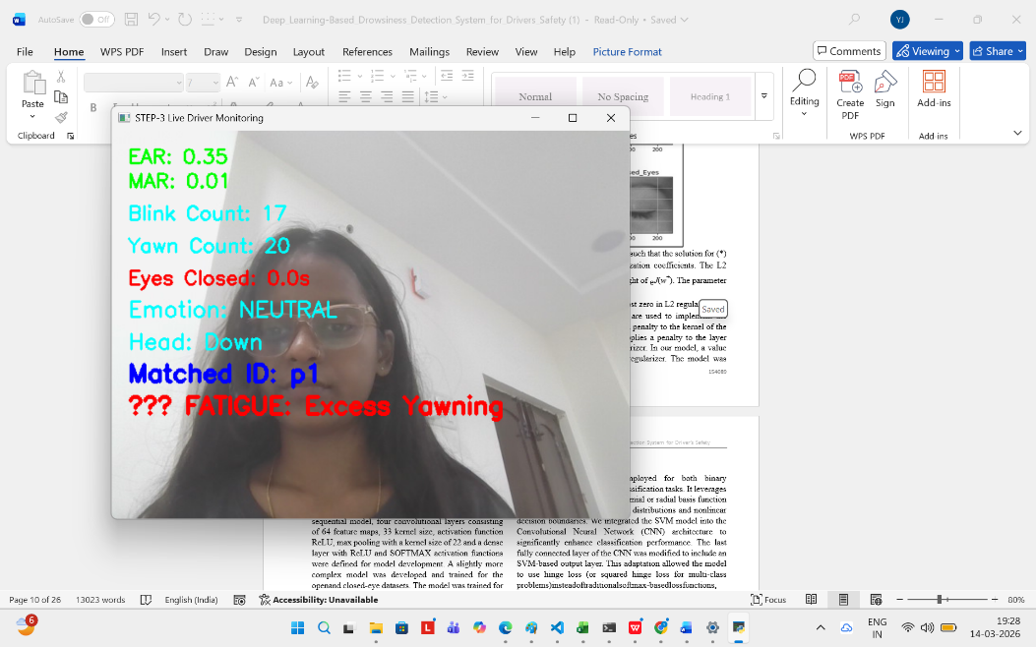
.
NORMAL STATE
Excess Blinking
Excess Yawning

Slide 14
conclusion
The proposed Smart Cam Driver Fatigue and Depression Detection System provides an effective real-time driver monitoring solution using facial behaviour analysis. By leveraging MediaPipe FaceMesh, the system extracts 468 facial landmarks to compute multiple behavioural features such as EAR, MAR, blink rate, yawn detection, head pose, and emotion. It operates through a three-phase pipeline consisting of feature extraction, dataset collection, and live monitoring with automatic person identification and alert generation. The system delivers reliable performance without requiring pre-trained deep learning models or specialized hardware, making it cost-effective and easily deployable. Compared to existing approaches, it offers improved multi-cue detection, real-time analysis, and lower false positives under different conditions. Overall, the system demonstrates strong potential for enhancing road safety and can be further extended using advanced models like CNN–LSTM for improved accuracy and real-world adaptability.

Slide 15
Future Work
The future development of this system focuses on enhancing accuracy, robustness, and real-world applicability. A hybrid CNN–LSTM model will be implemented to replace the existing rule-based classifier, enabling improved emotion detection and temporal analysis of driver behavior. To ensure better performance under challenging conditions, low-light image enhancement techniques will be incorporated. The system will also integrate advanced face recognition methods such as ArcFace or FaceNet for reliable driver identification. Additionally, it will be extended to detect driver distractions, including mobile phone usage and other activities. Large-scale evaluation with diverse users will be conducted to obtain reliable performance metrics, and the system will be optimized for deployment on embedded platforms like Raspberry Pi and Jetson Nano.

Slide 16
Thank You

