Slide 1
iCare : Smart Healthcare Platform
Presenter : Yamini Sehrawat
NUID : 001617219
Course: Application Engineering Development 5100
Department : Information Systems
Professor : Kal Bugrara

Slide 2
OBJECTIVE
Efficient utilization of Medical resources
Proactive health monitoring of sensitive patients.
How to maximize doctor’s time
Medication feedback system
Patient’s feedback
Doctor’s assessment
Pharmaceutical company’s reaction
FDA supervising over medication response
Centralized patient history database

Slide 3
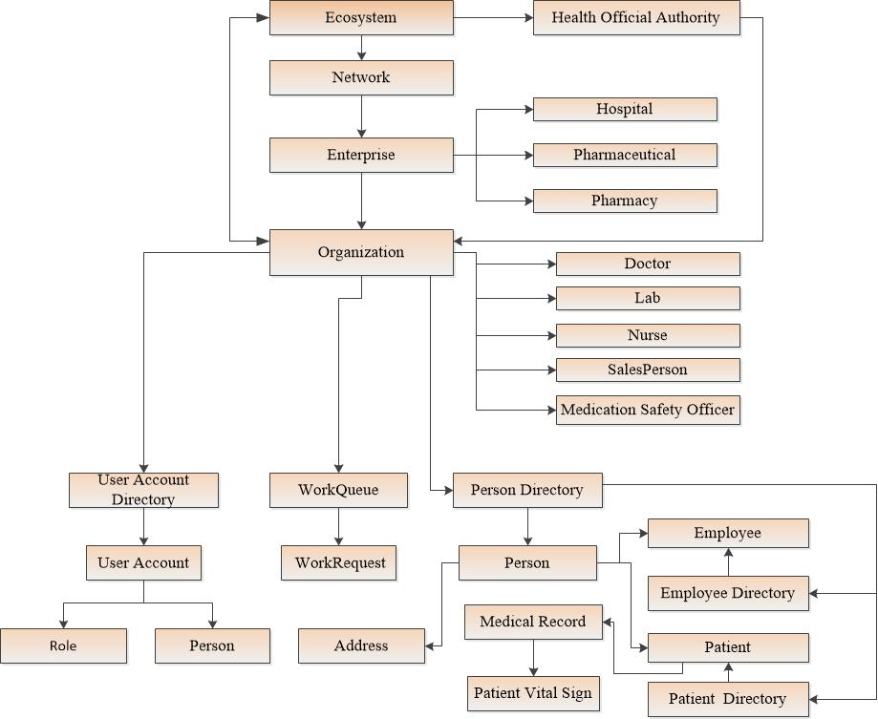
Object Model

Slide 4
Key Features
IOT feature to enable patients to track vital stats at any given time and get informed when to visit doctor.
Maintain centralized Patient Medical History.
Pharmaceutical Companies to send drugs for approval to Health official Authority(FDA) .
Force callback options given to Health official Authority(FDA) for some disputed drug.
Patient Referred to other doctor for better treatment.
Direct pick of drug from pharmacy by the patients as prescribed by the Physician.
Options to interact with Pharmaceutical companies on feedback of medication.
Approved Medication survey by the pharmaceutical companies.

Slide 5
Use Cases
System Admin
Create enterprises in the network. Create Enterprise admins accounts.
Enterprises – Hospital Enterprise, Pharmaceutical Enterprise and Pharmacy Enterprise.
Create Health Official Authority.
Enterprise Admin
Create Organizations and their respective roles in the enterprises.
Manage Patient accounts if required.
Create drug information for pharmaceutical is required.
Health Official Authority
Medication analysis, inquire medicine approval request and approve/disapprove medicines.
Customer feedback on Medications usage.

Slide 6
Continued..
Doctor
Patient medical checkup and review past medical history
Communicate with Lab Assistant and Nurse concerning patient checkup.
Refer patient to other doctors and respond to referred patient request.
Medication feedback to Pharmaceutical company.
Lab Assistant
Check patient vital stats and update patient records per visit upon requests from doctors.
Nurse
Prescribed treatment to the patient as directed by doctors.

Slide 7
Continued..
Patient
Check vital stats and act proactively.
Medication feedback to Pharmaceutical and doctors.
Check Medical record
Medical Safety Officer(Pharmaceutical)
Send medications for approval to health official Authority.
Review approved medication and send approved drugs for survey to Pharmacy and doctors.
Customer feedback on medications and take required actions – callback or validate the medication.
Sale Person(Pharmacy)
Manage prescribed medications.
Send medication survey feedback to pharmaceutical.

Slide 8
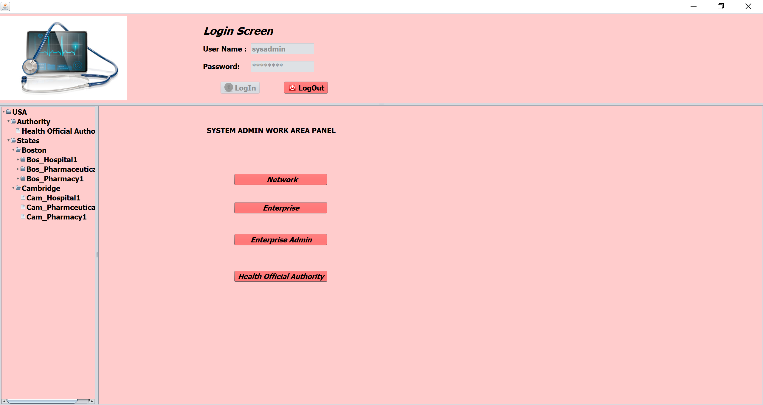
System Admin Work Area
Create Networks in the System. Create Enterprises in the Networks such as for Hospitals, Pharmaceuticals, Pharmacy.
Creating supreme authority – Health Official Authority (FDA) for approving, disapproving the medicines and to callback the medicines if necessary.

Slide 9
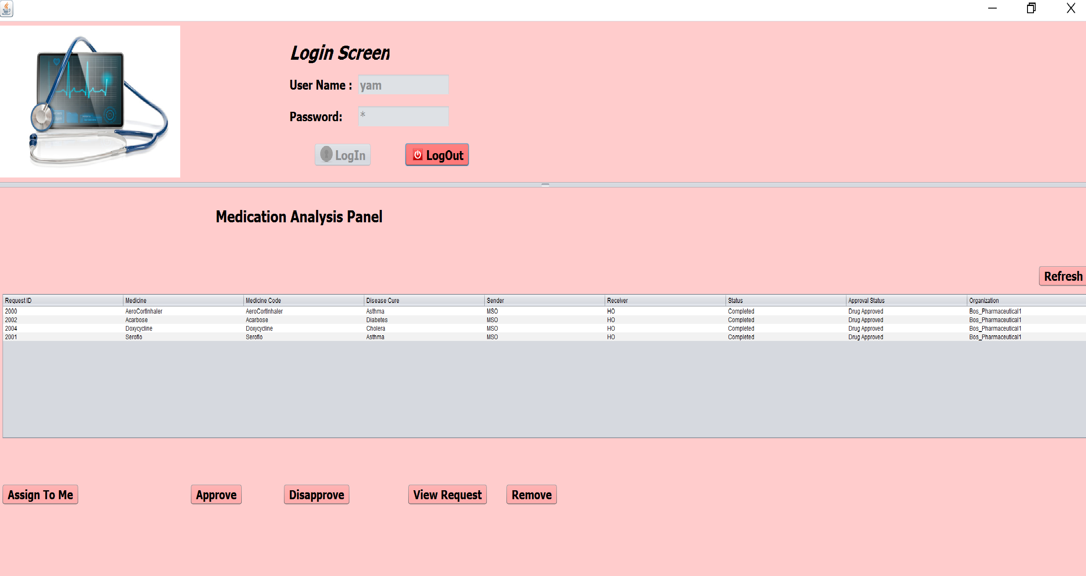
Health Official Authority Work Area
Medication Analysis – approve/disapprove drugs after enquiring the usage and the risks involved as per the set guidelines.
Customer Medication Issues, callback drugs if pharmaceutical companies not taking action.

Slide 10
Doctor Work Area
Patient medical checkup and review past medical history
Communicate with Lab Assistant and Nurse for patient checkup.
Refer patient to other doctors and respond to referred patient request.
Provide the pharmacy with the prescription request for the patient, so patient can pick the prescription from the pharmacy in the city.
Respond to drug surveys request from the Pharmaceutical Companies and also submit the issue related to the drugs back to the pharmaceutical companies.

Slide 11
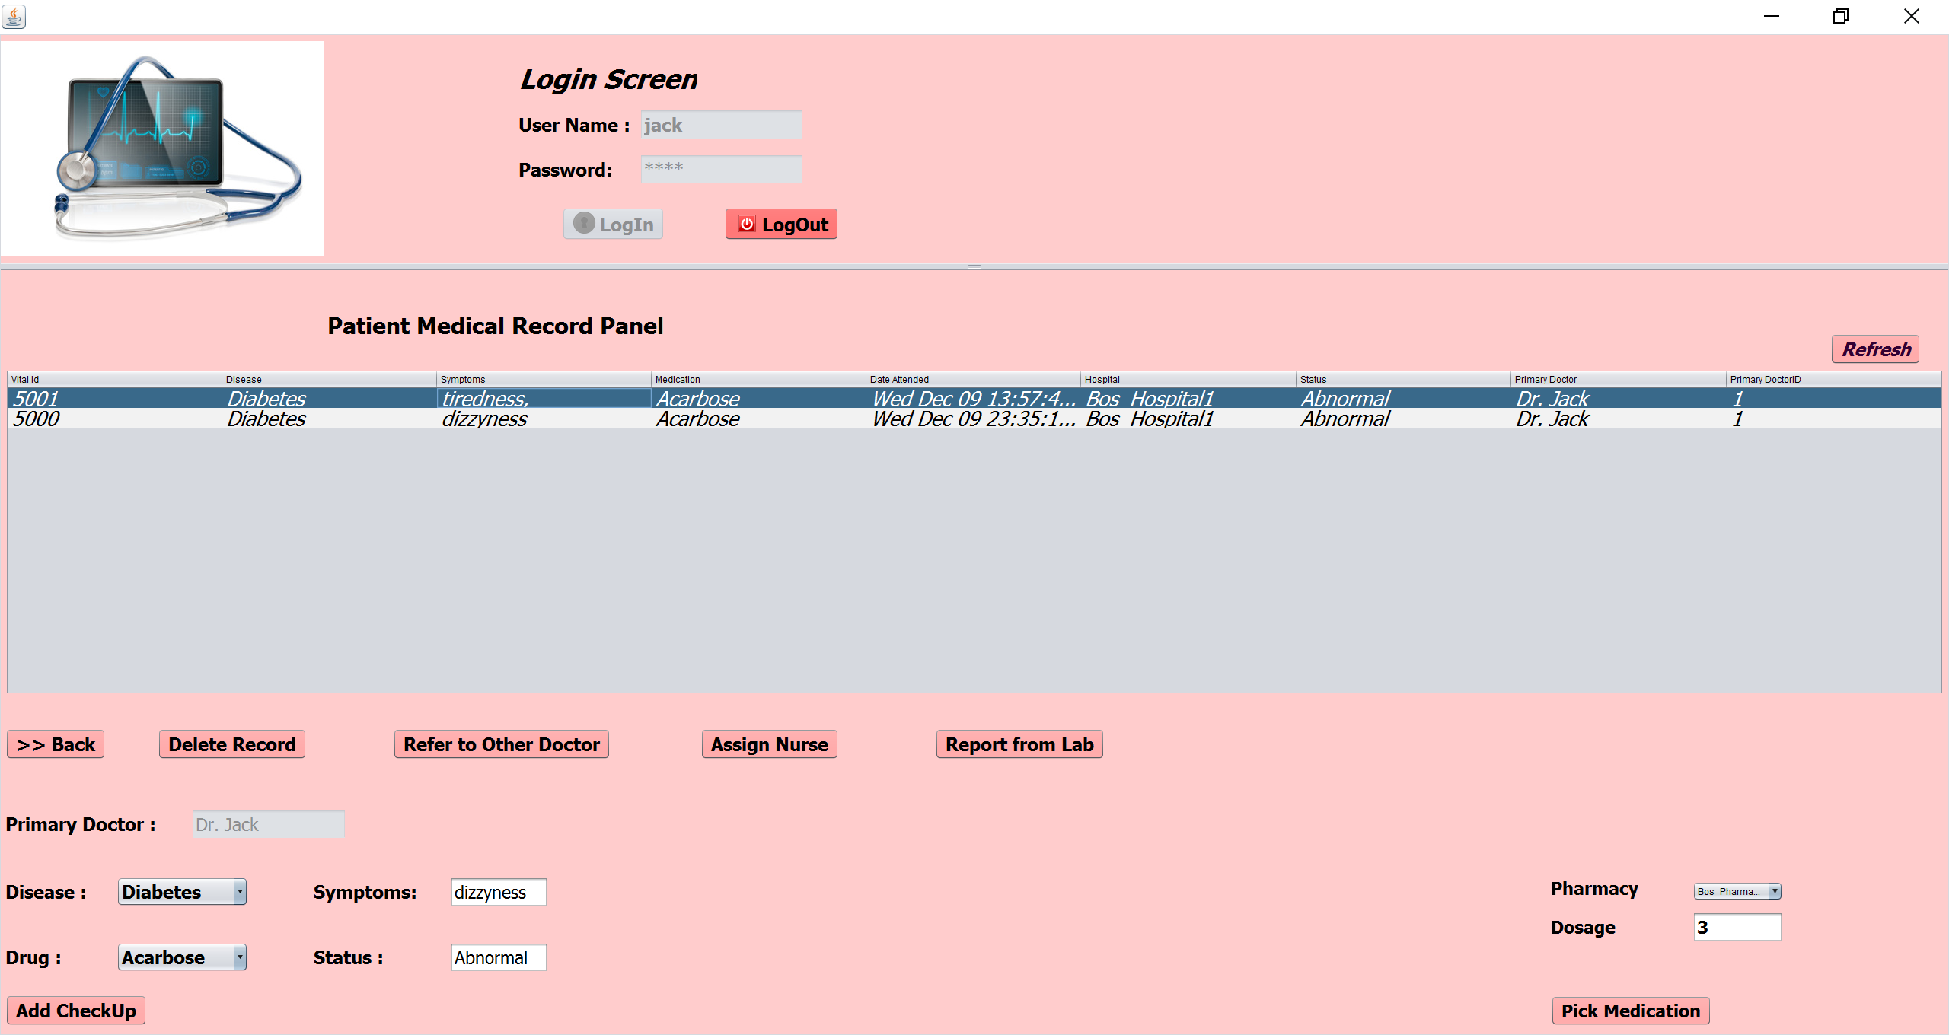
Doctor Work Area : Patient Medical Record

Slide 12
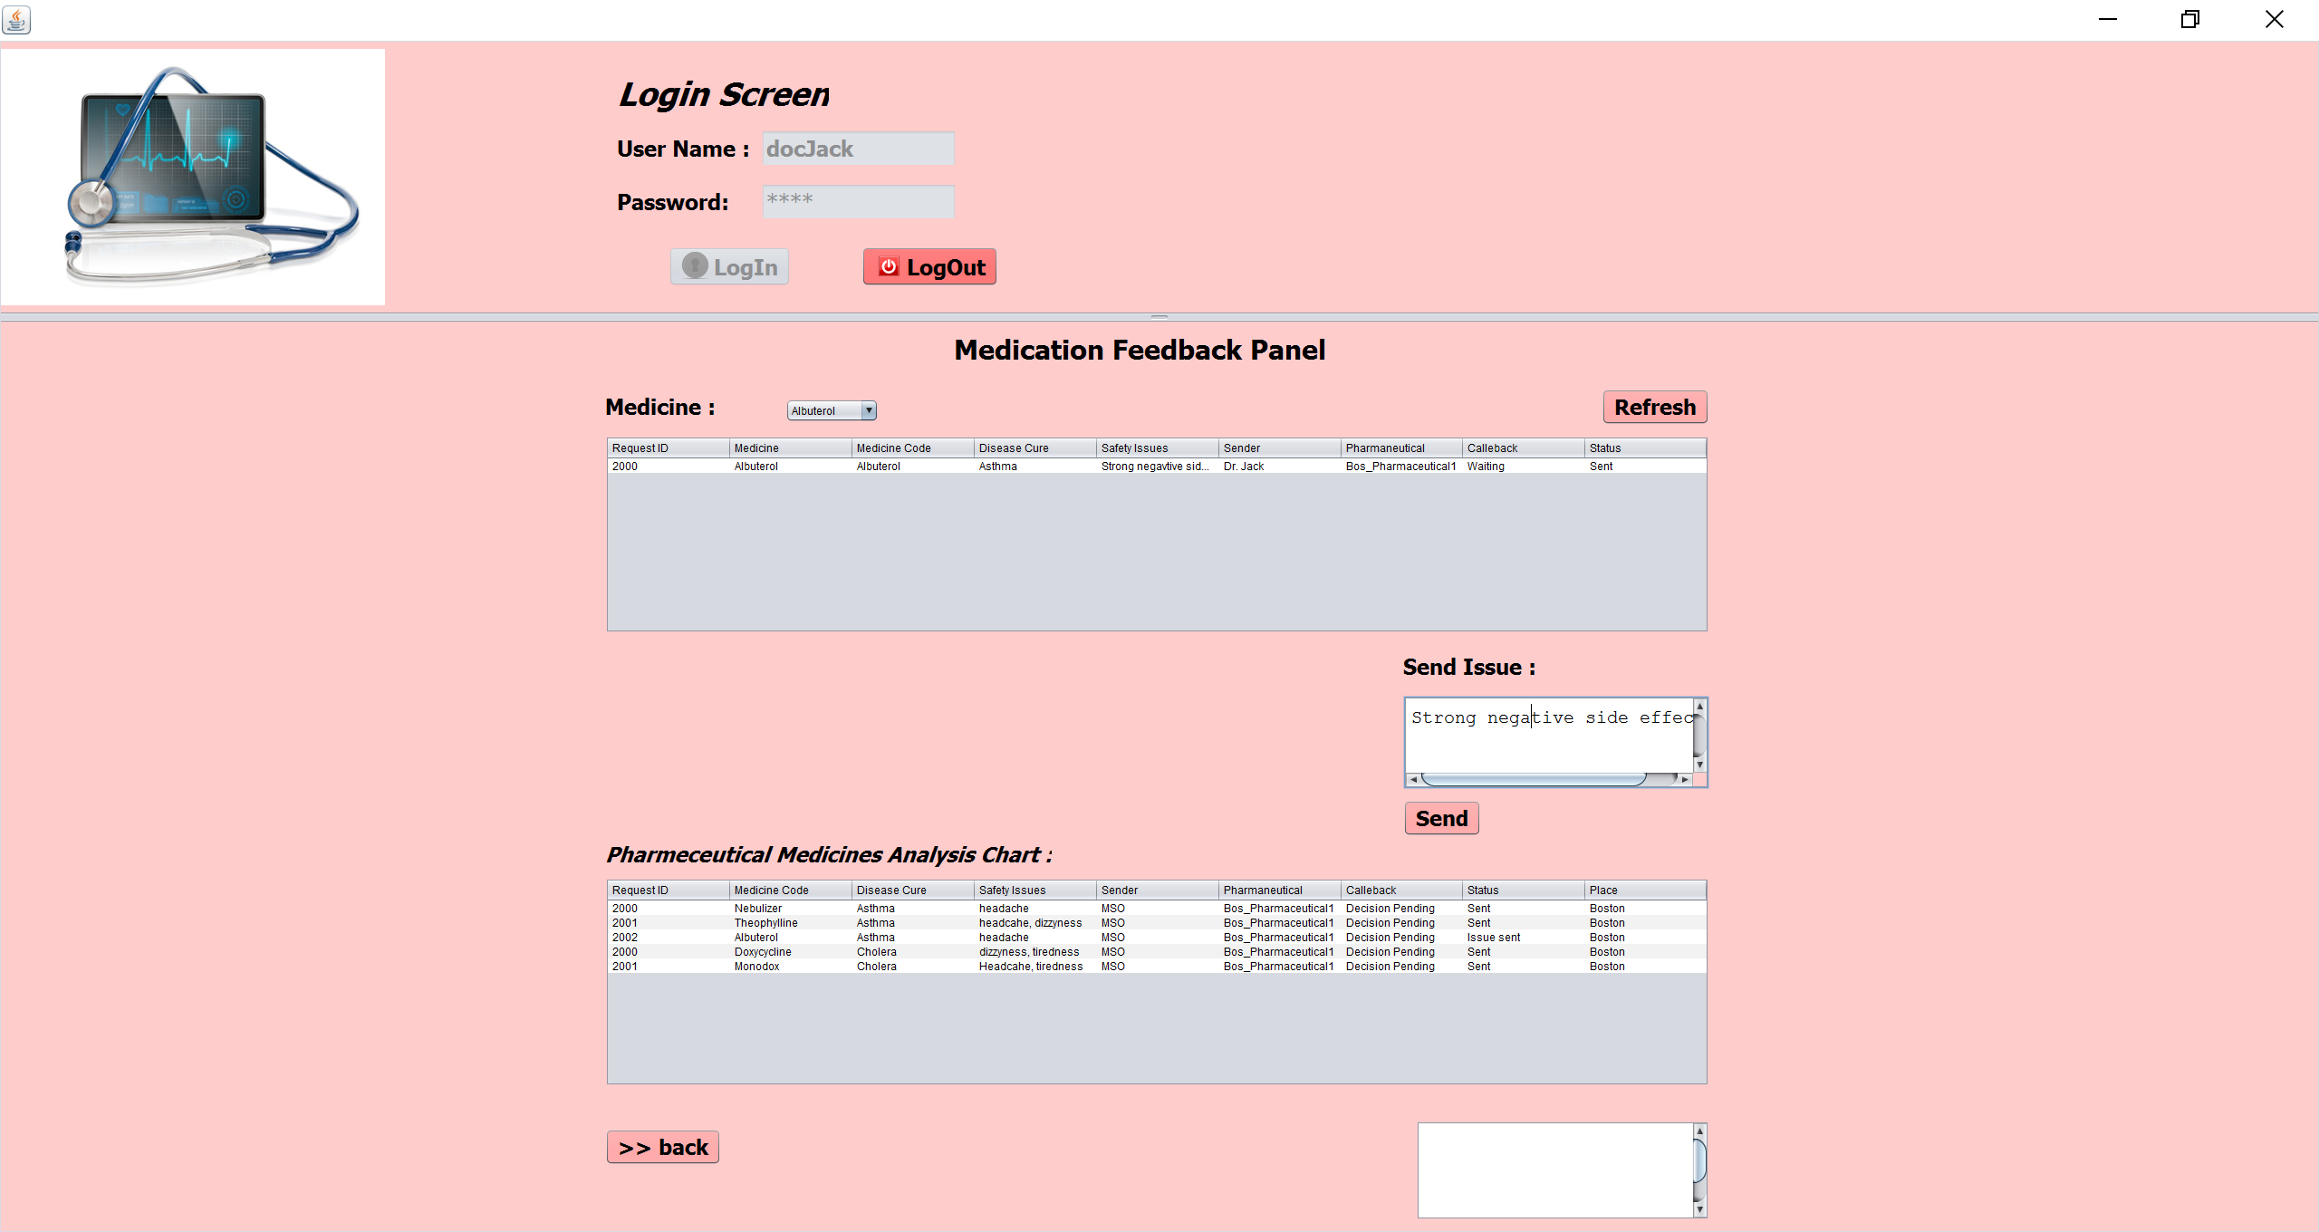
Doctor Work Area: Medication feedback to Pharmaceutical

Slide 13
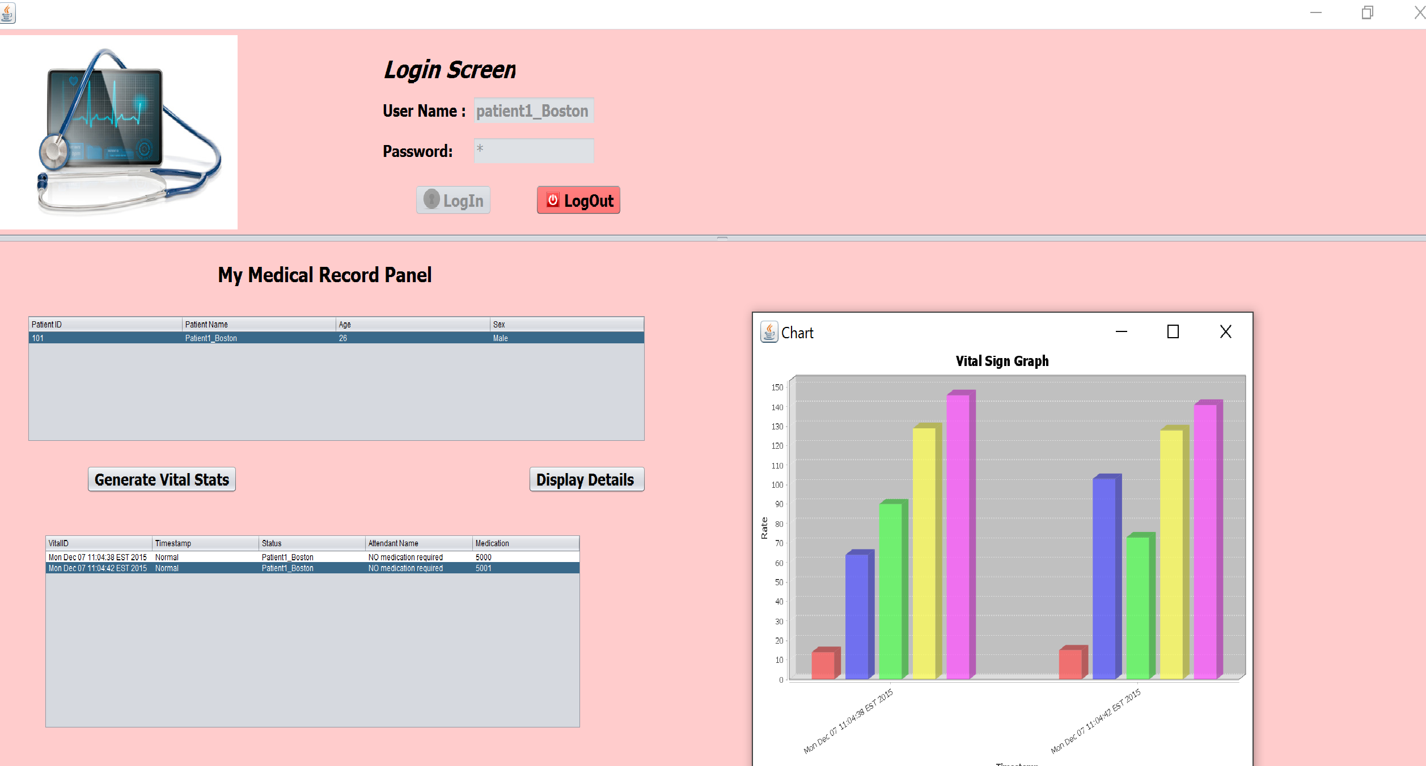
Patient Work Area
Track Vital signs at any given time, can see medical history.
Report to Doctors for any health issues.
Medication response to pharmaceutical

Slide 14
Pharmaceutical Admin Work Area
Create employee accounts such as Medical Representative etc.
Creating medicines for the pharmaceutical company
Medical Safety Officer Work Area
Drug Approval Request to the Health Official Authority.
Pharmaceutical drug survey to doctors and Pharmacies
Customer medication response handling, , the issues pertaining to drugs and making a decision if the drugs is a valid or not.

Slide 15
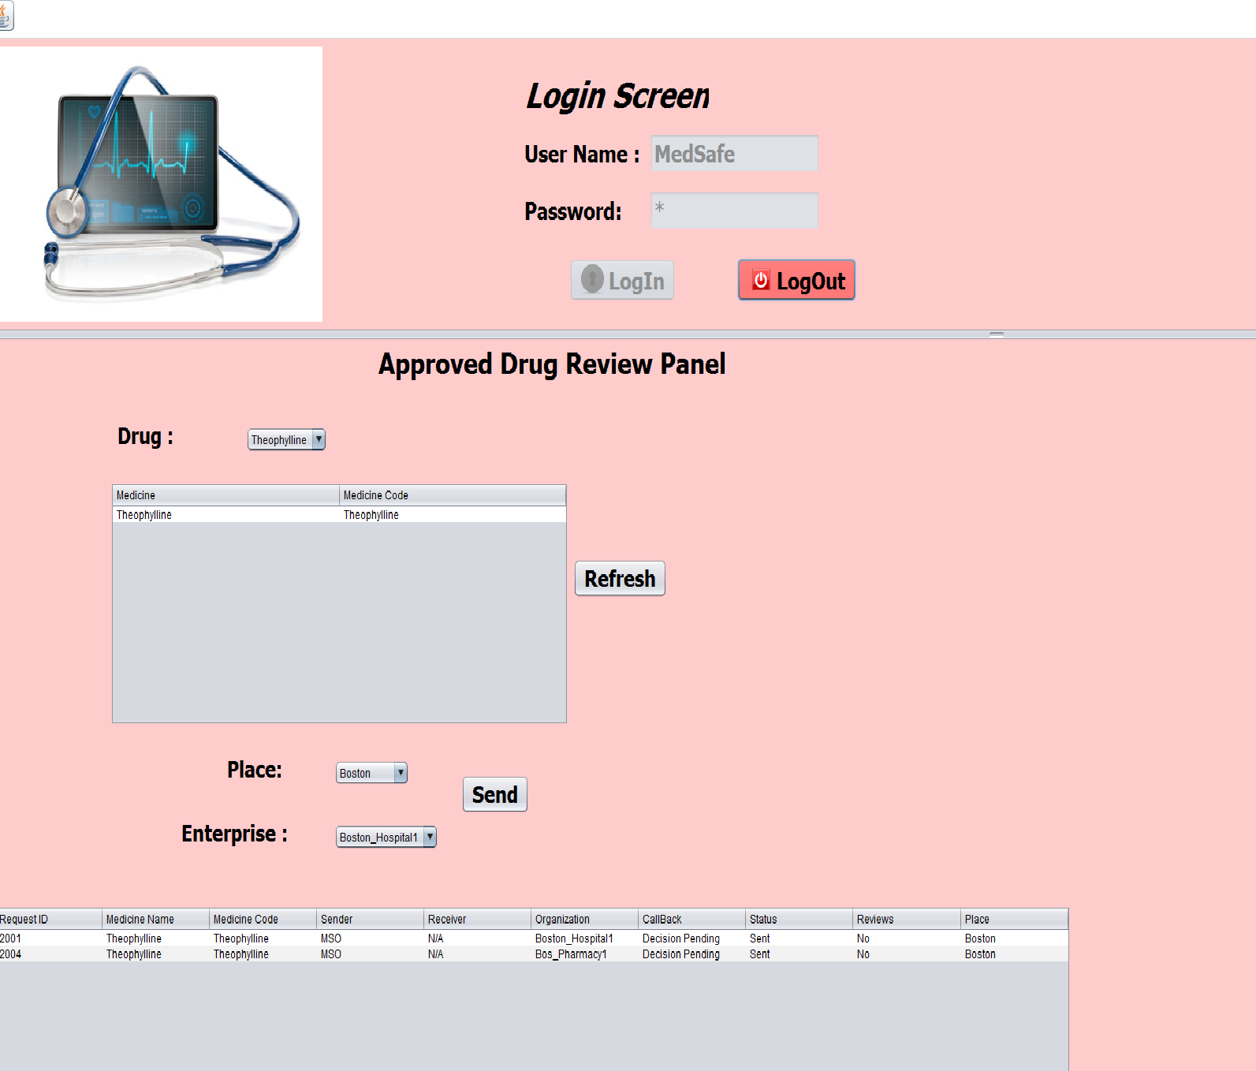
Medication safety Officer: Approved drug survey.

Slide 16
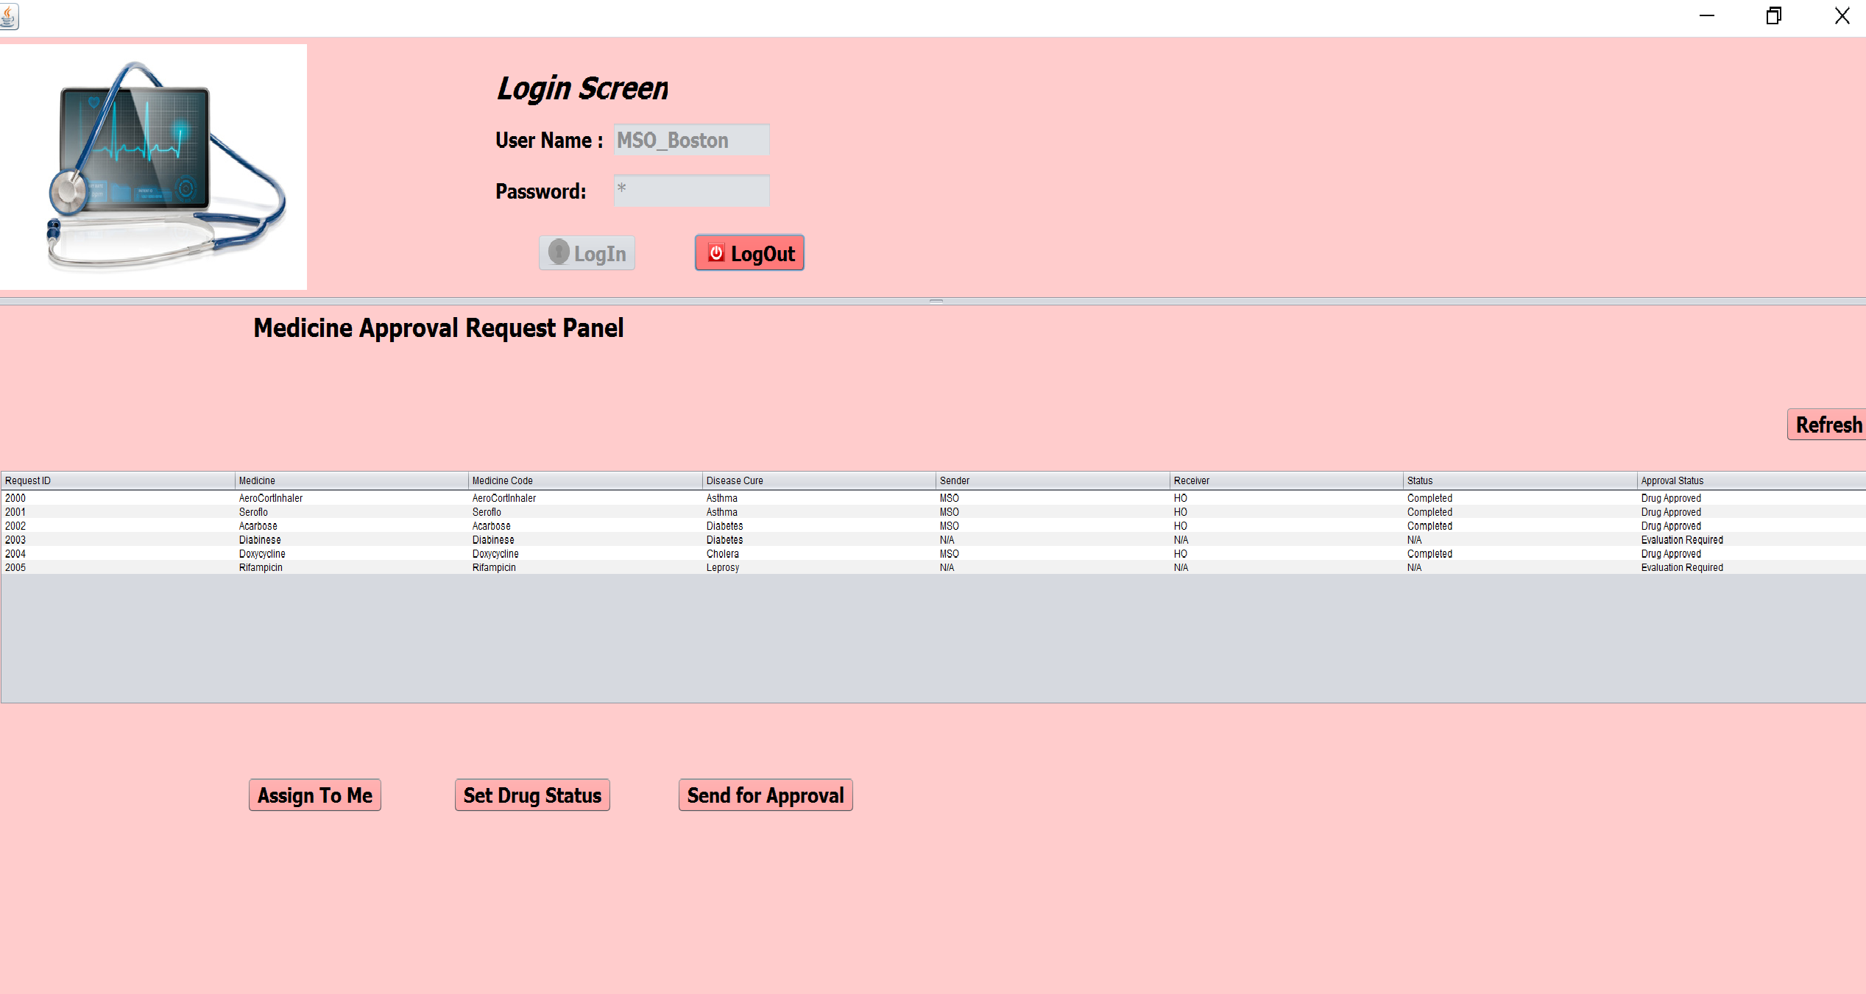
Medication Safety Officer: Work Area

Slide 17
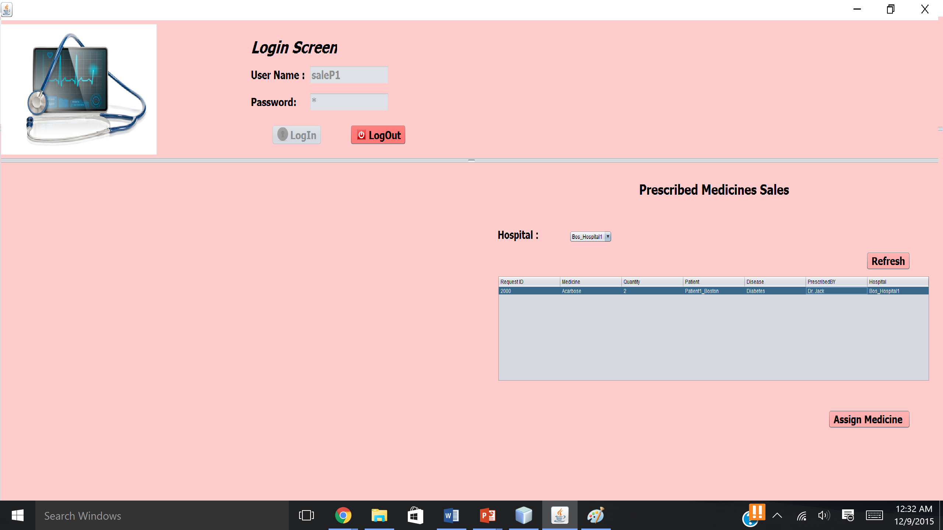
Pharmacy Work Area
Create employee accounts such as Sales Person .
Manage Prescribed Drugs, sell the prescribed drugs to patients.
Manage approved medicines, medicines reviews for the pharmaceutical drug survey request.

Slide 18
Thank You

