Slide 1
Database MANAGEMENT AND SYSTEMS Final project
Submitted by: Group 14
Members: Yamini Sehrawat
Palak Gupta
Ankita Pandharpurkar

Slide 2
Dimensional Data Models
Absences
Discipline Behavior
Academic Performance
Special Programs

Slide 3
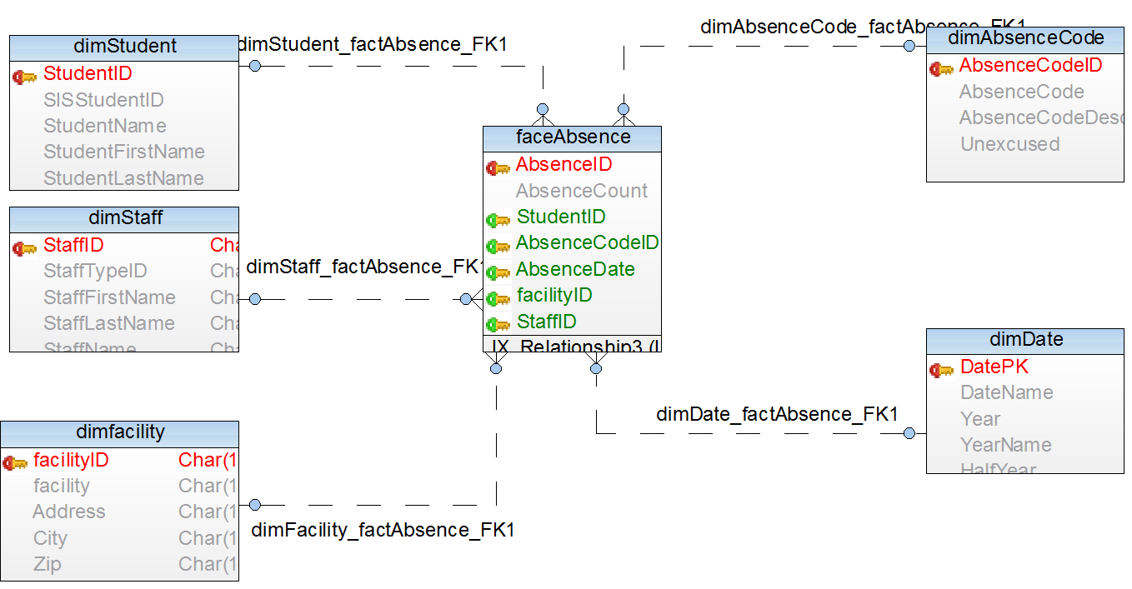
DataBase MANAGEMENT AND SYSTEMS Final project
Submitted by: Group 14
Members: Yamini Sehrawat
Palak Gupta
Ankita Pandharpurkar
Absences

Slide 4
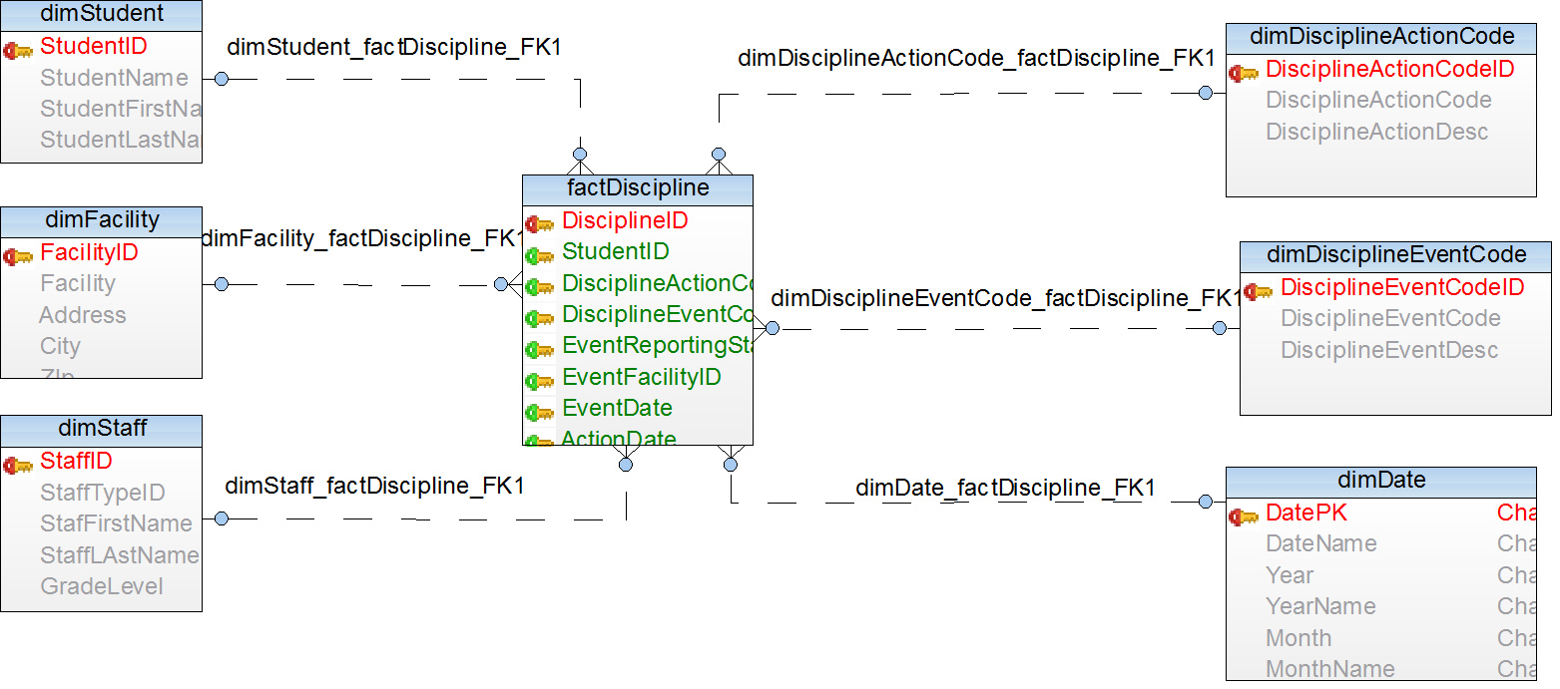
Discipline Behavior

Slide 5
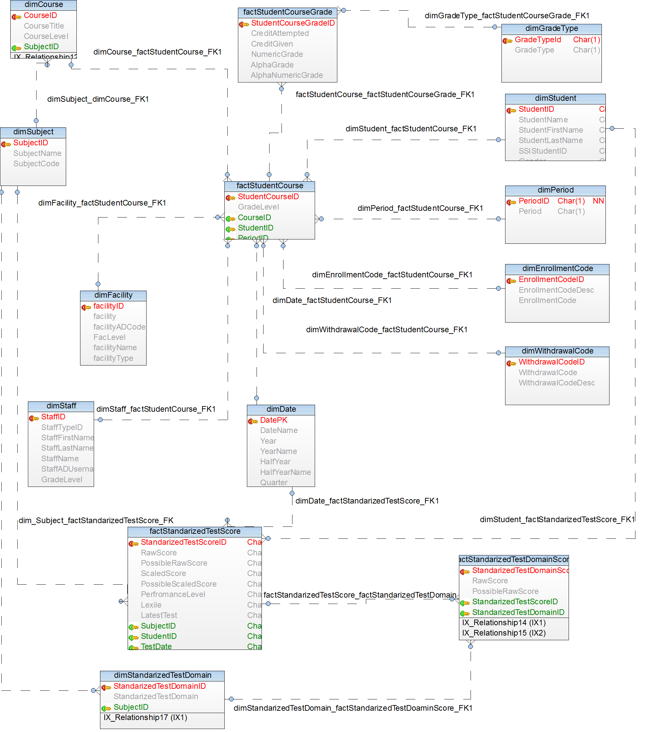
Academic Performance

Slide 6
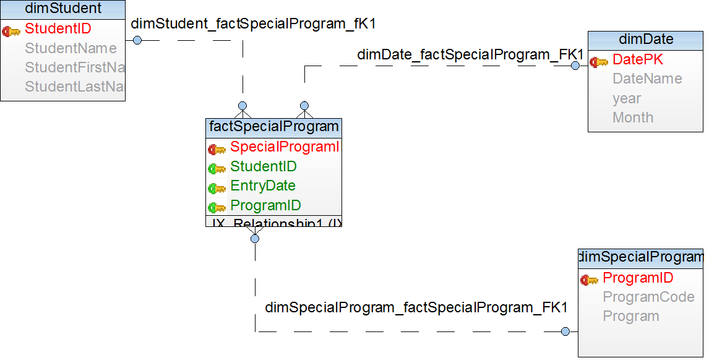
DataBase MANAGEMENT AND SYSTEMS Final project
Submitted by: Group 14
Members: Yamini Sehrawat
Palak Gupta
Ankita Pandharpurkar
Special Programs

Slide 7
Analysis/queries for each data subset from the following perspectives:
School Administrator
Teacher
Parent

Slide 8
School Administrator
→ School administrator would like to know about the Total number of regular students in the school. This can be queried as follows:
select count(s.studentID) as RegularStudents
from [dbo].[dimEnrollmentCode] as e
join dbo.dimStudent as s on e.EnrollmentCodeID = s.EnrollmentCodeID
where e.EnrollmentCodeID = 1;
→How many students are there in each special program offered by the School. This will be helpful to bring more programs in the school looking at the count of students currently enrolled. This can be queried as :
select sp.programID,sp.Program, count(fsp.StudentID) as Students
from [dbo].[factSpecialProgram] as fsp
join [dbo].[dimSpecialProgram] as sp
on sp.ProgramID = fsp.ProgramID
group by sp.ProgramID,sp.Program

Slide 9
Teacher
→ A teacher would keep a check on maintaining discipline. There would be need to know the students who are violating the discipline rules:
Select dec.DisciplineEventCodeID,dec.DisciplineEventDesc,
count(fd.StudentID) as Students
from [dbo].[dimDisciplineEventCode] dec
full outer join [dbo].[factDiscipline] as fd on fd.DisciplineEventCodeID=dec.DisciplineEventCodeID
group by dec.DisciplineEventCodeID,dec.DisciplineEventDesc
→Teacher would keep a check on absences in the class like for some unaccountable reasons :
select count(ds.studentID) as NumberOfStudentsUnaccountableAbsence
from [dbo].[factAbsence] fa
join [dbo].[dimStudent] ds on fa.StudentID=ds.StudentID
where AbsenceCodeID=22
→ Total number of students in each course
select count(fsc.studentid) Students,c.CourseID, c.CourseTitle
from [dbo].[factStudentCourse] as fsc
join [dbo].[dimCourse] as c on c.CourseID = fsc.CourseID
group by c.CourseID, c.CourseTitle,fsc.FacilityID

Slide 10
Parents
→ What all special programs they have for special children. This is specifically important for parents of sensitive children.
Select * from [dbo].[dimSpecialProgram];
→What all courses student is enrolled in the school: For example, to check for a student with ID 12, Along with Grades in the courses.
select * from [dbo].[factStudentCourse] where StudentID=12;
Select * from [dbo].[factStudentCourseGrade] as c
join [dbo].[factStudentCourse] as sc On c.StudentCourseID=sc.StudentCourseID
Where sc.studentID = 12
Is student has been accounted for violating any discipline rule in the school. If yes, what action has been taken against the student?
Select fd.StudentID, fd.DisciplineEventCodeID,
de.DisciplineEventDesc, fd.DisciplineActionCodeID,
da.DisciplineActionDesc, fd.EventDate, fd.ActionDate
from [dbo].[factDiscipline] as fd
join [dbo].[dimDisciplineEventCode] as de
on de.DisciplineEventCodeID = fd.DisciplineEventCodeID
join [dbo].[dimDisciplineActionCode] as da
on da.DisciplineActionCodeID = fd.DisciplineActionCodeID
where StudentID=11

Slide 11
OLAP (SSAS) cube
Absences
Discipline Behavior
Academic Performance
Special Programs

Slide 12
Power BI
Absences
Discipline Behavior
Academic Performance
Special Programs

Slide 13
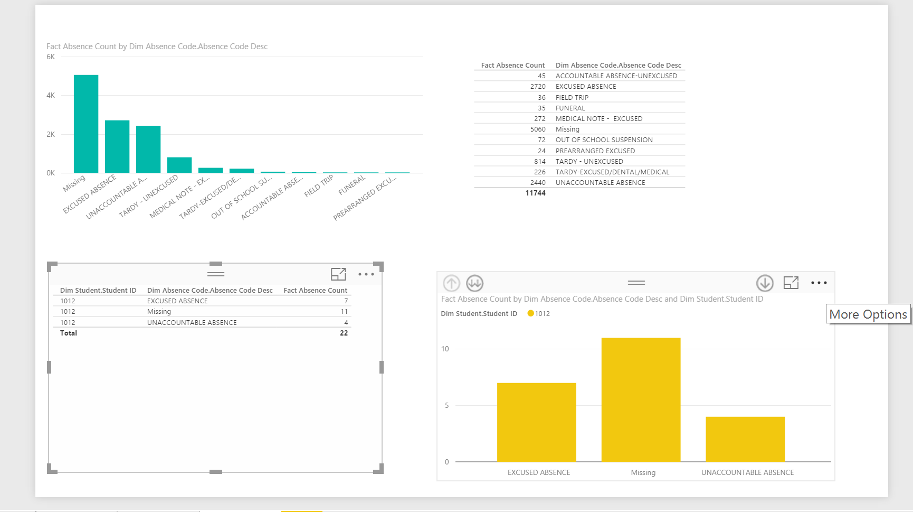
Absences By Total Count:

Slide 14
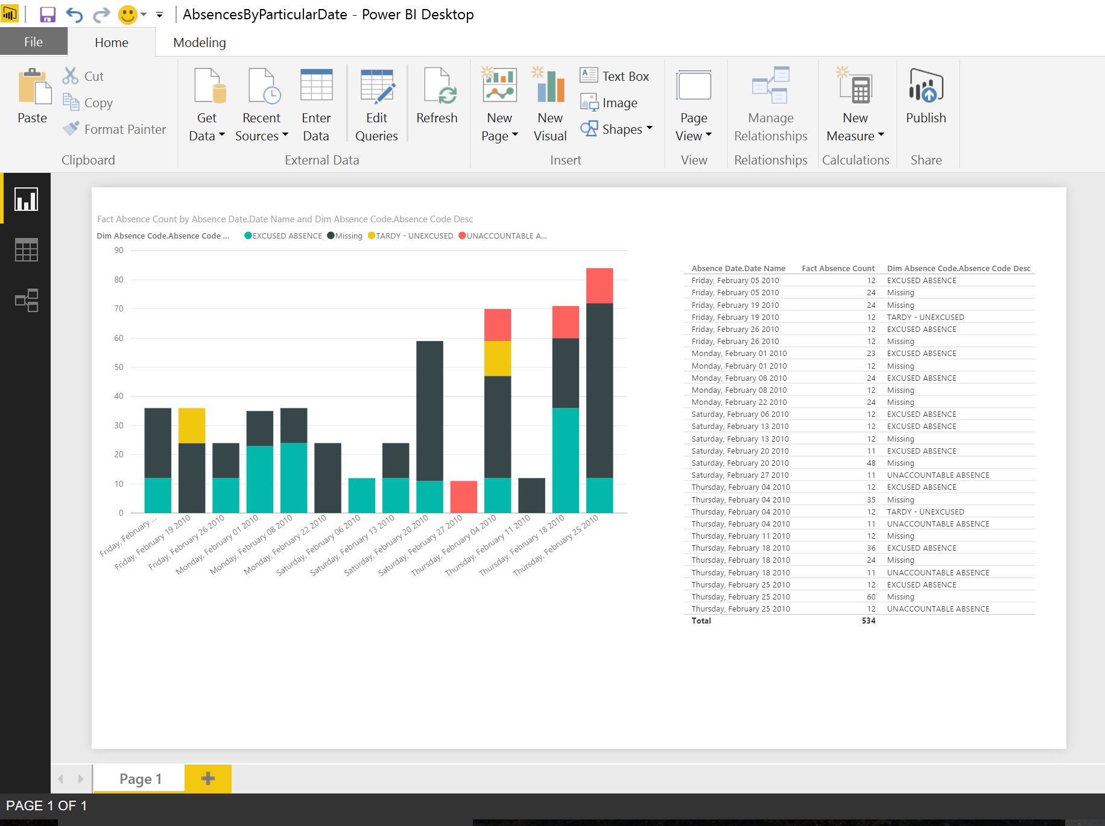

Slide 15
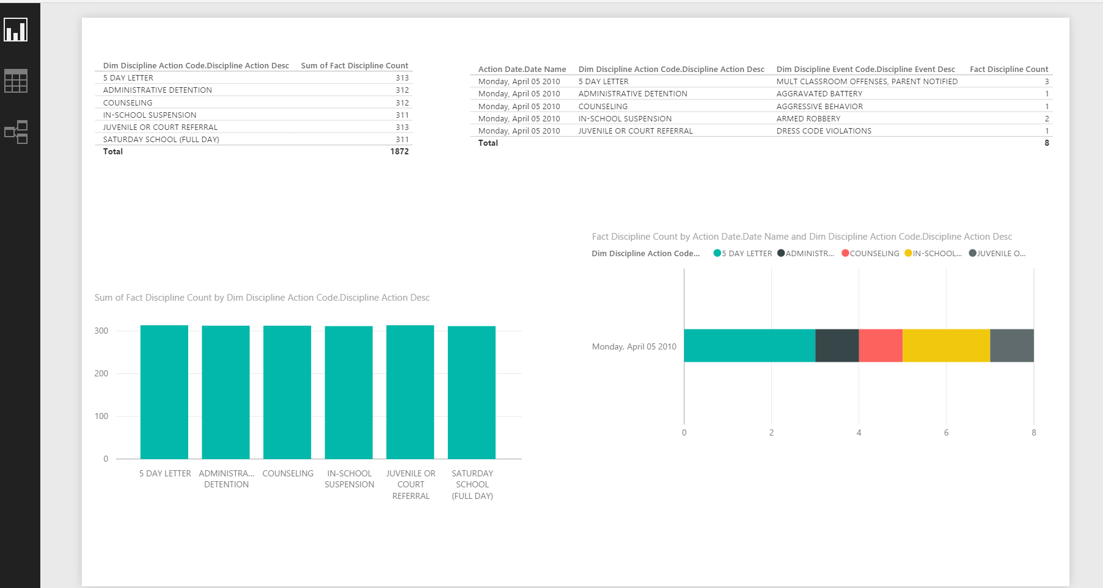
Discipline behavior Overall count and discipline actions and events on a particular date:

Slide 16
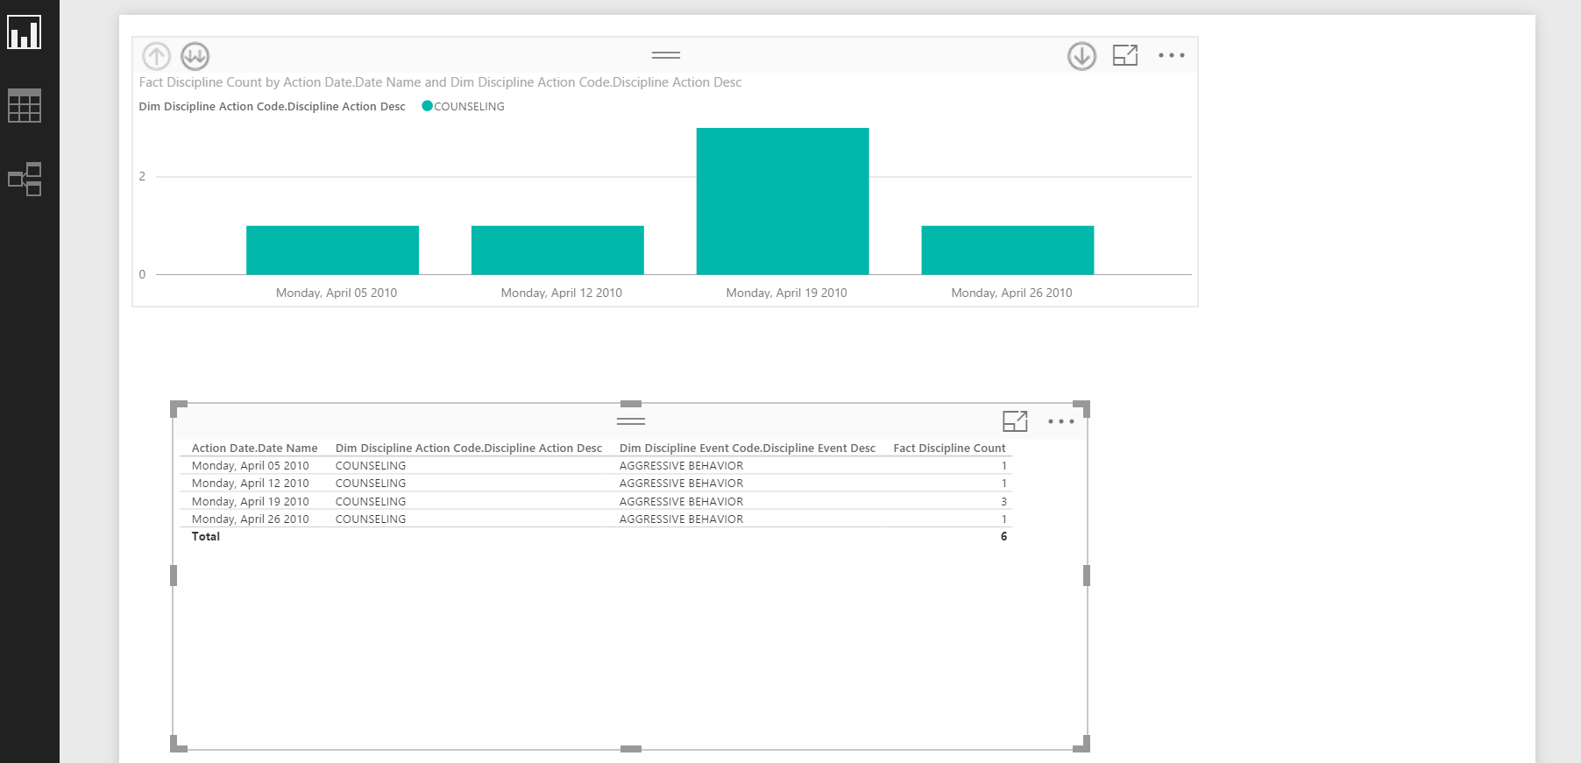
Discipline behavior in a particular month for “Counselling” action code.

Slide 17
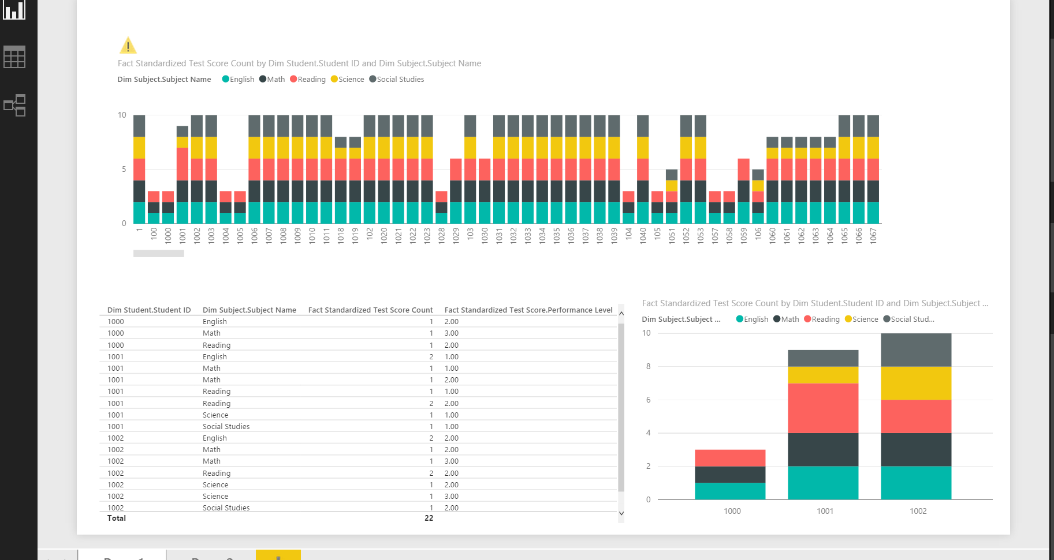
Academic behavior:
By Students and Performance Level

Slide 18
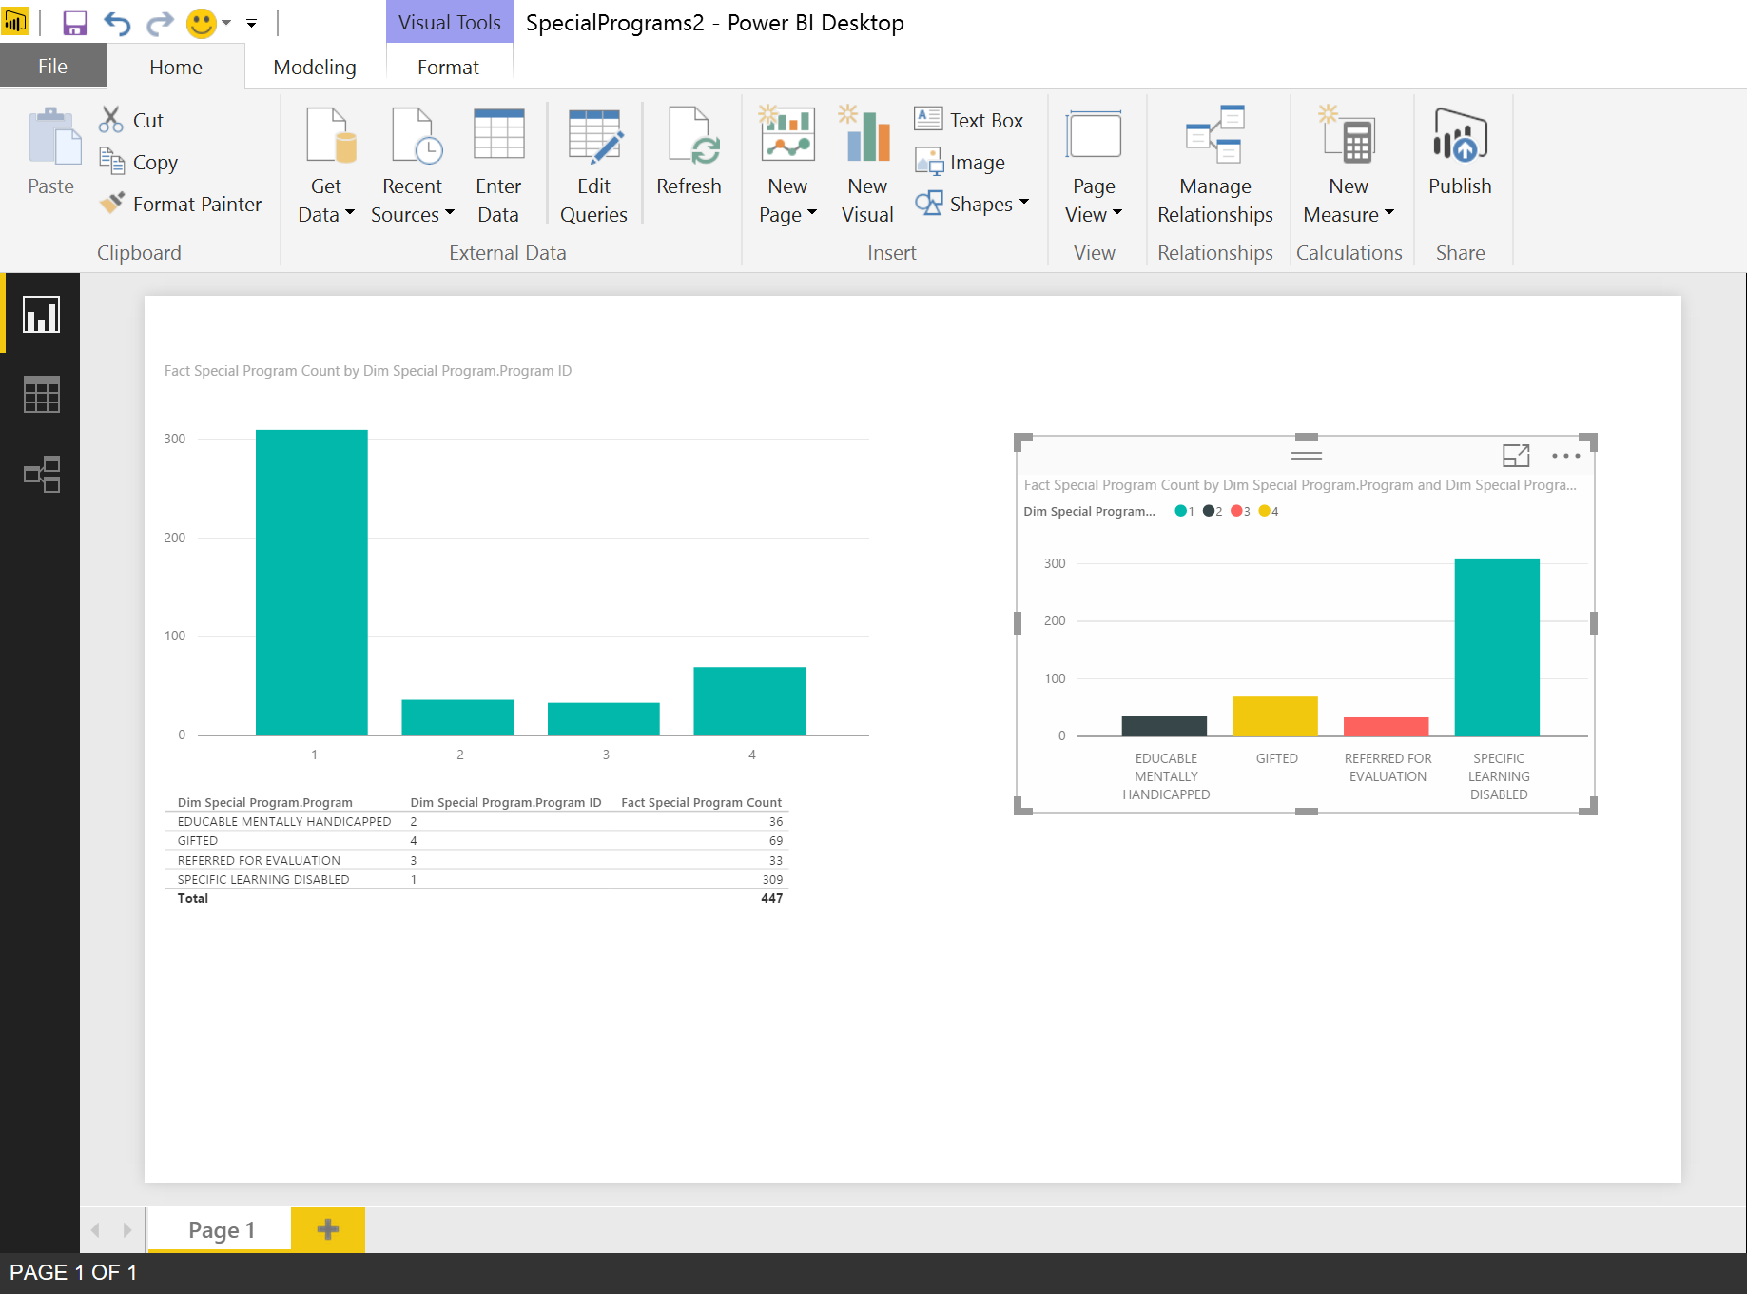
Special Programs: overall count and enrollments

Slide 19
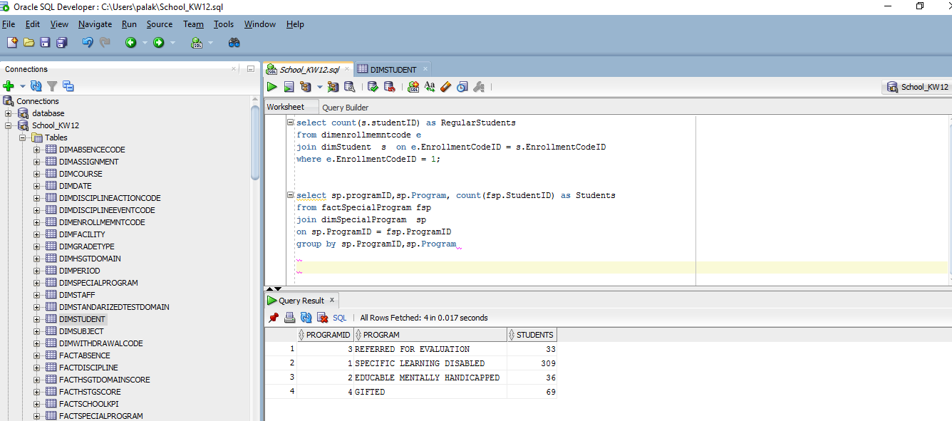
Schools_K12_DW
Oracle

Slide 20
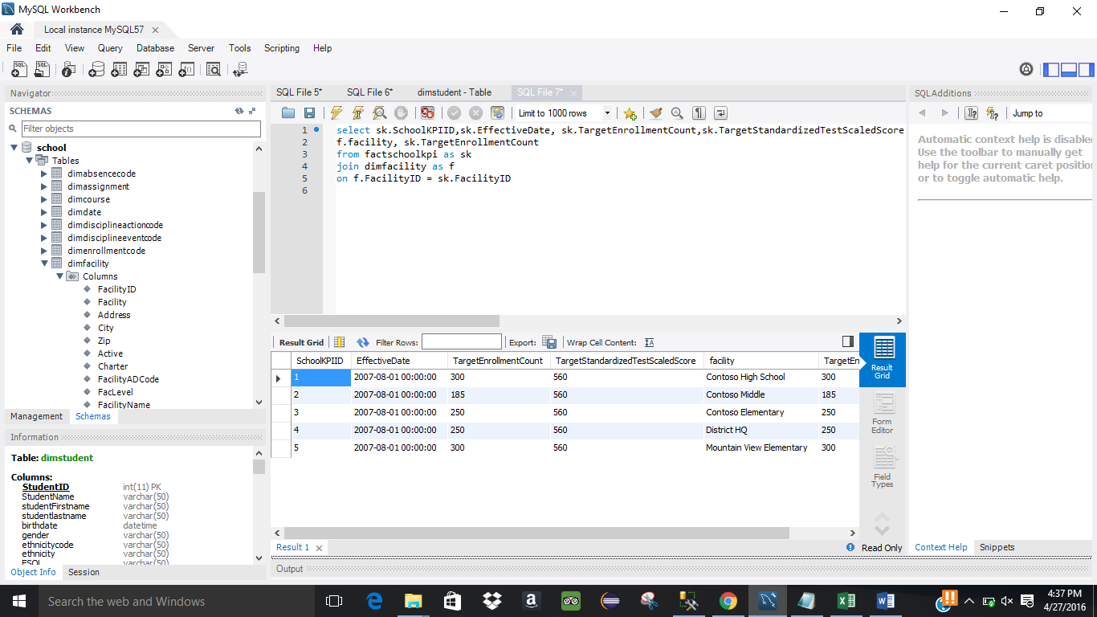

Slide 21
Thank You

