Slide 1
🚀
Swiggy Business Performance Analysis
Transforming Raw Data into Actionable Insights
TOOLS USED
SQL Server • Python • Excel • Power BI
KEY FOCUS AREAS
✅
Sales Analysis
✅
Restaurant Performance
✅
Location Insights
✅
Customer Ordering Trends
✅
Interactive Reporting
Prepared By: Sudulaguntla Yamini

Slide 2
Project Overview
An end-to-end analytics pipeline, from raw order data to a decision-ready dashboard.
Objective
Business Questions Addressed
Build a complete data analytics pipeline that transforms raw Swiggy order data into meaningful business insights — cleaning and validating the data, modeling it into a star schema, and delivering interactive dashboards that help stakeholders understand sales, restaurant, and location performance.
Which days and months drive the most revenue?
Which restaurants and states generate the most sales?
How does demand differ between veg and non-veg orders?
How consistent is customer satisfaction (ratings) over time?
What is the average order value, and how does it vary?
How does quarterly performance trend across the year?
Dataset Information
5 linked source tables: fact_orders, dim_restaurant, dim_location, dim_dish, dim_date
197K+ orders merged into a single analytical dataset
Coverage across 25+ Indian states and union territories
2 / 10

Slide 3
SQL Analysis
Data cleaning & validation layer — drop in your query screenshots below.
🖼
🖼
🖼
🖼
🖼
Add screenshot
Add screenshot
Add screenshot
Add screenshot
Add screenshot
Data Cleaning
NULL Checks
Duplicate Removal
Joins
KPI Queries
Typical validation checks: orders without matching customers/restaurants, negative order amounts, delivery time earlier than pickup time, and referential integrity across the star schema (fact_orders ↔ dim_restaurant, dim_location, dim_dish, dim_date).
3 / 10

Slide 4
Python Analysis
Exploratory data analysis in pandas — merging, feature engineering, and trend discovery.
Pipeline Steps (pandas)
Merged fact_orders with dim_restaurant, dim_location, dim_dish, dim_date
Engineered Year, Month, Quarter, Day features from order_date
Classified dishes into Veg / Non-Veg via keyword matching
Computed KPIs: total sales, AOV, avg rating, order count
🖼
Add notebook / heatmap screenshot
4 / 10

Slide 5
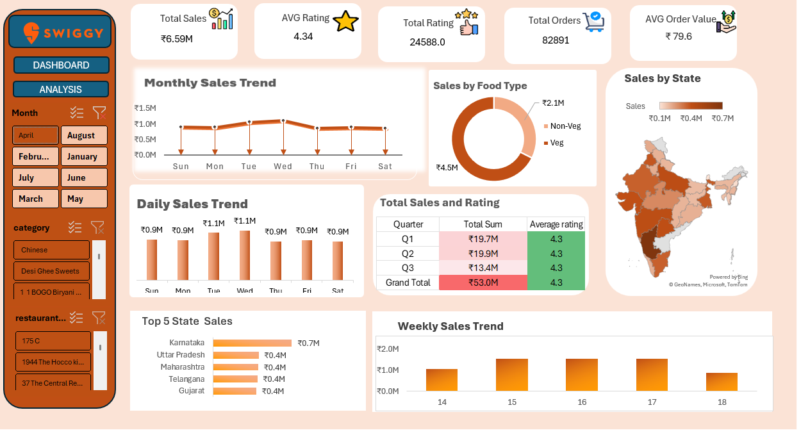
Excel Analysis
Pivot-table driven dashboard with quarter and day-level detail.
What's In It
Data model linking orders to restaurant, location, and date dimensions
Pivot tables & pivot charts for daily, weekly, and monthly sales
Quarterly KPI table: total sales & average rating per quarter
Slicers for month, category, and restaurant-level filtering
Key Excel KPIs: Grand Total ₹53M sales, Total Orders 24,588 (Q1 slice), Average Rating 4.34, held steady at 4.3 across every quarter.
5 / 10

Slide 6
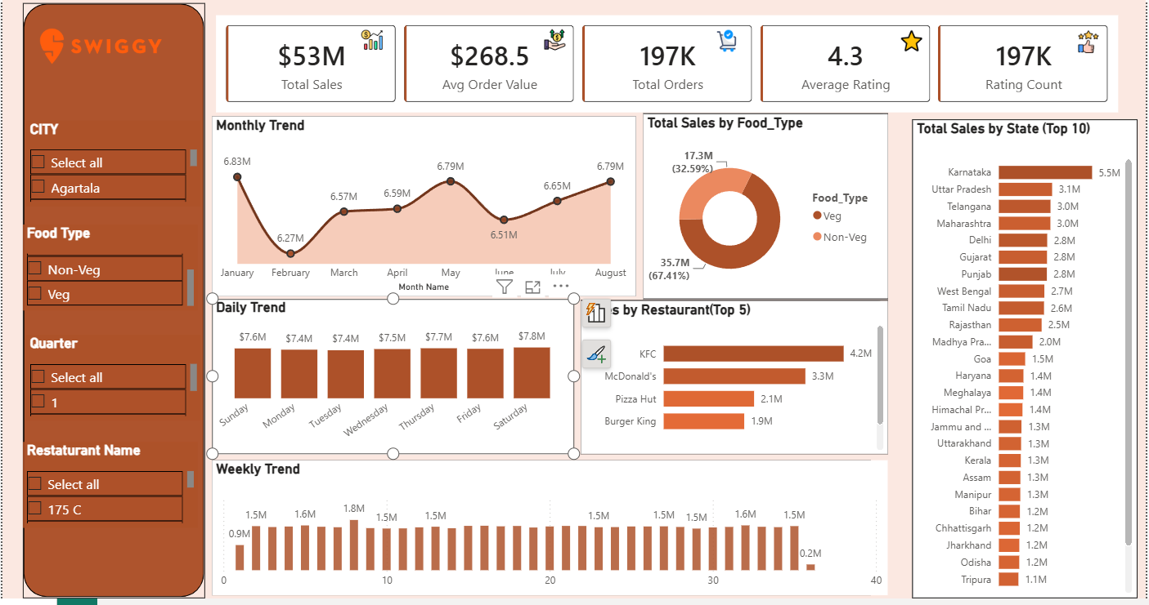
Power BI Dashboard
The full interactive report — filterable by city, food type, quarter, and restaurant.
$53M
197K
$268.5
4.3 ★
Total Sales
Total Orders
Avg Order Value
Avg Rating
6 / 10

Slide 7
Power BI Dashboard — Category & Location Insights
Extracted views from the report for restaurant, state, and food-type performance.
Reading the Cuts
KFC and McDonald's alone out-sell the other top brands combined
Karnataka nearly doubles the next closest state
Veg orders outnumber non-veg roughly 2 to 1 across the platform
7 / 10

Slide 8
Key Insights
What the data tells us.
🏆
Top restaurants lead the pack
KFC ($4.2M) and McDonald's ($3.3M) are the top 2 restaurant brands by sales — together outselling the next four brands combined.
📅
Weekends outperform weekdays
Saturday sales peak at $7.8M, roughly 5% above the weekly low on Monday/Tuesday ($7.4M).
📍
Karnataka is the strongest state
At $5.5M, Karnataka nearly doubles the next closest state, Uttar Pradesh ($3.1M).
🥗
Veg dominates demand
67% of revenue comes from veg dishes, vs. 33% for non-veg — a 2:1 split.
⭐
Ratings held steady all year
Average rating stayed at 4.3 in every quarter, even as sales volumes shifted.
8 / 10

Slide 9
Skills Demonstrated
The toolkit behind this project.
🗄️
🐍
🧹
🔍
SQL
Python
Data Cleaning
EDA
📊
📈
🧩
🖥️
Excel
Power BI
Data Modeling
Dashboarding
9 / 10

Slide 10
Conclusion
What I Learned
Business Impact
How to build an end-to-end analytics pipeline — from raw multi-table data to a polished dashboard
The importance of validating one consistent source of truth across Python, Excel, and Power BI
How small data-quality issues (duplicates, nulls, referential integrity) cascade into dashboard accuracy if not caught early
Gives stakeholders a self-serve view of sales, restaurant, and location performance
Surfaces where to focus promotions — weekend timing, top-performing states like Karnataka
Confirms service quality held steady (4.3★) even as demand fluctuated quarter to quarter
Built end-to-end: SQL → Python → Excel → Power BI
Thanks for reading — let's connect! [Your Name] | [LinkedIn handle]

