Slide 1
Guardian Media GROUP Brexit
Data exploration and analysis

Slide 2
Data Extraction
Get request to http://content.guardianapis.com/search
Saved results in a dict object
Converted dict to pandas dataframe
Export to csv

Slide 3
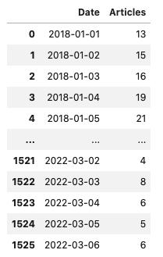

Total number of articles Since 01-01-2018
Average No. of Articles - 19.4

Slide 4
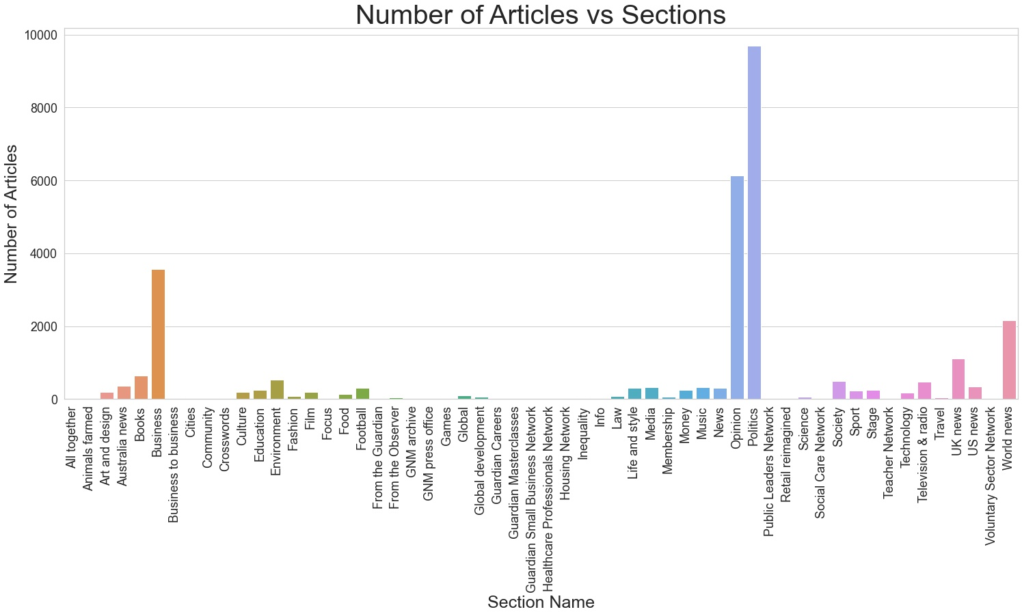

Slide 5
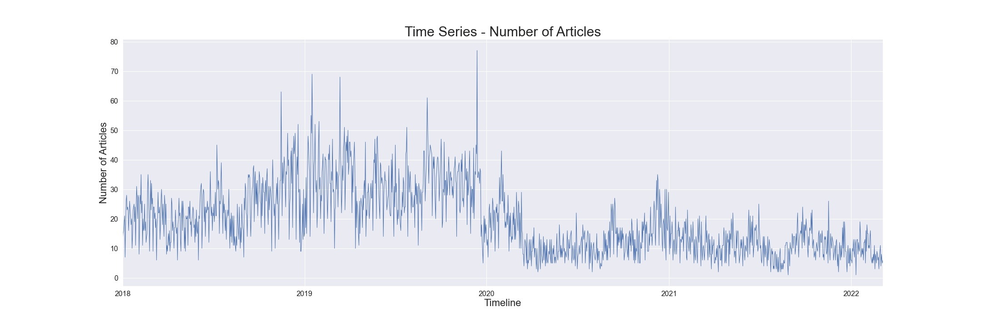

Slide 6
Covid Pandemic
Brexit
End of transition period
2021 Olympics
Covid Pandemic- Delta Variant

