Slide 1
Closing the Gap
Wake County Affordable Housing Supply-Demand Analysis
Built with Real Data from wakehousingdata.org
Wake County HACR | April 2026

Slide 2
KEY PERFORMANCE INDICATORS | Wake County Housing Crisis at a Glance
26,037
39 Years
$3.8B
89%
Units Missing
To Close the Gap
Total Investment Needed
Entry-Level Collapse
Affordable rental shortage for households under $35K
At current HACR pace of 660 units/year (closes 2065)
Same cost regardless of pace— only the timeline changes
Drop in homes sold under $250K 2018 to 2022
3.72%
+$8,920
96%
16 / 100
Vacancy Rate
2021 Rent Shock
Renters Under $20K
Affordable Homes
Well below 5% healthy benchmark— landlords set the terms
Income jump needed in a single year to keep up with rent
Are cost-burdened—spending >30% of income on housing
Only 16 affordable units for every 100 renters under $20K
Source: wakehousingdata.org | HACR FY2025 Annual Report | All real data, no estimates

Slide 3
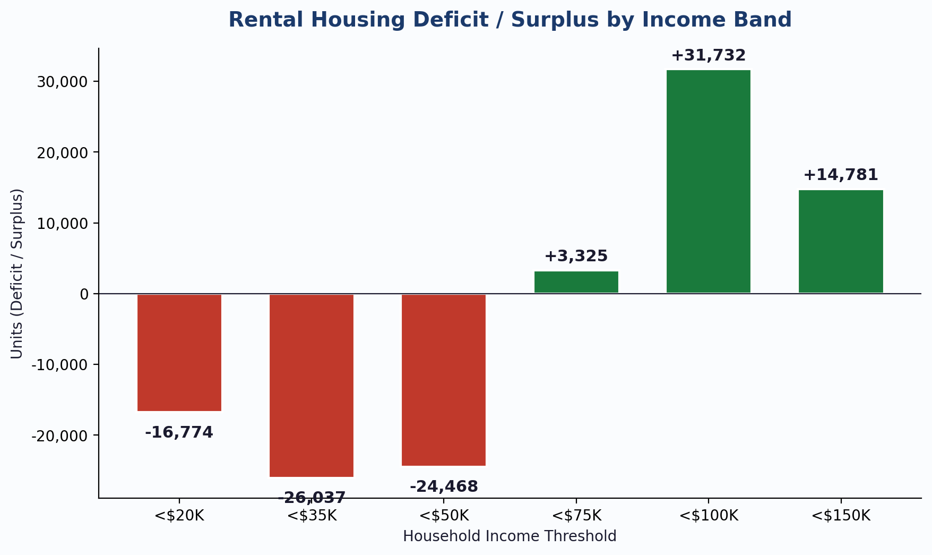
THE GAP | Rental Housing Deficit by Income Band
What This Shows
Red bars = shortage. Green bars = surplus.
The shortage is concentrated at the lowest income levels:
<$20K: 16,774 units short
<$35K: 26,037 units short
<$50K: 24,468 units short
Above $75K, supply exceeds demand. The crisis is an income-targeted problem.
KEY INSIGHT: Wake County has enough housing overall — but not for people who need it most. The market works for $75K+ households. Below $50K, 67,279 families have no affordable option.

Slide 4
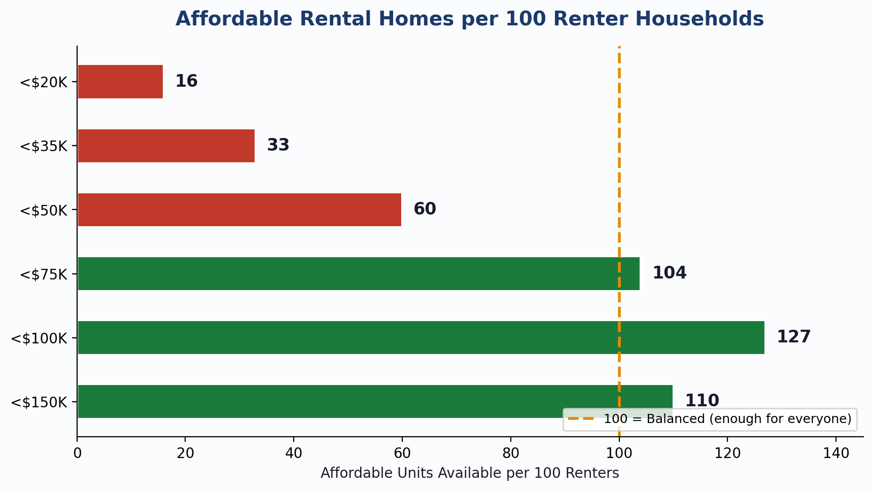
SUPPLY PER 100 RENTERS | How Many Chairs for 100 People?
Musical Chairs Analogy
At <$20K income:
100 people, only 16 chairs.
84 people are left standing.
At <$75K income:
100 people, 104 chairs.
Everyone sits, a few to spare.
The dashed line = 100 (balanced).
Below it = shortage. Above it = surplus.
KEY INSIGHT: The lowest-income renters face the most extreme competition for housing. At <$20K, each affordable unit has 6 households competing for it.

Slide 5
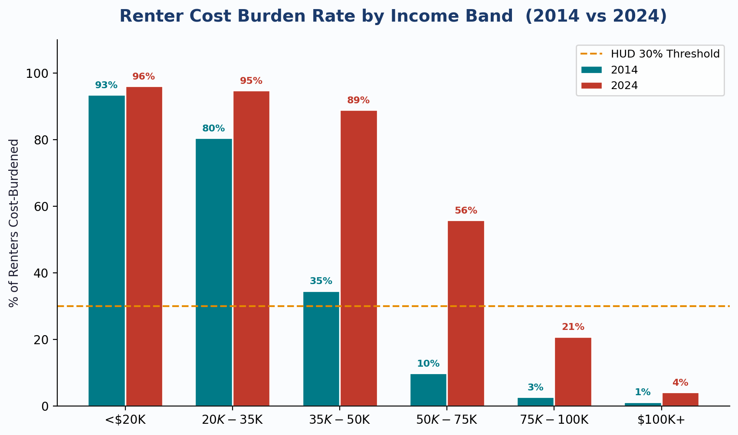
COST BURDEN EXPLOSION | The Crisis Moves Up the Income Ladder
Biggest Shifts (2014 to 2024)
$35K-$50K: 34.5% --> 88.9%
Jumped +54 percentage points
$50K-$75K: 9.8% --> 55.8%
Nearly 6x increase
$75K-$100K: 2.7% --> 20.8%
Even upper-middle income is affected
The dashed line = HUD's 30% threshold.
Every bar above it = cost-burdened.
KEY INSIGHT: In 2014, only renters under $35K were in crisis. By 2024, the crisis has engulfed the $35K-$75K range — the working class and middle class are now cost-burdened too.

Slide 6
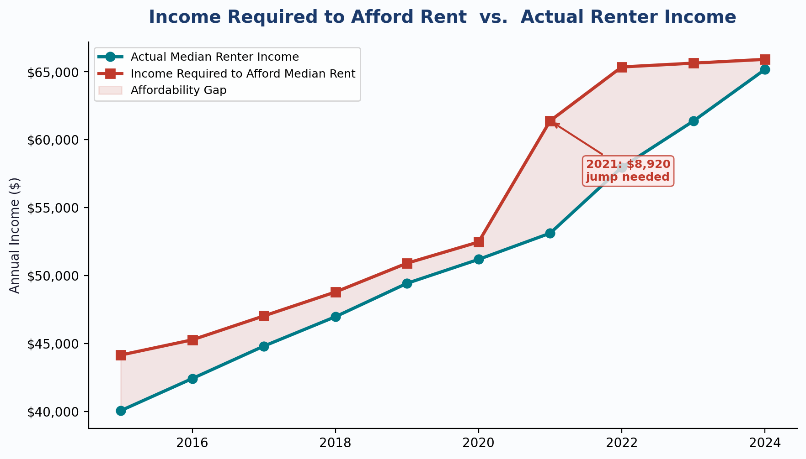
THE AFFORDABILITY SQUEEZE | Renter Income vs. What Rent Actually Costs
Reading This Chart
Teal line = what renters actually earn.
Red line = income needed to afford rent.
Shaded area = the gap.
The 2021 Shock:
Rents jumped $223/month in one year.
Income needed to jump $8,920.
By 2024:
The lines nearly converge — the gap is
closing, but only because incomes are
finally catching up after 3 years.
KEY INSIGHT: The median renter in Wake County spent 3 years underwater after the 2021 rent shock. The gap peaked at $8,272/year — money that came from food, healthcare, and savings.

Slide 7
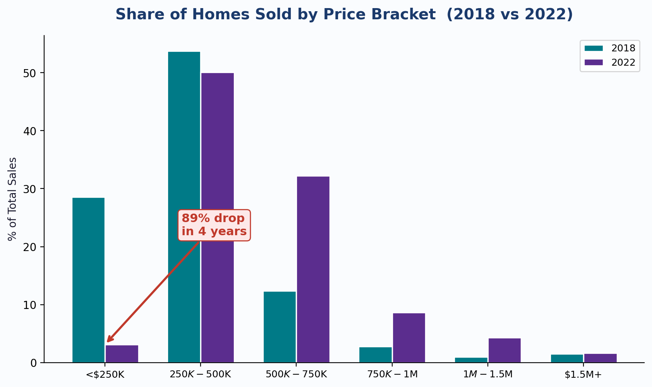
ENTRY-LEVEL COLLAPSE | First-Time Buyers Priced Out
The Shift in 4 Years
Under $250K homes:
2018: 28.6% of all sales
2022: 3.1% of all sales
$500K+ homes:
2018: 17.7% of all sales
2022: 46.8% of all sales
The market flipped: nearly half of all
homes sold are now $500K+, a price
most first-time buyers cannot reach.
KEY INSIGHT: In 2018, nearly 1 in 3 homes sold was affordable for a first-time buyer. By 2022, it was 1 in 32. The path from renting to owning has effectively closed for most Wake County residents.

Slide 8
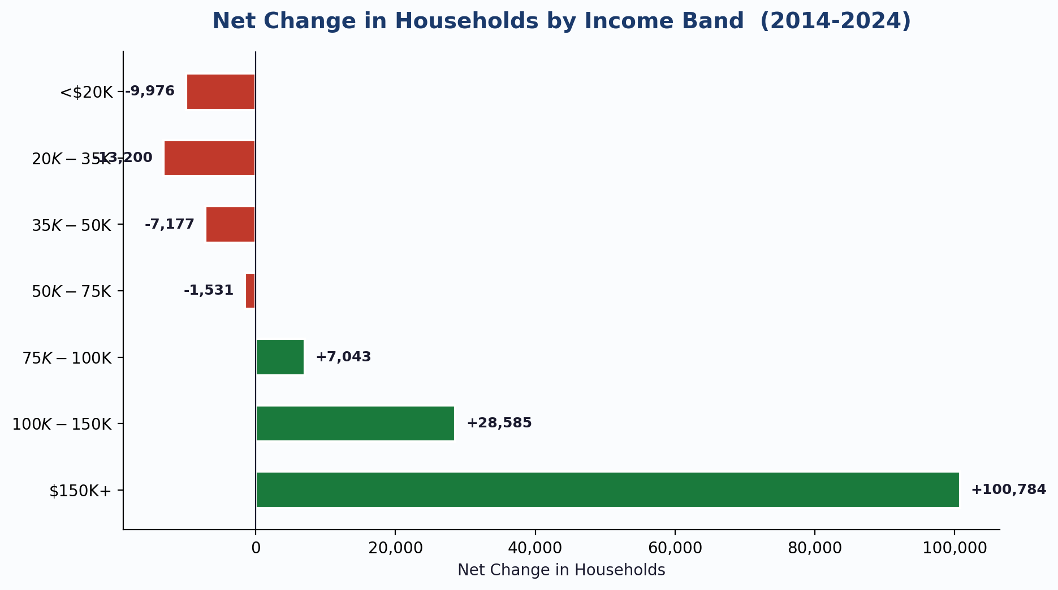
DISPLACEMENT | Who Left Wake County? (2014-2024)
The Wealth Polarisation
Bottom 3 bands lost:
-30,353 households
Top 2 bands gained:
+129,369 households
4:1 ratio — for every low-income
household that left, four high-income
households moved in.
KEY INSIGHT: 23,176 households earning under $35K disappeared from Wake County in a decade. They didn't get richer — they were priced out. Meanwhile, $150K+ households grew by 100,784.

Slide 9
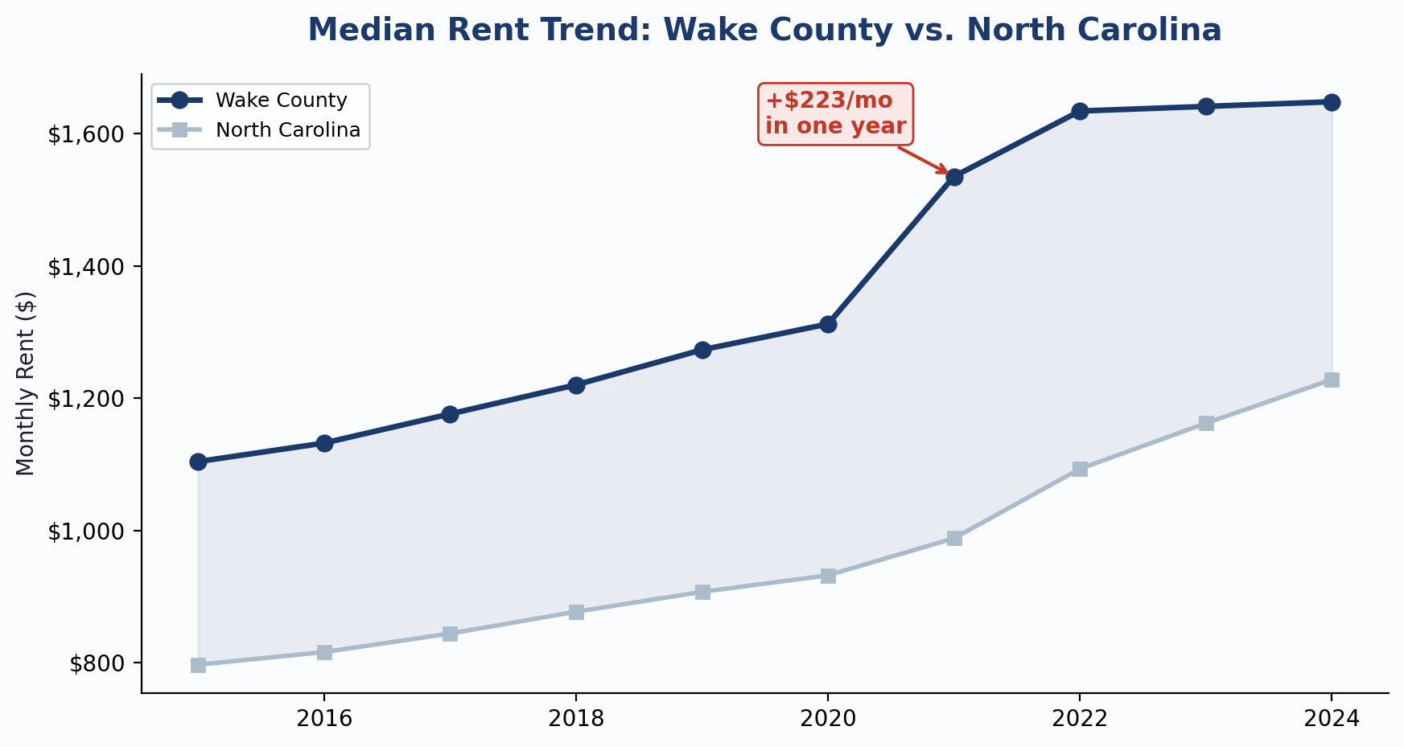
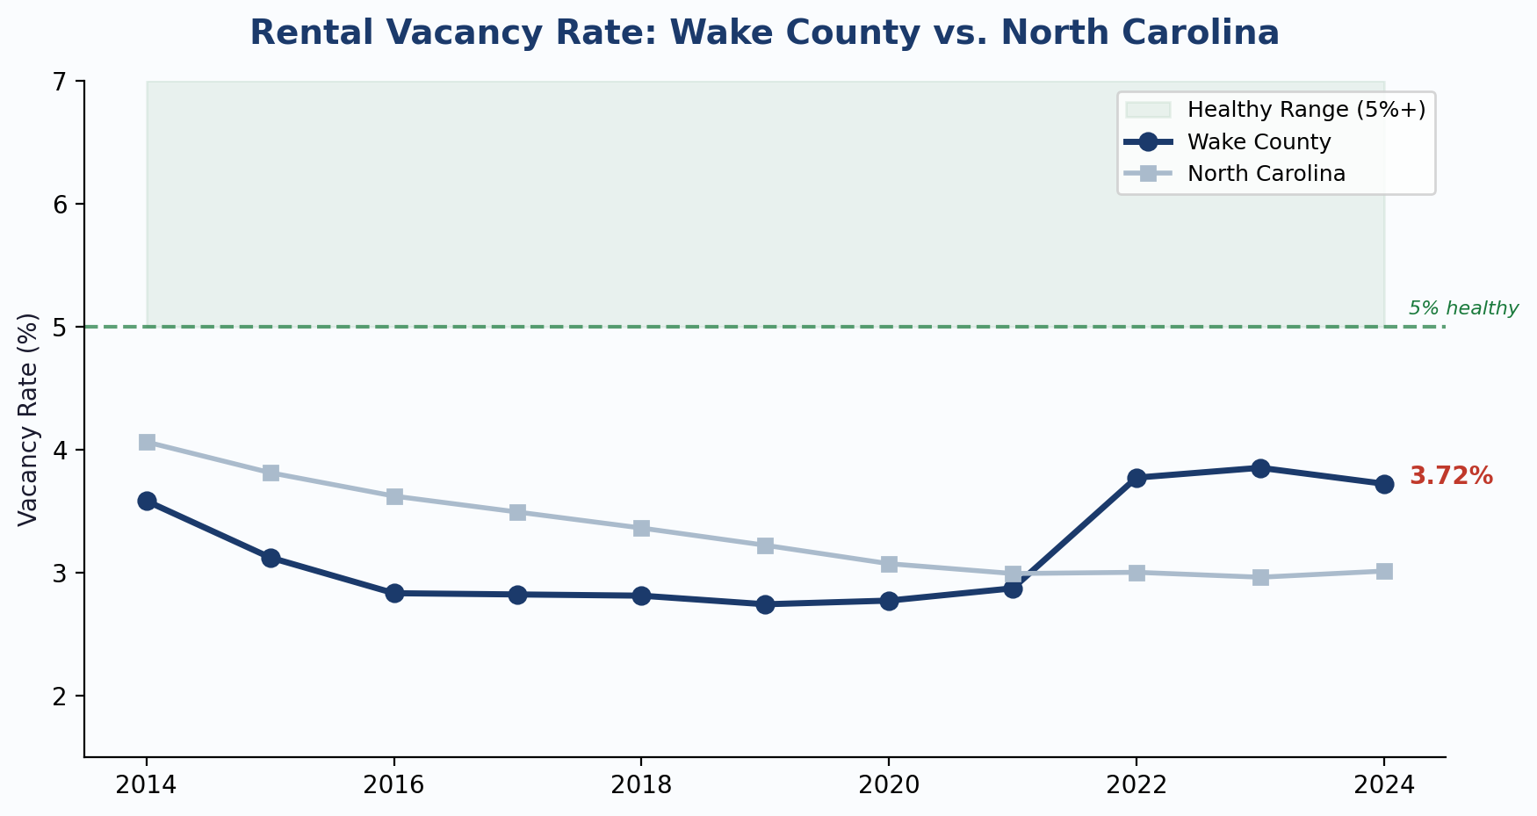
SUPPLY PRESSURE | Rent Trend & Vacancy Rate
How These Two Charts Connect:
Low vacancy (left chart: 2.74% in 2019) gave landlords pricing power → rents spiked +$223/month in 2021 (right chart). As new multifamily units came online (2022+), vacancy rose to 3.77% and rent growth stalled. But 3.72% is still well below the 5% healthy benchmark — tenants have no real bargaining power.

Slide 10
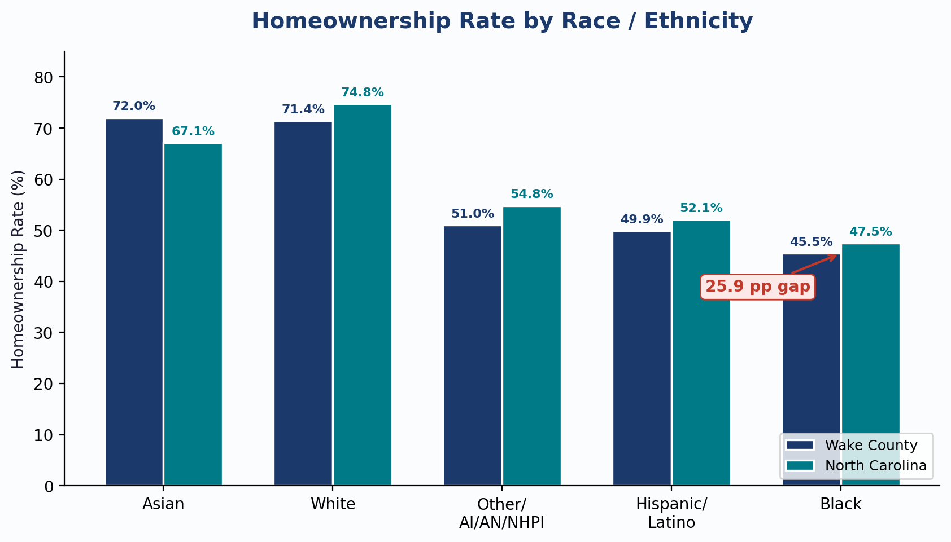
EQUITY LENS | Homeownership Rate by Race / Ethnicity
The Equity Gap
White homeownership: 71.4%
Black homeownership: 45.5%
25.9 percentage point gap.
With 88,430 Black households in
Wake County, that gap represents
roughly 22,900 families locked out
of homeownership relative to the
White rate.
KEY INSIGHT: Wake County's homeownership gap mirrors national disparities. Black and Hispanic/Latino households own at rates 20-26 points below White households — a gap that compounds generational wealth inequality.

Slide 11
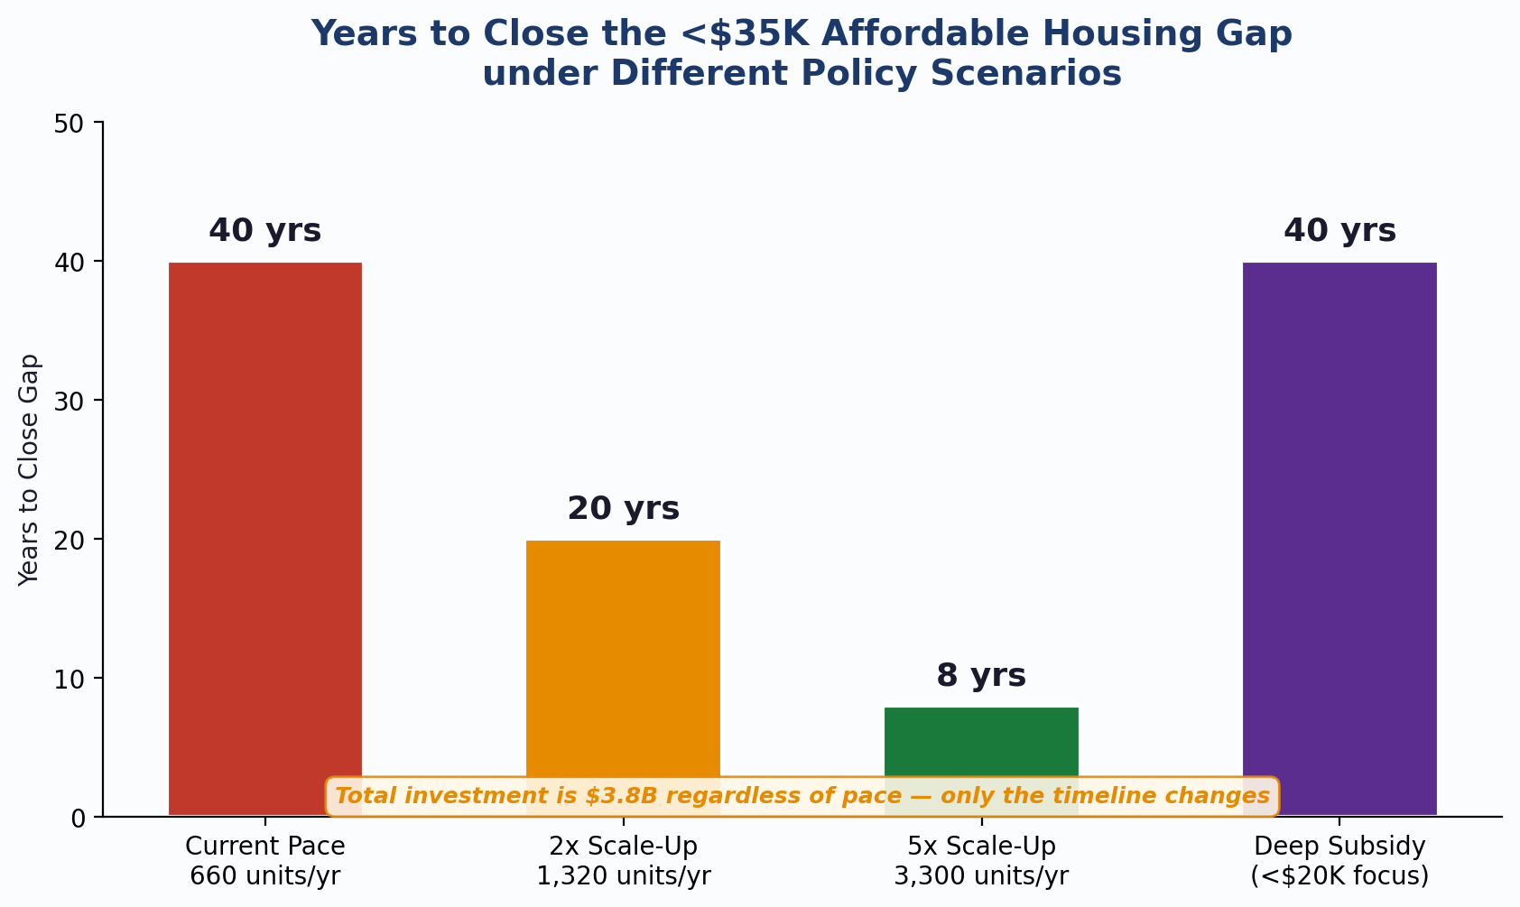
SCENARIO PLANNER | What Would It Take to Close the Gap?
4 Policy Scenarios
Current Pace (660/yr):
40 years. Closes in 2065.
2x Scale-Up (1,320/yr):
20 years. Closes in 2045.
5x Scale-Up (3,300/yr):
8 years. Closes in 2033.
Deep Subsidy (<$20K focus):
40 years. Prioritizes deepest need.
Total cost: $3.8B in ALL scenarios.
Only the annual budget changes.
KEY INSIGHT: The total investment is fixed at $3.8B. The only question is how fast to spend it. Doubling production halves the timeline — but the county will spend the same total amount regardless.

Slide 12
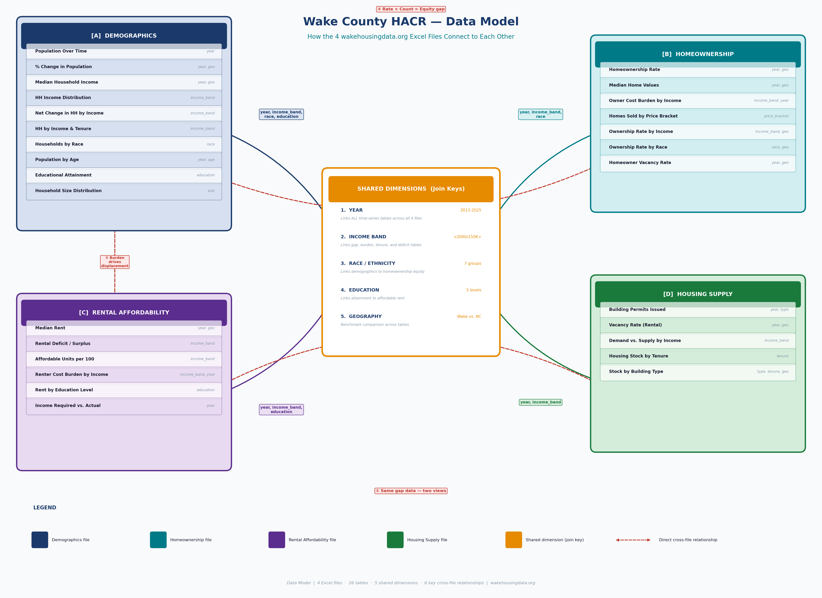
DATA MODEL | How the 4 Source Files Connect

Slide 13
SUMMARY & NEXT STEPS
What the Data Tells Us
1. 26,037 affordable units missing for <$35K renters
2. 39 years to close at current pace (660 units/yr)
3. $3.8B total investment needed regardless of timeline
4. Entry-level homes collapsed 89% (2018-2022)
5. Crisis has spread to $35K-$75K income bands
6. 30,353 low-income HHs displaced in a decade
7. Vacancy at 3.72% gives renters zero leverage
8. 25.9 pp racial homeownership gap persists
What I Would Build Next
1. Census tract-level mapping (geographic equity)
2. Race/ethnicity overlay on all gap analyses
3. Live HMIS integration (homelessness correlation)
4. "What-if" tool for new development proposals
5. Automated CAPER table generation from live data
6. Landlord incentive ROI calculator for HACR
Built with:
Python 3.9 | Streamlit | Plotly | pandas
All data from wakehousingdata.org (real, public)

