Slide 1

CALCULATOR
Name: Yamini
Topic: calculator

Slide 2
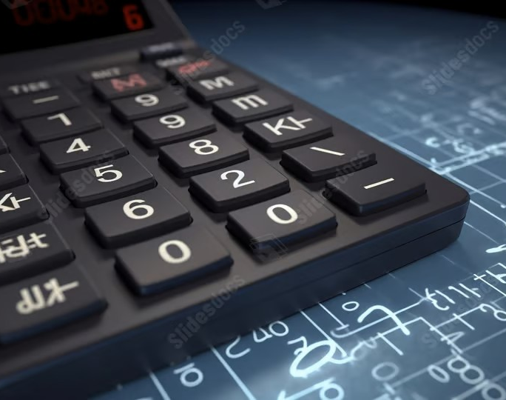
Introduction
A Simple Calculator is a basic software tool designed to perform essential arithmetic operations such as:
Addition (+)
Subtraction (−)
Multiplication (×)
Division (÷)
It features a clean and user-friendly interface, allowing users to input numbers, select operations, and receive instant results

Slide 3
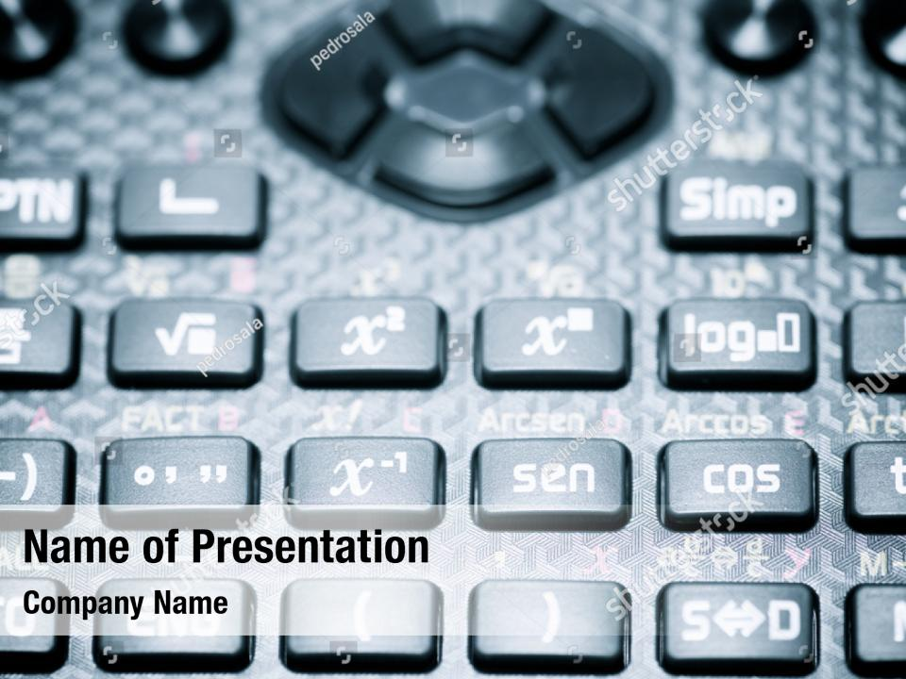
OBJECTIVES OF THE PROJECT
Develop a calculator for basic arithmetic operations
Design a simple and user-friendly interface
Provide real-time calculation results
Ensure accuracy and proper error handling
Support basic math learning and practice

Slide 4

What is a Calculator?
A calculator is an electronic or software-based device used to perform mathematical calculations. It can handle basic arithmetic and, in advanced models, complex mathematical functions.
Used for solving numerical problems quickly and accurately
Available as physical devices or digital applications
Comes in various types: basic, scientific, financial, and graphing
Essential tool for students, professionals, and everyday use

Slide 5
Key Features
Basic Arithmetic Operations Performs addition, subtraction, multiplication, and division accurately and instantly.
✅ User-Friendly Interface Clear buttons, number pad, and display area for easy interaction.
✅ Real-Time Calculations Displays results immediately after input, improving efficiency and usability.
✅ Error Handling Handles common errors like division by zero with appropriate messages.
✅ Lightweight Design Minimal system resources required, making it fast and responsive.

Slide 6
Types of Calculators
Basic Calculator
Scientific Calculator
Financial Calculator
Graphing Calculator
Software Calculator
Programmable Calculator

Slide 7
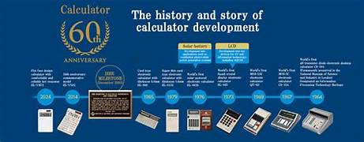
Brief history and evolution
Abacus (c. 2400 BC)
The earliest known tool for calculation.
Used in ancient Mesopotamia, China, and other civilizations.
Mechanical Calculators (1600s–1800s)
Blaise Pascal (1642):Invented the Pascaline, a gear-based calculator for addition and subtraction.
Gottfried Wilhelm Leibniz: Created a stepped drum mechanism for multiplication or division.
Electromechanical Calculators (1930s–1960s)
Combined electric motors with mechanical parts.
Faster and more reliable than purely mechanical devices.

Slide 8
Electronic Calculators (1960s–1970s)
First models used vacuum tubes and then transistors.
Rapid miniaturization with the invention of integrated circuits (ICs).
Pocket Calculators (1970s–1980s)
Became affordable and portable.
LCD screens replaced LED displays for longer battery life.
Modern Calculators (1990s–Present)
Scientific and graphing calculators for advanced math and engineering.
Built into smartphones and computers as apps.

Slide 9
Calculator vs. Phone Calculator
Calculator
Phone Calculator
Dedicated to mathematical calculations
Allowed in exams and schools
Distraction-free and reliable
Physical buttons for faster input
Long battery life
Part of a multi-purpose device
Always available on smartphones
Can switch to scientific mode
Copy/paste functionality
Not allowed in most exams

Slide 10
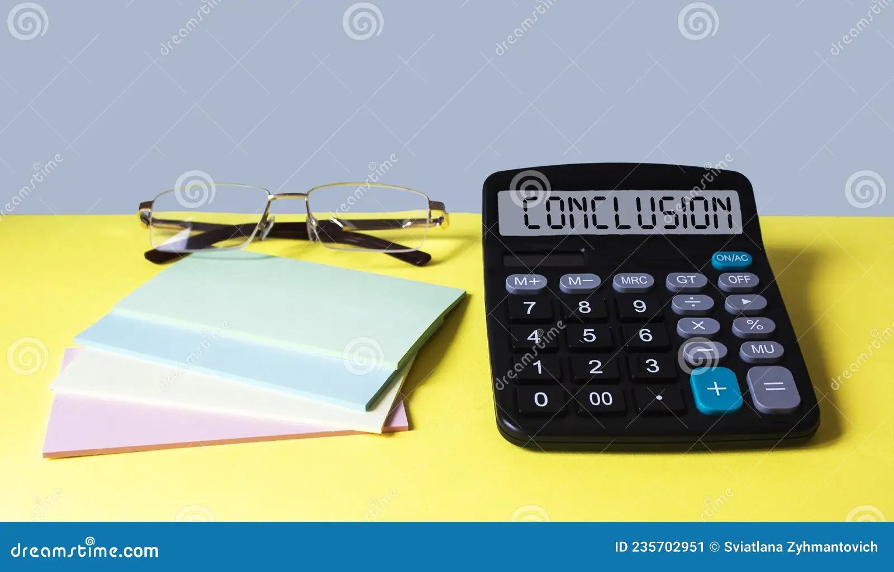
Conclusion
The Simple Calculator is a fundamental yet essential tool for performing basic arithmetic operations quickly and accurately.
It features a user-friendly design, making it accessible to users of all ages and backgrounds.
The project helps reinforce problem-solving and programming skills while delivering a practical and useful application.
Its simplicity, accuracy, and ease of use make it ideal for everyday tasks, educational purposes, and quick calculations on various platforms.

Slide 11


