Slide 1

User Analytics in the Telecommunication Industry
Title - User Analytics and Investment Potential in the Telecommunication Industry: A Case Study of TellCo
Name:-Yamini Nagpure

Slide 2
Objective -
1.To analyze user analytics in the telecommunication industry, specifically for TellCo, a mobile service provider in the Republic of Pefkakia.
2.To evaluate the profitability and growth opportunities for TellCo by examining system-generated data on customer behavior and activities.
3.To provide strategic recommendations for the investor on whether TellCo is worth purchasing by identifying key business areas that could drive profitability.
4.To present insights and findings from the data analysis to support the investment decision, highlighting which products or services could be optimized.

Slide 3
Project Description:
This project involves conducting a detailed analysis of user data in the telecommunication industry to support an investment decision. The objective is to evaluate TellCo, an existing mobile service provider in the Republic of Pefkakia, by analyzing customer behavior data and identifying profitable areas for growth. The investor, known for purchasing undervalued assets, seeks insights into TellCo's potential for profitability and strategic expansion.

Slide 4
Project Goal:
To provide actionable insights and a recommendation on whether to buy or sell TellCo based on a data-driven analysis of its user analytics. This will include identifying key customer segments, evaluating usage patterns, and pinpointing growth opportunities that could increase TellCo's market value and profitability.

Slide 5
Problem Statement:
The challenge is to determine whether TellCo is a viable investment by conducting an in-depth analysis of its user analytics data and to make an informed recommendation on whether TellCo should be bought or sold.

Slide 6
Data Overview
Customer Demographics
Service Usage
Network Interactions
Revenue Metrics
SOURCE: telcom_data.xlsx

Slide 7
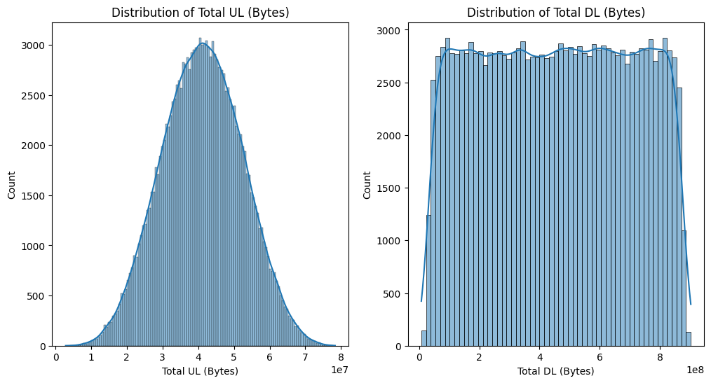
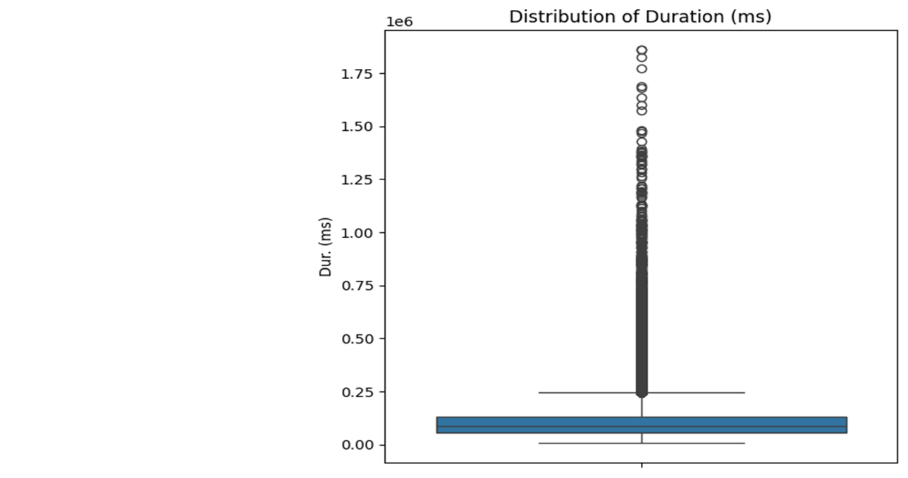
Insights into typical user behaviors and potential areas for optimizing data plans or targeting high-consumption users for premium services.
Insights:Upload Behavior: Users tend to have a central range for upload data usage, with most sessions clustering around a typical size.
Download Behavior: Download data usage is widely distributed, likely due to diverse usage across streaming, browsing, and other data-intensive activities.Session
Duration: The presence of outliers in session duration highlights potential anomalies or high-usage behaviors, indicating certain users may engage in prolonged sessions.

Slide 8
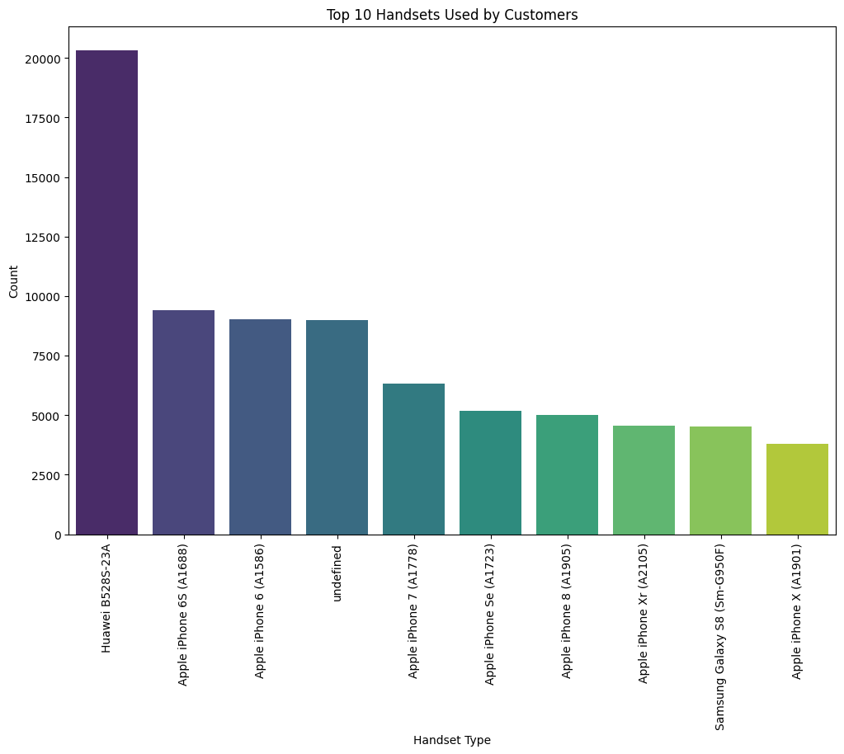
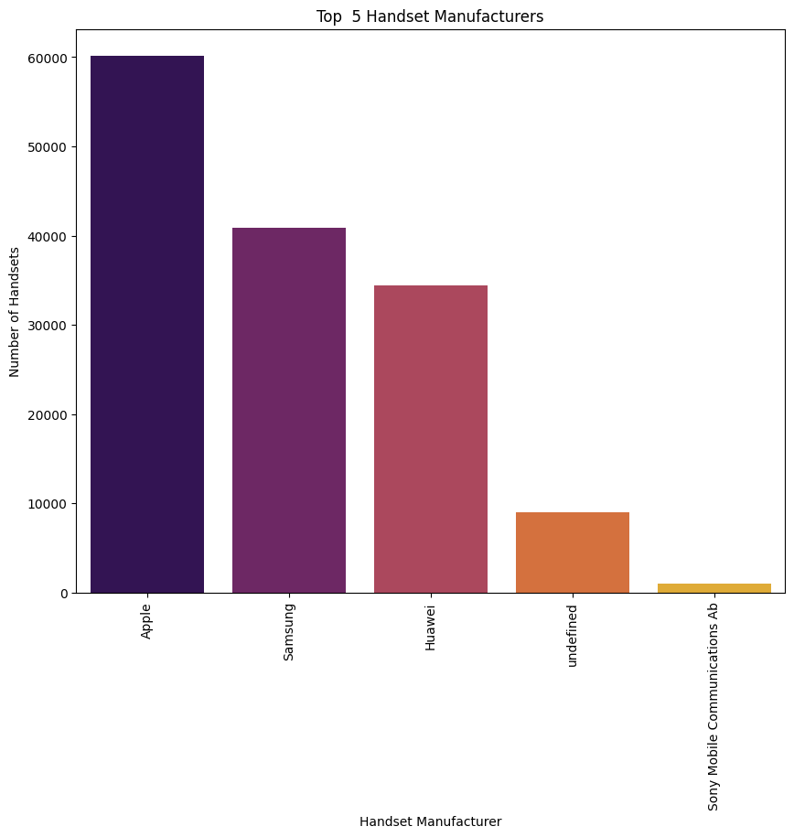
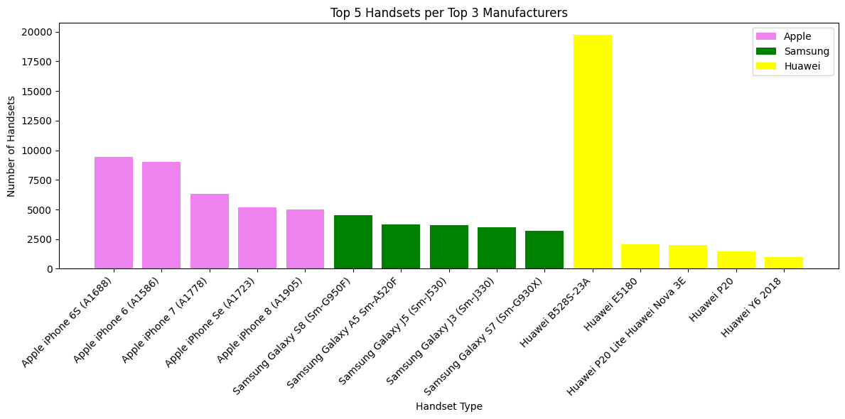
User Overview Analysis
Top 10 Handsets:Huawei B525S-23A: This model is the most popular handset by a large margin, with significantly higher usage than any other handset. This suggests that Huawei has a strong market presence with this specific model.
Top 5 Handset ManufacturersApple has the highest number of handsets by a substantial margin, indicating a strong preference for its brand in the market.Samsung and Huawei follow Apple, with Samsung in second place and Huawei in third. This suggests that while Apple leads, these brands also hold considerable market shares.
This chart shows Apple’s strong, consistent market presence, Samsung’s diverse range with moderate popularity, and Huawei’s standout model amid lower engagement with other devices. The trends may reflect differing strategies in model updates, pricing, and regional popularity.

Slide 9
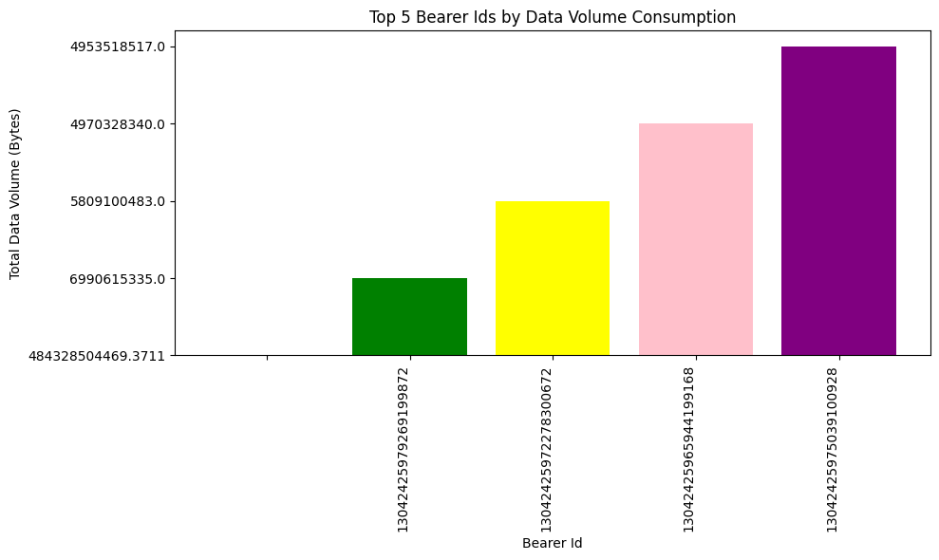
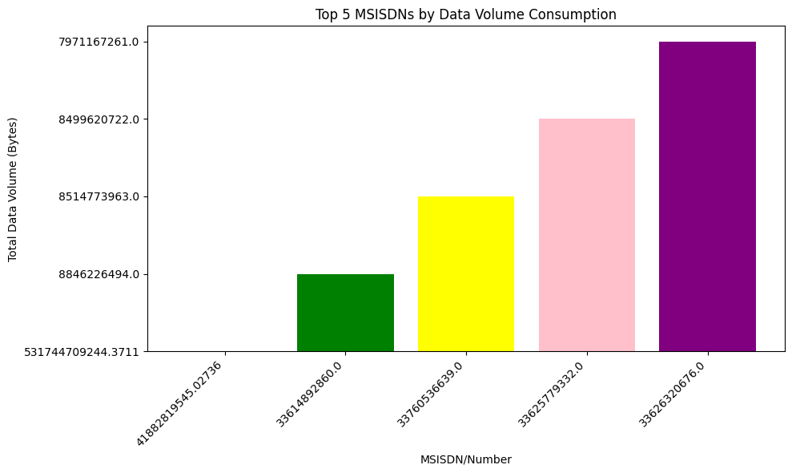
High Data Consumers: Both charts indicate a concentration of high data usage among specific bearer IDs and MSISDNs. These outliers might represent users with high data needs, special service plans, or usage patterns that require large amounts of data.
Potential for Targeted Services: The data could be used to target high data consumers with tailored data plans or promotional offers, as they seem to have a higher demand for data.
Network Optimization: The information could help network providers optimize services for high-data-demand bearer IDs or MSISDNs, ensuring a better experience for heavy users.

Slide 10
Summary Insights High Data Consumption for Streaming and Gaming: Both YouTube and Netflix exhibit significant data demands for downloads and uploads, aligning with video streaming’s known data requirements. Gaming also shows high data use, especially for downloads. Moderate Data Usage for Google and Social Media: Data use for Google and Social Media services is moderate compared to streaming, likely due to varied content types (e.g., images, browsing, moderate video content). Low Data Requirements for Email: Email exhibits the lowest data requirements, with minimal download and upload volumes, consistent with text-based usage. Overall, the data suggests that gaming and streaming services (YouTube, Netflix) are the most data-intensive activities, while email is the least. This could inform network optimization efforts, especially for improving bandwidth allocation to high-demand services like streaming and gaming.
Variable Minimum Maximum Average 1st Quartile 2nd Quartile (Median) 3rd Quartile
0 Dur. (ms) 7142.0 1859336.0 1.046086e+05 57442.0 86399.0 132430.0
1 Total DL (Bytes) 7114041.0 902969616.0 4.546434e+08 243107173.0 455840911.0 665705138.0
2 Total UL (Bytes) 2866892.0 78331311.0 4.112121e+07 33222029.0 41143242.0 49034238.0
3 Social Media DL (Bytes) 12.0 3586064.0 1.795322e+06 899148.0 1794369.0 2694938.0
4 Social Media UL (Bytes) 0.0 65870.0 3.292843e+04 16448.0 32920.0 49334.0
5 Youtube DL (Bytes) 53.0 23259098.0 1.163407e+07 5833501.0 11616019.0 17448518.0
6 Youtube UL (Bytes) 105.0 22011962.0 1.100941e+07 5517965.0 11013447.0 16515562.0
7 Netflix DL (Bytes) 42.0 23259189.0 1.162685e+07 5777156.0 11642217.0 17470478.0
8 Netflix UL (Bytes) 35.0 22011955.0 1.100175e+07 5475981.0 10996384.0 16507268.0
9 Google DL (Bytes) 207.0 11462832.0 5.750753e+06 2882393.0 5765829.0 8623552.0
10 Google UL (Bytes) 3.0 4121357.0 2.056542e+06 1024279.0 2054573.0 3088454.0
11 Email DL (Bytes) 14.0 3586146.0 1.791729e+06 892793.0 1793505.0 2689327.0
12 Email UL (Bytes) 2.0 936418.0 4.673734e+05 233383.0 466250.0 700440.0
13 Gaming DL (Bytes) 2516.0 843441889.0 4.220447e+08 210473253.0 423408104.0 633174167.0
14 Gaming UL (Bytes) 59.0 16558794.0 8.288398e+06 4128476.0 8291208.0 12431624.0

Slide 11
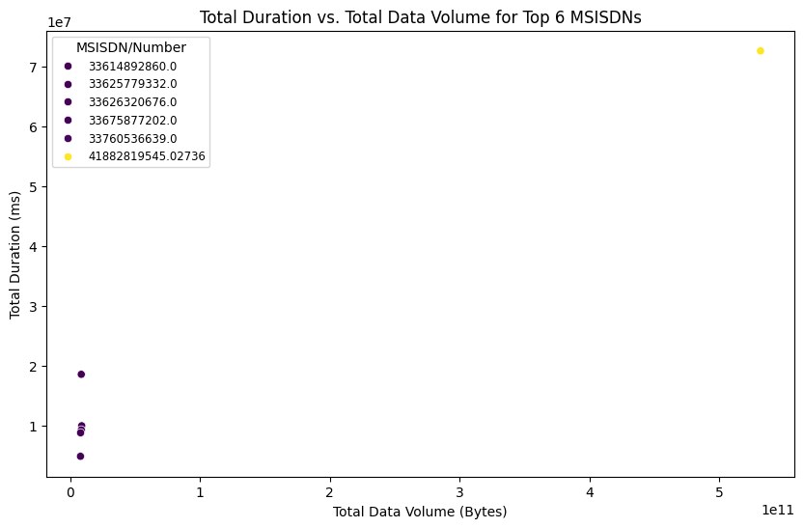
total duration spent and total data volume consumption for top 6 MSISDN/Number
total duration spent and total data volume consumption for top 6 MSISDN/Number
The scatter plot helps to understand a positive correlation between session duration and data volume, indicating that users with longer sessions generally use more data. It also helps yo identify outliers, where users have short sessions but very high data volume.

Slide 12
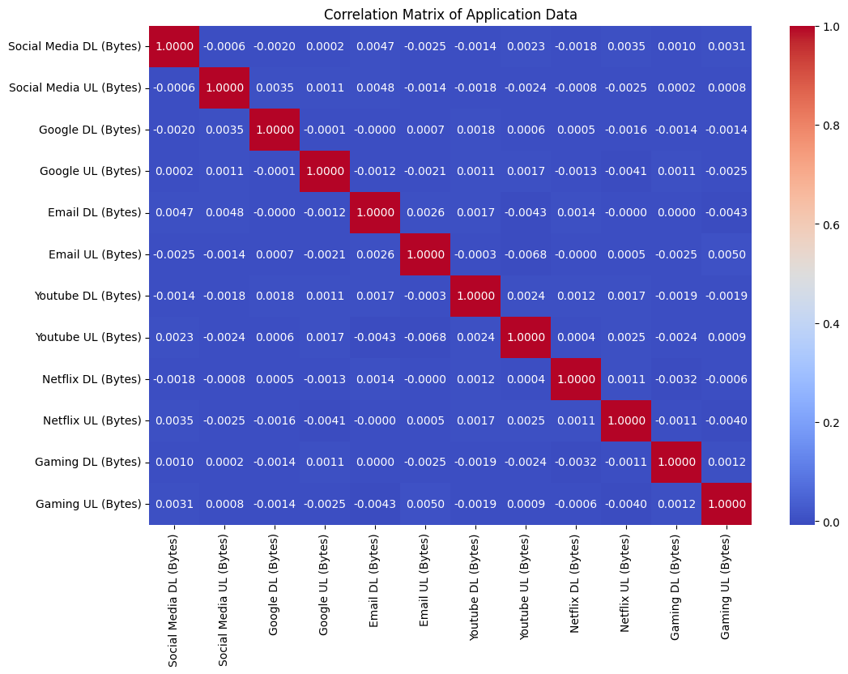
Insight- Social Media data and YouTube data have a strong positive correlation, it suggests users who heavily use social media also tend to consume more YouTube content.
Correlation Matrix of Application Data

Slide 13
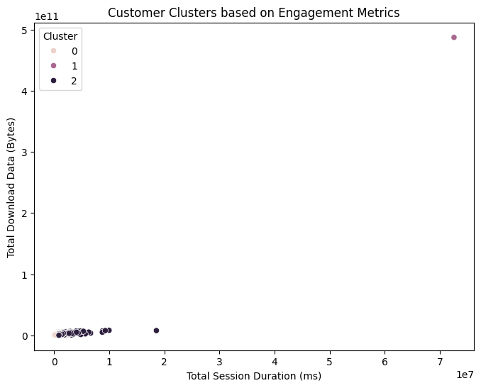
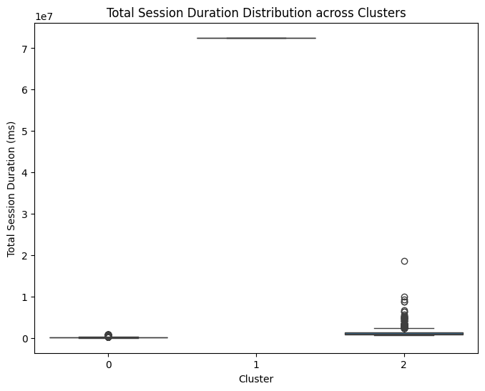
Cluster 0 might represent high-engagement users with long sessions and high data volume, while Cluster 1 might represent medium-engagement users, and Cluster 2 might represent low-engagement users.
Cluster 0 represent high-engagement users, characterized by significantly longer total session durations and higher total data download volumes compared to other clusters
Cluster 1 represents moderate engagement, showing intermediate values for session duration and data volume
Cluster 2 shows the lowest engagement levels with the shortest session durations and smallest total data volumes

Slide 14
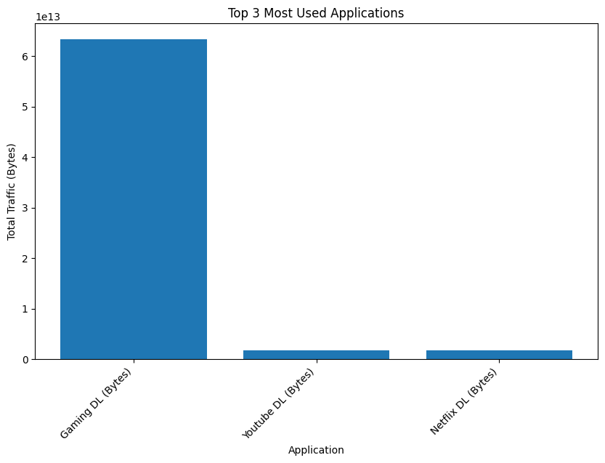
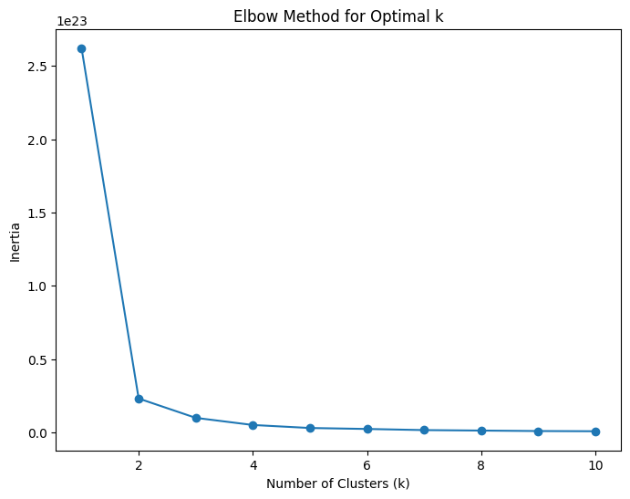
Gaming DL (bytes) is the most used application followed by YouTube DL (bytes) and Netflix DL ( bytes)
Insight- It represents a balance between maximizing variance explained within clusters and minimizing the number of clusters.

Slide 15
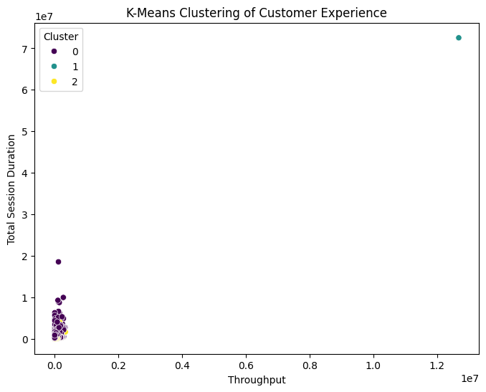
Cluster 0 could be customers who are using the service infrequently but for long periods of time. Cluster 1 could be customers who are using the service more frequently but for shorter periods of time. Cluster 2 could be customers who are using the service very frequently and for long periods of time.

Slide 16
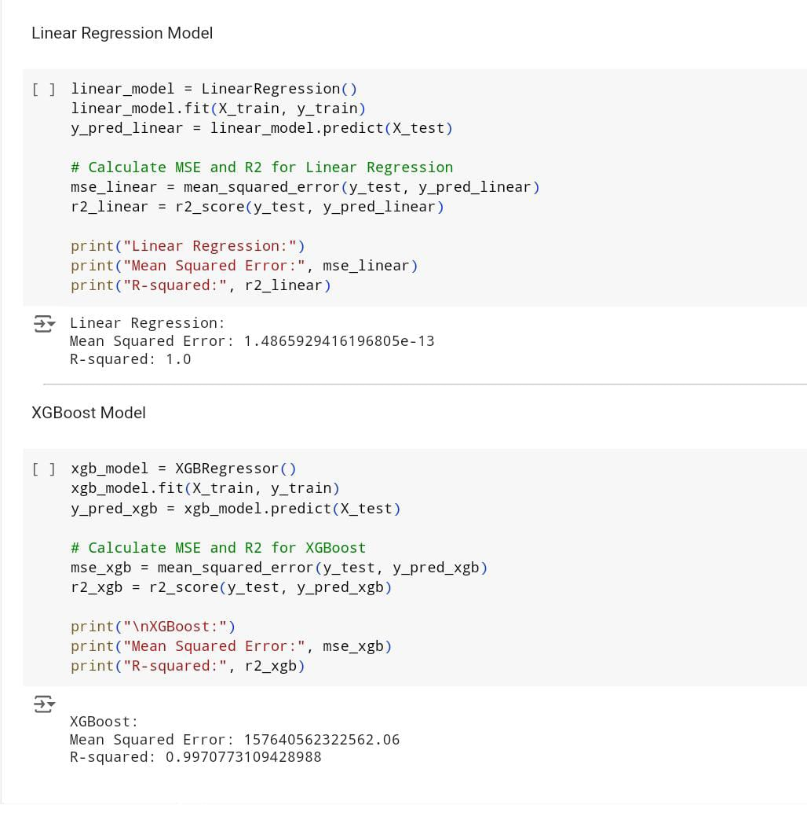
Both Linear Regression and XGBoost models perform well in this case. Linear Regression:Achieves a near-perfect R-squared value of 1.0, indicating that the model explains almost all of the variance in the target variable.Mean squared error is extremely low, implying minimal prediction error. XGBoost:Shows a high R-squared value of 0.997, indicating a strong fit.The mean squared error is higher compared to linear regression, but still relatively low.

Slide 17
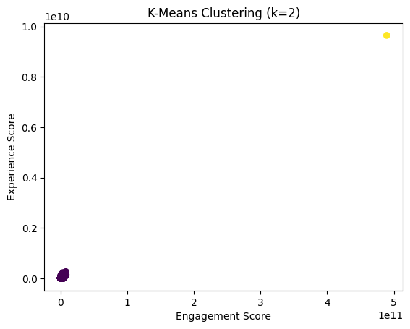
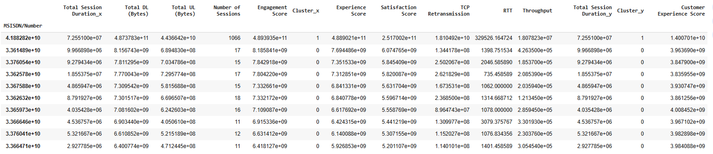
Clear separation between clusters suggests two distinct customer segmentsMost customers appear to be in the lower cluster (near origin)Smaller group of customers with both high engagement and experience scoresThe clustering appears to effectively separate high-value customers from others
Top 10 satisfied customer based on Customer Experience Score

Slide 18
Conclusion:
Customer engagement is highest with Game download application .
Most users are engaged in Game download. The Huawei B- 5285 is used by most of users.
Recommemdations :
Huawei and Apple customers need to focus for higher satisfaction and experience.
Social Media engagement user need to check for higher experience.

Slide 19
THANK YOU

