Slide 1

Evolution of Knowledge Areas in Publications
Capstone Project Phase A – 61998
26-1-R-16
Students:
Yamit Moreno
Shaked Tadessa
Supervisors:
Dr. Dvora Toledano-Kitai
Prof. Zeev Volkovich
1

Slide 2
Table of contents
01
04
02
05
03
Problem Definition and Challenges
Insights and Applications
Model Validation
Project Goal
06
Testing Plan
Workflow
2

Slide 3

01
Problem Definition & Challenges
3

Slide 4
Problem Definition
Citation networks model the evolution of scientific knowledge through citation links between research papers and grow continuously over time.
However, their large scale and dynamic nature make it difficult to track how research communities form, evolve, and change.
Static analysis methods fail to capture these temporal structural changes, creating the need for a framework that can identify meaningful community evolution while filtering out noise.
4

Slide 5
Key Challenges
Scale and Complexity: The network includes thousands of papers and links that continuously evolve over time.
Data Noise: Not every citation reflects a meaningful connection between papers, making analysis less straightforward.
Temporal Community Changes : Research communities may split, merge, or emerge, complicating consistent tracking.
Stability and Clarity: Results can be sensitive to randomness; temporal changes must be presented clearly and reliably.
5

Slide 6

02
Project Goal
6

Slide 7

Project Goal
Objective
Develop a model to analyze and visualize structural changes in
citation networks.
How This Solves the Problem?
Detecting research trends: Track growth, decline, splits, and merges of topics.
Noise Filtering: Highlight only meaningful citations.
Improves interpretability: Provides clear visualizations for understanding knowledge evolution.
7

Slide 8
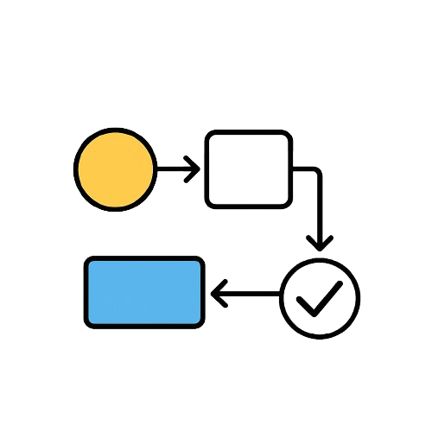
03
Workflow
8

Slide 9
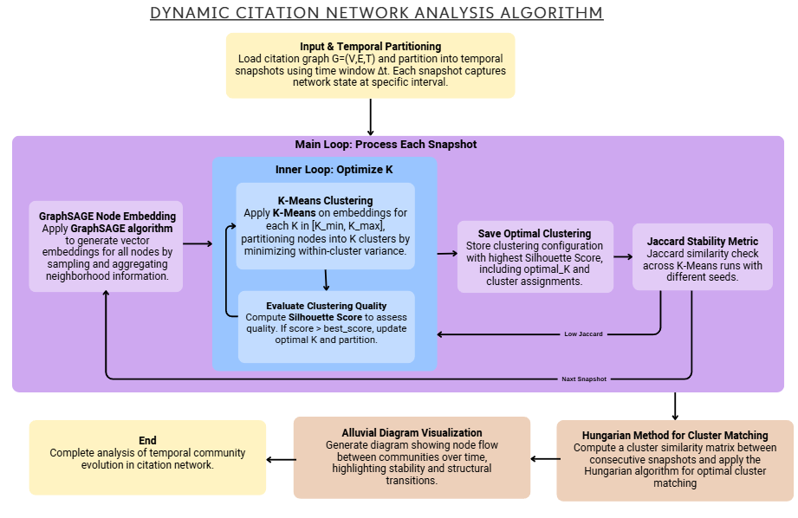
Workflow
9

Slide 10
Dynamic Citation Network Analysis High-Level Workflow
Input → Embedding → Clustering → Matching → Visualization → Outcome
Input & Temporal Partitioning: Load citation graph and split into temporal snapshots to capture evolving network states.
Node Embedding: Generate compact vector representations for papers using GraphSAGE.
Clustering & K Optimization: Partition nodes into clusters with K-Means, select optimal K via Silhouette Score and Jaccard stability checks.
Cluster Matching: Track cluster evolution across snapshots using similarity-based matching (Hungarian Method)
Visualization: Display community dynamics and structural changes over time with Alluvial Diagrams.
Outcome: Provides a complete temporal view of citation network evolution, highlighting stable and evolving communities.
10

Slide 11
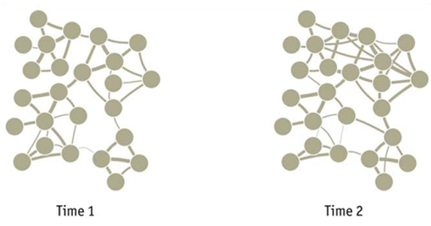
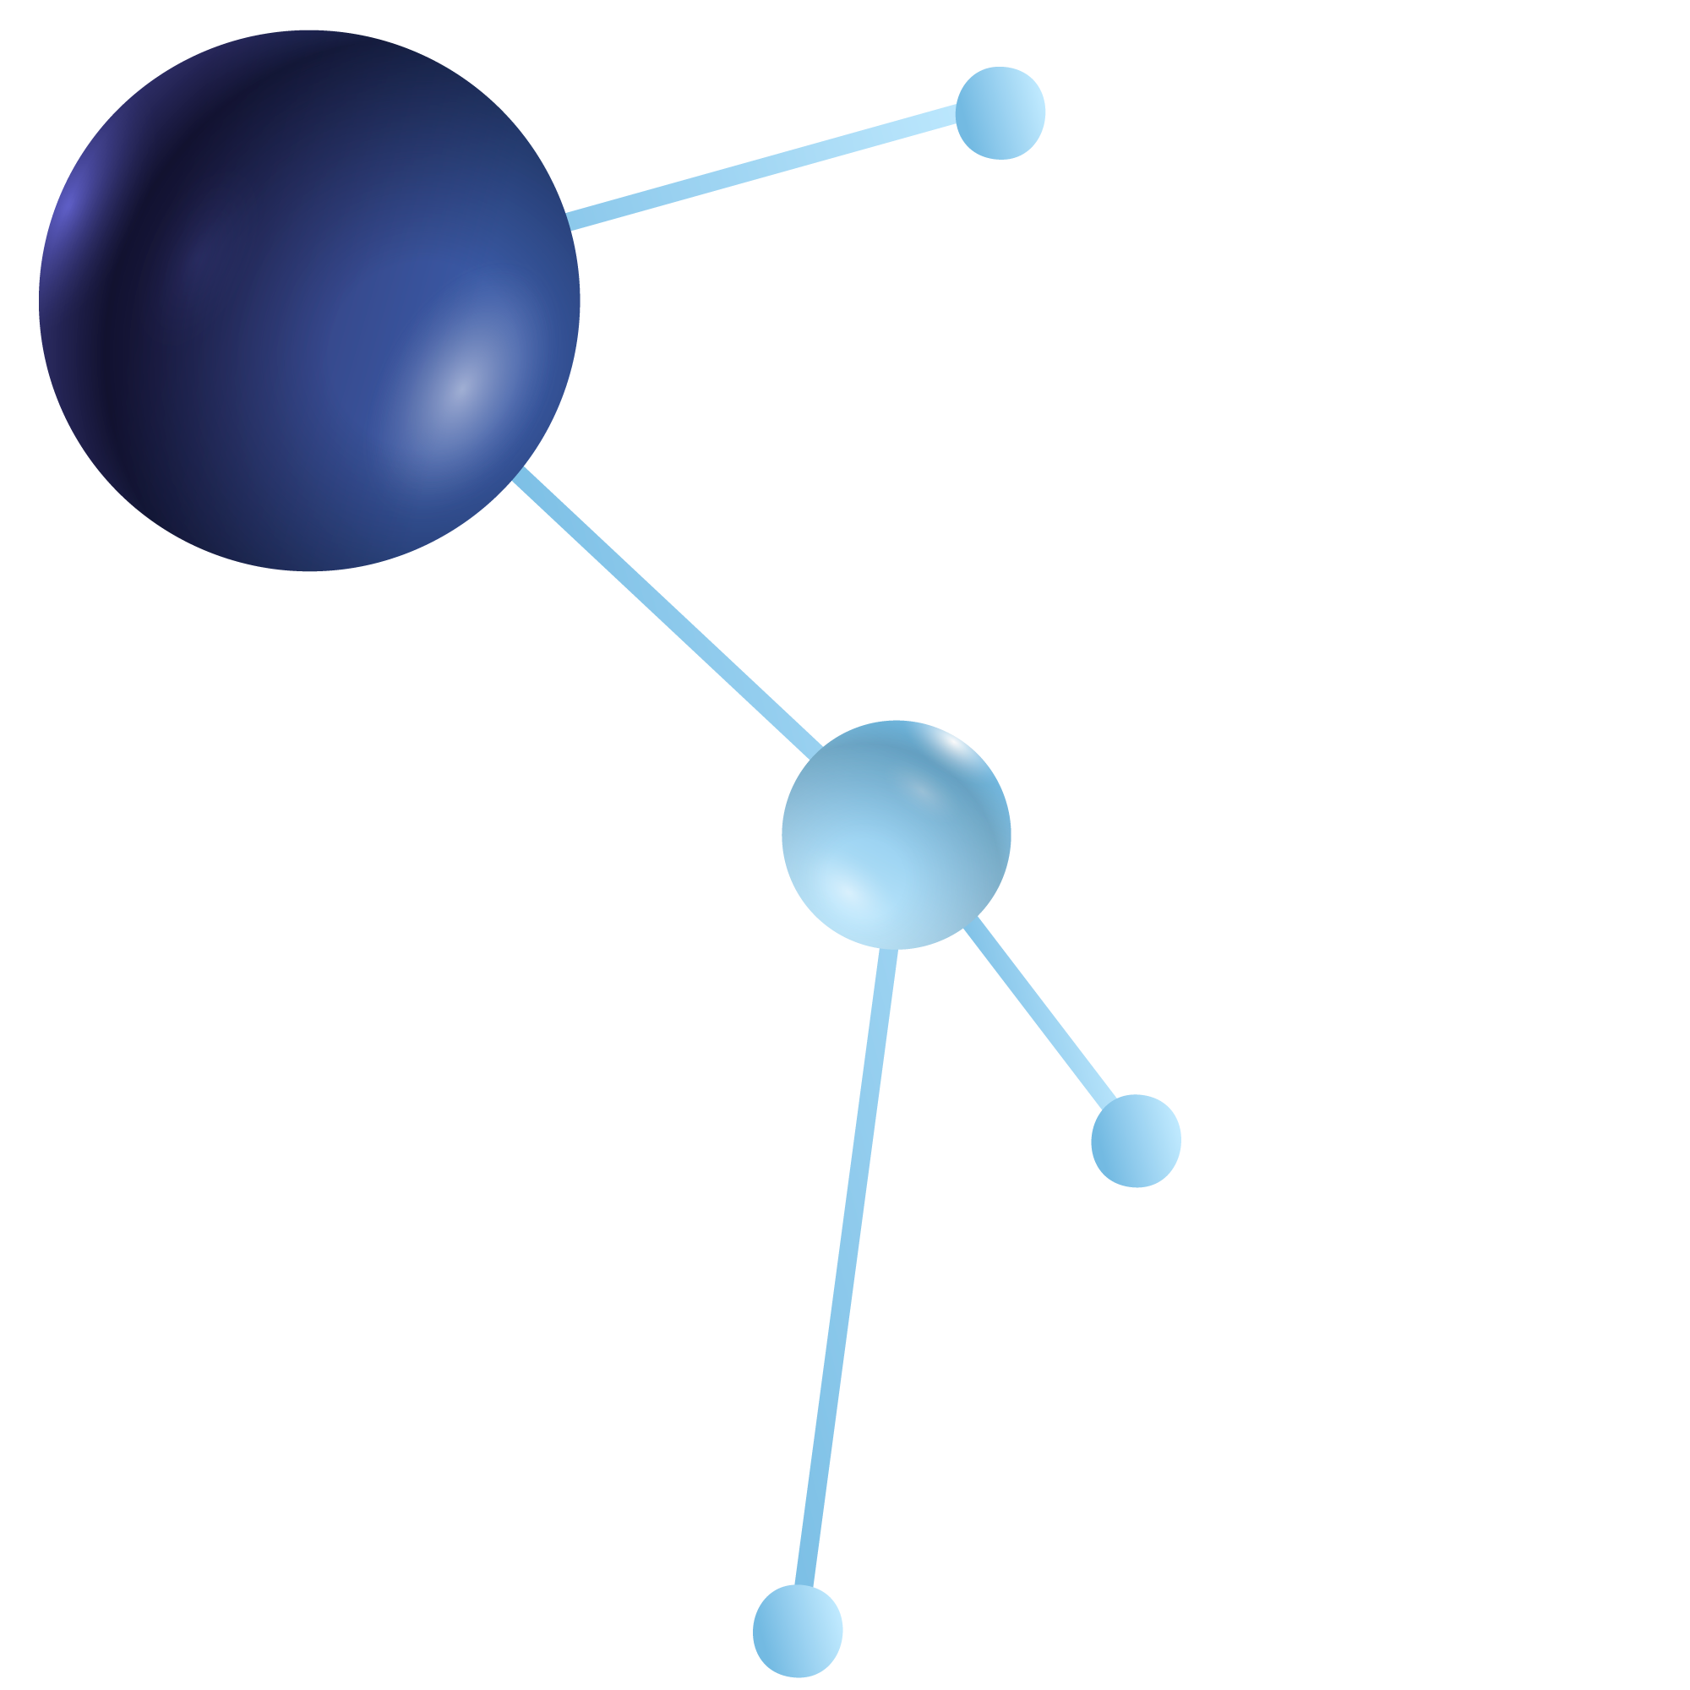
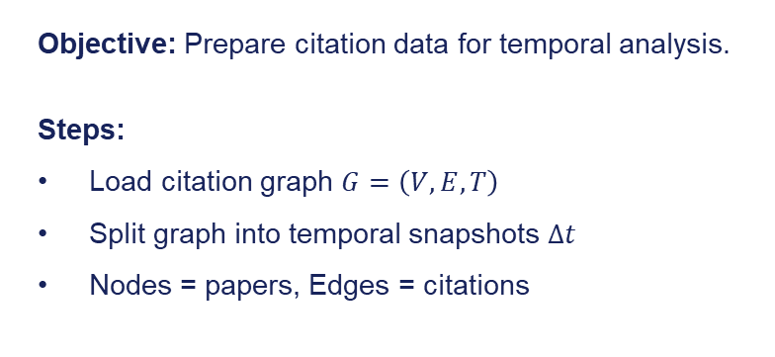
Workflow: Input → Embedding → Clustering → Matching → Visualization → Outcome
1. Input and Temporal Partitioning
Objective: Prepare citation data for temporal analysis.
Steps:
Load citation graph $G=\left(V,E,T\right)$
Split graph into temporal snapshots $Δt$
Nodes = papers, Edges = citations
Each snapshot represents the network in one time period
11

Slide 12
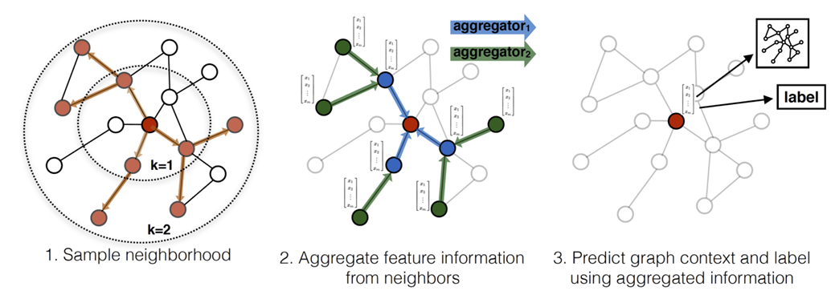
Workflow: Input → Embedding → Clustering → Matching → Visualization → Outcome
2. Node Embedding
Objective: Generate compact vector representations for papers using GraphSAGE.
Method:
GraphSAGE algorithm: samples neighbors, aggregates features, merge with
node, update embedding.
Outcome: Each node is represented as a compact vector for clustering and analysis.
12

Slide 13
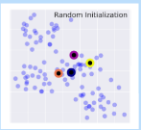
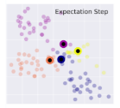
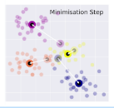
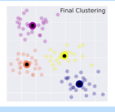
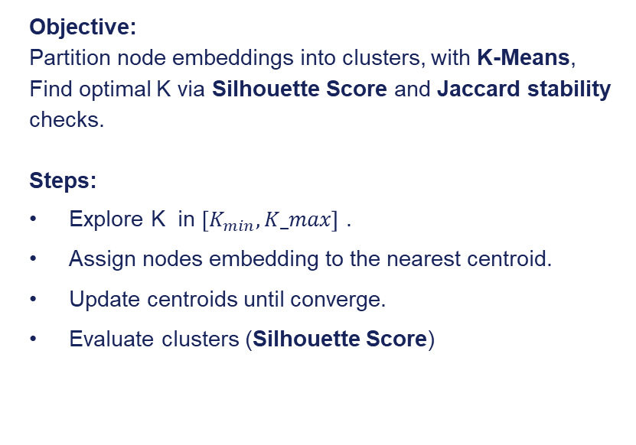
Workflow: Input → Embedding → Clustering → Matching → Visualization → Outcome
3. Clustering & K Optimization
Objective:
Partition node embeddings into clusters, with K-Means,
Find optimal K via Silhouette Score and Jaccard stability
checks.
Steps:
Explore K in $\left[K_{min},K_max\right]$ .
Assign nodes embedding to the nearest centroid.
Update centroids until converge.
Evaluate clusters (Silhouette Score)
13

Slide 14
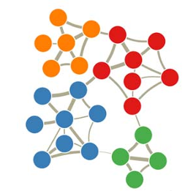
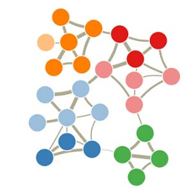
Workflow: Input → Embedding → Clustering → Matching → Visualization → Outcome
4. Cluster Matching
Objective: Track cluster evolution across snapshots using similarity-based matching (Hungarian Method).
Process:
Compare consecutive snapshots.
Detect splits, merges, new clusters.
Match clusters optimally using Hungarian Method.
Time-1
Splits cluster
Time-2
14

Slide 15
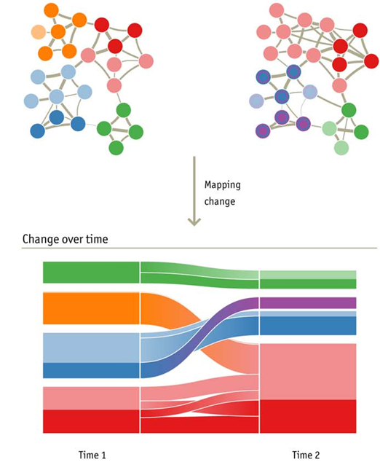
Workflow: Input → Embedding → Clustering → Matching → Visualization → Outcome
5. Visualization
Objective: Display community dynamics and structural changes over time with Alluvial Diagrams.
Diagram Features:
Blocks: Represent clusters
Streams: Show transitions (split, merge, stable).
Colors: distinguish clusters.
6. Outcome
Provides a complete temporal view of citation network evolution, highlighting stable and evolving communities.
15

Slide 16
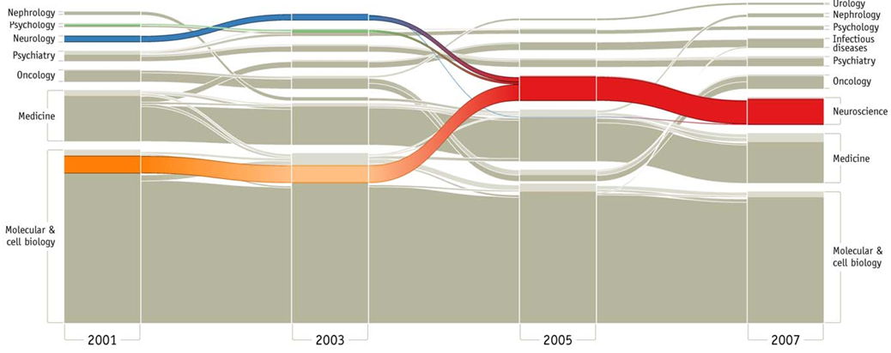
Alluvial Diagram Visualization
16

Slide 17
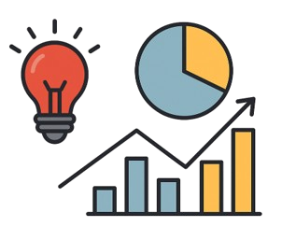
04
Insights and Applications
17

Slide 18
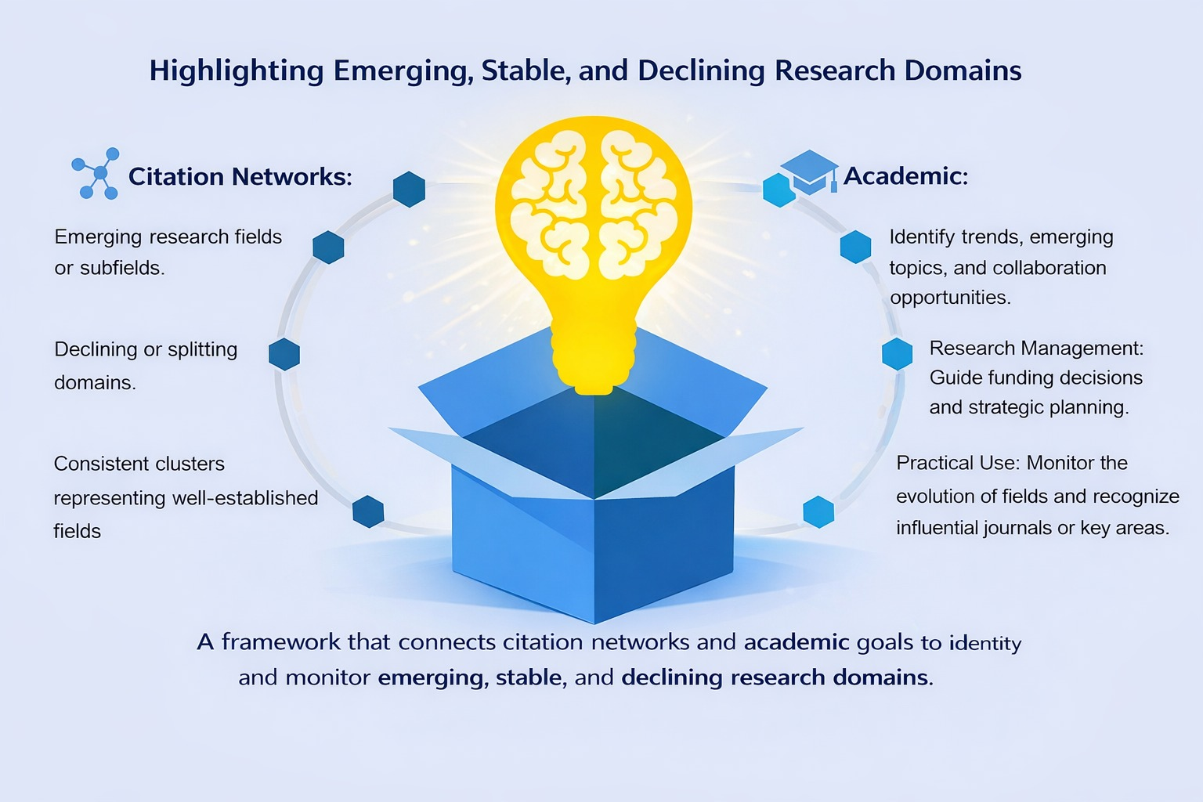
Insights and Applications
18

Slide 19

05
Model Validation
19

Slide 20
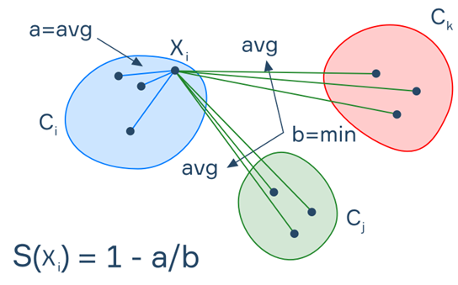
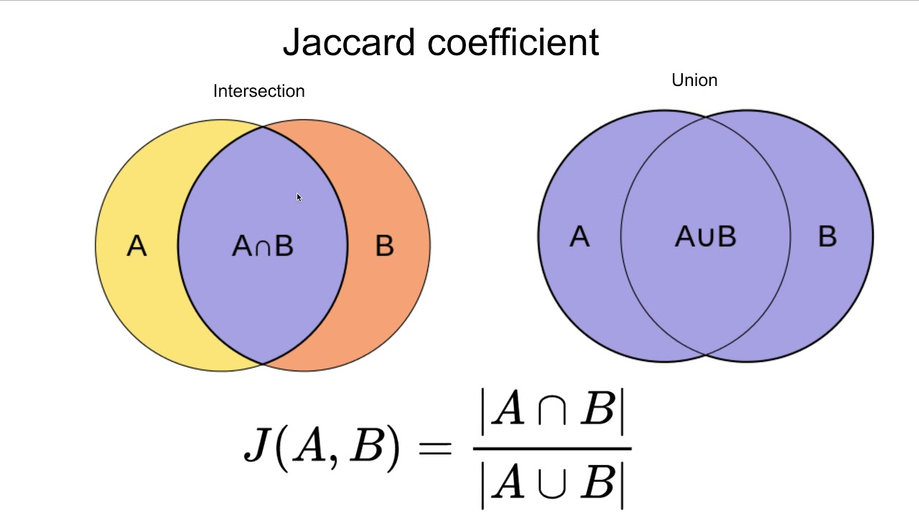
Validation Framework & Stability Criteria
Evaluation combines real-world citation networks and synthetic graphs with known temporal structures, enabling both realistic analysis and controlled validation.
1. Cluster Quality & K Selection Goal: Identify meaningful communities
Tool: Silhouette Score (per snapshot)
2. Temporal Stability Goal: Track persistence across consecutive snapshots Tool: Jaccard Similarity between matched clusters
20

Slide 21
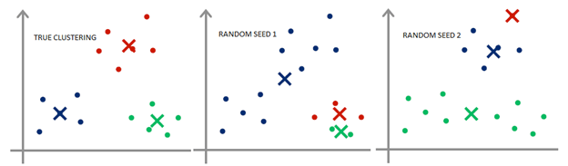
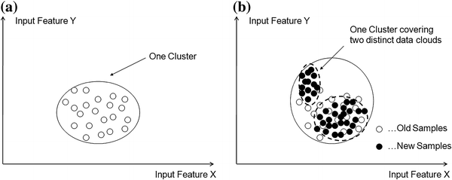
Validation Framework & Stability Criteria
3. Robustness to Initialization Goal: Ensure consistent and reproducible clustering Tool: Multiple K-Means runs with different random seeds
4. Structural Dynamics Goal: Capture meaningful structural changes over time Tool: Analysis of cluster splits, merges, and evolution
21

Slide 22

06
Testing Plan
22

Slide 23
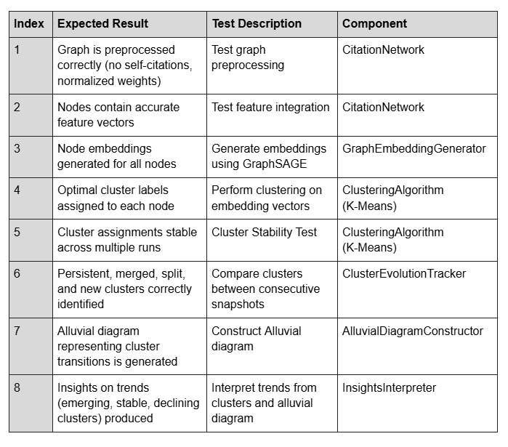
Testing Plan
23

Slide 24


Thanks!
Any Questions?
24

