Slide 1

Cutting Edge Salon Management & Booking System
TEAM MEMBERS
Goitse Kgwele 221050663
Facilitator / ASP.NET Dev
Thabang Zitha 223007074
Requirements Analyst / ASP.NET Dev
Yamkela Mazamani 224007421
Documentation Lead / ASP.NET Dev
ITC327W Phase 3: Final Prototype & Live Demonstration
Nyakallo Pali 223060226
Backend Lead / Flutter Dev
Group: Framework Fanatics
Bennet Linda 224004294
Frontend Lead / Flutter Dev
Notes:
Good day, Panel. We are Framework Fanatics. Today we are presenting the final integrated prototype for Cutting Edge Salon. This presentation will cover our system architecture, a live demonstration of the Flutter and ASP.NET applications working together via Supabase, and an overview of our project journey and known limitations. (Goitse)

Slide 2




The Problem & Our Solution
Our Integrated Solution
The Stakeholder Problem
Flutter App
A luxury digital experience for Customers and Stylists.
Manual paper-based diaries and phone calls.
Frequent double-bookings and lost customer details.
Inefficient management of stylist availability.
ASP.NET Portal
A secure administrative dashboard for the Manager.
Shared Supabase Backend
Centralised data keeping all platforms consistent.
Notes:
Cutting Edge Salon struggled with manual booking errors. Our solution digitizes the entire workflow. We built a premium Flutter app for customers and stylists, and a robust ASP.NET web portal for the manager. Both platforms are powered by a single, secure Supabase database. (Thabang)

Slide 3




System Architecture & Shared Backend
Flutter App
Customer & Stylist
Supabase
24 tables · Auth · RLS
ASP.NET Portal
Manager
Role-based access through Row Level Security
Customers
Own data only
Stylists
Assigned schedules
Managers
Full administrative access
Full 24-table ERD schema approved in Phase 2: Bookings, Profiles, Schedules, Promotions, Leave Requests and more.
Notes:
Both applications connect to a single shared Supabase project. We implemented strict Row Level Security. Customers can only see their own bookings, stylists can only see their assigned schedules, and managers have full administrative access. Our database implements the full 24-table ERD schema you approved in Phase 2. (Nyakallo)

Slide 4
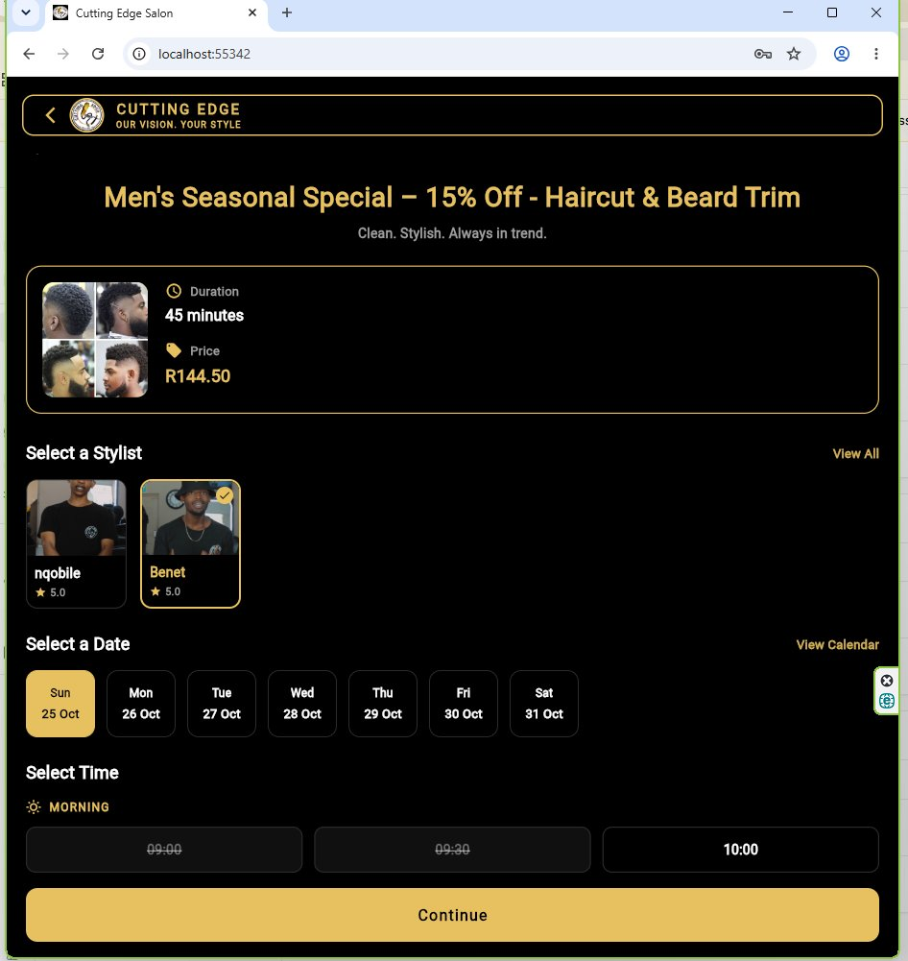
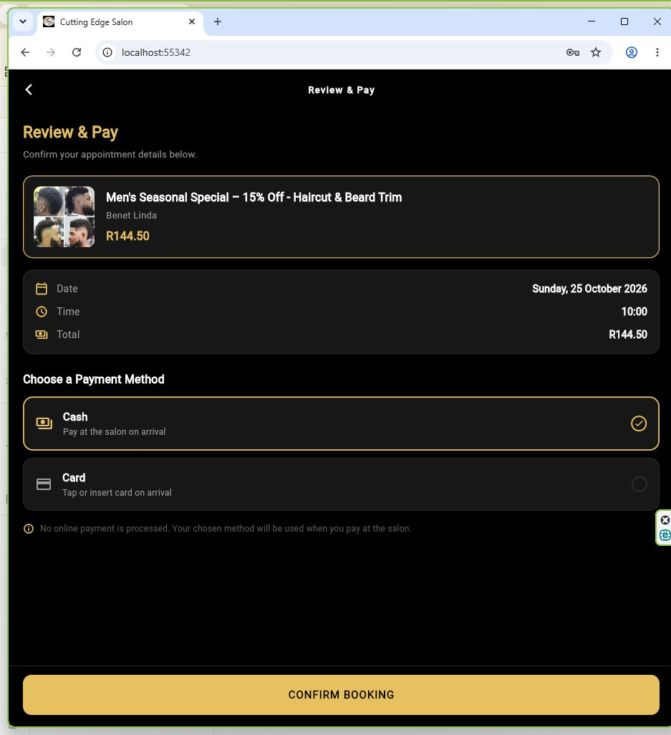
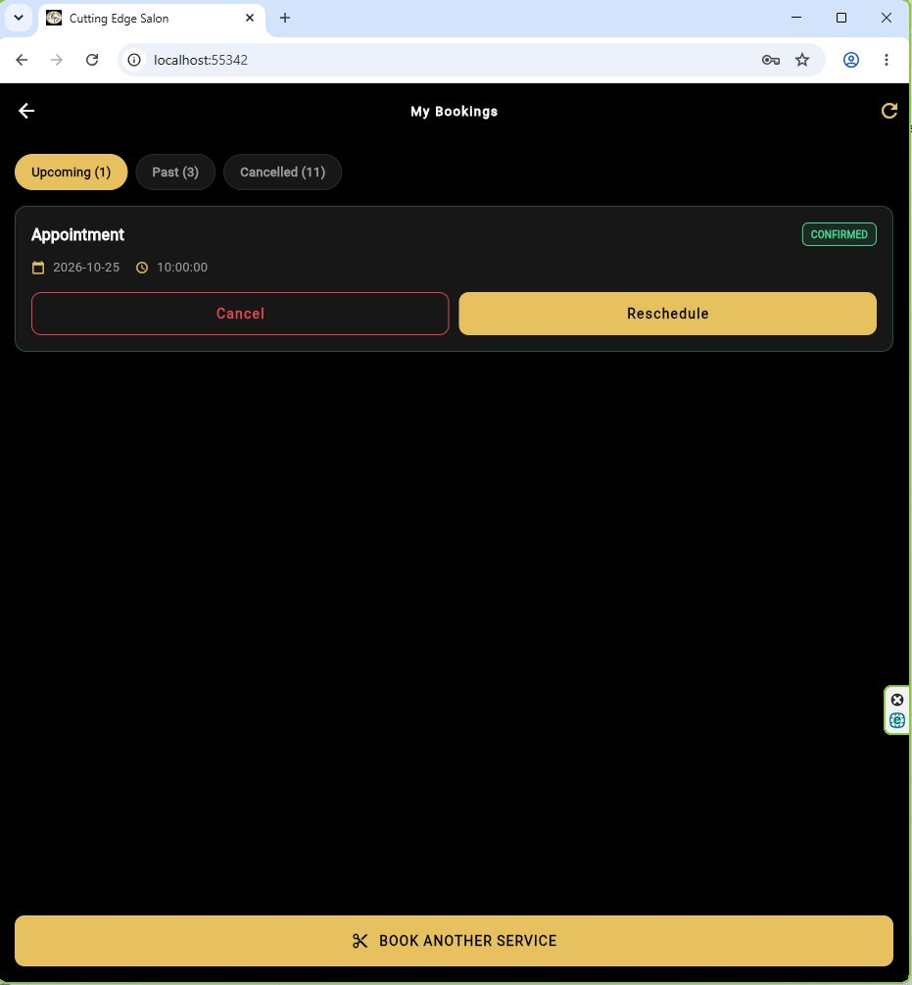
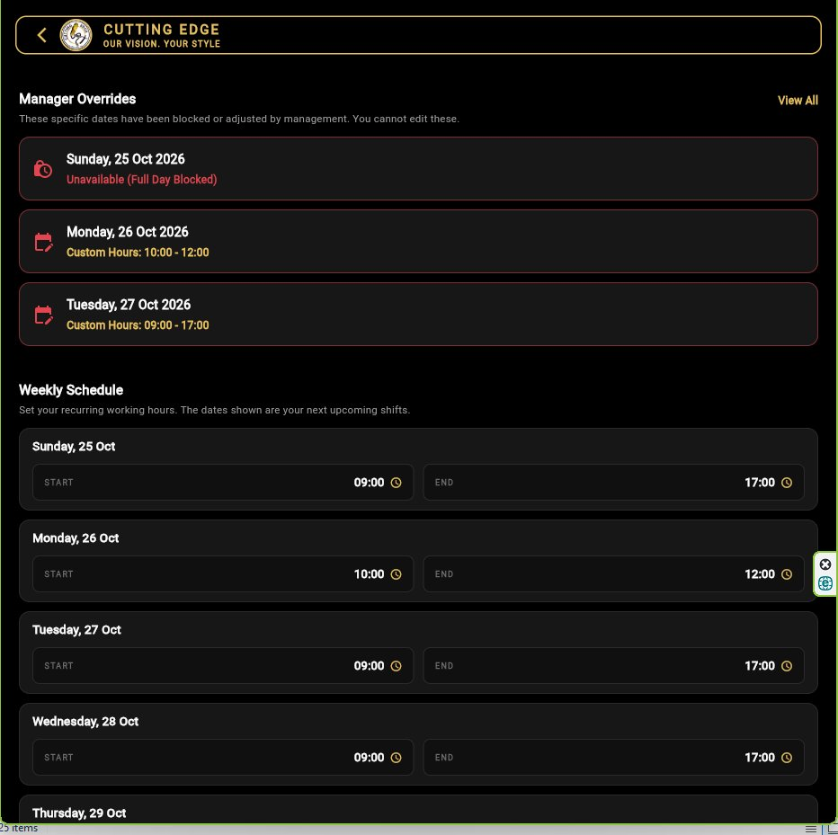
Flutter Mobile Application
Presented by Bennet Linda & Nyakallo Pali
Role Selection: Shared app for Customer and Stylist.
Booking Engine: Real-time availability, Cash/Card preference and BookingGate logic to prevent double bookings.
Customer: Book, cancel, view salon location, view promotions.
Stylist: View daily schedule, manage working hours, block dates.
Design: Premium black-and-gold UI reflecting the salon’s brand.
Notes:
The Flutter app was built with a strong focus on UX and the salon’s luxury brand. A key technical feature is our BookingGate. Before a customer can book, the app queries Supabase to ensure they don’t already have an active booking, and checks the stylist’s availability. The stylist side allows them to manage their own blocked dates seamlessly. (Bennet)

Slide 5
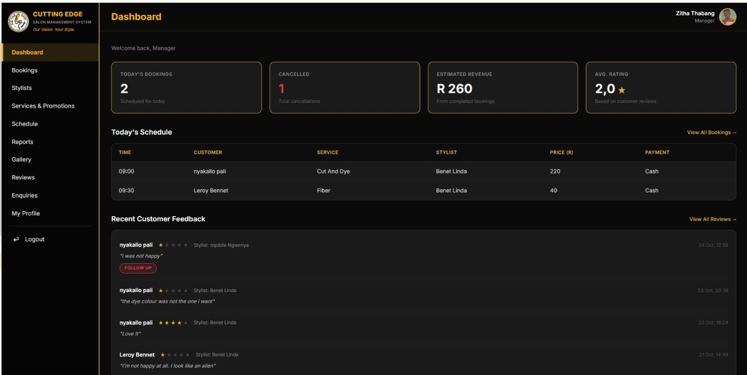
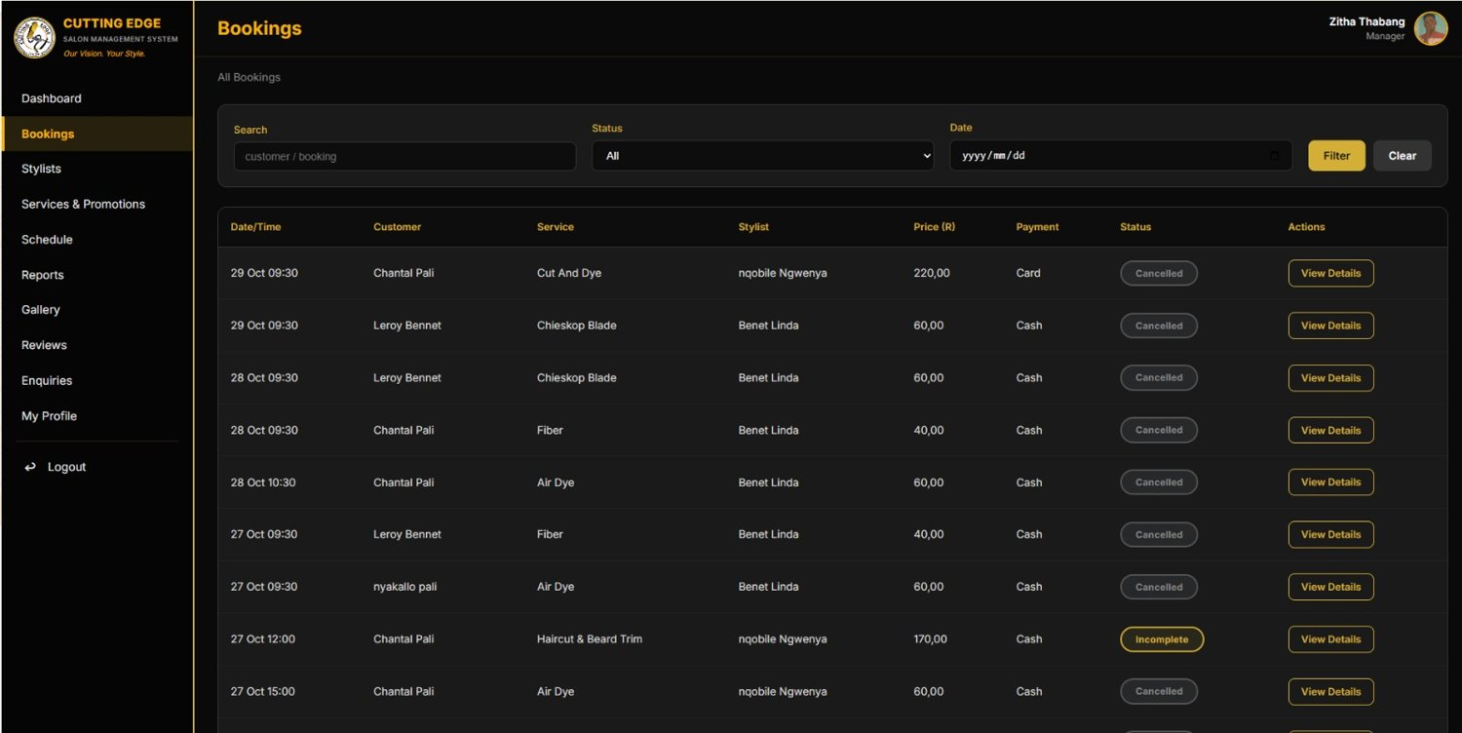
ASP.NET Manager Portal
Presented by Goitse, Thabang & Yamkela
Secure Login: Cookie-based authentication restricted to the Manager role.
Dashboard: Real-time metrics on bookings, revenue and cancellations.
Management: Full CRUD for Bookings, Stylists, Services and Promotions.
Enquiries & Reviews: Reply to customer enquiries and send apologies directly to the customer’s Flutter inbox.
Notes:
For the Manager Portal, we used ASP.NET Core MVC. Security was a priority; we implemented anti-forgery tokens and secure sessions. The dashboard pulls live metrics directly from Supabase. We also built features for the manager to approve leave requests and reply to customer enquiries, which are instantly pushed to the Flutter app. (Yamkela)

Slide 6
Integration & Shared Processes
Two shared processes demonstrated today
Flutter
Customer action
Supabase
Shared data
ASP.NET
Manager action
Process 1: Booking Request & Approval
Process 2: Booking Cancellation
Customer books via Flutter.
Supabase saves booking as “Pending”.
Manager views and approves in ASP.NET.
Supabase updates to “Confirmed”.
Customer refreshes Flutter and sees the update.
Customer cancels via Flutter.
Supabase updates status to “Cancelled”.
Manager sees the cancellation in the ASP.NET dashboard.
Notes:
Now, we will switch to a live demonstration. We will show you exactly how Flutter and ASP.NET communicate through Supabase. [Proceed to Live Demo]. First, Bennet will create a booking in Flutter. Then, I will log into ASP.NET to approve it. Finally, Nyakallo will show the updated status on the mobile app. (Goitse)

Slide 7


Challenges & Project Management
Project Management
Technical Challenges
Challenge: Getting every member to complete tasks on time required frequent reminders.
Solution: Weekly check-ins and the Project Progress Tracker as a single source of truth. Tasks were redistributed and peers supported each other so the ASP.NET and Flutter teams met their deadlines.
Data consistency: Flutter and ASP.NET used different status names (“Approved” vs “Confirmed”). Standardised to:
Pending
Confirmed
Cancelled
Completed
Integration: Resolved query mismatches and ensured proper foreign key joins between the two applications.
Notes:
Project management was a significant part of this phase. We faced challenges with keeping everyone accountable. To solve this, we established weekly check-ins and tracked everything transparently. Technically, aligning the field names and status values between the two applications was tricky, but we standardized our data contracts and resolved all integration bugs. (Thabang)

Slide 8




Known Limitations & Honest Assessment
Email Reminders
Real-time Auto-Refresh
Automated reminders (FR-09) were simplified to manual reminders via the admin dashboard.
Flutter needs a manual refresh to show ASP.NET updates. Supabase Realtime was not fully deployed.
Payment Processing
Customer Reviews
Cash/Card selection is a preference only. No online payment gateway is integrated.
Submitting reviews from Flutter is partial; manager viewing and follow-up is fully functional.
Notes:
We want to be completely honest about the system’s limitations. We did not implement automated email reminders; the manager handles these manually. Also, the apps do not auto-refresh in real-time; a user must refresh to see cross-app updates. Finally, payment is cash/card on arrival—we did not integrate a payment gateway as per the project scope. (Yamkela)

Slide 9


Summary & Conclusion
Delivered
A fully integrated, secure and functional prototype.
GitHub Repository
Stakeholder Value
Solves double bookings, streamlines salon operations and provides a luxury digital experience.
github.com/Yamkela47/Group-B-
Contains the mobile/ and web/ folders.
Project Status
Complete. Ready for formal testing and handover.
Source Code
Available on GitHub with full setup instructions.
Thank you. Questions?
Notes:
In conclusion, Framework Fanatics has delivered a robust, integrated prototype that meets the core requirements of the stakeholder. The system solves the manual mismanagement problem and gives the manager total oversight. The code is fully documented on GitHub. Thank you for your time, and we are ready to answer your questions. (Goitse)

