Slide 1
YamRail/Code_CLI
An agent handover can lose intent,
limits, and the source of a claim.
One transferable CLI for read-only research and bounded code tasks,
with native WorkLedger evidence and A4 reports.
For authorized technical operators handing off research and coding
yr-code demo --evidence-mode replay
LOCAL_EXECUTED with SYNTHETIC_FIXTURE inputs
Notes:
Private hackathon candidate. Track: Wildcard (Tinkerer). Product is the transferable YamRail/Code_CLI package and executable yr-code. Current scope: Observed scope: Windows 11 / Python 3.12.10. This capture is not another-machine or VM proof.. No live sponsor inference/query or multi-model execution is inferred from an offline interface. Current execution source pins:
[
{
"path": "evidence/observed_and_labelled/CLI_WINDOWS_SCOPED.json",
"sha256": "6a08df61941f87465b1159d94e6a7f5d8cc181ed419da6b5c12c418ce6924727",
"bytes": 13801
},
{
"path": "media/source_evidence/SOURCE_CHECKPOINT_VERIFICATION.json",
"sha256": "78c7d71235955180dc5e9d4ed536d358c58c744485fc533bb62cba4a194d9dcc",
"bytes": 999
},
{
"path": "media/source_evidence/R008_CLI_SCOPE.json",
"sha256": "877894e5b674a6e469a65a656cf2773ec27472d2b7ea36dc7c4532413203bd5e",
"bytes": 2821
},
{
"path": "media/source_evidence/R008_RENDERER_RECEIPT.json",
"sha256": "442e2e6d611ae54e5e963fd26af079440c8734200937876151eac35a916b47c8",
"bytes": 3319
},
{
"path": "evidence/observed_and_labelled/sponsor_rules/OFFICIAL_SOURCE_RECEIPT.json",
"sha256": "7ba74c9d4ac56d5028a03223aaefd038b76eb5348a580b6491af0984666f888c",
"bytes": 1876
},
{
"path": "evidence/observed_and_labelled/sponsor_rules/ELIGIBILITY_MATRIX.json",
"sha256": "baf3181ac167608433512e7bfd2226f265c52ebc38c90ca38c1df166730d210c",
"bytes": 4099
}
]

Slide 2
One command surface, visible evidence
The same package exposes environment checks, bounded work and independent readback.
Command | Observed result
yr-code doctor --format json | Python 3.12.10 / Windows 11; no provider invocation
yr-code demo --evidence-mode replay --format json | 12 / 12 scoped checks; no new model generation
yr-code recon local --root fixtures/safe_public_or_synthetic --format json | Three fixture files read; target not executed
yr-code evidence verify --manifest MANIFEST.json | Captured byte-verification scope: PASS
yr-code status --format json | Native durable readback: PASS
Local fixtures stay labelled synthetic; unavailable dependencies stay on HOLD.
02
Notes:
Rows summarize selected fields of fresh R007 stdout; they are not invented shell output. Captures and byte hashes live under package-relative evidence paths. [
{
"path": "evidence/observed_and_labelled/CLI_WINDOWS_SCOPED.json",
"sha256": "6a08df61941f87465b1159d94e6a7f5d8cc181ed419da6b5c12c418ce6924727",
"bytes": 13801
},
{
"path": "media/source_evidence/SOURCE_CHECKPOINT_VERIFICATION.json",
"sha256": "78c7d71235955180dc5e9d4ed536d358c58c744485fc533bb62cba4a194d9dcc",
"bytes": 999
},
{
"path": "media/source_evidence/R008_CLI_SCOPE.json",
"sha256": "877894e5b674a6e469a65a656cf2773ec27472d2b7ea36dc7c4532413203bd5e",
"bytes": 2821
},
{
"path": "media/source_evidence/R008_RENDERER_RECEIPT.json",
"sha256": "442e2e6d611ae54e5e963fd26af079440c8734200937876151eac35a916b47c8",
"bytes": 3319
},
{
"path": "evidence/observed_and_labelled/sponsor_rules/OFFICIAL_SOURCE_RECEIPT.json",
"sha256": "7ba74c9d4ac56d5028a03223aaefd038b76eb5348a580b6491af0984666f888c",
"bytes": 1876
},
{
"path": "evidence/observed_and_labelled/sponsor_rules/ELIGIBILITY_MATRIX.json",
"sha256": "baf3181ac167608433512e7bfd2226f265c52ebc38c90ca38c1df166730d210c",
"bytes": 4099
}
]

Slide 3
Portable supervisor and the existing native ledger
The CLI binds bounded work to native stages, root limits and captured bytes.
WORK_ORDER
Safe local fixture
yr-code
Supervisor
Declared adapter or task
Receipt + artifact hash
Reused WorkLedger + Intent Guard
The native runtime is the only work-state writer
Read views: World Model, typed graph, status and byte verification
Transfer source and evidence; moved active journals stay on HOLD
03
Notes:
Editable architecture diagram of the current wrapper/native-runtime integration. This is local package work state, not a new canonical YamRail ledger. The fresh offline workflow executes native Python processes, a controlled exit23 crash, durable STOP/RESUME and current tests of retained code fixtures. Domain inputs and cost units are synthetic. No new model generation or original model-execution receipt is imported. Only the reused WorkLedger writes local workflow state. No private/canonical ledger is imported. Source relocation supports a fresh run; relocated active journals remain HOLD pending reconciliation. This is outer task supervision, not proof of full Agent-to-yard isolation. This Windows capture explicitly configured an optional Node runtime via RTA_NODE. Doctor correctly reported Node absent from PATH; no default Node installation is claimed. The raw author path remains outside the package. Sources: [
{
"path": "evidence/observed_and_labelled/CLI_WINDOWS_SCOPED.json",
"sha256": "6a08df61941f87465b1159d94e6a7f5d8cc181ed419da6b5c12c418ce6924727",
"bytes": 13801
},
{
"path": "media/source_evidence/SOURCE_CHECKPOINT_VERIFICATION.json",
"sha256": "78c7d71235955180dc5e9d4ed536d358c58c744485fc533bb62cba4a194d9dcc",
"bytes": 999
},
{
"path": "media/source_evidence/R008_CLI_SCOPE.json",
"sha256": "877894e5b674a6e469a65a656cf2773ec27472d2b7ea36dc7c4532413203bd5e",
"bytes": 2821
},
{
"path": "media/source_evidence/R008_RENDERER_RECEIPT.json",
"sha256": "442e2e6d611ae54e5e963fd26af079440c8734200937876151eac35a916b47c8",
"bytes": 3319
},
{
"path": "evidence/observed_and_labelled/sponsor_rules/OFFICIAL_SOURCE_RECEIPT.json",
"sha256": "7ba74c9d4ac56d5028a03223aaefd038b76eb5348a580b6491af0984666f888c",
"bytes": 1876
},
{
"path": "evidence/observed_and_labelled/sponsor_rules/ELIGIBILITY_MATRIX.json",
"sha256": "baf3181ac167608433512e7bfd2226f265c52ebc38c90ca38c1df166730d210c",
"bytes": 4099
}
]

Slide 4
Native evidence after STOP and recovery
Selected current stdout fields stay traceable to the original captured bytes.
Native field | Observed state
ROOT_A | 3 / 3 consumed across parent, child and grandchild
ROOT_B | UNKNOWN_COMPLETION; automatic retry refused
ROOT_C | Independent local work continued
Presence | Final active=false; STOP/restore preserves consumption
Current readback | PASS_NATIVE_DURABLE_READBACK
12 / 12 scoped checks pass. Uncertainty survives restart.
The independent purpose continues in the same native demo.
04
Notes:
This editable state table is derived from current native execution, not an illustrative success diagram. Native fields selected from evidence/observed_and_labelled/CLI_WINDOWS_SCOPED.json SHA256 6a08df61941f87465b1159d94e6a7f5d8cc181ed419da6b5c12c418ce6924727. No author-host journal is shipped. The fresh offline workflow executes native Python processes, a controlled exit23 crash, durable STOP/RESUME and current tests of retained code fixtures. Domain inputs and cost units are synthetic. No new model generation or original model-execution receipt is imported. Only the reused WorkLedger writes local workflow state. No private/canonical ledger is imported. Source relocation supports a fresh run; relocated active journals remain HOLD pending reconciliation. This is outer task supervision, not proof of full Agent-to-yard isolation. This Windows capture explicitly configured an optional Node runtime via RTA_NODE. Doctor correctly reported Node absent from PATH; no default Node installation is claimed. The raw author path remains outside the package.

Slide 5
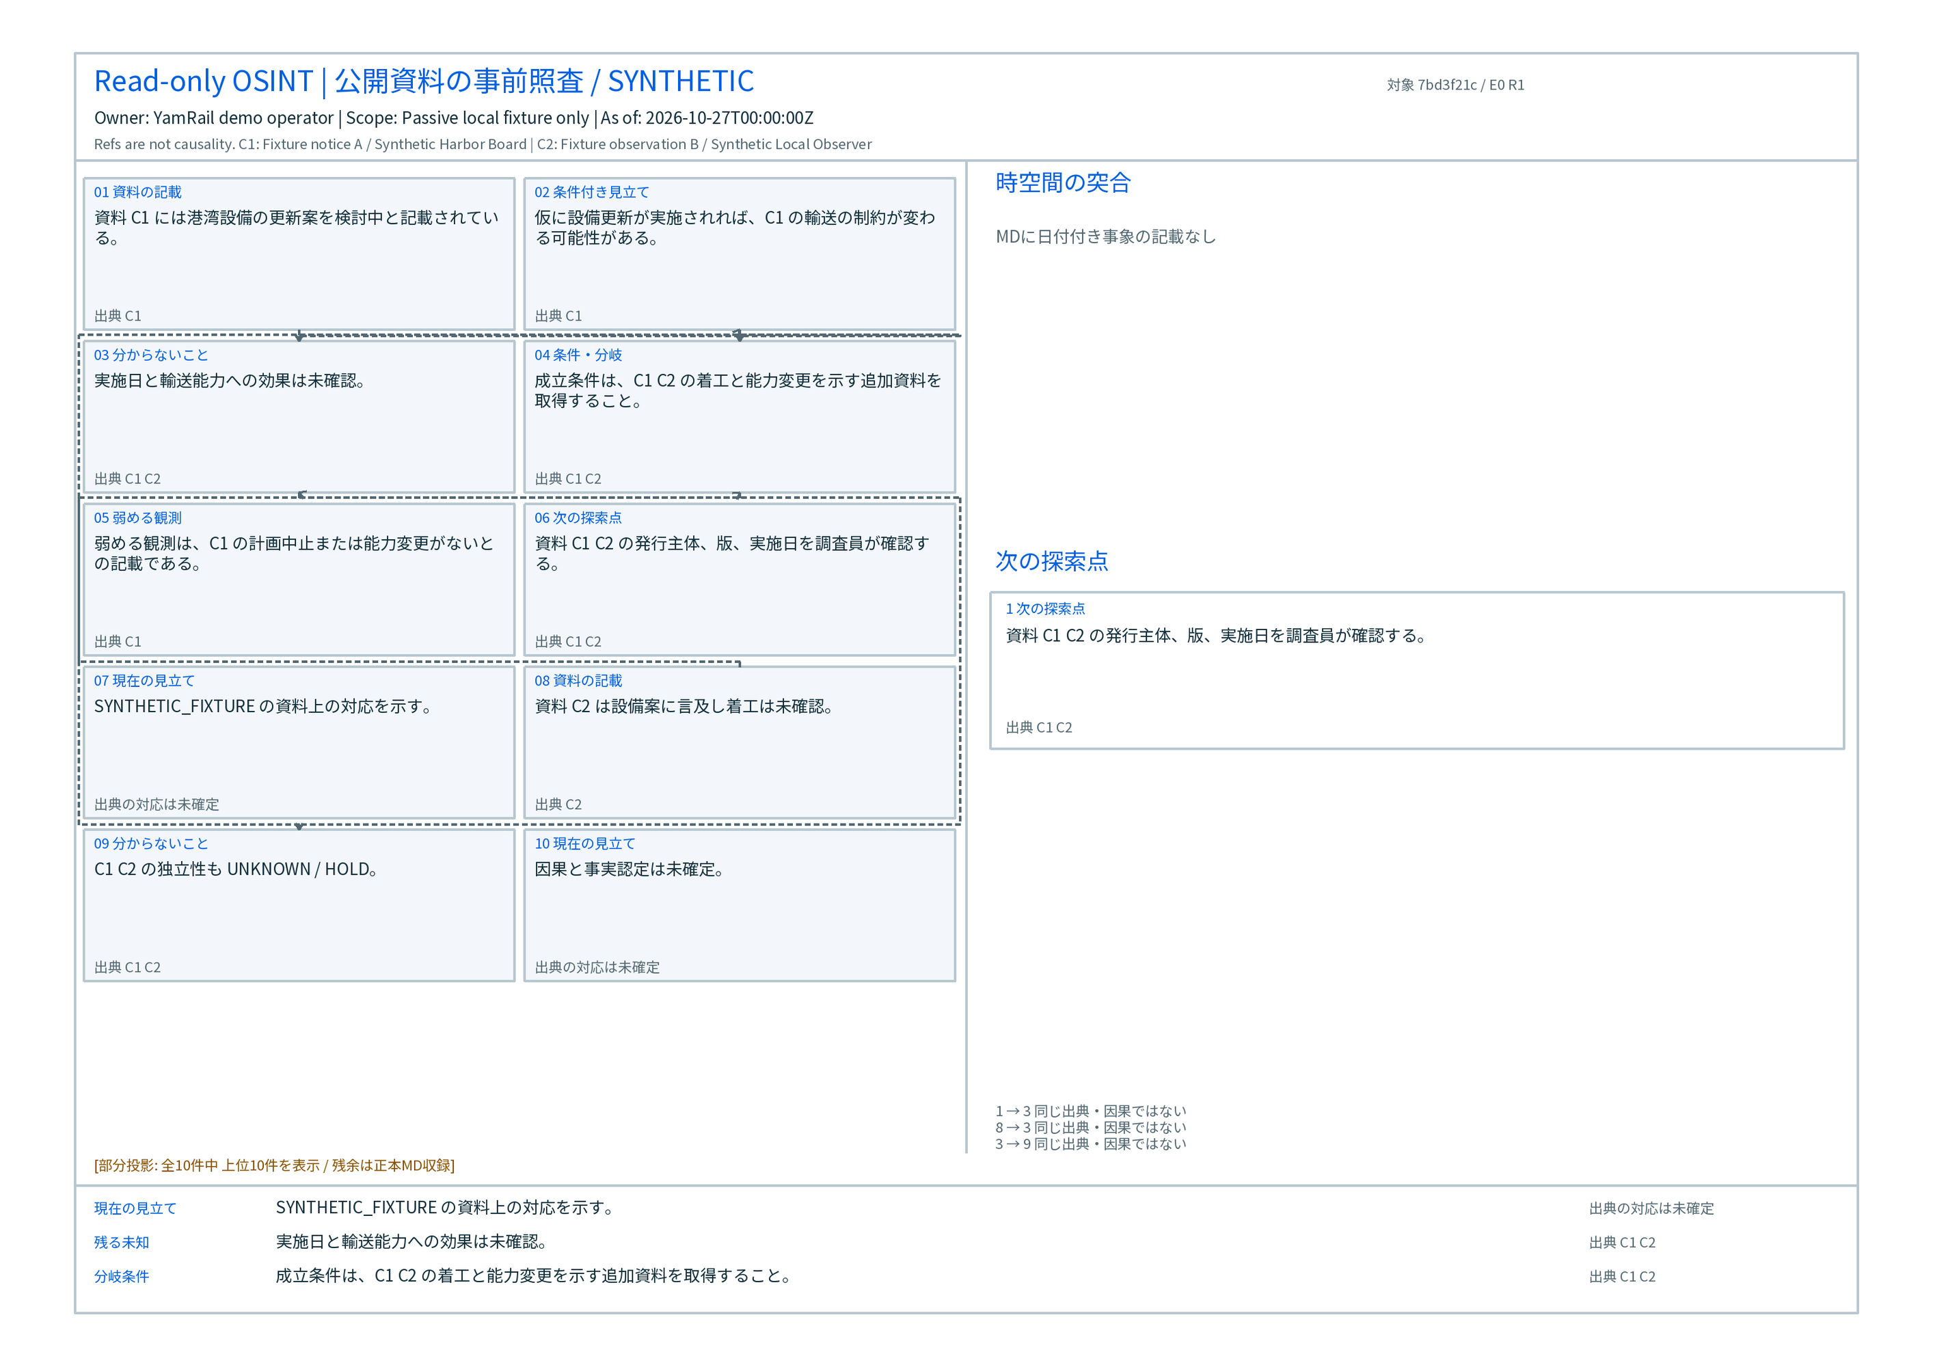
Source-linked reports and A4 landscape graphs
The local renderer carries sources, typed relations and visible UNKNOWN / HOLD.
A4 landscape 297 × 210 mm
SVG / PNG / PDF
Graph master JSON + receipts
Reused YamRail/OSINT
PR79 / PR62 lineage
Source digest tied to report
yr-code report make
yr-code graph render
AutoCAD policy: user desktop only; unverified license / session stays HOLD.
Server / cloud always denied. No fallback or test bypass.
05
Notes:
R008 mandatory local report/graph outputs: actual source-linked A4 landscape 297x210mm SVG, PNG, PDF, graph master JSON and receipts. Preserve source relationships and uncertainty; reference relations do not establish causality. Actual source-class SYNTHETIC_FIXTURE. Renderer receipt media/source_evidence/R008_RENDERER_RECEIPT.json SHA256 442e2e6d611ae54e5e963fd26af079440c8734200937876151eac35a916b47c8. Current CLI/native supervision selection: media/source_evidence/R008_CLI_SCOPE.json SHA256 877894e5b674a6e469a65a656cf2773ec27472d2b7ea36dc7c4532413203bd5e. Source-linked image bytes SHA256 3ca1663a039ac3d3307b62ba7686d25ba0374909b1ae33baf07adaceec23fce6. Shared citations do not establish causation; UNKNOWN/HOLD and source IDs remain visible. Optional AutoCAD execution is only user-initiated on that user’s own workstation with verified interactive local licensed product/session and explicit scope. Executable/registry/COM presence alone does not establish entitlement. Unknown license/session means HOLD_CAD_LICENSE_UNVERIFIED_NO_AUTOCAD_LAUNCH. Server/cloud/headless/hosted/proxied AutoCAD, Autodesk Platform Services Design Automation for AutoCAD and fallback/test bypass are prohibited. No AutoCAD launch occurred or is inferred from graph generation. Cloud may transport sanitized non-CAD orders/evidence but may not invoke or remote-control AutoCAD. Local open-format graph/report rendering continues without AutoCAD.

Slide 6
Reused source and new package work
The source history stays distinct from new transferable construction.
Retained source | New package work
WorkLedger + Intent Guard | Portable command wrapper and fresh shared-root counterexamples
Typed Graph + retained code fixtures | Source checks and current tests; no new model generation
YamRail/OSINT PR79 / PR62 line | Local source-linked A4 report and graph exports
Existing tool-source shelf | Origin and license inventory; source import grants no execution authority
Observed scope: Windows 11 / Python 3.12.10. This capture is not another-machine or VM proof.
06
Notes:
Wildcard track permits extending prior work; only new work is represented as the competition contribution. Source maturity and licenses stay explicit. Source imports do not establish that all tools are installed or executable. No host/private canonical ledger is included. Native source comes from declared YamRail work and pinned source manifests. OSINT PR79 pin9f3a5e61b72a0517f683d3e7ccd22a0904782fec and PR62 pin907593e0d045cfc926943d186eb0aa19ad7c92bb. The competition delta is the transferable command surface, safe recon, local report/graph adapters, evidence packaging and portable installation work. Prior prototypes retain their maturity and license notes.

Slide 7
Sponsor use and the current eligibility gap
A working offline demo and the required live sponsor request have separate evidence.
Technology | Current evidence | Remaining closure
Meterless World Model | Upstream engine ran locally Current read projection | Keep engine/test evidence and source-of-truth boundary
Nightshift / NVIDIA | HOLD No live inference receipt | Authorized real Nightshift request with backend evidence
Zetaris | HOLD No real query receipt | Authorized data read with source and row evidence
Development tool | Actual Codex construction Cursor use unexecuted | Any AI coding tool allowed under current Academy FAQ
Current Academy rules ask for a real Nightshift request in the demo.
07
Notes:
Current primary official rules: https://academy.genai.works/courses/open-agent-hackathon-2026/details . Fresh public serialized FAQ5/8 states Zetaris data, at least one working Meterless Engine with a test, and Nightshift primary AI provider with NVIDIA connected. Cursor or any AI coding tool is allowed; no Cursor use is claimed. Secondary official event page has a broader NVIDIA-use statement and is preserved separately: https://hackathon.genai.works/event/open-agent-hackathon-2026 . Follow the user-designated Academy source; do not silently close the difference. Source hashes in evidence/observed_and_labelled/sponsor_rules/OFFICIAL_SOURCE_RECEIPT.json. Meterless upstream World Model actually ran locally. Nightshift/NVIDIA and Zetaris live requests remain UNEXECUTED/HOLD, with zero new model/provider calls in the captured journey. Current Academy rules require the actual provider/data integrations and a real Nightshift request in the demo; this offline package does not establish full contest eligibility. Cursor was not used; actual Codex construction is declared separately from product runtime.

Slide 8
Reproduction and the next acceptance step
The package carries its entry point, safe fixtures and labelled evidence.
CURRENT LOCAL CANDIDATE
OPEN CLOSURE
Install and run doctor
Run the offline workflow
Verify evidence and inspect state
Authorized live sponsor request
Real Zetaris data receipt
Human external submission decision
Other-machine / VM proof, RAM / encryption and full agent-to-yard routing remain HOLD.
Moved active journals stay HOLD; transfer source and evidence for a fresh run.
Local construction and Private review do not grant external submission authority.
08
Notes:
Submission has not occurred. Human authority is required for registration/submission, public disclosure, new billable calls and canonical promotion. No complete RAM isolation, universal portability, full Agent-to-yard isolation or proprietary Office/CAD license is inferred. Other-machine / VM proof, RAM / encryption and full agent-to-yard routing remain HOLD.
Moved active journals stay HOLD; transfer source and evidence for a fresh run.

