Slide 1
Fraud detection with Graph Attention Networks
- By Sing Kwan NG and Anthony TAING
Notes:
Hello, I am Rohith Yamsani. we are a group of 2 people. I did this project along with sachin. We did a project called Fraud detection with Graph Attention Networks by Sing Kwan NG and Anthony TAING.

Slide 2
Introduction
Fraud Detection: It is a set of procedures and analysis that allow organizations to identify and prevent unauthorized financial activity
These activities include cyber hacking, insurance scams, fraudulent credit card transactions, identify theft and many more
Most of the traditional Machine learning fail to detect a fraud because of the complex network structure that these frauds use.
Graph Machine learning handles many complex issues and improves the accuracy of fraud predictions by using more relevant features information from the network.
Notes:
Introduction,
What is fradud detection,
It is a set of procedures and analysis that allow companies to prevent fradulent financial activity
Thses activities include different scams, cyber hacking, fraudulent credit card transactions, identify theft and many more
Most of machine learning techniques fail to detect theses frauds because of the network structure of these frauds.
Graph Machine learning detect frauds as it can handle many complex structures
Graph Machine learning improves the accuracy by using relevant features from network

Slide 3
Dataset:
For this project, we are using the Bitcoin dataset which maps Bitcoin transactions to real entities belonging to 2 different categories i.e., licit or illicit transactions.
Dataset is available in Kaggle.
Dataset is composed of three csv files.
The first file maps nodes according to their label (licit/illicit/unknown), the second introduces the edges between 2 nodes by using their "Ids," and the final file has nodes ids with 166 features.
Notes:
The dataset used for this project is called Bitcoin dataset which tells Bitcoin transactions are licit or illicit transactions.
We got this dataset from Kaggle. The dataset contains three csv files.
First file maps nodes according to their label.
Second file contains edges between 2 nodes labeled by Ids
Third file has all the nodes ids with 166 fetaures

Slide 4
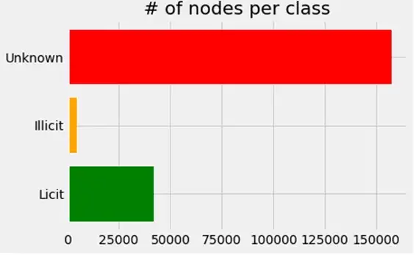
Dataset:
The graph contains 203,769 nodes and 234,355 edges, with 2% (4,545) of the nodes classified as class 1 (illicit) and 21% (42,019) as class 2 nodes, respectively (licit)
A node represents a transaction in the graph, an edge represents a movement of bitcoins between transactions.
Each node contains 166 features and has been classified as a "licit," "illicit," or "unknown" objects.
Notes:
Each node has been classified as a "licit," "illicit," or "unknown" objects.
Dataset contains 203,769 nodes and 234,355 edges.
From the beside we can see that 2% of the nodes as illicit and 21% as licit . remaing nodes are unknown
Here, nodes represent a transaction, an edge represents a movement of bitcoins between transactions.

Slide 5
Data transformations
We are joining the Feature and Classes data frames
Changing the classes from name to integers in the classes file.
We created three different inputs to create a PyG dataset i.e., edge index, node features and edge weights.
We did data preprocessing for the node feature by removing unnecessary columns like transaction IDs and classes.
We then used the previously initialized node features, edge index, weights, and labels to transform the data to PyGeometric graph data format.
Notes:
Data preprocessing
We joined both Feature and Classes data frames
We also changed the classes from name to integers
We created three different inputs with edge index, node features and edge weights to create a pyg dataset
We transformed the data to PyGeometric graph data format
We also removed unnecessary columns like transaction IDs..

Slide 6
Graph Attention Networks (GATs)
Graph Neural Networks(GNN) are neural networks that provide an easy way to do node-level, edge-level, and graph-level prediction tasks.
Graph Attention Networks (GATs) are one of the most popular GNN architectures that performs better than other models.
We will use the Pytorch Geometric(PyG), which is the most popular graph deep learning framework.
PyG is useful for fast implementing GNN models because it already has a large number of graph models established for a variety of applications involving structured data.
Notes:
Graph attention network
Graph Neural Networks(GNN) provide an easy way to do node-level, edge-level, and graph-level prediction problems.
Graph attention network is one of the most popular GNN model which performs better than other GNN model
We will use the Pytorch Geometric(PyG) for this project
It is used for fast implementing as it already contains high number of graph models which are established to use for variety of applications involving structured data

Slide 7


GAT v1
Any node in a GAT model that attends to its neighbors changes its representation by utilizing its own representation as the query.
As a result, each node calculates a weighted average of its neighbors and then chooses those that are most relevant to it.
This model uses an attention mechanism α(ij) to assess the significance of each message sent by various nodes in the neighborhood.
We can calculate attention score between two neighbors by a scoring function e
Notes:
For GAT version1, node in a GAT model changes its representation by utilizing its own representation as the query.
each node calculates a weighted average of its neighbors and then chooses which are most relevant to it.
model uses an attention mechanism α(ij) to assess the significance of each message sent by various nodes in the neighborhood.
We can see the formulas for attention mechanism and scoring function. From the images

Slide 8
Coding GAT with PyG : Message Passing
Using PyG, we can create a simplified form of a GAT layer.
PyG provides the MessagePassing base class, which helps in creating message passing graph neural networks by automatically taking care of message propagation.
By using the message() function, you can specify what node information we want to pass for each edge.
With the help of the aggregate() function, we can specify how we want to combine the messages coming from all edges to the destination node (e.g., "add," "mean," "max," etc.).
The propagate() function enables us to do message aggregation and passing over each edge and node in the graph.
Notes:
Coding with GAT:
With the help of PyG, we can create a GAT layer
PyG also provides the MessagePassing class, Since it takes care of message propagation, we can create a message passing graph neural networks
With the help of the message() function, we can tell what node information we want to pass for each edge.
we can tell how we want to combine the messages coming from all edges to the destination node with the helo of aggregate() function
By using the propagate() function, we can do do message aggregation and message passing

Slide 9
Model Training
For model training and evaluation, a trainer and metric manager classes are created
The GNNtrainer helps to run the training epochs. we also added helper functions to make training and testing easier.
With the help of MetricManager all the necessary metrics are calculated at each epoch.
The metric manager has an in built function to help calculate the best results for the entire run.
Notes:
Major step of the project is to train the model
For model training and evaluation, we created trainer and metric manager classes
The trainer class GNNtrainer helps to run the training epochs
We can calculate all the metrics at epoch with the help of Metric manager class
The metric manager also has an built-in function to calculate the best results for the entire run.

Slide 10
GAT v2
With the help of GAT v2, we can calculate dynamic attention which overcomes the GAT model's prior drawback.
Every query has a different ranking of attention coefficients of the keys.
The GATv2 model performs better than the previous version of GAT as it uses a dynamic graph attention variant.
Dynamic graph attention variant has a universal approximator attention function
Since dynamic attention can "concentrate" on the most relevant information, it offers a considerably stronger robustness to noise.
Notes:
For GAT version2, we can calculate dynamic attention which was not possible by GAT version1.
In dynamic attention, Every query has a different ranking of attention coefficients of the keys.
Since it GAT v2 uses dynamic attention, It performs btter than all other previous versions of GAT.
It has a universal approximator attention function
Since it filter most relevant information, we get better robustness to noise

Slide 11
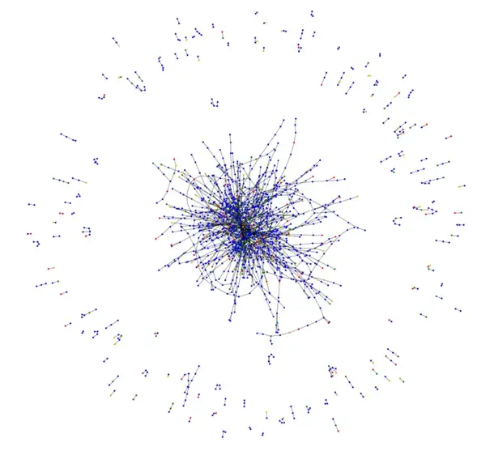
Visualization:
Green = Not illicit (not fraud)
Red = illicit (Fraud)
Blue = Predicted not illicit
Orange = Predicted illicit
Majority of transactions nodes are heavily linked in a cluster.
The actual fraud and the predicted fraud from the new model are fairly distributed among the central cluster and the shorter transaction chains.
Notes:
Visualization
From the given graph we can see that most of the trasactions nodes are linked to each other in a cluster.
We can also see that most of them are clustered towards centre.
actual fraud and the predicted fraud are fairly distributed among the central cluster

Slide 12
Conclusion:
Graph Attention Network assigns varied priorities to nodes in the same neighborhood to increase the model's capacity, while still working on all of the neighboring nodes.
On the fraud dataset, both of the prebuilt GAT models perform very well, achieving 0.92 F1 macro and 0.97 accuracy.
The GATv2 model should be used as a standard instead of the original GAT model because it performs better than GAT on several benchmarks.
Notes:
Conclusion of the project
Graph Attention Network assigns varied priorities to nodes in the same neighborhood to increase the model's capacity, while still working on all of the neighboring nodes.
Both the GAT models perform very well. We got the accuracy of 0.97 and f1 score of 0.92
From this project, we can say that GATv2 model should be used as a standard instead of the original GAT model as it performs better than all the previous versions of GAT on several benchmarks

Slide 13
Thank You
Team Members:
Rohith Yamsani, ID: 6364594
Sachin Sravan Kumar Komati, ID: 6384991
Notes:
Thank you
Our team consists of 2 people myself Rohith and my teammate sachin

