Slide 1
Home Work 1 RFFI Project Basic Code
- Rohith Yamsani
- Raja Duggirala

Slide 2
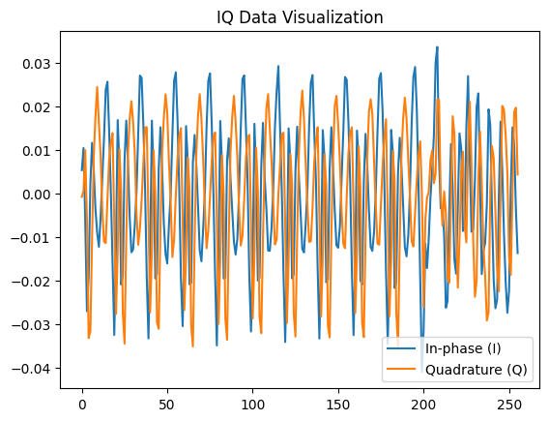
Data Processing
Load the required libraries such as numpy, torch and pickle
dataset: wisig.node3-19.stratified_ds.2022A.pkl
Input the dataset to the code using pickle_path
Visualize the In-phase vs Quadrature plot

Slide 3
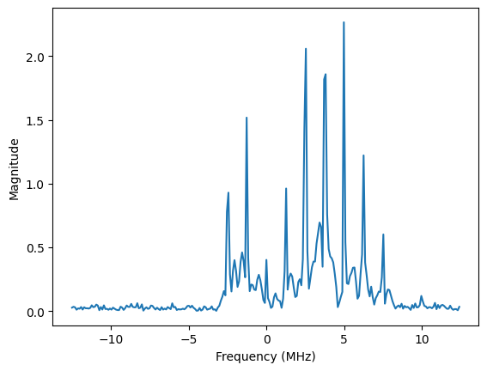
Fast Fourier Transform (FFT)
Used for computing the discrete Fourier transform (DFT) of a sequence or signal.
The FFT reduces the DFT's computational cost from O(N^2) to O(N log N), where N is the number of samples in the sequence.
Fourier transform is a mathematical technique that converts a time (or spatial) function into a frequency function. It enables us to analyse the frequency components of a signal.
The Fourier transform decomposes a complex waveform into a series of sine and cosine waves of varying frequencies, which are represented in the frequency domain.

Slide 4
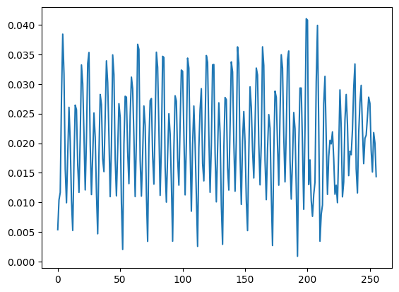
Inverse Fast Fourier Transform (IFFT)
Mathematical procedure that computes the inverse of the Fast Fourier Transform. It translates a function from the frequency domain to the time domain.

Slide 5
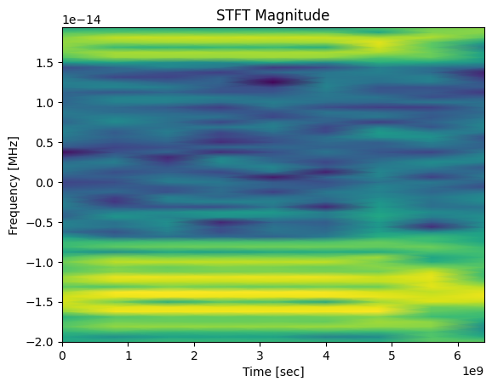
Short-Time Fourier Transform (STFT)
STFT builds on the Fourier Transform by computing a sequence of Fourier Transforms across small, overlapping time windows of the signal.
enables us to examine the frequency composition of a signal as it evolves over time.
Parameters Used: window_size=64, window='hann', return_onesided=False

Slide 6
Utilizing Convolutional Neural Networks (CNNs) for Signal Classification
Initial Configuration:
Comprised of two convolutional layers each followed by batch normalization and ReLU activation to introduce non-linearity and manage internal covariate shift, improving training dynamics.
Functionality of Layers:
Conv1: Captures basic feature maps from the raw input data.
Conv2: Further abstracts features from Conv1’s output, enhancing feature detection.

Slide 7
Enhancements in CNN Architecture for Improved Performance
Architectural Modifications:
Added Layers: Introduction of an additional convolutional layer (conv3) and batch normalization layer (bn3).
Enhances the network’s ability to capture more complex features and patterns, potentially improving learning efficacy and model accuracy.
Code:
self.conv3 = nn.Conv2d(80,20,kernel_size=(1,7),stride=1,padding=(0,3),bias=False)
self.bn3 = nn.BatchNorm2d(20)

Slide 8
Enhancements in CNN Architecture for Improved Performance
Results After Implementation:
Performance metrics: The original model's accuracy at epoch 6 was 95%, but with the extra layer, it improved to 96.1137%.
Epoch: 6 Training Loss: 0.160902
Epoch: 6 Training Accuracy: 96.448976
Evaluation Accuracy: 96.1137%
Demonstrates the benefit of extra convolutional layers in improving learning capacities and increasing accuracy.

Slide 9
Enhancements in CNN Architecture for Improved Performance
Target Domain Improvements: The target_loader's average accuracy rose from 87.423 to 88.326%.
Epoch: 6
0%| | 0/50 [01:32<?, ?it/s, loss=0.212] 100%|██████████| 50/50 [00:46<00:00, 1.08it/s]
Model test on 50tasks. Accuracy: 96.258%
100%|██████████| 20/20 [00:08<00:00, 2.24it/s]
Model test on 20tasks. Accuracy: 88.327% ------------------------ Average accuracy: 0.8832692307692308 ------------------------
Fine-tuning post-modifications increased the model's fine-tuning accuracy from 87.5% to 91.596%, demonstrating the architectural improvements.

Slide 10

Exploring LSTM for Signal Processing
LSTM: type of recurrent neural network (RNN) that is great for processing sequences and time-series data because of their capacity to recall previous information.
Configuration: The LSTM model was structured with multiple layers to enhance its learning capability, each layer tuned to optimize for temporal dependencies present in the signal data.
Performance Metrics: The LSTM model achieved an accuracy better than the initial CNN model, and a comparable accuracy of Enhanced CNN model.

Slide 11
Conclusion:
Enhanced CNN model: With additional convolutional and batch normalization layers to the initial two-layer CNN model, We get better model accuracy at epoch 6 of 96.1137% compared to the initial accuracy of 95%. Better fine-tuning accuracy on target domain tasks from 87.5% to 91.212%
We get similar model accuracies with LSTM and Enhanced CNN model which are better accuracies than initial CNN model.

Slide 12
Thank you!!

