Slide 1
The problem
Consider a task consisting of setting up nginx for load balancing.
its tested locally. Now you document what is needed to be done for test servers and give installables , configurations and scripts.
You gave different configuration file , the file you copied was wrong.
Will it work?

Slide 2
What is Docker
Docker is an open platform that automates the deployment of applications inside software container
Docker containers wrap up a piece of software in a complete filesystem that contains everything it needs to run:code,runtime,systemtools,systemlibraries–anything you can install on a server.
This guarantees that it will always run the same ,regardless of the environment it is running in.
It is a container manager.
Notes:
is an open platform for developing, shipping, and running applications. Docker enables you to separate your applications from your infrastructure so you can deliver software quickly.
By taking advantage of Docker’s methodologies for shipping, testing, and deploying code quickly, you can significantly reduce the delay between writing code and running it in production

Slide 3
Docker keeps code and its dependencies together and lets us more fully utilize our computing resources.
Docker is really just a way to encapsulate the infrastructure required to run our code in a self-contained package.

Slide 4
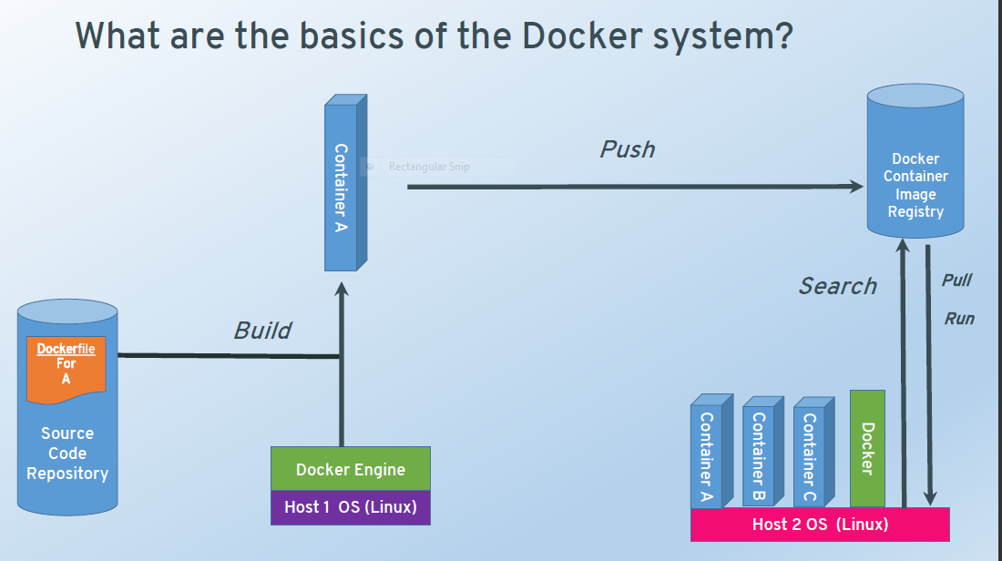
Notes:
Docker Workflow

Slide 5
Terms around Docker
Docker host : machine or VM or AWS which runs docker engine
Docker image : template from which containers are created
Docker container : isolated process which runs your code. It is an instance of your image
Docker Machine : Your laptop or desktop from which containers can be managed.
Docker file :
Docker Engine : The core of docker, the process which runs as a deamon or in background and listens to docker commands
Docker Hub : Docker repository

Slide 6
Install Docker on Centos
sudo yum install docker
sudo service docker start
sudo chkconfig docker on #(start at boot) docker info
docker version
sudo service docker restart
Notes:
Doing on Ubuntu
- Either Ec2 instance with ubuntu or Vagrant image with ubuntu

Slide 7
Images and Containers
Container : isolated Docker process
Templates for Docker container. It is the build component of Docker. You can create images, update them or pull images built by others.
You can create multiple container instances from same image.
Think of it like you have tomcat installer, you install and run the same installer on multiple VMs.(so in docker terms from same image , you are running different containers)

Slide 8
Container states
Started, stopped, running, removed.
The software/packages you install on a container stays with it untill the container is removed.
Lets start a ubuntu container and install apache and curl on it.
Now stop the container, restart it
Check if apache is still there and accessible
Create another container from ubuntu , run it , stop and restart.
Now remove both containers
Run a new container

Slide 9
Commands for the repo.
Docker search Ubuntu : here we are searching in repository for ubuntu images. There could be many.
docker search -s 10 ubuntu (limit results to 10)
docker pull ubuntu:14.04 # gets version 14.04 of ubuntu

Slide 10
Lets explore the difference between following commands
docker run ubuntu:latest
docker run -it –d ubuntu:latest /bin/bash
docker run -it ubuntu:latest
docker run -it –d –name myctr ubuntu:latest /bin/bash
docker exec myctr echo "HELLO FROM CONTAINER”
Docker exec myctr du -mh
docker attach myctr
docker logs myctr

Slide 11
docker ps
docker ps #lists details running containers
docker ps –a #lists details of all containers
docker ps –l #lists details of the container which was last started
docker ps –q #lists only container names
docker start -a -i `docker ps –a -q -l` #starts the container which was last started docker start $(docker ps -a -q --filter "status=exited") # start all conatiners which exited

Slide 12
Practice
Exercise : start busybox containers with name without name, with run , with start
Kill by containerId ,name ,
stop some by container id or name
Kill bulk
rm all containers
Remove busybox image

Slide 13
Install new stuff on base container
docker run -itd --name job1 ubuntu /bin/sh
sudo docker run --name WebServer -p 9999:80 -t -i ubuntu:14.04 /bin/bash
apt-get update
apt-get install apache2
service apache2 start
To test : install curl on docker container
Apt-get install curl
Curl localhost
When you restart the container, you can see that apache is already available
docker start WebServer /bin/bash
docker attach WebServer
docker commit -m "Apache web server" -a “Anju" WebServer ubuntu:Apache
Docker history ubuntu:Apache
Notes:
Note in virtualbox it may be necessary to configure port fwding in the vm definition
IN AWS it will work without further configuration
THIS IS AN EXERCISE : ON BASE IMAGE OF UBUNTU , COMMIT an install of apache

Slide 14
environment variables
Docker supports setting environment variables with the -e switch.
# docker run -e GREET=“Hi There” busybox env
Multiple variables can be added with multiple -e switches.
# docker run -e GREET=“Hi THERE” -e ME=$(whoami) busybox env
Notes:
This runs the busybox container passing 2 env variables and list the environment variables available
EXERCISE : install open jdk on ubuntu and set JAVA_HOME

Slide 15
Docker Volumes
In order to be able to save (persist) data and also to share data between containers, Docker introduced volumes.
volumes are directories (or files) that are outside of the default Union File System and exist as normal directories and files on the host filesystem.
In Docker , you can
- Dynamically add file system when you run a container
- File system as part of image , all containers will have the file system
- Access host file system – but you cannot code this in your image
- share data between containers

Slide 16
Volumes and docker portability?
When you run container from an image say ubuntu, the ubuntu system is accessible until the image is NOT removed.
It is isolated from the underlying OS. When you use volumes, u are depending on the host file system which now makes the container dependant on host.
Use this feature freely in development or testing but advisable not to use in production.

Slide 17
Continued …
docker run -it --name vol-test -h CONTAINER -v /data ubuntu /bin/bash
docker volume ls
where is this located on host?
Where is docker root directory
Get this with command docker info
Now navigate the docker root folder
cd /var/lib/docker/volumes/ ….

Slide 18
Touch a new file in this location
You can see it inside your container.

Slide 19
Volume - create
docker volume create --name my-vol
docker run -d -v my-vol:/data ubuntu
You can add files from inside container and from the host. They are visible to each other.
You can share data between containers using this created volume.

Slide 20
Share data from a container
docker run –name vol-test2 -it -h NEWCONTAINER -v 8e0b3a9d5c544b63a0bbaa788a250e6f4592d81c089f9221108379fd7e5ed017:/my-data ubuntu /bin/bash

Slide 21
Volumes-from option
docker run -it --name ctr1 -v ~/staticfiles:/files ubuntu
docker run -it --name ctr2 --volumes-from ctr1 ubuntu
You can have multiple -–volumes-from for a container

Slide 22
Practice: Nginx with docker volume

Slide 23
Deleting Volumes
Volumes are only automatically deleted if the parent container is removed with the
docker rm –v <container-name or id>
A volume will never be deleted as long as a container is linked to it
So in our example folder named data will not be deleted until vol-test and vol-test2 is removed.

Slide 24
Volume delete
docker volume rm <volume>
To delete all volumes not in use, try:
docker volume rm $(docker volume ls -q)
Dangling volumes : containers are removed without removing the associated volumes
docker volume ls -f dangling=true and remove the listed volumes by name.

Slide 25
Data only containers
u can create data only containers and share its volume across multiple containers.
Example : mysql database , postgres database can be made data-only containers and shared with docker container running the instances.

