Slide 1
Docker host : machine or VM or AWS which runs docker engine
Docker image : template from which containers are created
Docker container : isolated process which runs your code. It is an instance of your image
Docker Machine :
Docker file :
Docker Engine :
Docker Hub :

Slide 2
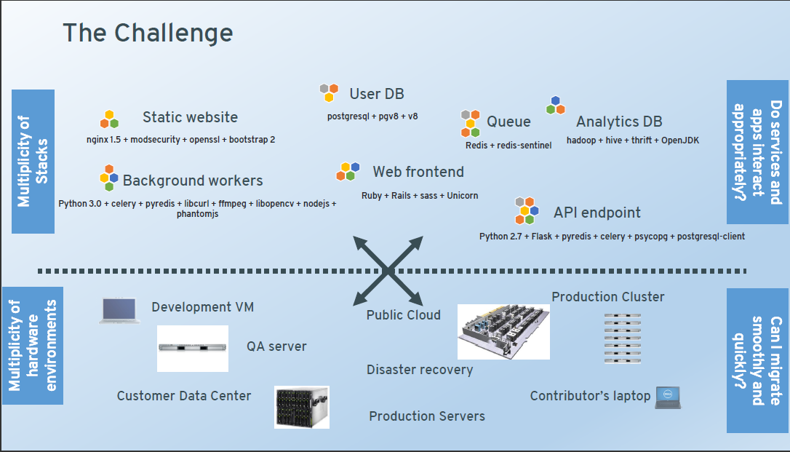

Slide 3
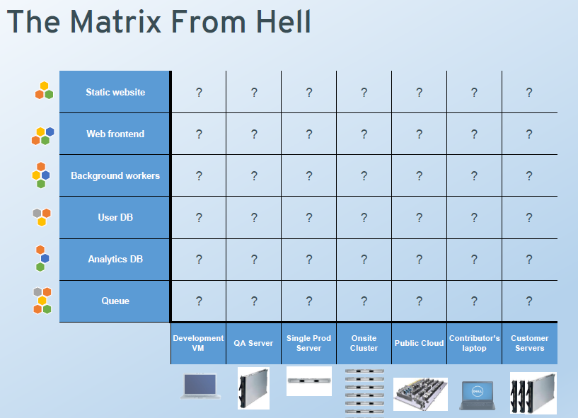

Slide 4
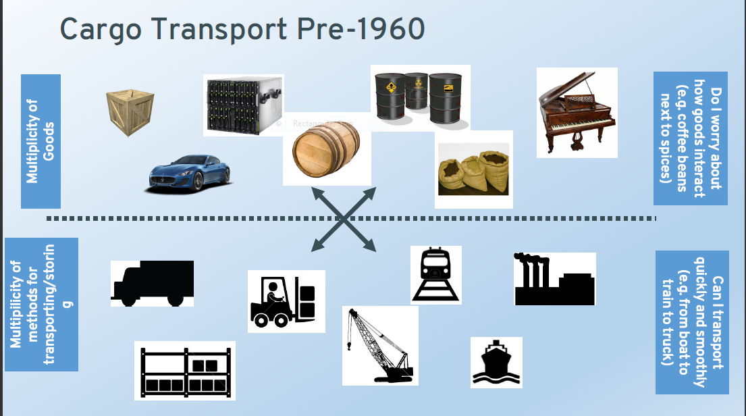

Slide 5
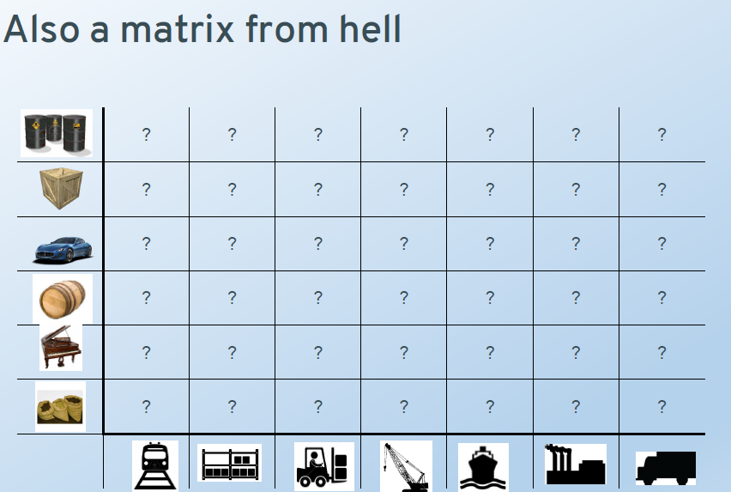

Slide 6
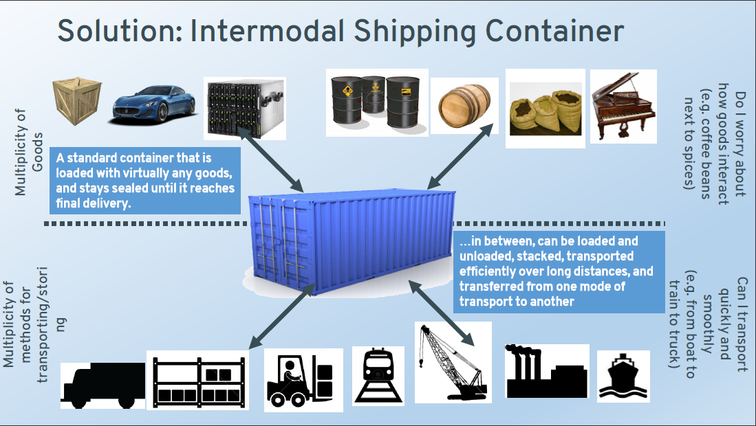

Slide 7
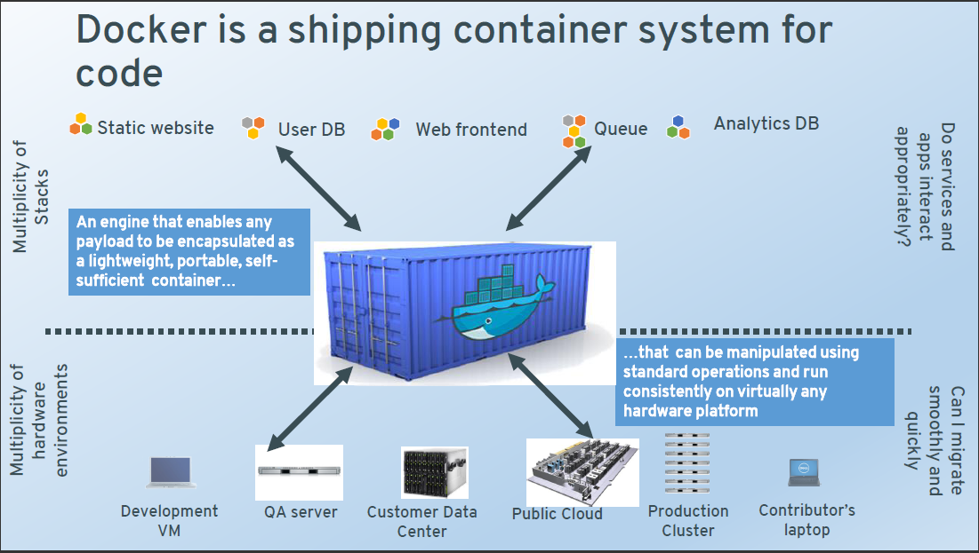

Slide 8
What is Docker
Docker is an open platform that automates the deployment of applications inside software container
Docker containers wrap up a piece of software in a complete filesystem that contains everything it needs to run:code,runtime,systemtools,systemlibraries–anything you can install on a server.
This guarantees that it will always run the same ,regardless of the environment it is running in.
It is a container manager.
Notes:
is an open platform for developing, shipping, and running applications. Docker enables you to separate your applications from your infrastructure so you can deliver software quickly.
By taking advantage of Docker’s methodologies for shipping, testing, and deploying code quickly, you can significantly reduce the delay between writing code and running it in production

Slide 9
Why developers love it
No worries about missing dependencies,packages and other pain points during subsequent deployments
Each application run isolated, so you can have various versions of libraries installed without any worries about breaking some code.
Automate testing , integration , packaging
No need to worry about platforms or environments code will run on

Slide 10
Why Devops love it
Configure once run anywhere
Efficient , consistent, repeatable installs
Inconsistencies between developer, test, production and customer environments are gone/eliminated
Speed and reliability of CI/CD is improved
Light weight and fast so improved performance , decreased cost of deployment
We are talking of running tons of containers in an average medium server.

Slide 11
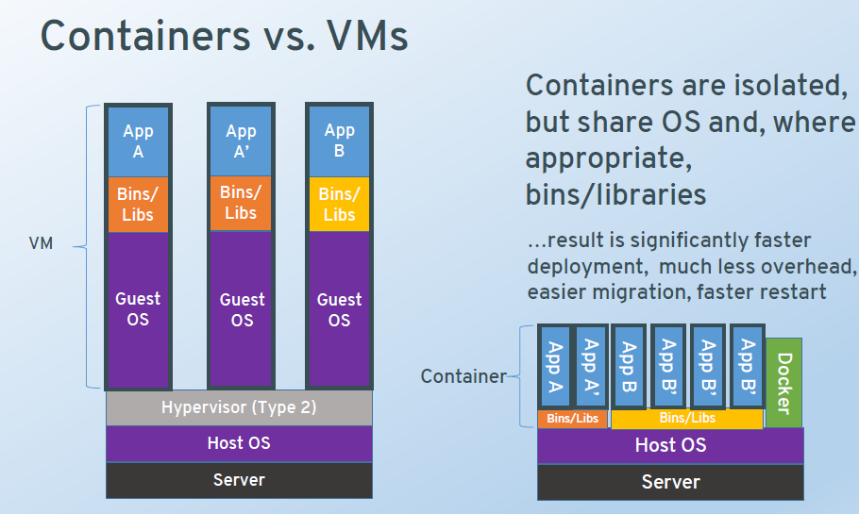

Slide 12
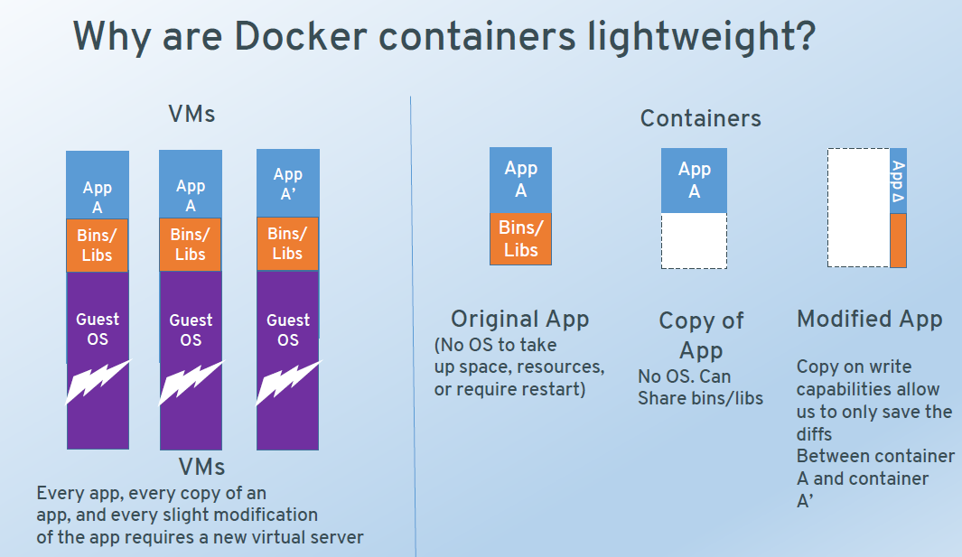

Slide 13
Notes – VM vs Docker
Docker originally used LinuX Containers (LXC), but later switched to runC (formerly known as libcontainer), which runs in the same operating system as its host. This allows it to share a lot of the host operating system resources. Also, it uses a layered filesystem (AuFS) and manages networking.
AuFS is a layered file system, so you can have a read only part and a write part which are merged together. One could have the common parts of the operating system as read only (and shared amongst all of your containers) and then give each container its own mount for writing.
So, let's say you have a 1 GB container image; if you wanted to use a full VM, you would need to have 1 GB times x number of VMs you want. With Docker and AuFS you can share the bulk of the 1 GB between all the containers and if you have 1000 containers you still might only have a little over 1 GB of space for the containers OS (assuming they are all running the same OS image).
A full virtualized system gets its own set of resources allocated to it, and does minimal sharing. You get more isolation, but it is much heavier (requires more resources). With Docker you get less isolation, but the containers are lightweight (require fewer resources). So you could easily run thousands of containers on a host, and it won't even blink. Try doing that with Xen, and unless you have a really big host, I don't think it is possible.
A full virtualized system usually takes minutes to start, whereas Docker/LXC/runC containers take seconds, and often even less than a second.
There are pros and cons for each type of virtualized system. If you want full isolation with guaranteed resources, a full VM is the way to go. If you just want to isolate processes from each other and want to run a ton of them on a reasonably sized host, then Docker/LXC/runC seems to be the way to go.

Slide 14
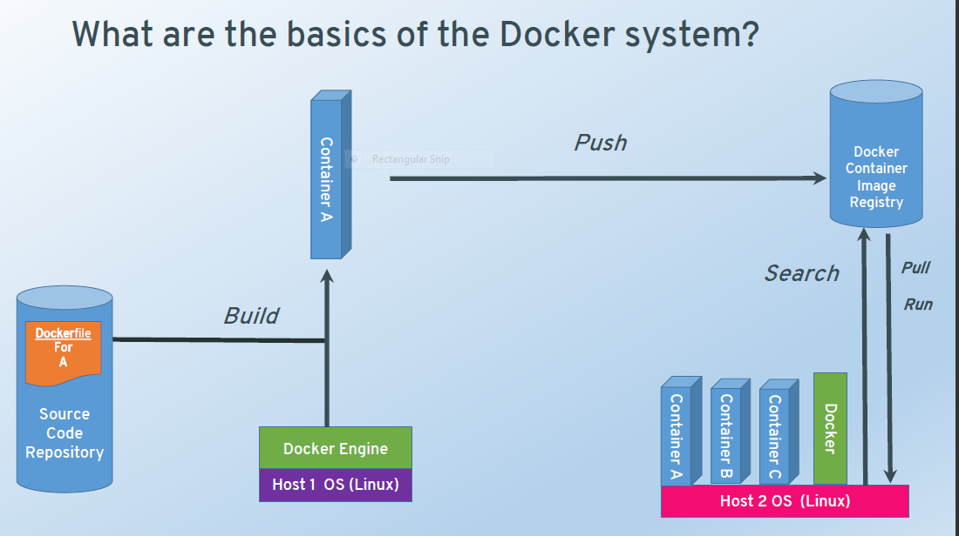
Notes:
Docker Workflow

Slide 15
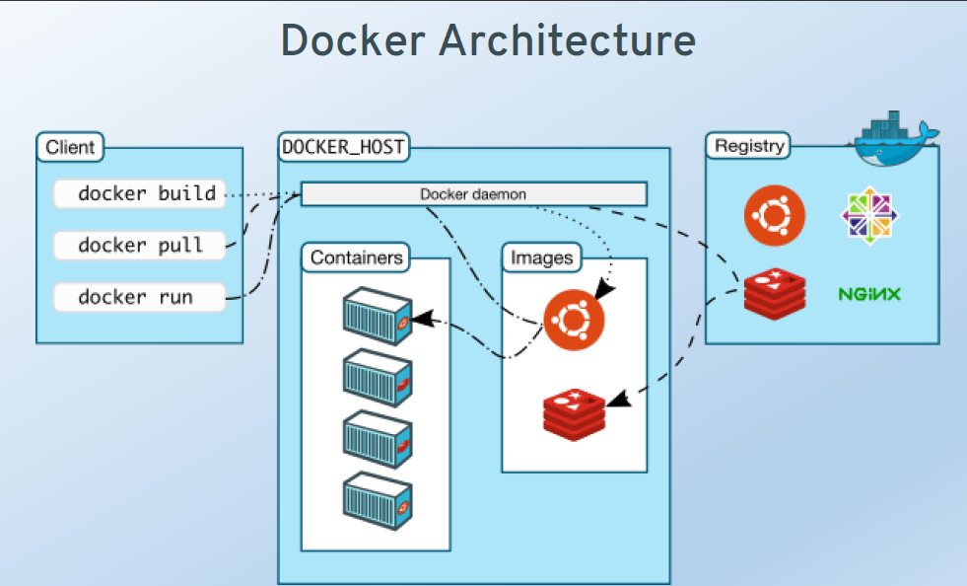
Notes:
Registry can be public or private/paid

Slide 16
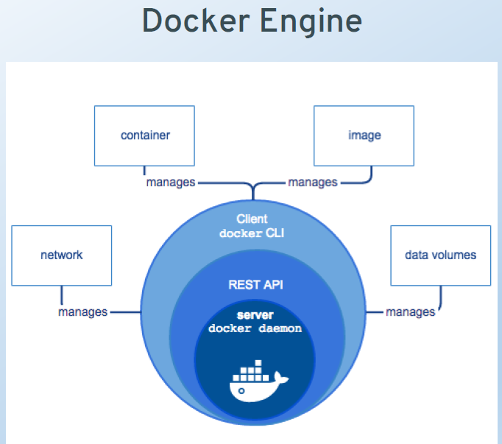

Slide 17
Install Docker on Centos
sudo yum install docker
sudo service docker start
sudo chkconfig docker on #(start at boot) docker info
docker version
sudo service docker restart
Notes:
Doing on Ubuntu
- Either Ec2 instance with ubuntu or Vagrant image with ubuntu

Slide 18
Images and Containers
Container : isolated Docker process
Lifecycle
docker create creates a container but does not start it.
docker rename allows the container to be renamed.
docker run creates and starts a container in one operation.
docker rm deletes a container.
docker update updates a container's resource limits.

Slide 19
Images
Templates for Docker container. It is the build component of Docker. You can create images, update them or pull images built by others.
Lifecycle
docker images shows all images.
docker import creates an image from a tarball.
docker build creates image from Dockerfile.
docker commit creates image from a container, pausing it temporarily if it is running.
docker rmi removes an image.
docker load loads an image from a tar archive as STDIN, including images and tags (as of 0.7).
docker save saves an image to a tar archive stream to STDOUT with all parent layers, tags & versions (as
docker history shows history of image.
docker tag tags an image to a name (local or registry).

Slide 20
Images and Containers
To install ubuntu container
Sudo su
Docker run ubuntu:latest
this will download the image, execute default cmd which is sh and then exit { ie it will start and stop immediately}
Docker search Ubuntu
To limit search
docker search -s 10 ubuntu (limit results to 10)
sudo docker pull ubuntu:14.04 # gets version 14.04 of ubuntu
To start the container again
docker run -it –d ubuntu:latest /bin/bash
docker exec <containerid> echo "HELLO FROM CONTAINER“
Docker exec <containerid> du -mh
docker attach <containerid>
docker logs <containerid>
Notes:
Difference between run and start

Slide 21
Revise
Search , pull , run, create, start, attach, detach
More commands
Inspect, exec ,logs ,stop, kill, flags for ps, rm, rmi ,
Notes:
Exercise : run docker image of ubuntu in detached mode
Docker exec <cotainerId/name> du –mh
Docker exec <cotainerId/name> uname –a
Docker exec <cotainerId/name> hostname
Docker exec <cotainerId/name> echo “Hello World”
docker run -itd --name test ubuntu /bin/bash -c "while true; do echo Docker rocks; sleep 1; done"
Docker logs test

Slide 22
docker start -a -i `docker ps -q -l`
docker start start a container (requires name or ID) -a attach to container -i interactive mode docker ps List containers -q list only container IDs -l list only last created container
docker start $(docker ps -a -q --filter "status=exited") # start all conatiners which exited
Notes:
Exercise : start busybox containers with name without name with run , with start
Kill by containerId or name , stop some by container id or name
Kill bulk , rm all containers
Remove an image

Slide 23
Fun with docker run
cid=$(docker run -itd ubuntu)
docker attach $cid
ulimit -a
cid=$(docker run -itd --ulimit nofile=1024:1024 ubuntu)
docker attach $cid
ulimit –a
cid=$(docker run -itd --ulimit nofile=1024:1024 --ulimit core=102400 --ulimit nproc=1000 --ulimit nice=100 --ulimit memlock=8196 --ulimit fsize=8192 --ulimit rss=4096 --ulimit cpu=4 --ulimit locks=1000 --ulimit sigpending=100 --ulimit msgqueue=1000 --ulimit nice=100 --ulimit rtprio=100 ubuntu)
docker attach $cid
ulimit -a

Slide 24
Notes on containers
You start a container from base image of say just ubuntu
You login to container , install apache webserver.
You stop the container , you restart it
U can see that apache is still there
What happens when u remove the container and launch a new one?

Slide 25
Install new stuff on base container
docker run -itd --name job1 ubuntu /bin/sh
sudo docker run --name WebServer -p 9999:80 -t -i ubuntu:14.04 /bin/bash
apt-get update
apt-get install apache2
service apache2 start
To test : install curl on docker container
Apt-get install curl
Curl localhost
When you restart the container, you can see that apache is already available
docker start WebServer /bin/bash
docker attach WebServer
docker commit -m "Apache web server" -a “Anju" WebServer ubuntu:Apache
Docker history ubuntu:Apache
Notes:
Note in virtualbox it may be necessary to configure port fwding in the vm definition
IN AWS it will work without further configuration
THIS IS AN EXERCISE : ON BASE IMAGE OF UBUNTU , COMMIT an install of apache

Slide 26
Setting environment variables
Docker supports setting environment variables with the -e switch.
# docker run -e FOO=bar busybox env
Multiple variables can be added with multiple -e switches.
# docker run -e FOO=bar -e BAR=foo busybox env
Notes:
This runs the busybox container passing 2 env variables and list the environment variables available
EXERCISE : install open jdk on ubuntu and set JAVA_HOME

Slide 27
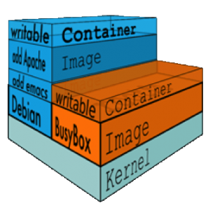
How file system works in docker
Docker images are stored as series of read-only layers. When we start a container, Docker takes the read-only image and adds a read-write layer on top. If the running container modifies an existing file, the file is copied out of the underlying read-only layer and into the top-most read-write layer where the changes are applied. The version in the read-write layer hides the underlying file, but does not destroy it — it still exists in the underlying layer. When a Docker container is deleted, relaunching the image will start a fresh container without any of the changes made in the previously running container — those changes are lost. Docker calls this combination of read-only layers with a read-write layer on top a Union File System.

Slide 28
Docker Volumes
Volumes = storage or use of hard disk
relate this as partition of Windows hard drive.
C :\ , D:\, E:\ …
On a unix machine run pvscan to list the volumes available
In order to be able to save (persist) data and also to share data between containers, Docker introduced volumes.
volumes are directories (or files) that are outside of the default Union File System and exist as normal directories and files on the host filesystem.
In Docker , you can
- Dynamically add file system when you run a container
- File system as part of image , all containers will have the file system
- Access host file system – but you cannot code this in your image
- share data between containers
Notes:
Union File system : layered file system , kernel , base (debian, redhat) apache, php, on top is writable - Multiple file system made to look like a single/unified file system
Volume bypass union filesystem
docker run -it -v /john1 busybox
Filesystem exist untill the container is removed
Docker exec <id> ls /john1

