Slide 1
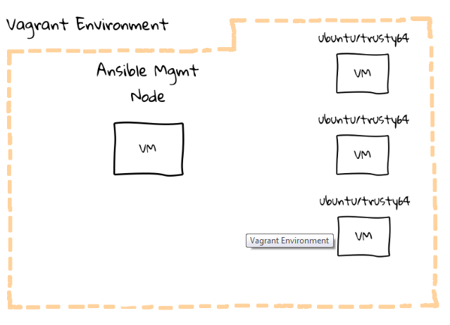
Setup for today

Slide 2
Ansible – configuration file
Its called ansible.cfg
master configuration file located in /etc/ansible
We can override this
How ansible looks for the configuration file
First checks if env variable called ANSIBLE_CONFIG is set
Then checks the current directory , then checks current user’s home directory
Then checks the master configuration file (/etc/ansible/ansible.cfg)

Slide 3
Inventory.ini
Ansible needs to know about the nodes it is managing, so it checks file hosts under its working directory.
As I said we can override ansible configuration, so I am mapping hosts to inventory.ini in vagrant home directory.
i.e I am writing my own custom inventory file

Slide 4
vagrant@mgmt:~$ cat ansible.cfg
[defaults]
hostfile = /home/vagrant/inventory.ini
vagrant@mgmt:~$ cat inventory.ini
[lb]
lb
[web]
web1
web2
#web3
#web4
#web5
#web6
#web7
#web8
#web9
Verify connectivity of the vms by pinging them.
Notes:
There are groups called lb and web
Now how does ansible resolve these machines? Its because I have edited /etc/hosts with the ip address of the machines brought up using vagrant

Slide 5
We are ready now!
ansible all -m ping
This will fail because the hosts we are connecting to are unknown and ssh warns abt the same.
Solution
ssh-keyscan lb web1 web2 >> .ssh/known_hosts
lets now try
ansible all -m ping --ask-pass

Slide 6
Basic: Running Commands
ansible all -m ping -s -k -u vagrant
all - Use all defined servers from the inventory file
-m ping - Use the "ping" module, which simply runs the ping command and returns the results
-s - Use "sudo" to run the commands
-k - Ask for a password rather than use key-based authentication
-u vagrant - Log into servers using user vagrant

Slide 7
Adhoc commands examples
Install a package
ansible web1 -m apt -a "name=ntp state
=installed“
ansible web1 -m apt -a "name=ntp state=installed" –sudo
Deploying a Configuration File
ansible web1 -m copy -a "src=/home/vagrant/files/ntp.conf dest=/etc/ntp.conf mode=644 owner=root group=root" –sudo
Stopping, Starting, and Restarting Services
ansible web1 -m service -a "name=ntp state=restarted"

Slide 8
Ad-hoc Shell Commands
ansible all -m shell -a "uptime“
ansible all -m shell -a "uname -a“
ansible web -m shell -a "/sbin/reboot"

Slide 9
Establishing a SSH Trust
Our first playbook : this installs public key of vagrant user to all the nodes to be managed.
It will deploy an authorized ssh key onto a remote machine, which will allow us to connect without using a password.
The playbook is ssh-addkey.yml

Slide 10
Directives used in ssh-addkey.yml
hosts: to define which hosts in our hosts inventory, we want to target
sudo: to run commands as sudo
gather_facts: facts are gathered when a playbook is run against a remote node. Here it is turned off since we can visit it later.
tasks: here we deploy an authorized ssh key onto a remote machine, which will allow us to connect without using a password.
Notes:
include things like hostname, network addresses, distribution, etc. These facts can be used to alter Playbook execution behaviour too, or be included in configuration files, things like that. It adds a little extra overhead, and we are not going to use them just yet, so I turned it off.
Each task will have a name associated with it, and it is just an arbitrary title. next you define the module that you want to use. We are using the authorized_key module here which will help us configure ssh password less logins on remote machines

Slide 11
Before running the playbook
ls .ssh
We don’t yet have a public key for vagrant user, go ahead and create it.
ssh-keygen -t rsa -b 2048
Now that we have the public key we can execute the playbook
ansible-playbook ssh-addkey.yml --ask-pass

Slide 12
Ansible is idempontent
ansible-playbook ssh-addkey.yml
-- this time without password
Lets now try the adhoc command without password
ansible web1 –m ping
ansible web –m ping
ansible all –m ping

Slide 13
Lets try few more adhoc commands
ansible web1 -m apt -a "name=ntp state=installed "
This fails
Try again
ansible web1 -m apt -a "name=ntp state=installed" –sudo
ansible web1 -m copy -a "src=/home/vagrant/files/ntp.conf dest=/etc/ntp.conf mode=644 owner=root group=root" --sudo

Slide 14
More on facts
ansible web1 -m setup | less
Tons of facts are returned and are in json
ansible web1 -m setup -a "filter=ansible_distribution"
ansible web1 -m setup -a "filter=ansible_distribution*“
ansible web1 -m setup -a "filter=ansible_all_ipv4_addresses"
Notes:
Less allows you to see page by page for enormous outputs
Does ohai ring bell? Chef ….?

Slide 15
1 more playbook
ansible-playbook ntp-install.yml
here we are targeting all hosts and installing ntp package.
Note that ansible will only do a task if it needs to be done. We have already installed on web1 so lets look at the output of running the playbook and pay attention to web1

Slide 16
Templates
Lets now go over the playbook called
ntp-template.yml
And lets also diff it against ntp-install.yml
you can see ntp-template.yml has new directives called
vars:
template:

Slide 17
The template file
Templates are written using jinja2
Every template file will have a .j2 extension
The template ntp.conf.j2 will be able to substitute the variable from ntp-template.yml playbook, and insert value to make the ntp configuration file.

Slide 18
Clean up
Run ntp-remove.yml to uninstall ntp from all servers.

Slide 19
A tip on playbooks
To check the syntax of a playbook:
ansible-playbook myplaybook.yml --syntax-check
This will run the playbook file through the parser to ensure its included files, roles, etc. have no syntax problems.

Slide 20
Assignment
All the machines we targeted here was ubuntu
Can we control a centos as well? Try running the ssh-addkey.yml playbook after adding a host running centos to the inventory.

