Slide 1
Student Performance Dashboard
Managing, Analyzing, and Visualizing Student Data
Python + MySQL + Streamlit

Slide 2
Overview
- Python-based dashboard application
- Manages student performance data
- Features: Data storage, entry, querying, visualization

Slide 3
Project Structure
StudentPerformanceDashboard/
├── app.py
├── conn.py
├── db_create.py
├── db_insert.py
Each module handles a distinct function for modular development

Slide 4
Project Steps
1. Requirements Gathering
2. Database Design
3. Database Connection
4. Data Insertion
5. Application Logic
6. Testing
7. Documentation

Slide 5
Database Design: Students Table
- Stores basic student information
- Fields: student_id, name, age, gender
email, phone, city
enrollment_year, course_batch, graduation_year

Slide 6
Programming Table
- Tracks programming performance:
language, problems_solved
assessments_completed, mini_projects
certifications_earned, latest_project_score

Slide 7
Soft Skills Table
- Evaluates soft skills:
communication, teamwork, presentation
leadership, critical_thinking, interpersonal_skills

Slide 8
Placements Table
- Stores placement outcomes:
mock_interview_score, internships_completed
placement_status, company_name
placement_package, interview_rounds_cleared, placement_date

Slide 9
Database & Schema
- Relational Schema using student_id
- Implemented in db_create.py
- Sample data generated using Faker

Slide 10
Application Logic
- Implemented in app.py
- Features:
Querying
Reporting
Visualization (via Streamlit)

Slide 11
Testing & Documentation
- Test scripts and schema
- Handle edge cases
- Usage instructions
- Recommendations for future

Slide 12
Technical Stack
- Language: Python 3.x
- Database: MySQL
- Libraries: mysql-connector-python / PyMySQL, Faker, pandas, stdlib

Slide 13
Running the Project
```bash
python db_create.py
python db_insert.py
streamlit run app.py
```

Slide 14
Key Insights
- Modular design & reusability
- Data integrity through validation
- Extensibility for new features
- Centralized DB connection logic

Slide 15
Future Improvements
- Web-based dashboard
- User authentication
- Advanced analytics (e.g., ML)
- Automate data import/export

Slide 16
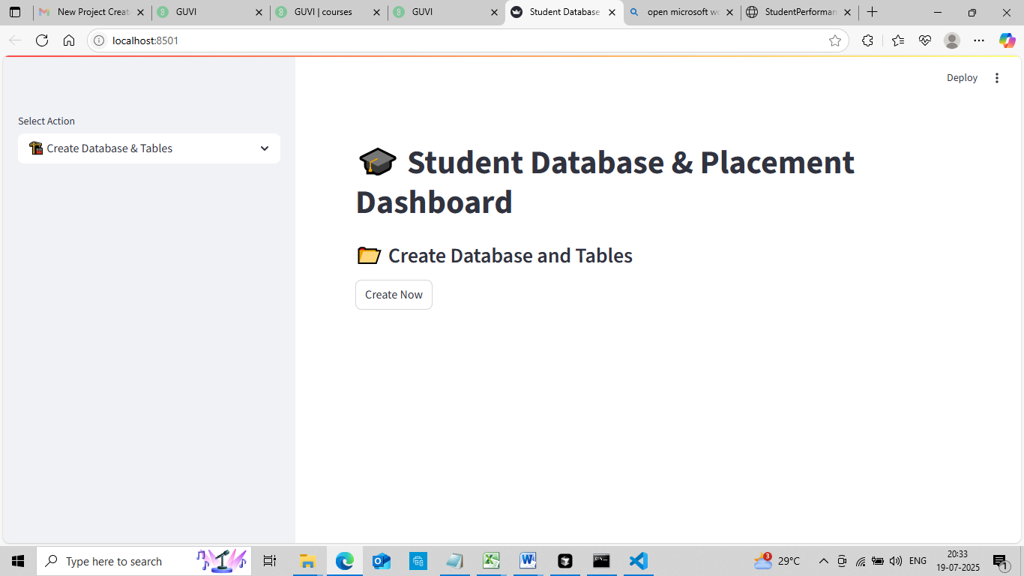
Screen Shots : Create Database and Tables

Slide 17
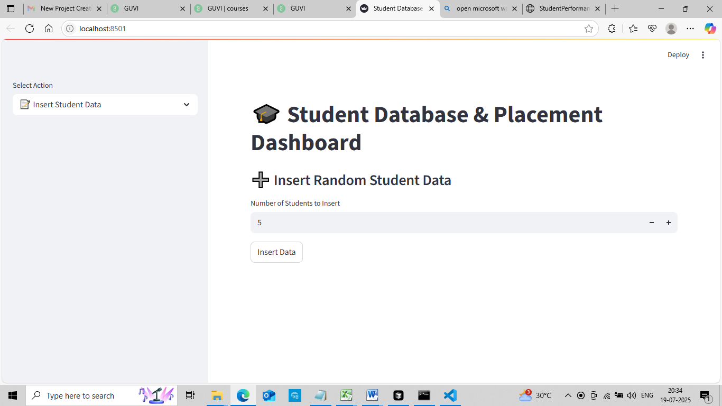
Insert Data in Table

Slide 18
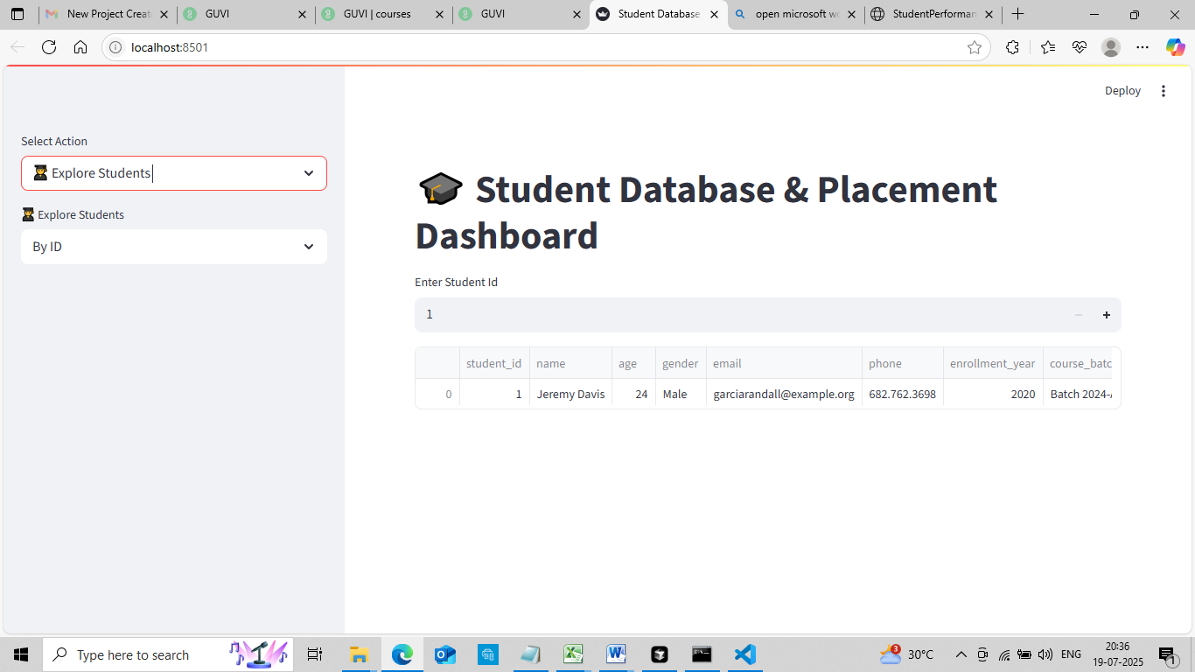
Explore Student details by Student Id

Slide 19
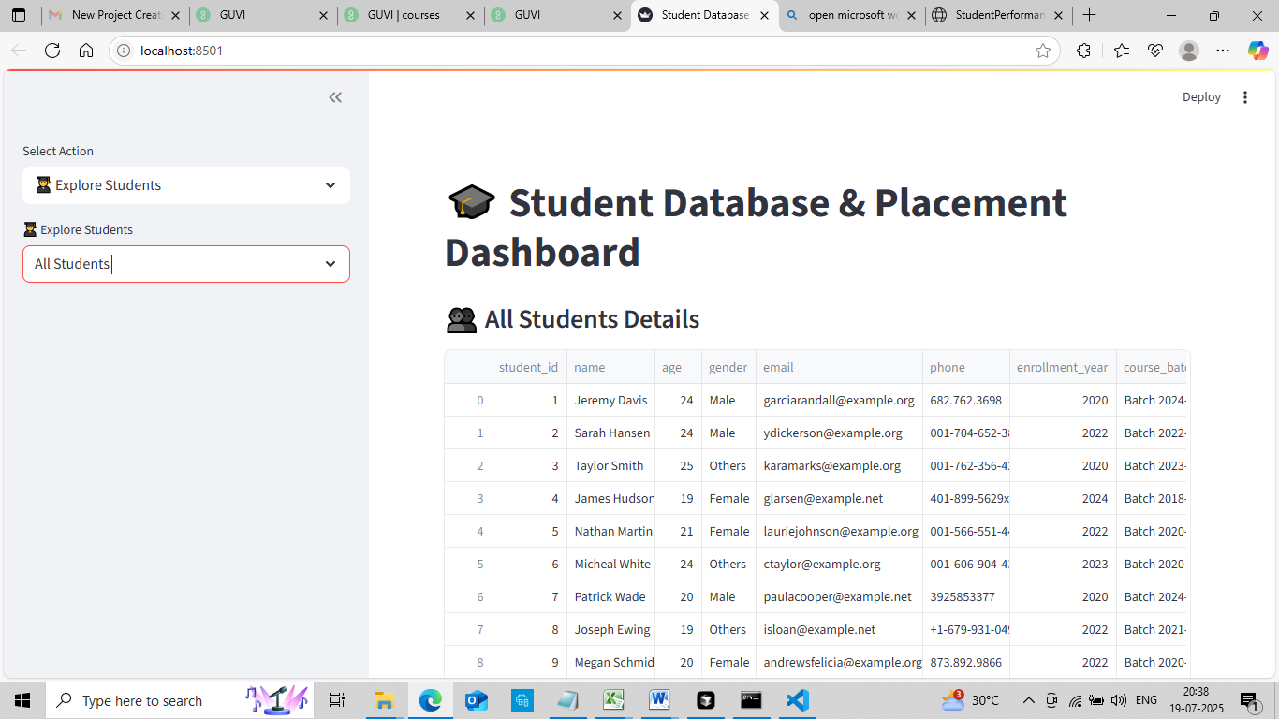
Explore All Students

Slide 20
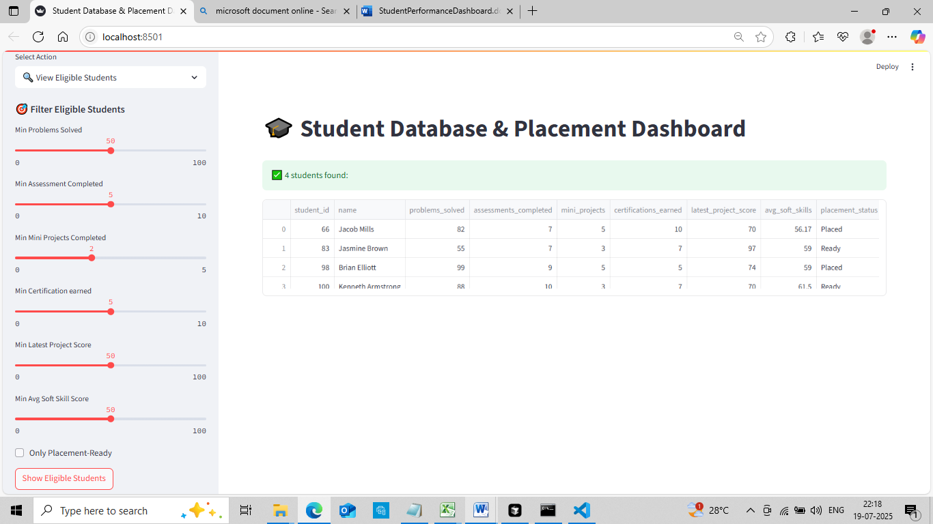
View Eligible Students dynamically

Slide 21
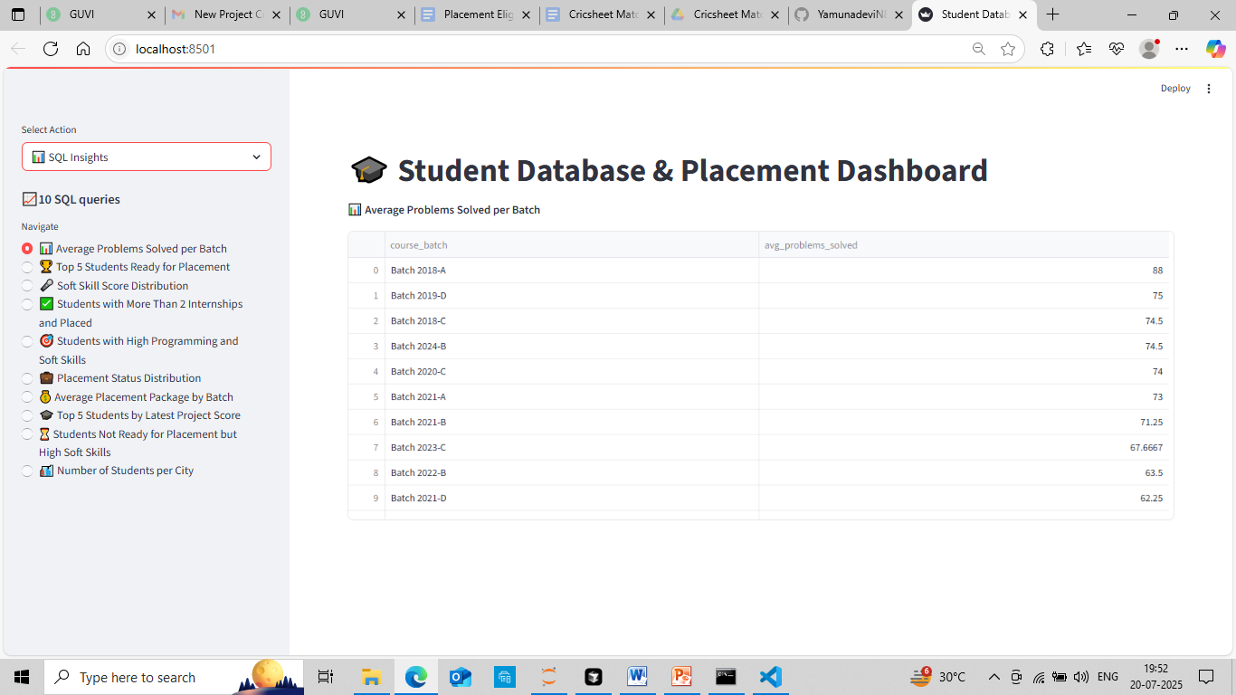
10 SQL Queries Insights

Slide 22
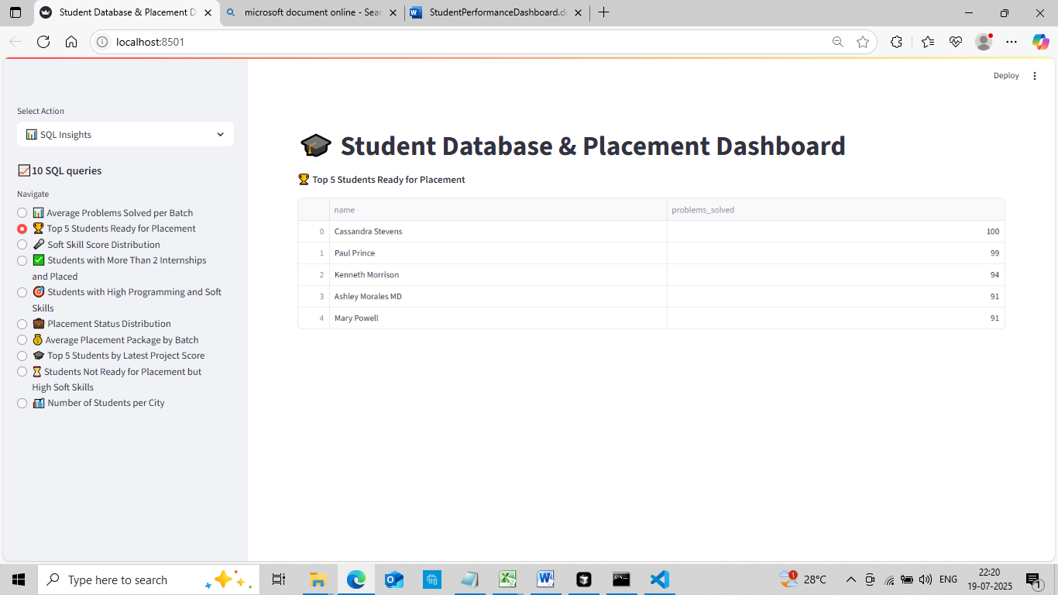

Slide 23


Slide 24
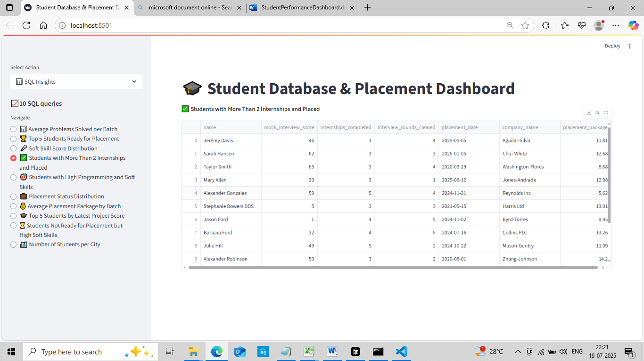

Slide 25


Slide 26
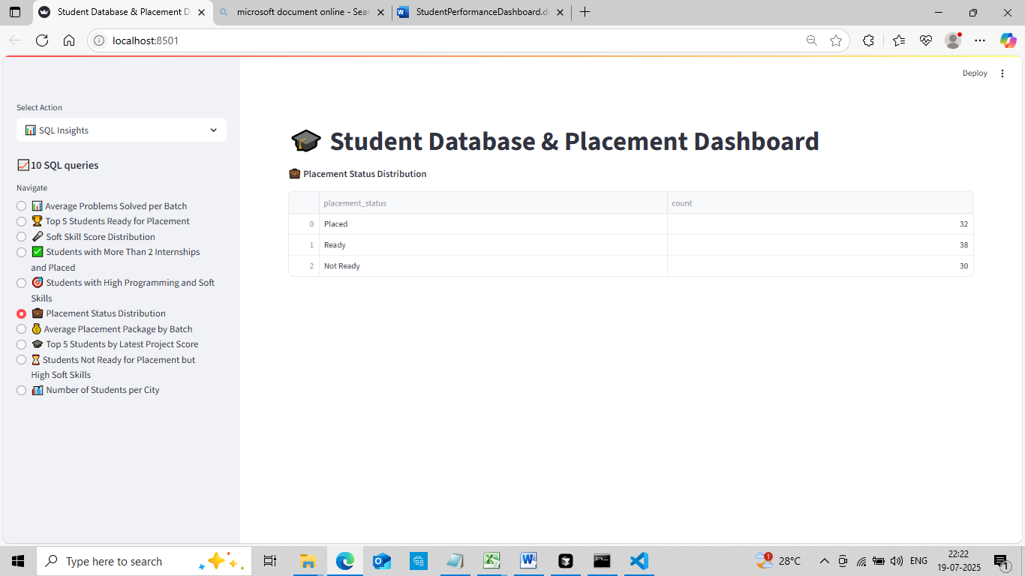

Slide 27
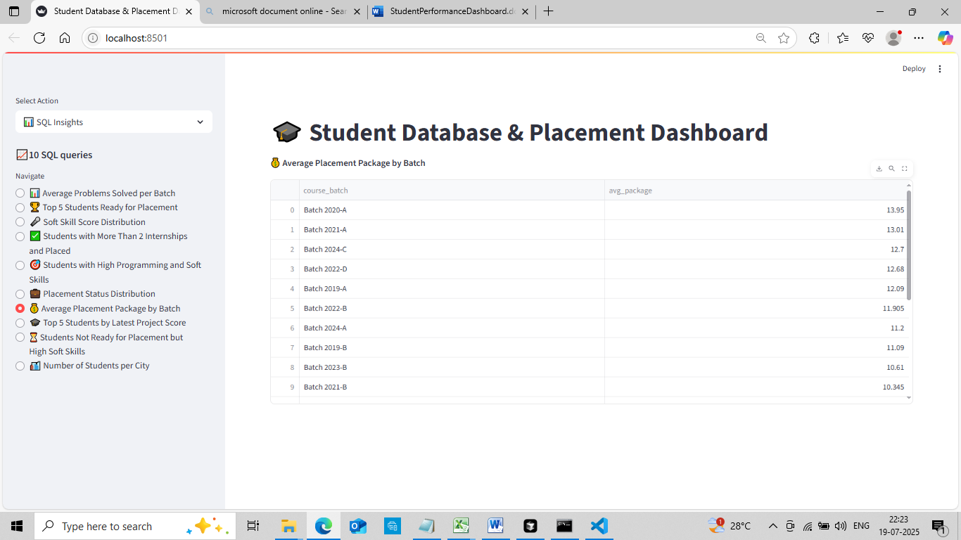

Slide 28


Slide 29
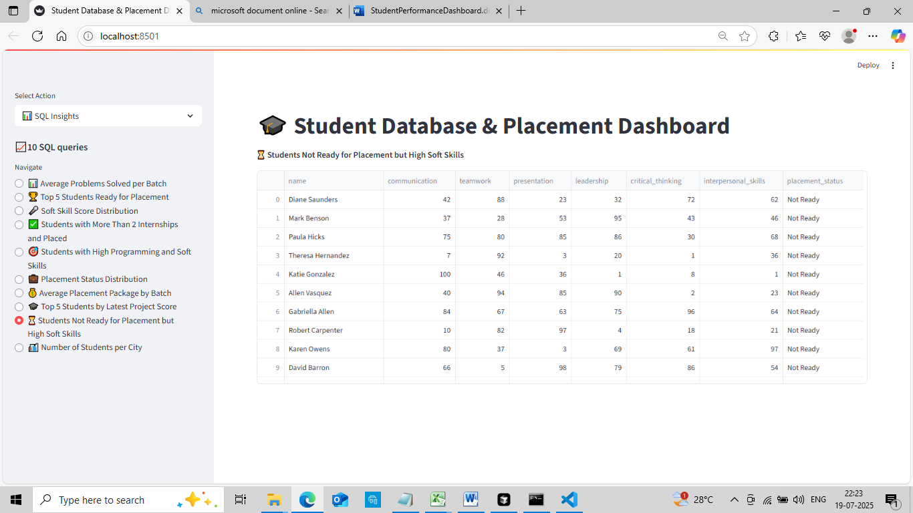

Slide 30
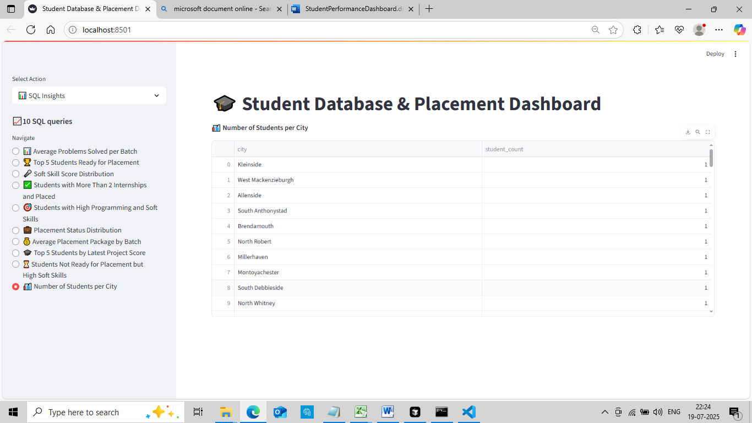

Slide 31
Conclusion
- Scalable foundation for student data analysis
- Modular & test-driven development
- Ready for real-world deployment

