Slide 1
DIGITAL PORTFOLIO
STUDENT NAME : YAMUNA SRI . K
REGISTER NO : 36336324U18077
DEPARTMENT : Bsc (computer science)
College :sree abiraami arts and science college for women
University :Thiruvalluvar university
Email no :yamunasri

Slide 2

PROJECT TITLE
This Photo by Unknown Author is licensed under CC BY-SA

Slide 3
AGENDA
PROBLEM STATEMENT
PROJECT OVERVIEW
END AND USERS
FEATURES AND FUNCTIONALITY
TOOLS AND TECHNOLOGIES
PORTFOLIO DESIGN AND LAYOUT
RESULTS AND SCREENSHOT
GITHUB AND PORTFOLIO LINK
CONCLUSION

Slide 4

PROBLEM STATEMENT
In the digital age, individuals across various fields—such as design, technology, education, and the arts—require professional and engaging ways to showcase their work online. Traditional resumes and static portfolios often fail to fully capture a person's skills, creativity, and growth over time. Many existing digital portfolio platforms lack customization, interactivity, and integration with modern tools, making it difficult for users to create a dynamic and personalized representation of their work. There is a need for an intuitive and flexible digital portfolio solution that allows users to easily present diverse types of content, reflect their unique identity, and keep their audience engaged.

Slide 5
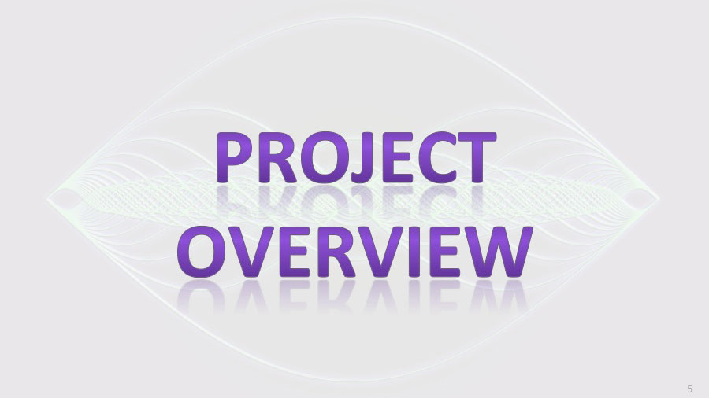
PROJECT OVERVIEW
The Digital Portfolio project aims to design and develop an interactive, user-friendly platform that allows individuals to showcase their skills, experiences, and creative work in a professional and visually appealing manner. This platform will support various content formats such as text, images, videos, code snippets, and project links, offering users the flexibility to build a personalized online presence. With features like customizable templates, responsive design, social media integration, and real-time updates, the digital portfolio will serve as a dynamic tool for job seekers, freelancers, students, and professionals to effectively present their work and achievements to potential employers, clients, or academic institutions.
This Photo by Unknown Author is licensed under CC BY-SA-NC

Slide 6

WHO ARE THE END USERS
The primary end users of the digital portfolio platform are individuals who need to present their work, skills, and achievements in a structured and engaging format. This includes students building academic or project-based portfolios, job seekers showcasing resumes and professional experience, freelancers and creatives such as designers, artists, and photographers presenting their work to potential clients, and professionals in fields like software development, marketing, or education who want to maintain a strong online presence. Additionally, recruiters, hiring managers, educators, and collaborators serve as secondary users who access these portfolios to evaluate the qualifications, creativity, and credibility of the individual.

Slide 7
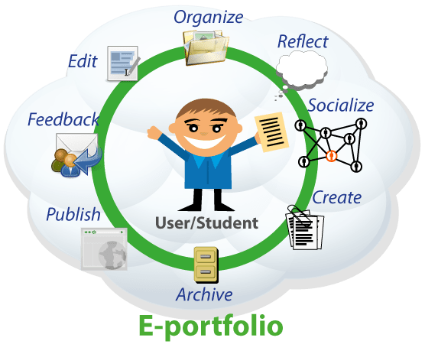
FEATURES AND FUNCTIONALITY
The digital portfolio platform will offer a range of features designed to enhance user experience, customization, and content presentation. Key functionalities include customizable templates, allowing users to tailor the layout, colors, and fonts to match their personal branding. The platform will support multimedia content such as images, videos, PDFs, code snippets, and embedded links for showcasing diverse work. A user-friendly drag-and-drop editor will simplify content management without requiring coding knowledge. Additional features include responsive design for mobile compatibility, social media and third-party integrations (e.g., LinkedIn, GitHub, Behance ), a contact form for direct communication, and SEO optimization to increase visibility. Users will also have the ability to update content in real time, track portfolio visits via analytics, and optionally protect sections with passwords for privacy.
This Photo by Unknown Author is licensed under CC BY-SA-NC

Slide 8

TOOLS AND TECHNOLOGIES
The digital portfolio platform will be developed using a combination of modern web technologies to ensure performance, scalability, and ease of use. The front-end will be built with HTML5, CSS3, and JavaScript, utilizing frameworks such as React.js or Vue.js for creating responsive and interactive user interfaces. On the back-end, Node.js with Express.js or Python with Django/Flask can be used to handle server-side operations and data management. For database management, MongoDB or MySQL will be implemented to store user data and portfolio content. Firebase or AWS may be used for hosting and authentication services. Additionally, third-party integrations such as GitHub, LinkedIn, or Google Analytics will enhance functionality, while Figma or Adobe XD may be used for UI/UX design and prototyping.

Slide 9
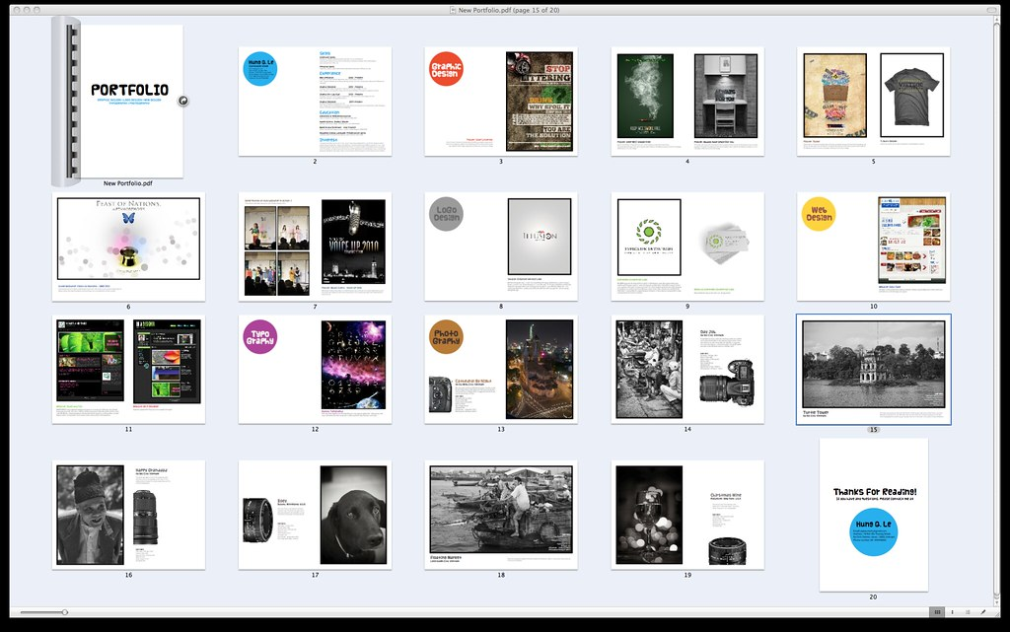
PORTFOLIO DESIGN AND LAYOUT
The design and layout of the digital portfolio will focus on clarity, responsiveness, and personalization to create a visually appealing and user-friendly experience. The layout will follow a clean, modern design with a modular structure, allowing users to organize content into clearly defined sections such as About Me, Projects, Skills, Resume, and Contact. Responsive design principles will ensure compatibility across devices and screen sizes, providing seamless access on desktops, tablets, and smartphones. Users will be able to choose from a selection of pre-designed templates or customize their layout with drag-and-drop functionality, color themes, font styles, and interactive elements. Emphasis will be placed on intuitive navigation, minimalistic aesthetics, and accessibility to ensure a professional and inclusive presentation of the user's work.
This Photo by Unknown Author is licensed under CC BY

Slide 10
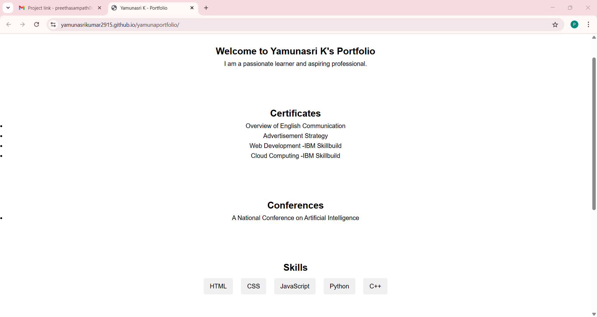
RESULTS ANS SCREENSHOT

Slide 11

GITHUB AND PORTFOLIO LINK
Portfolio link
https://yamunasrikumar2915/github/.demo
Github link
https://github.com/Yamunasrikumar2915

Slide 12


CONCLUSION
In conclusion, the digital portfolio project provides a powerful platform for individuals to present their skills, experiences, and achievements in a professional and engaging way. By combining modern design, responsive layout, and user-friendly features, the portfolio enhances personal branding and improves visibility in competitive environments such as job markets, academic admissions, and freelance opportunities. The integration of multimedia content, customization options, and real-time updates ensures that users can maintain a dynamic and current online presence. Overall, this digital portfolio serves as a versatile and impactful tool for showcasing talent, building connections, and advancing careers in the digital age.

