Slide 1
Mancala Defence
Game Program Designing - Final Presentation YAN Zehao, XIU Lei, XIAO Yang June 16, 2021

Slide 2
Mancala Defence
A modern game integrated with traditional game logic, offering a unique game mechanism.
A strategy game needs dynamic planning, with randomness involved.

Slide 3
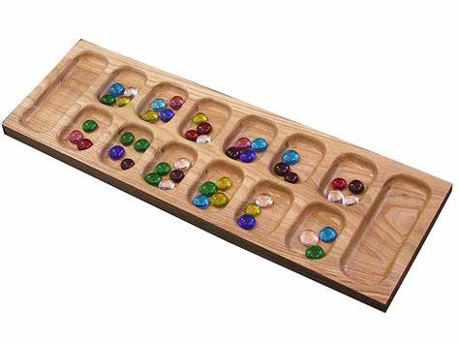
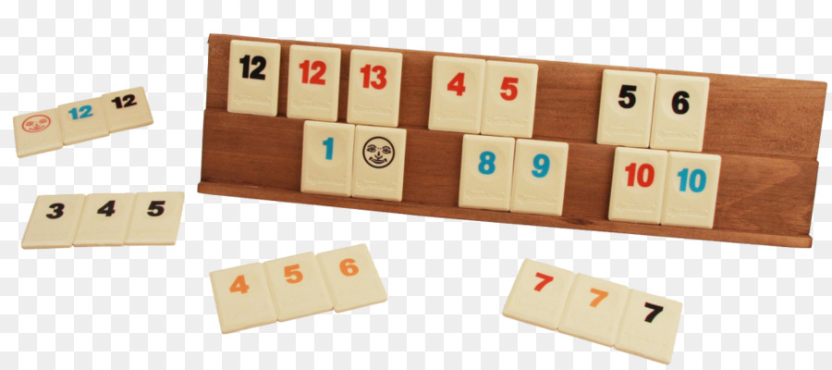
Game Mechanism Design
Mancala Defence is a tower defence game combining mechanisms of mancala and card drawing.
Mancala
Rummikub
(a card drawing game which mechanism we referenced)

Slide 4
Unit & Enemy Types
Unit type | Life | Damage | Skill
White | + | - | ++
Green | ++ | + | -
Red | - | ++ | +
Enemy Type | Life | Speed | Damage*
C. Enemy | 10 | 1 | 6
E. Enemy | 50 | 0.5 | 35
Q. Enemy | 50 | 2 | 110
Boss | 250 | 0.3 | 125
-: disadvantage, +: advantage, ++: great advantage
* damage = (0.2 + speed) * life * k,
where k is 0.5 for C. Enemy, and 1 for E. Enemy, Q. enemy and Boss.

Slide 5
Wave Information (Stage 2)
Wave | Enemy Type (path1 and path2) | #Enemy | Total Damage
1 | C. Enemy+C. Enemy | 2+2 | 24
2 | C. Enemy+C. Enemy | 5+3 | 48
3 | E. Enemy+C. Enemy | 2+5 | 100
4 | C. Enemy+E. Enemy | 20+5 | 295
5 | Q. Enemy+E. Enemy | 2+5 | 395
6 | Boss+Boss | 1+2 | 375
7 | Q. Enemy+Boss | 5+4 | 1050
8 | Boss+Q. Enemy | 30+80 | 12550

Slide 6
Cards and Coins
Unlike common defence games, players have two kinds of resources: cards and coins.
Cards are the major resource in this game. They are randomly drawn, and requires time to produce. The speed of drawing cards is related to the number of units on the player base.*
Coins are the minor resource in this game. They are gained by killing enemies.
The two kinds of resources have some common purposes. For example, player can upgrade units either by cards or coins(one by one).
* t = 5 / (sqrt(n)), where n is the number of units on the player base, t is the time it takes a player to draw a card.

Slide 7
Mancala
Once deployed, the unit is waiting for be destroyed, or change its place by Mancala. Mancala plays the following roles in the game:
The only way to place units on base.
Activate the cell for direct spawning later on.
Distribute units to avoid E. enemies form attacking the units on the whole cell.

Slide 8
Game Strategy
The effects of five options can be divided into short-term effects and long-term effects:
Short-term: Spawn unit, Fix unit
Long-term: Upgrade unit, Add hand limit, Mancala
If too many resource are used for long-term benefits , player cannot tackle the current situation.
If too many resource are used for short-term benefits, player cannot solve the future waves.

Slide 9
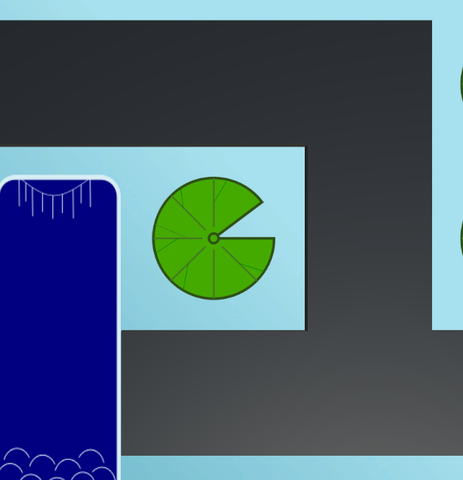
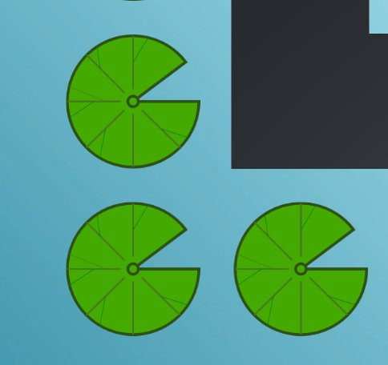
Cell Efficiency
Cells located inside the corner of enemy path and adjacent to two (or more) paths is considered efficient.
Cell of good efficiency
Cell of bad efficiency

Slide 10
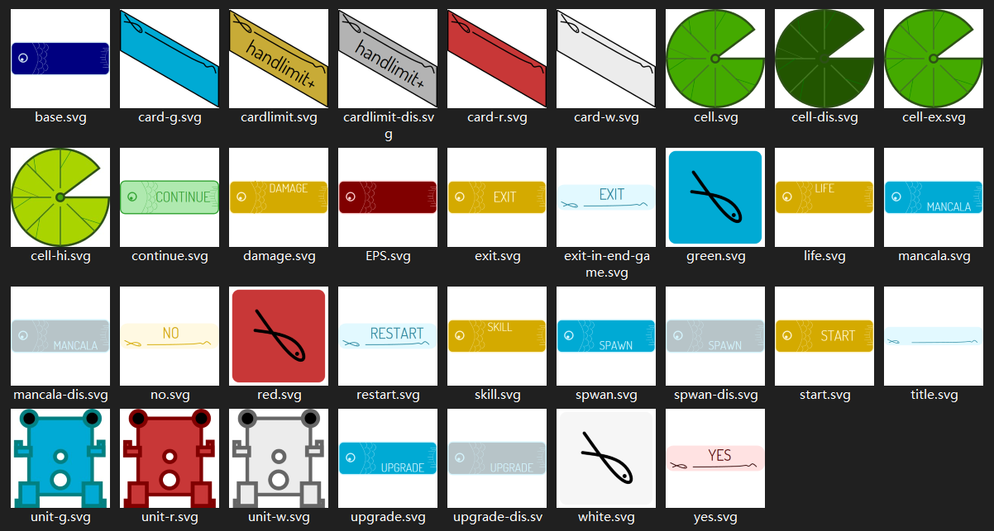
UI Design
The theme of UI is pond scene. The elements containing lotus leaves, frogs, pearls and carps. All created by ourselves.

Slide 11
For details, please see the project document.
Mancala Defence YAN Zehao, XIU Lei, XIAO Yang June 16, 2021

