Slide 1

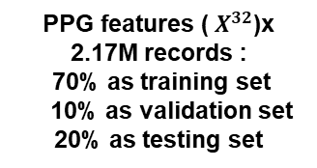
Feature Engineering
Step I : Noise Removal + Normalization + Abnormal Cycles Removal
Database
( MIMIC II )
PPG Raw Data
Step II : Features Point Detection + Features Extraction + Selection Algorithm +32 Selected Features
Neural Network
$X^{32}$x 2.17 M
Layer 1 : Dense(2048), activation = ‘relu’
Layer 2 : Dense(4096), activation = ‘relu’
Layer 3 : Dense(8192), activation = ‘relu’
Layer 4 : Dense(2048), activation = ‘relu’
Layer 5 :Dense(2), activation = ‘relu’
PPG features (${ X}^{32}$)x 2.17M records :
70% as training set
10% as validation set
20% as testing set
SBP
DBP

Slide 2

PPG Raw Data Preprocessing
Deep-Neural Network Predictor
Noise Removal
Input Layer:shape = 1x32,
Normalization and 1st, 2nd derivative of PPG waves
Layer 1 : Dense(2048), activation = ‘relu’
DBP
Database
( MIMIC II )
PPG Raw Data {X}
Features’ set
Layer 2: Dense(4096), activation = ‘relu’
Feature Points’ Detection
$η^{32}$ x 2.17M
Partitioning and Abnormal Cycles’ Removal
Layer 3: Dense(8192), activation = ‘relu’
SBP
Features’ Extraction and Selection Algorithm
Layer 4: Dense(2048), activation = ‘relu’
Output Layer: Dense(2),
activation = ‘relu’

Slide 3
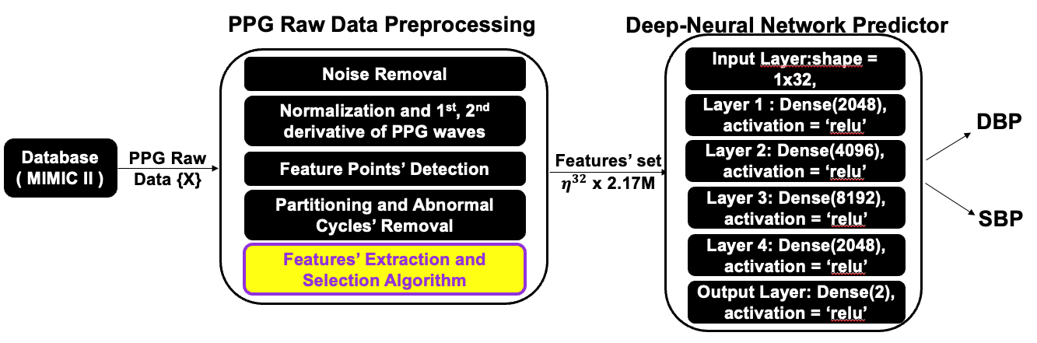


Zoom in view
A Perceptron Unit
Perceptron x 2048
$$⋯$$
Input = a
relu(w$∙$a + b)
SBP
DBP

Slide 4
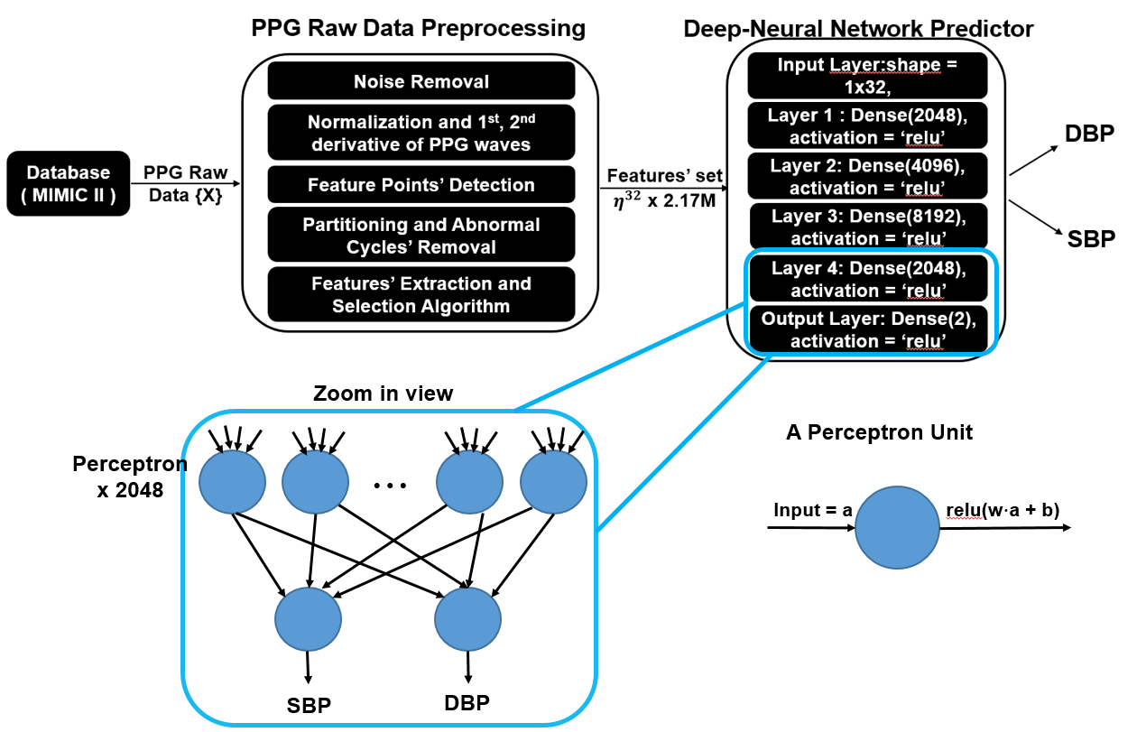

Slide 5
Comcom Project
Users’ UI
Comcom Frontend
Comcom Backend
Html/CSS/JS
Python Frontend (PyScript)
Python Backend (Django && Flask)
Route 53
Cloudfront
Anaconda
Docker
AWS Certificate Manager
OS: AWS EC2
OS: AWS EC2
AWS CLI
Staffs

Slide 6
User’s Web Browser
Serverless Framework
Html/CSS/JS
https requests
Cloudfront
S3
Internet Gateway and Router
https responses
AWS Certificate Manager
AWS EC2
AWS CLI
Website Maintainer

