Slide 1
Requests Process Direction
DNS Router
Edge Location: find the nearest response server
Requests
Web UI or CLI
Midway Authentication
Responses
Cloudfront: ACM authentication and link to App or Service
Sensai Platform

Slide 2
Personal Website Single Page
Personal Website Multiple Page
AWS Cert Manage
certbot
Encryption
Encryption
Users
Users
HTTPS
Next.js && React.js
HTTPS
Cloudfront
Nginx
GUI
S3
GUI
:8080
:80
:443
:443
AWS EC2
Ubuntu Azure VM
AWS CLI
Azure CLI
Me
Me

Slide 3
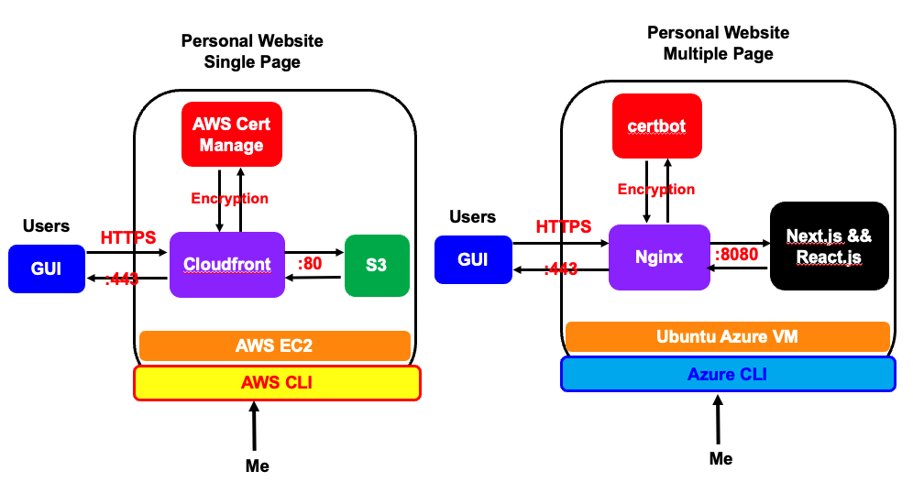

Slide 4
Comcom Project
≈
certbot
SQL Database
Encryption
:3306
Users
HTTPS
GUI
Nginx
React.js Frontend
Python Backend (Django && Flask)
:3000
:5000
:443
Docker
OS: Amazon Linux 2
AWS CLI
Staff

Slide 5



Sensai Tenant Directory App
Information Collection…
Customers: Onboarding Requests
Path Naming Guidelines
Information Collection…
Information Collected
Failed
Auto Validation and Promotion System
CreateTenant $λ$
Sensai Tenant Table(DB)
generateStagedList $λ$
Failed
CloudWatch
Sensai Team Member
Midway Factory
Staged Tenant List (S3)
Failed
Midway Endpoints
ValidateandPromote $λ$
Succeeded
Live Tenant List (S3)

Slide 6
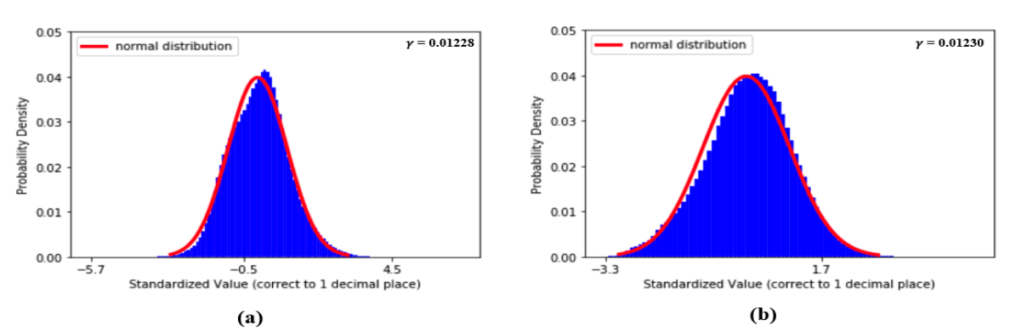


Slide 7
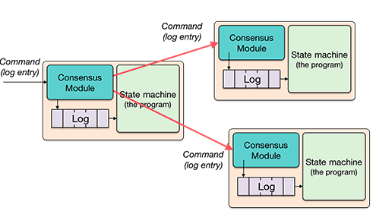
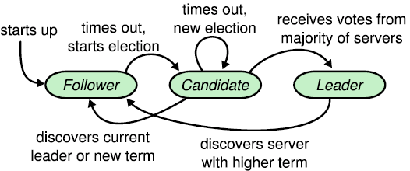
RAFT on File Sharing System

Slide 8
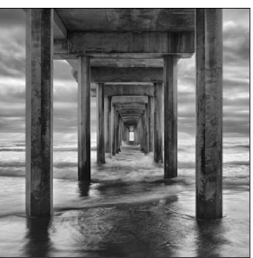
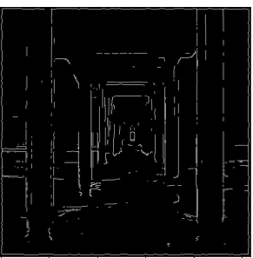

Slide 9
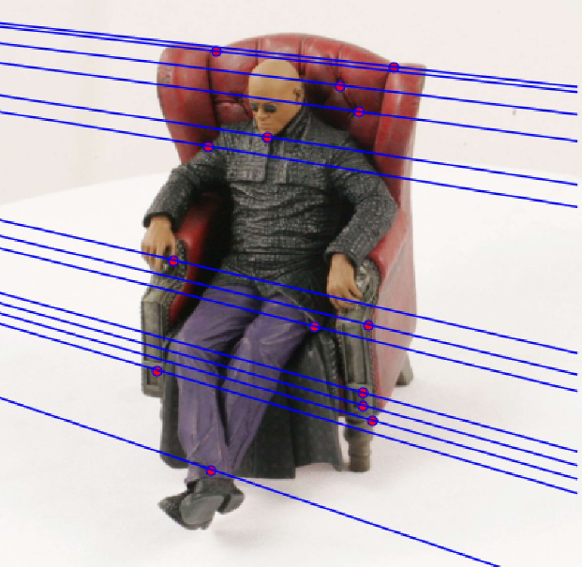
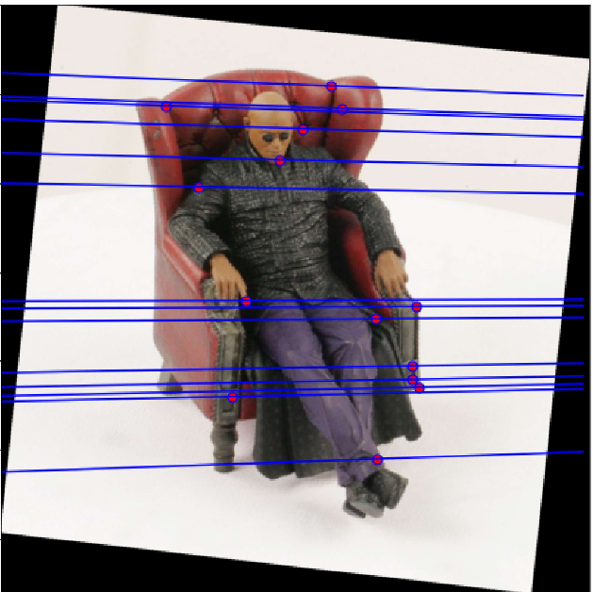

Slide 10
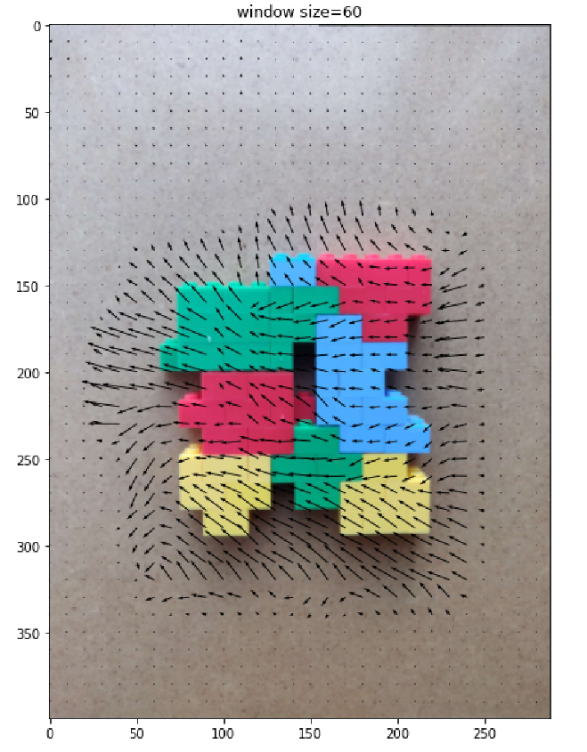

Slide 11
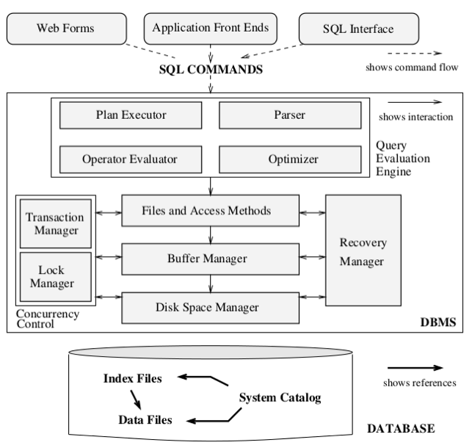
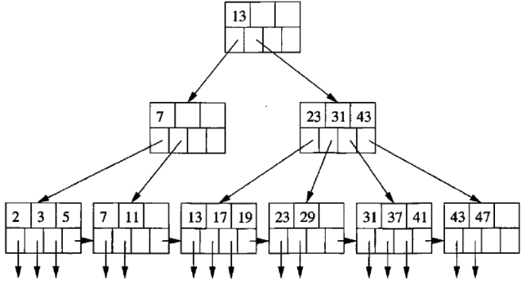
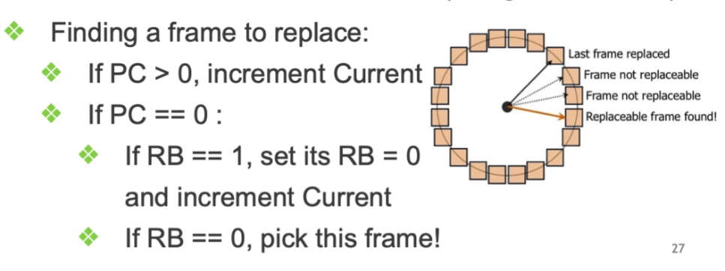
Database
B+ tree
Clock Algo

Slide 12









Designed and Modified
Users
Designed and Implemented
$$λ$$
$$GUI$$
Team Members
React.js
CloudFront
Cloud Watch
SNS
Notification System
Route 53
<->
s3
Servers
$$λ$$
$$DB$$
DynamoDB Stream
s3
S3 events
$$λ$$
Cookie Handler $λs$
$$λ$$
update/create
update/create
Access Controller
$$APIs/APP$$
DynamoDB
Access Control

