Slide 1

PART A: CLUSTERING
Customer segmentation
EDA and data preprocessing
PCA and model comparison
Choosing the number of clusters
Segment profiles and insights
200 customers before cleaning
198 customers after cleaning
AIML
CA2
PRESENTED BY:
YAN MYOE NAING

Slide 2

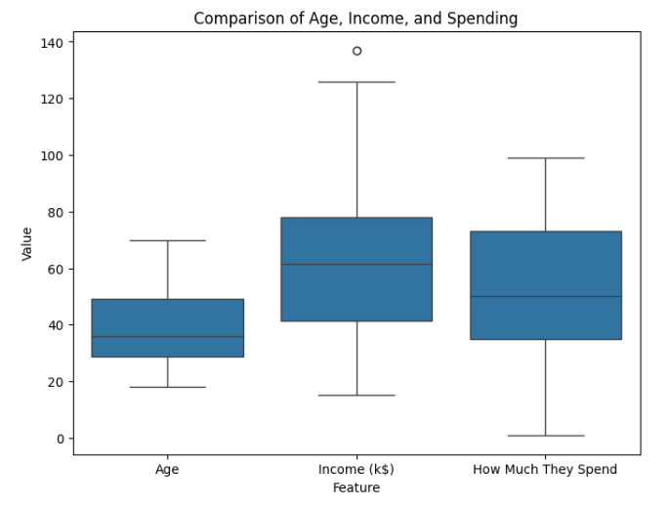

EDA AND DATA PREPROCESSING
Part
A
Checked 200 records. No missing values.
Reviewed Age, Income, Spending and Gender.
Removed 2 customers with income of $137k.
Dropped ID, encoded Gender, scaled numeric features.
EDA Key Findings
Age: 18–70 years
Income: $15k–$137k
Spending score: 1–99
Age and Spending show a negative trend
Income and Spending show a weak linear relationship
Gender shows no clear separation

Slide 3
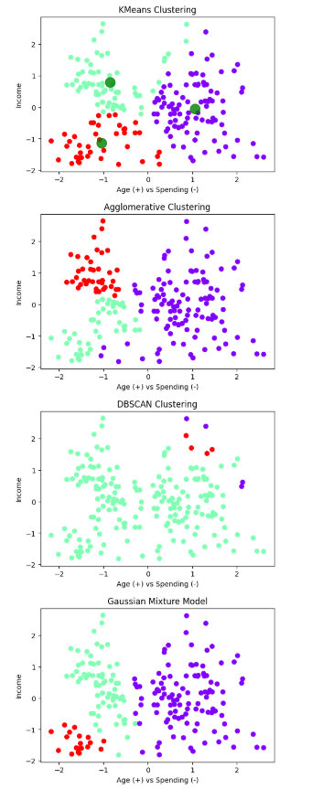
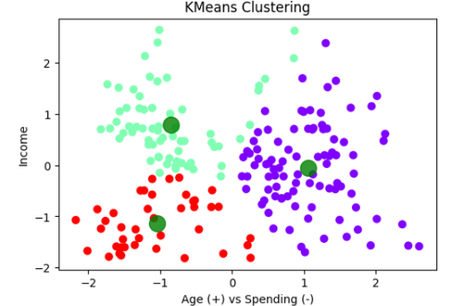
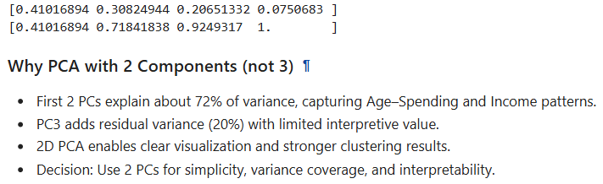
PCA AND MODEL TESTING
Part
A
    Reduced 4 inputs to 2 PCA components.
    PC1: Age (+0.706) and Spending (−0.706).
    PC2: Income (+0.999). Gender contributes little.
    The first 2 PCs retain 71.84% of variance.
    Compared KMeans, Agglomerative, DBSCAN and GMM. Also examined a Ward dendrogram.
Initial comparison at k = 3
KMeans: 0.419
Agglomerative: 0.367
GMM: 0.392
DBSCAN: 0.184 (includes noise)

Slide 4
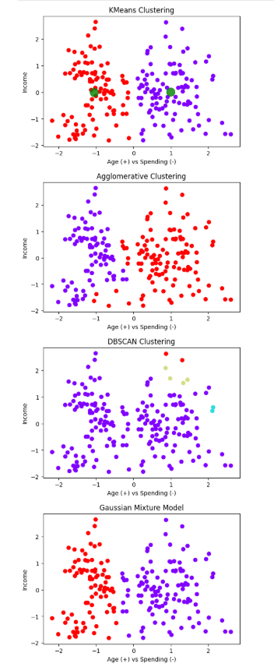
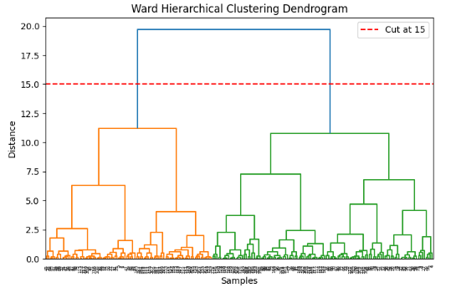

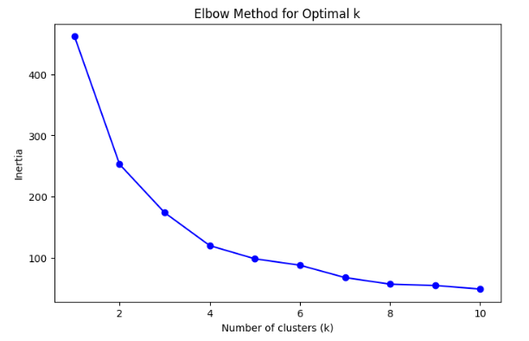
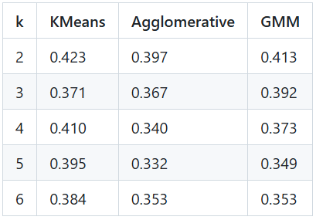
FINDING THE BEST K VALUE
Part
A
Tested k = 1–10 using Elbow Method (inertia curve).
Tested k = 2–6 using Silhouette Score
k = 2 gives the best tested silhouette scores.
Selected k = 2 and plotted the final clusters.

Slide 5



FINAL INSIGHTS
Part
A
    Age and Spending distinguish the two selected segments.
    DBSCAN scored 0.104 with eps = 0.5 and min_samples = 2.
Cluster 0
Cluster 1
Older, average income, lower spending.
Younger, average income, higher spending.
Age z-score: +0.71
Income z-score: 0.00
Spending z-score: −0.70
Test value offers and practical bundles. Lower spending alone does not prove price sensitivity.
Age z-score: −0.76
Income z-score: 0.00
Spending z-score: +0.74
Test loyalty rewards, premium offers and bundle upgrades.
Limits: 198 customers, 28.16% of variance omitted. Check stability across seeds and test campaign ideas before use.

