Slide 1
What career outcomes can graduates expect in Singapore, based on their degree choice and gender?
Sub-questions:
How do different degrees influence salary outcomes and extra benefits?
How does gender affect employment rates?
How does gender shape work‑life balance through differences in working hours?¶
YAN MYOE NAING
TAN HANG RUI RILEY
ST1510 Programming for Data Analytics

Slide 2

UI path Features
Download CA2 dataset from Brightspace.
Open excel file from mom.gov.sg
Save the excel file
Download External dataset
Extract(unzip) the CA2 dataset from step 1
Run Python file with start process
Send mail from outlook

Slide 3
Resources
ca2_df1, ca2_df2
https://splms.polite.edu.sg/d2l/le/dropbox/777145/695157/DownloadAttachment?fid=75856992
mom_df
https://stats.mom.gov.sg/iMAS_Tables1/LabourForce/LabourForce_2023/LFR2023_SectionF.xlsx
external_df
Employment Rate of Residents Aged 25 to 64 by Sex | MOM | data.gov.sg

Slide 4
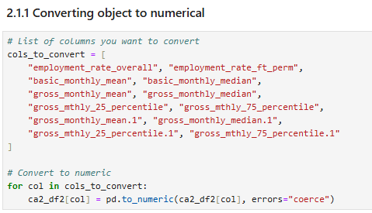
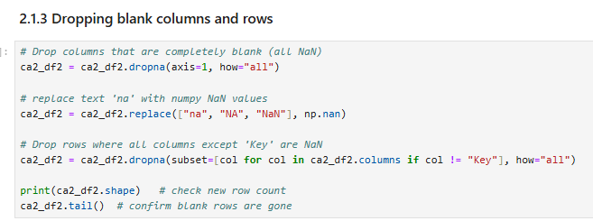
Dataset 1 – Importing and Inspecting Data
Imported dataset into a Pandas DataFrame
Used .head() and .info() to review structure and data types
Identified key variables: degree, salary, extra benefits
Performed initial type conversion for salary-related columns
Dropped blank columns and row using dropna

Slide 5
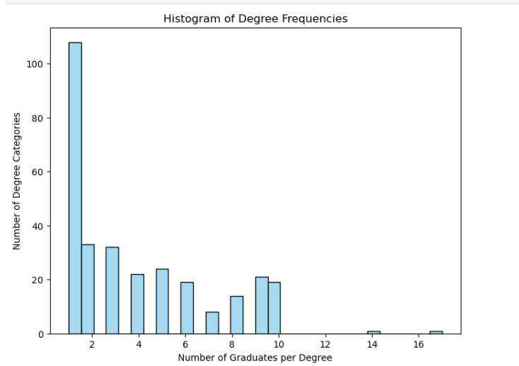
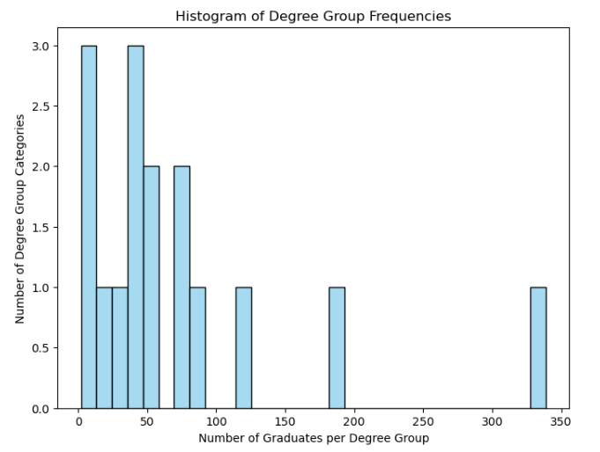
Dataset 1 – Standardisation and Preparation
Merged the two tables using keys
Handled duplicated rows using drop_duplicates() and dropped duplicated columns.
Used lambda function to check for outliers.
Scaled year range to be 2013:2022 for all datasets.
Used plt.hisplot to figure out the frequencies of the degrees across the dataset.
Standardized degree names into broader groups for comparison
Calculated extra benefits for each rows for later use
Before grouping degrees
After grouping degrees

Slide 6
Dataset 1 – Choice of Visualisation
Used boxplot to show salary distribution and variation across degrees
Used bar chart to compare average extra benefits between degree groups
Used pairplot with regression to study for relationships between the variables.
These graphs allow easy comparison of compensation differences
Outcome: Visualisations clearly highlight variation and group differences

Slide 7
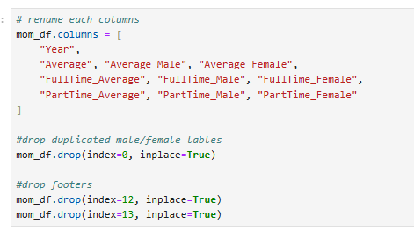
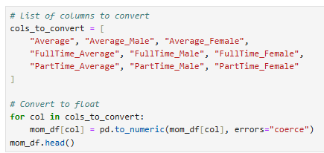
Dataset 2 –Inspecting and Processing Data
Loaded employment dataset into Pandas using pd.read_excel, selected sheet 8, skip 6 rows.
Reviewed structure and converted work hours to numeric format using for loop
Reformatted muti-layer labels
Dropped duplicated labels and footers
Checked for outliers in dataset using lambda function
Scaled year range to be 2013:2022 for all datasets.

Slide 8
Dataset 2 – Choice of Visualisation
Used line charts to show working hours over time
Used kde plot to compare working hours by gender
These graphs effectively show trends and differences between groups
Outcome: Visualisations make time-based and gender-based comparisons clear

Slide 9
Dataset 3
Imported dataset into Pandas DataFrame.
Reviewed structure and identified columns using .head().
No missing row or duplicated rows and columns in the dataset.
Scaled year range to be 2013:2022.
Choice of visualization: Heatmap that show Employment Rate by year and gender

Slide 10
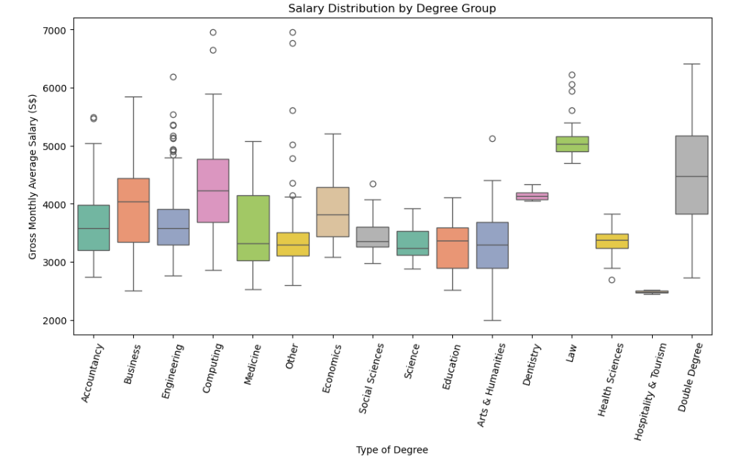
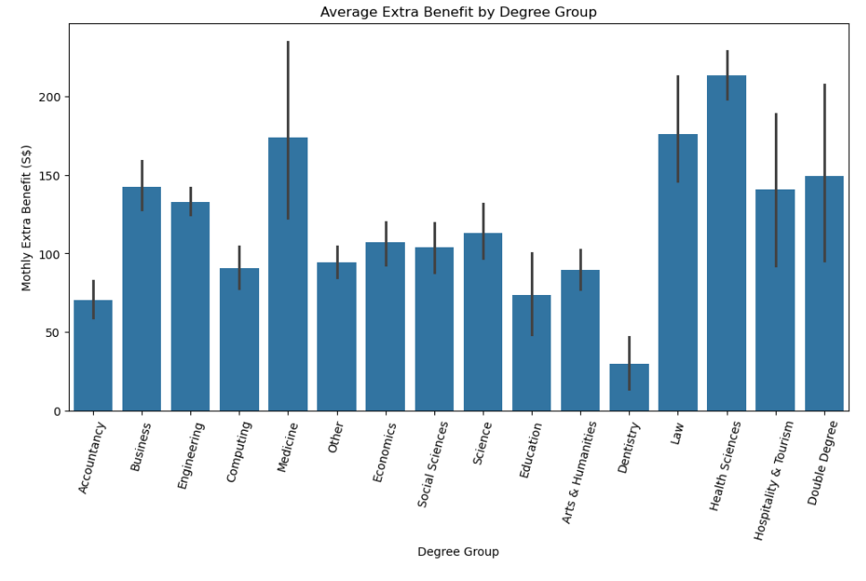
Sub Q1: How do different degrees influence salary outcomes and extra benefits?
Professional degrees such as Law, Dentistry and Double Degree graduates earn the highest salaries.
Hospitality & Tourism graduates earn the lowest salaries.
Medicine, Law and Health Sciences provide the highest extra benefits.
Degree choice strongly influences total compensation (salary + benefits).
Key Takeaway: Field of study is a major factor shaping a graduate’s earning potential and compensation package.

Slide 11
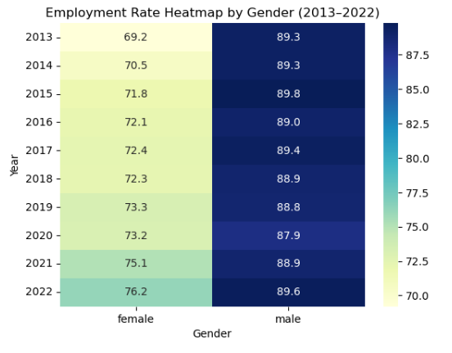
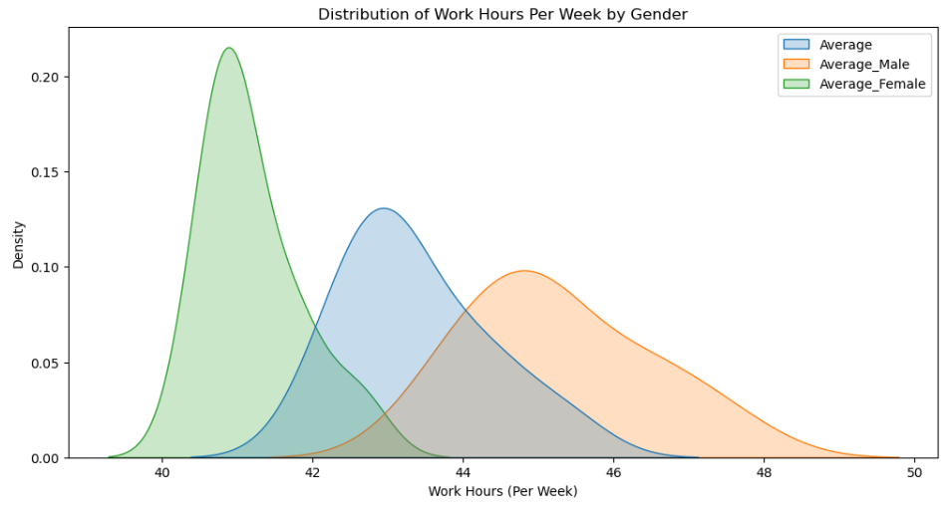
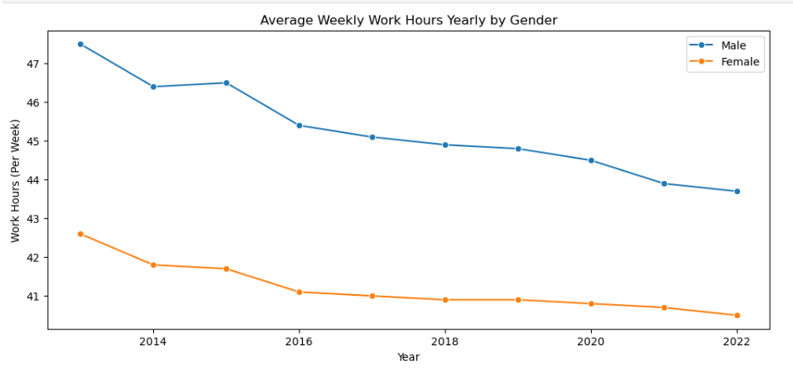
Sub-Question 2: How does gender affect employment rates?
Sub-Question 3: How does gender shape work‑life balance through differences in working hours?
Male employment rates remain consistently high (around 88–90%)
Female employment rates have increased steadily, narrowing the gender gap
Men work longer hours on average (45 hours vs 41 hours for women)
Weekly working hours for both genders are gradually decreasing
Key Takeaway: Gender differences in employment and workload are reducing over time, suggesting improving parity and work-life balance.

Slide 12
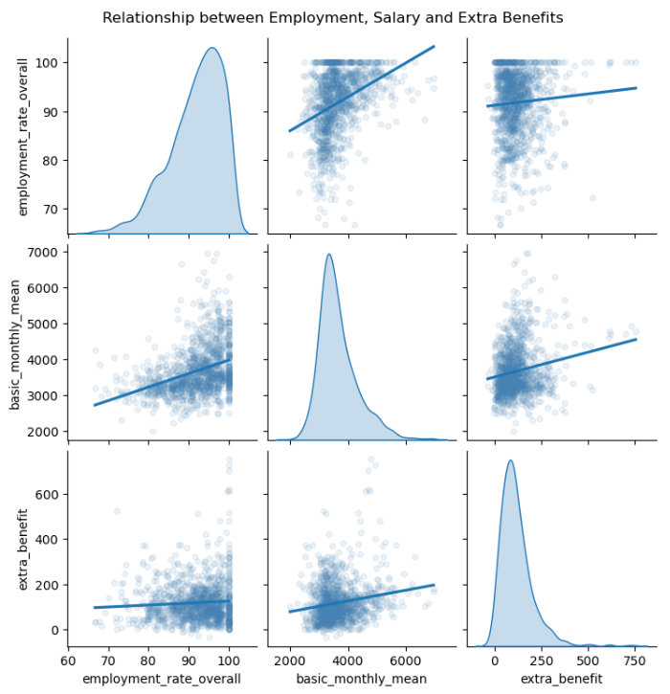
What career outcomes can graduates expect in Singapore based on degree choice and gender?
Higher salaries tend to come with more extra benefits
Degree choice mainly affects salary and benefits
Gender trends mainly influence employment rates and working hours
Final Answer:
Graduates in Singapore can expect strong employment prospects, moderate working hours, and salary outcomes that depend largely on their field of study, while gender differences in employment and workload continue to narrow.Big clear numbers:
Salary: ~SGD3500/month
Benefits: ~SGD100/month
Employment rate: >85%
Work hours: ~43 hours/week

Slide 13
Task Assignments
Task
Jupyter Notebook Data Preparation | Louis
Jupyter Notebook Graphical Data Analysis | Riley
Jupyter Notebook Final Insights | Louis
Uipath workflow and video | Louis, Riley
Presentation slides | Louis, Riley

