Slide 1

Data Science and AI
Mini Project 1
How Data can Drive Fairer Car Insurance Pricing
-- A Data Science Approach to Predicting Insurance Premiums
Yan Zhang
26 April 2025

Slide 2
Agenda
1. Introduction & Business Context
2. Data Overview & Problem Statement
3. Exploratory Data Analysis (EDA)
4. Hypothesis & Analysis
5. Modeling & Results
6. Conclusion & Insights

Slide 3

Introduction & Business Context
Business Problem:
Insurance companies need to predict car insurance premiums accurately to optimize pricing strategies based on factors such driver and vehicle characteristics.

Slide 4
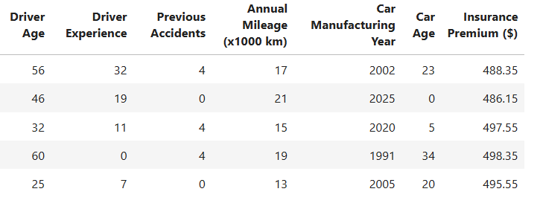
Data Overview& Data Problem
The dataset is from www.kaggle.com
Columns:
Driver Age, Driver Experience, Previous Accidents, Annual Mileage(x1000 km), Car Manufacturing Year, Car Age, Insurance Premium($)
Data Problem:
build a predictive model that can estimate car insurance premiums based on these features.

Slide 5
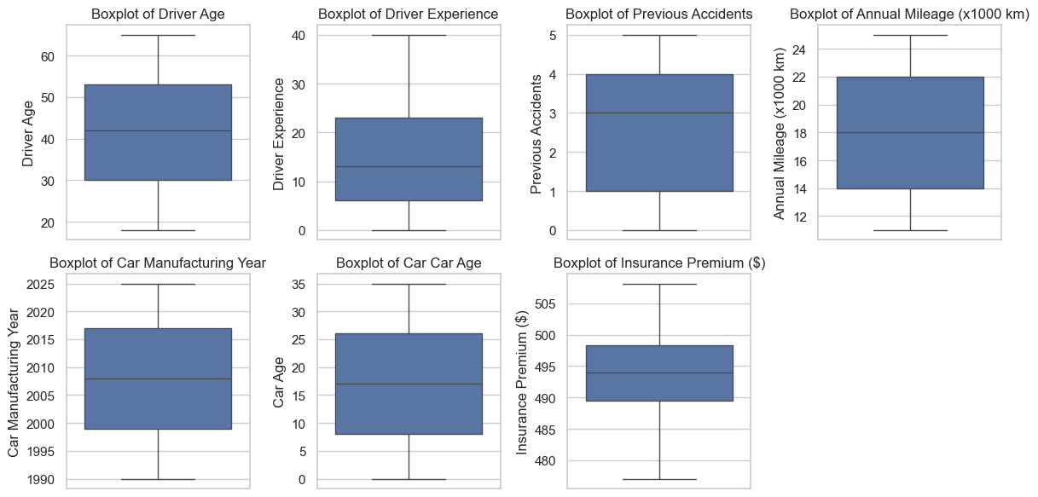
Data Wrangling & Cleaning
No NULL value
No duplicated rows
No outlier data

Slide 6
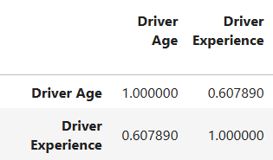
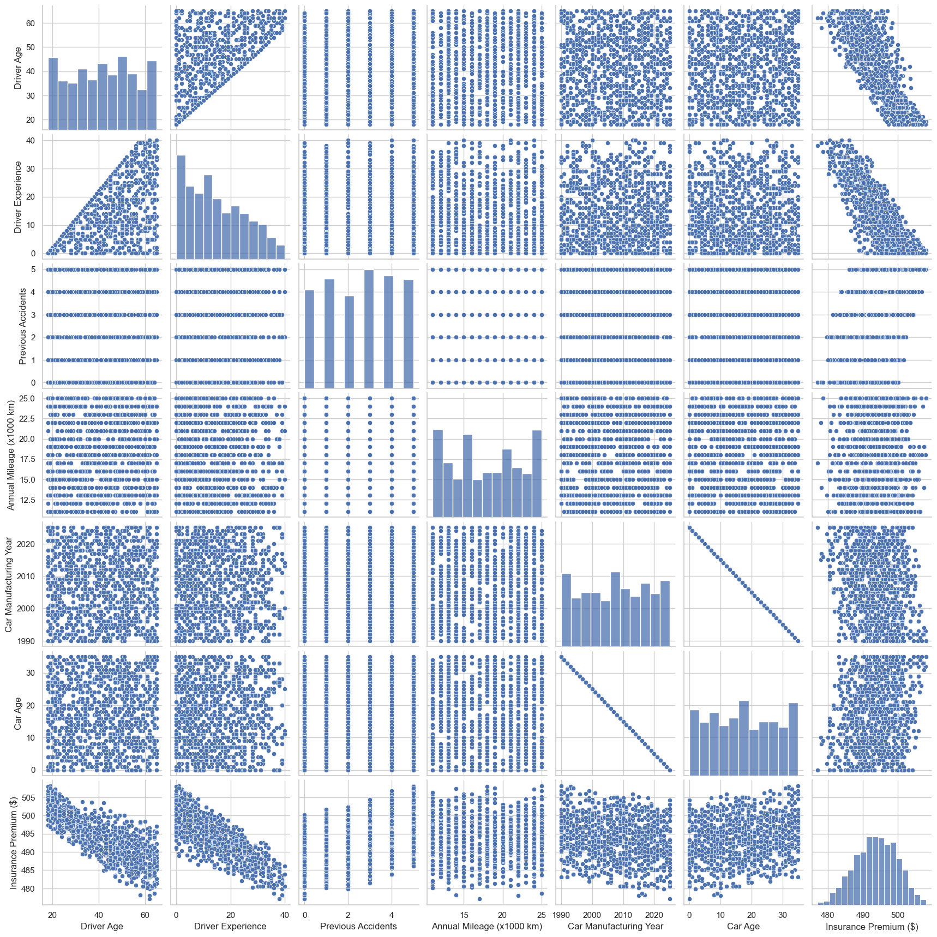
Exploratory Data Analysis (EDA)
Corraltion: Driver Age vs Driver Experience
Correlation (each feature vs Insurance Premium) :
Driver Experience -0.803323
Driver Age -0.776848
Car Manufacturing Year -0.171829
Annual Mileage (x1000 km) 0.022131
Car Age 0.171829
Previous Accidents 0.410786
Insurance Premium ($) 1.000000
pairwise plot matrix
Driver experience and driver age are the most strongly correlated with insurance premiums, both negatively
Driver age and driver experience are positively correlated with each other

Slide 7
Hypothesis Testing
Null Hypothesis (H₀):
"Driver Experience does not significantly affect car insurance premiums."
Alternative Hypothesis (H₁):
"Driver Experience significantly affects car insurance premiums."
Test Method:
A t-test was performed to check the significance of the relationship between Driver Experience and Premium.

Slide 8
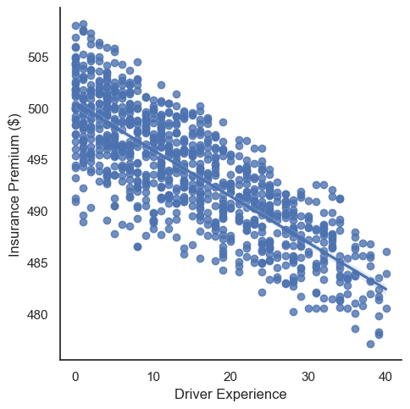
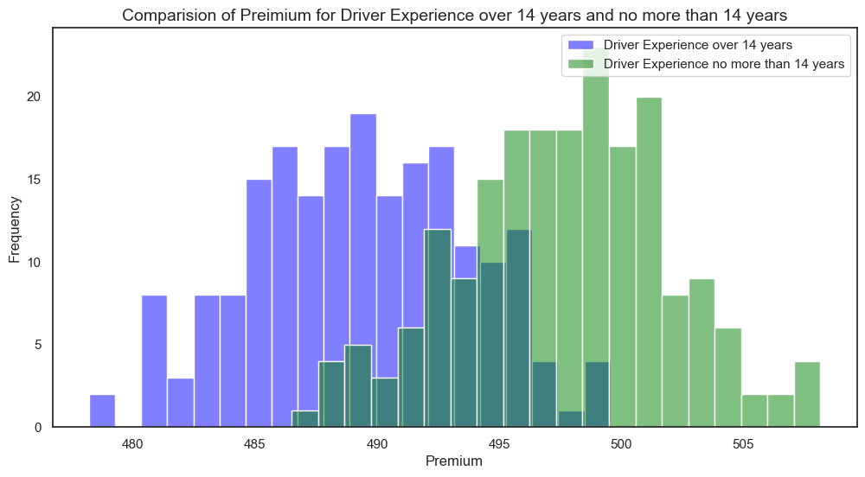
Hypothesis Testing – RESULTS & VISUALIZATION
alpha = 0.05
t = -18.778445334825797
p = 8.541512483416088e-57
We reject our null hypothesis.
Conclusion:
There is strong statistical evidence that driver experience significantly affects car insurance premiums.
.

Slide 9
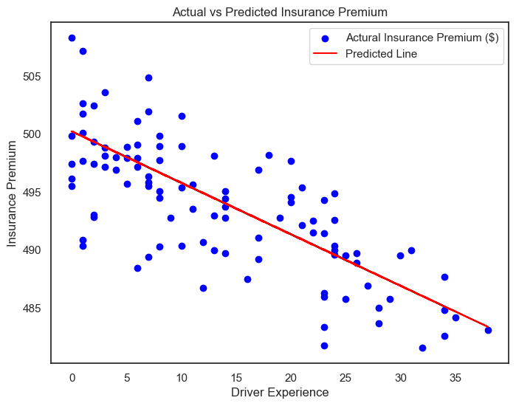
Modelling (Linear Regression Model)
Model:
Linear Regression was used to predict Insurance Premium based on Driver Experience.
Model Results:
Intercept: 500.22
Coefficient: -0.44366
(for each extra year of experience, the premium drops by about 44 cents.)
More experienced drivers tend to pay lower insurance premiums.

Slide 10
Model Evaluation – How Well Does It Work?
5-fold cross validation
Overall Performance:
The model performs fairly consistently across all folds, with relatively stable R² and RMSE values.
The average test RMSE is around 3.52, indicating the model maintains a reliable level of accuracy across different subsets of the data.
 | Training R2 | Test R2 | Training RMSE | Test RMSE
1 | 0.655881 | 0.601505 | 3.465519 | 3.719343
2 | 0.649873 | 0.624903 | 3.512102 | 3.540192
3 | 0.634097 | 0.683574 | 3.541980 | 3.424669
4 | 0.636770 | 0.676312 | 3.543693 | 3.415562
5 | 0.649701 | 0.626167 | 3.522816 | 3.497520

Slide 11
Insights & Business Impact
Key Findings:
Our linear regression model provides a solid baseline point for predicting insurance premiums based on driver experience.
Business Impact:
This model can support insurance companies in setting more accurate and fair premiums, especially for experienced drivers.
Strong negative relationship between driver experience and insurance premiums - driver experience increases, insurance premiums tend to decrease
By integrating this model into pricing strategies, companies can:
Improve customer satisfaction by offering premiums that reflect actual risk
Stay competitive in the market through data-driven, personalized pricing

Slide 12
Conclusion & Next Steps
Conclusion:
The linear regression model predicts car insurance premiums based on driver experience, with R² of 0.64. It is not perfect. There’s still significant room for improvement in capturing the relationship between Driver Experience and Premium.
Next Steps:
Try other machine learning models
Incorporate additional features like age or car type for improved accuracy.
Test the model on new data to ensure generalizability.

Slide 13

Q&A
Thank you!
Your feedback is welcome — it helps make the next iteration even better!

