Slide 1
Automated Car Damage Detection for Insurance Claims
Data Science and AI
Mini Project 3
Presented by: Yan Zhang
Date: 21 July 2025

Slide 2
Agenda
The Problem
Solution Overview
Dataset overview
CNN Model Architecture
Model Evaluation
Business Impact
Future work and Conclusion

Slide 3
Manual Car Damage Assessment – The Problem
Time-consuming and labor-intensive process
Inconsistent evaluations by human assessors
Prone to human error and subjectivity
Delay in claim settlements and customer dissatisfaction
High operational costs and potential for fraud

Slide 4
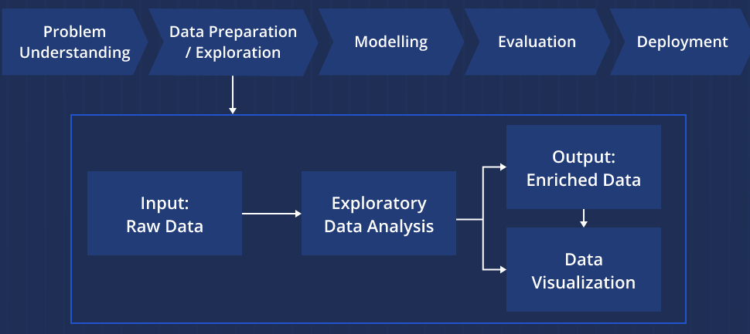
Solution Overview Automated Damage Detection using Image Classification

Slide 5
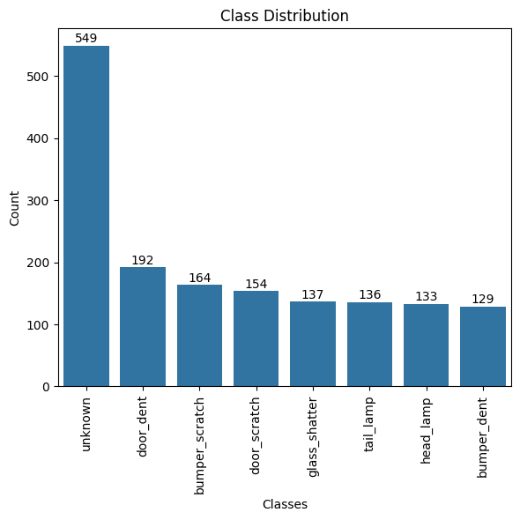
Dataset Overview
~1,500 unique RGB images
Resolution: 224 x 224 pixels
8 damage categories

Slide 6
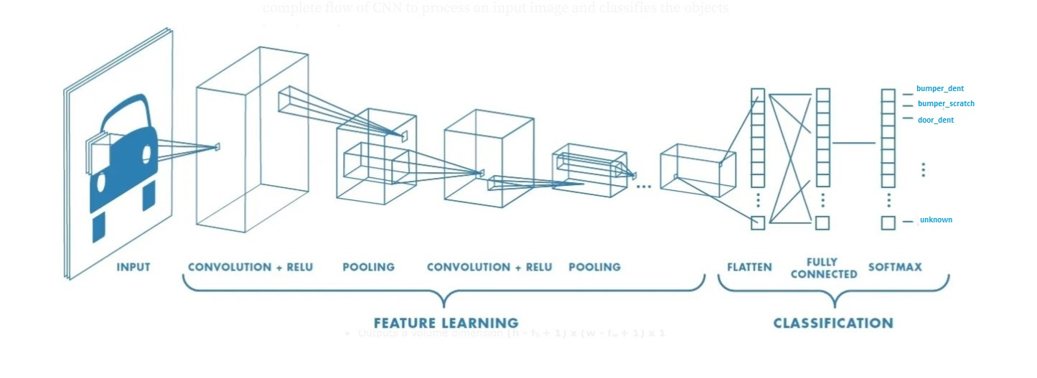
CNN Model Architecture
Input: 224x224x3 RGB image
Convolutional layers for feature extraction
Pooling layers to reduce dimensionality
Fully connected layers for classification
Output layer: 8 softmax-activated nodes (one per class)

Slide 7
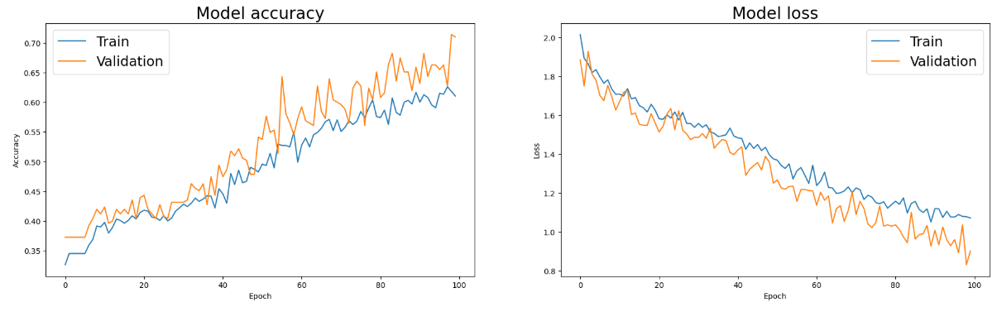
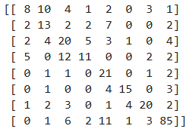
Model Evaluation
Confusion Matrix
Training accuracy: 0.61 Validation accuracy: 0.71

Slide 8
Business Impact
Faster claim processing → improved customer satisfaction
Lower operational costs for insurance companies
Reduced errors and fraud in damage evaluation
Scalable solution for nationwide deployment
Real-time assessment possibilities

Slide 9
Future Work
Expand
Expand dataset with more labeled images
Improve
Improve classification for similar/ambiguous damages
Integrate
Integrate with mobile apps for live assessments
Use
Use segmentation models for pinpointing damage areas
Explore
Explore multimodal inputs (image + textual description

Slide 10
Conclusion
CNN-based image classification offers a viable solution
Improvements in speed, accuracy, and consistency
Automation aligns with digital transformation goals in insurance
Next steps: expand dataset, integrate with claim systems

Slide 11

Q&A
Thank you!
Your feedback is welcome — it helps make the next iteration even better!

