Slide 1
Vehicle Insurance Claim Fraud Detection
Data Science and AI
Mini Project 2
Presented by: Yan Zhang
Date: 30 June 2025

Slide 2
The Problem
Vehicle insurance fraud leads to significant financial losses.
Includes staged accidents, false injury claims, and inflated reports.
Strains insurance systems, increases premiums, and damages trust.

Slide 3
Project Objective
.
Develop a machine learning model to detect fraudulent claims.
Analyze claim patterns to identify high-risk profiles
Enable early fraud detection for proactive decision-making.

Slide 4
Dataset Overview
Vehicle insurance claim dataset with over 15,000 entries.
Includes 32 features like vehicle age, accident details, policy type, etc.
Target variable: FraudFound_P
(1 - fraud , 0 – non fraud).

Slide 5
Data Cleaning
Remove column: PolicyNumber which is just a sequence number
Drop DayOfWeekClaimed & MonthClaimed == 0 (the 0 in the same row and only one row, so we can drop it)
Fixed nonsensical entries (e.g., Age = 0).

Slide 6
Exploratory Data Analysis (EDA)
Analyzed fraud patterns by Age, Vehicle Age, Fault, etc.
Visualized using bar charts and pie chart.
Found patterns linking features with fraud likelihood.

Slide 7
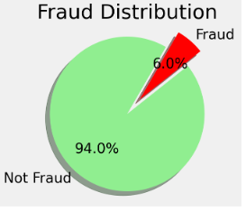
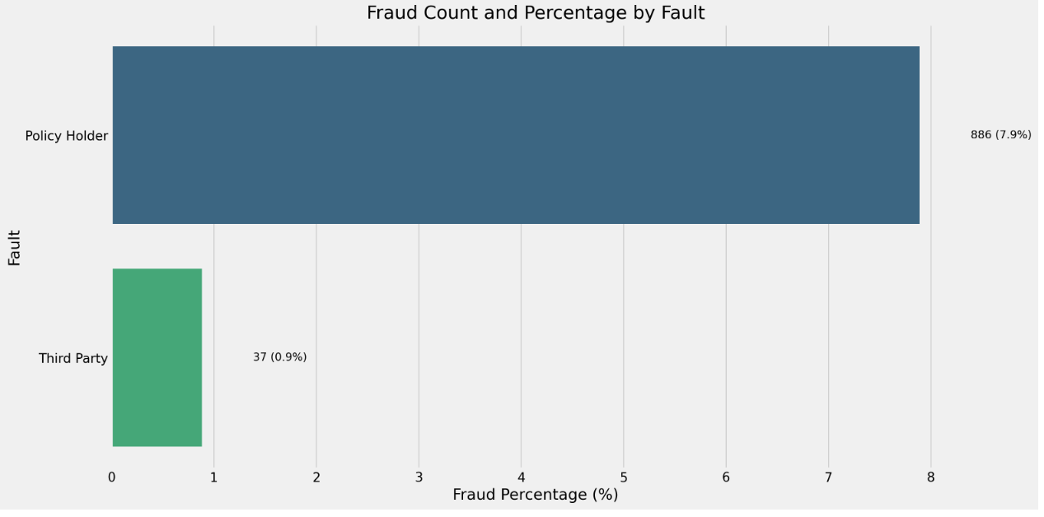
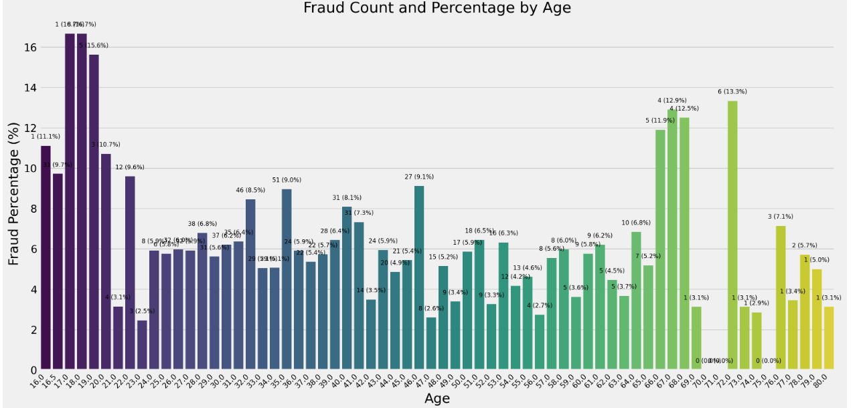
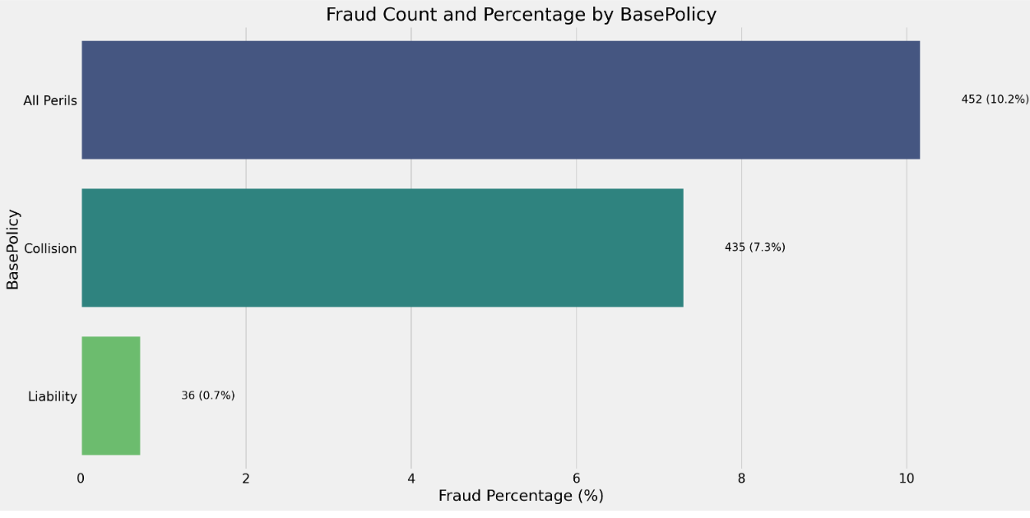
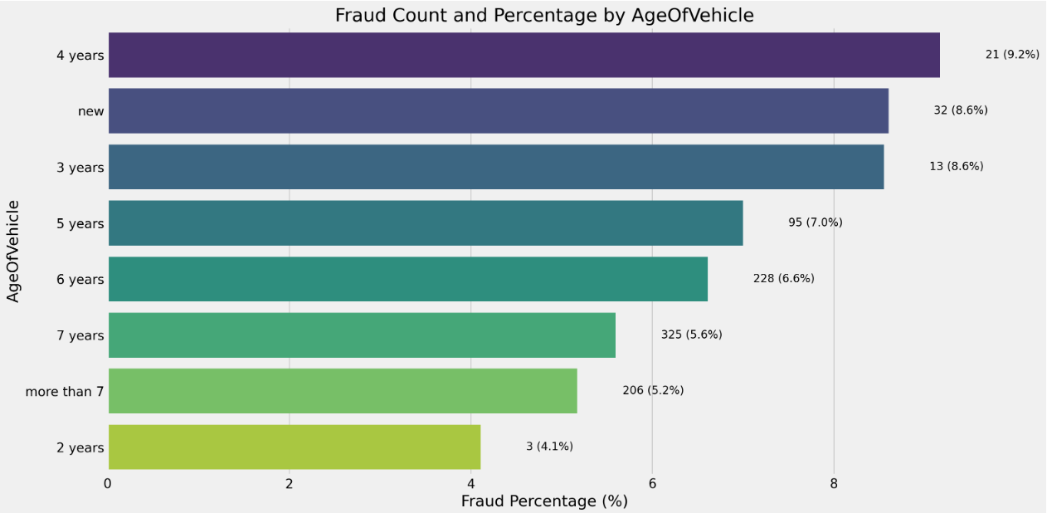
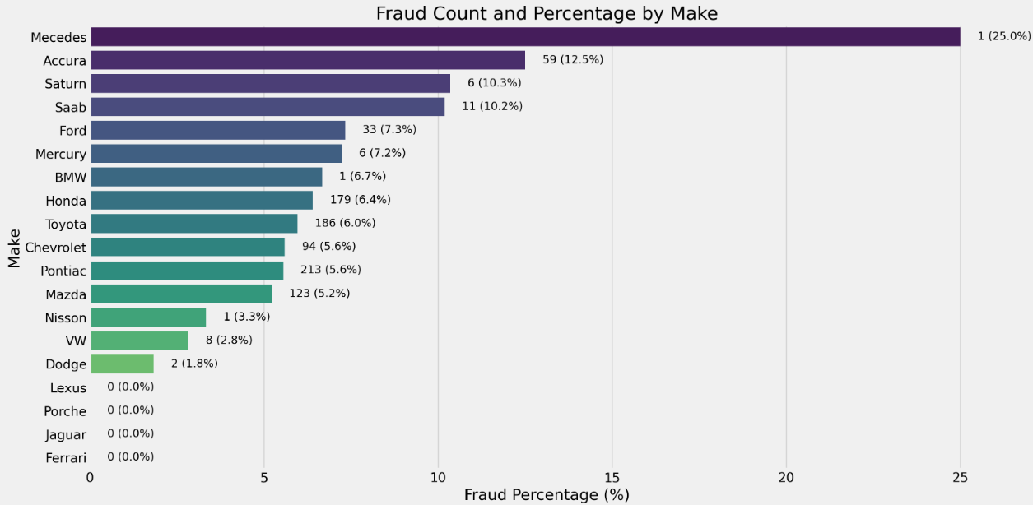

Slide 8
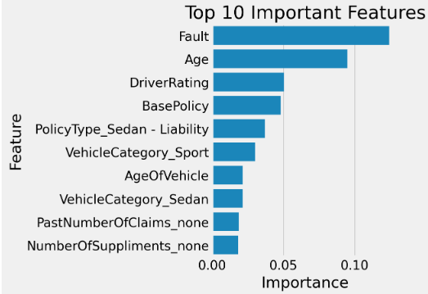
Feature Engineering
Drop useless columns
Created dummy variables
Use Random Forest model to get top 10 features
Categorized and Encoding Binary Variable
Useless columns:
Year
Month
WeekOfMonth
DayOfWeek
DayOfWeekClaimed WeekOfMonthClaimed
RepNumber
Categorized features:
VehiclePrice, AgeOfVehicle, BasePolicy
Binary Variables:
AccidentArea, Sex, Fault, PoliceReportFiled, WitnessPresent, AgentType, VehiclePrice
Dummy_columns:
Make, MonthClaimed, MaritalStatus, PolicyType, VehicleCategory, Days_Policy_Accident, Days_Policy_Claim, PastNumberOfClaims, AgeOfPolicyHolder, NumberOfSuppliments, AddressChange_Clai', NumberOfCars

Slide 9
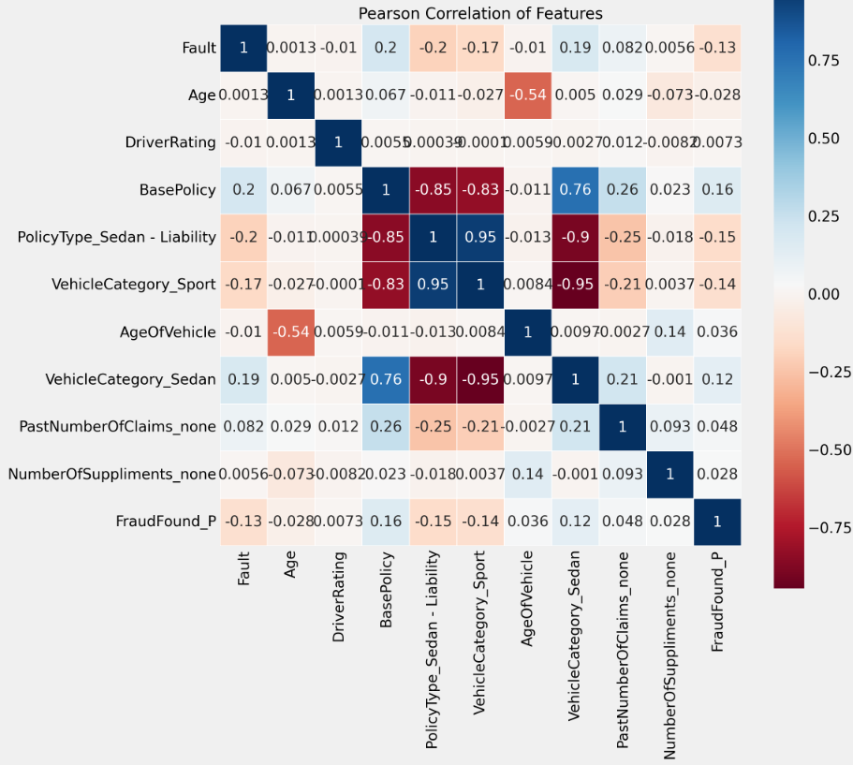
Feature Columns:
Fault
Age
DriverRating
BasePolicy
AgeOfVehicle
PastNumberOfClaims_none
NumberOfSuppliments_none
Target Column:
FraudFound_P
Combined with feature importance, we can drop: VehicleCategory_Sport,
PolicyType_Sedan - Liability,
VehicleCategory_Sedan

Slide 10
Modeling & Evaluation
Trained multiple models: Logistic Regression, SVM, Naive Bayes, K-NN, Random Forest, XGBoost, Stacking
Evaluated using Accuracy, Precision, Recall, F1-score, ROC_AUC.
Handled imbalanced data using class_weight option

Slide 11
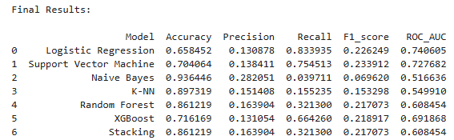
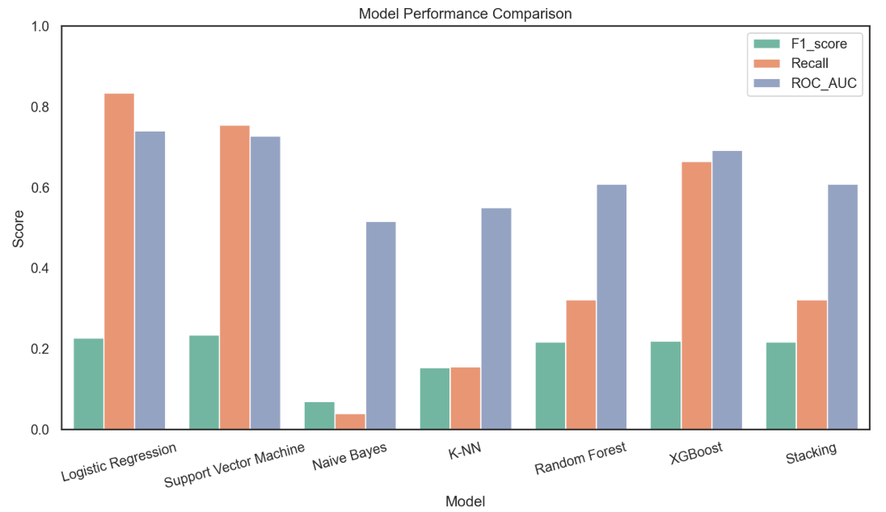
Model Performance Comparison

Slide 12
Business Insights
83% of fraud detected – major reduction in financial loss.
Accuracy isn’t enough – focused on recall and fraud-specific metrics.
Balancing security and user experience – fine-tuning to reduce false positives.
Cost savings – fewer chargebacks and reduced manual review effort.
Model improves over time – learns from new data and becomes smarter.

Slide 13
Conclusion & Next Steps
Conclusion:
Logistic Regression performed best with high fraud detection (83% recall)
Accuracy alone is not reliable in fraud detection
Recall, F1-score, and ROC-AUC are better performance metrics
Simple models can be highly effective with the right tuning
Next Steps:
Optimize decision threshold to reduce false positives
Apply resampling (e.g., SMOTE) to handle class imbalance
Test model on real or live data for validation
Plan for deployment with monitoring and feedback loop

Slide 14

Q&A
Thank you!
Your feedback is welcome — it helps make the next iteration even better!

