Slide 1
Automated Car Damage Detection for Insurance Claims
Data Science and AI
Capstone Project
Presented by: Yan Zhang
Date: 20 August 2025

Slide 2

BIO
Education
Data Science and AI
Ph.D. in Computer Science
Experience
Middleware Technologies
Cloud Computing
Certificates
AWS Certified DevOps Engineer – Professional
AWS Certified Solution Architect – Professional

Slide 3
Agenda
The Problem
Solution Overview
Dataset Overview
CNN Model Architecture
Modelling and Model Evaluation
Deployment
Future Work and Conclusion
Business Impact

Slide 4
Manual Car Damage Assessment – The Problem
🕒
⚖️
❌
⏳
💰
Time-consuming & labor-intensive
Inconsistent evaluations
Prone to human error
Delay in claim settlements
High costs & fraud risk

Slide 5
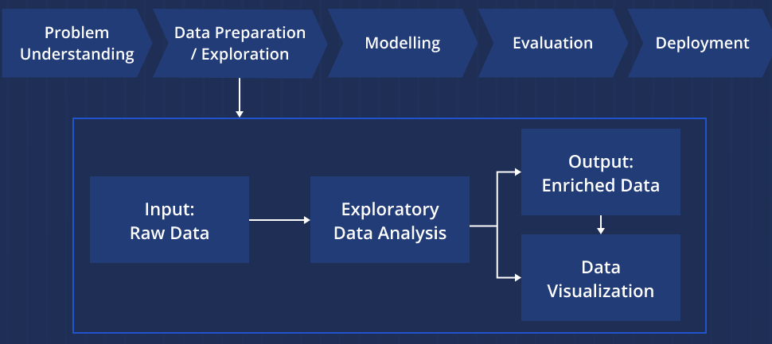
Solution Overview Automated Damage Detection using Image Classification

Slide 6
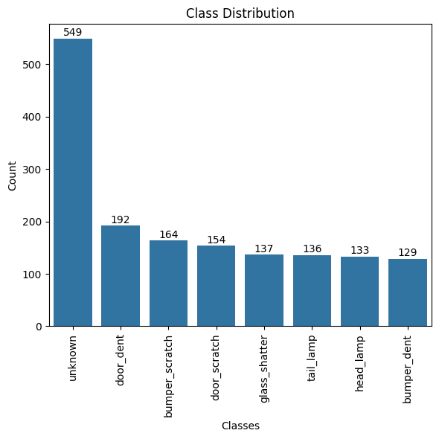
Dataset Overview
~1,500 unique RGB images
Resolution: 224 x 224 pixels
8 damage categories

Slide 7
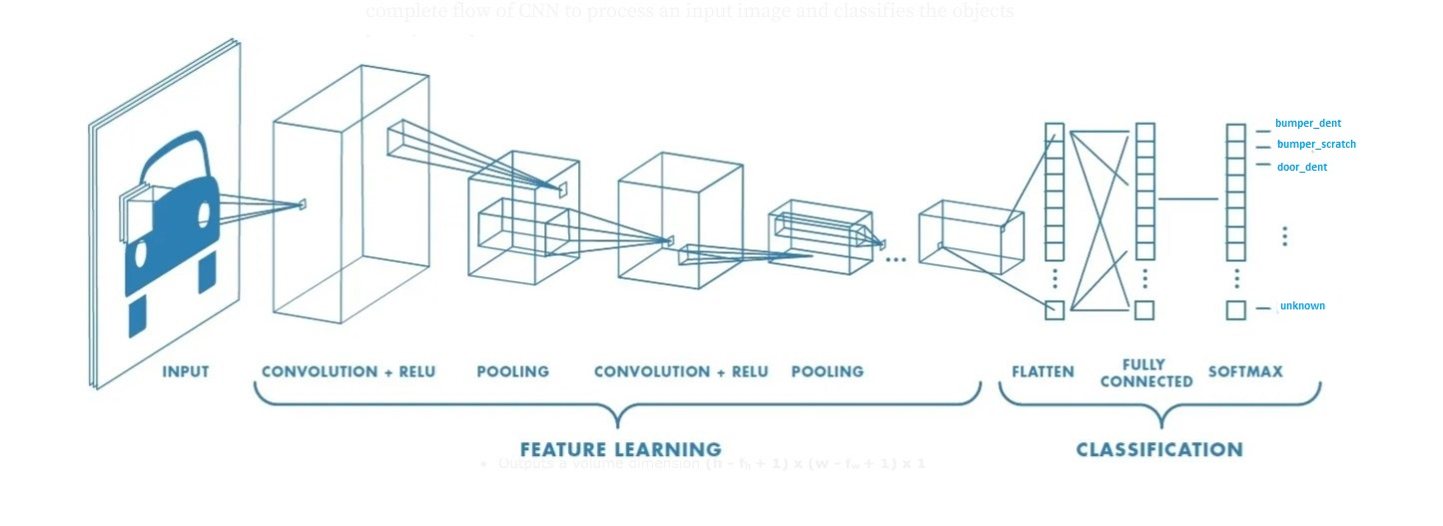
CNN Model Architecture
Input: 224x224x3 RGB image
Convolutional layers for feature extraction
Pooling layers to reduce dimensionality
Fully connected layers for classification
Output layer: 8 softmax-activated nodes (one per class)

Slide 8
Modelling
Several models were built and tested during the project:
MobileNetV2 (using transfer learning)
VGG-16 (using transfer learning)
Custom CNN (built from scratch)
For each model, we experimented with different dropout rates—0.2, 0.3, and 0.5—to assess their impact on model performance.

Slide 9
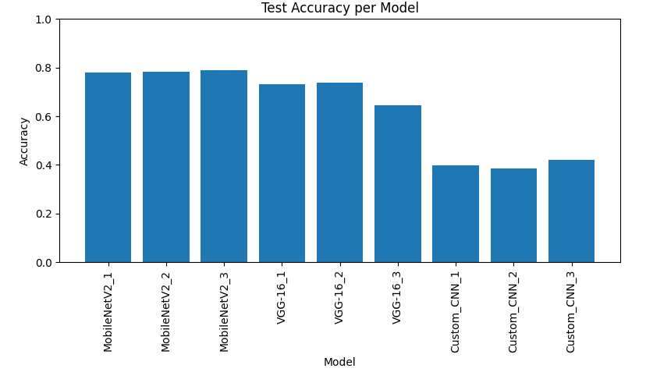
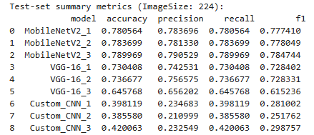
Summary of the Test Results

Slide 10
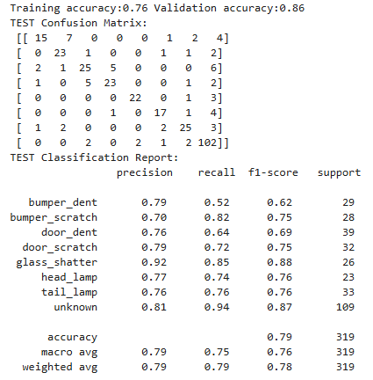
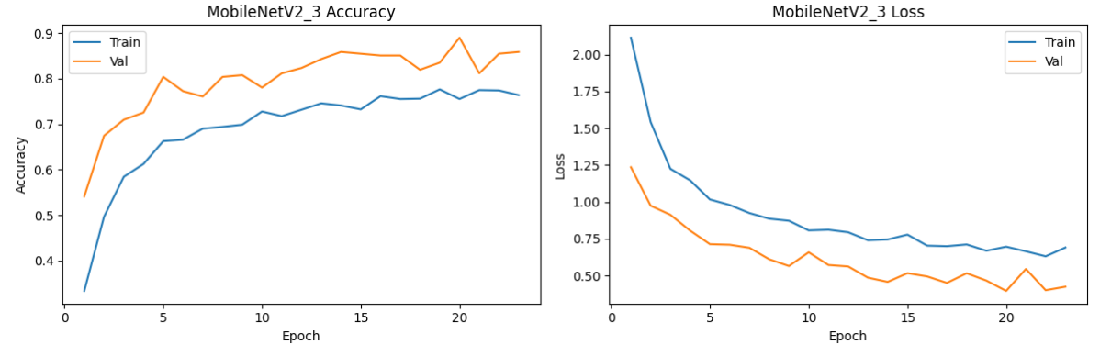
Model Selection
MobileNetV2_3 (dropout rate: 0.5): accuracy 79%
offers the most balanced and reliable performance across all metrics

Slide 11
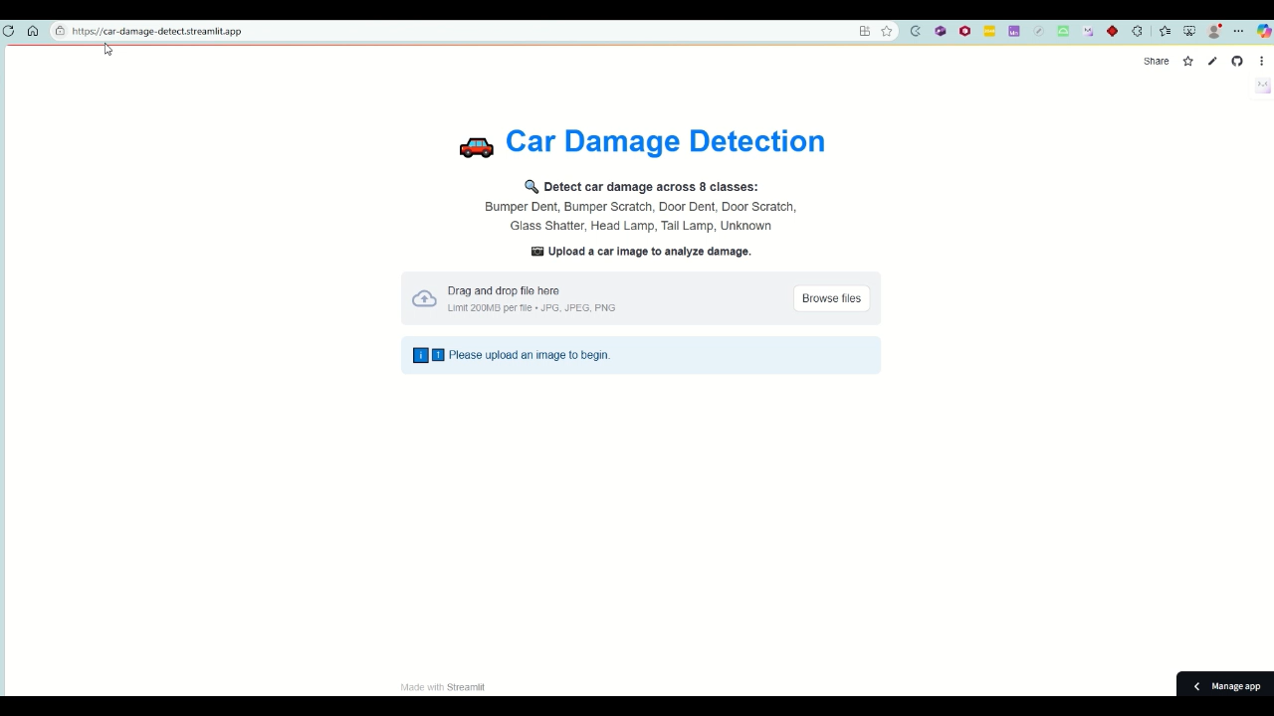
Deployment

Slide 12
Business Impact
Faster claim processing → improved customer satisfaction
Lower operational costs for insurance companies
Reduced errors and fraud in damage evaluation
Scalable solution for nationwide deployment
Real-time assessment possibilities

Slide 13
Future Work
Expand
Expand dataset with more labeled images
Improve
Improve classification for similar/ambiguous damages
Integrate
Integrate with mobile apps for live assessments
Use
Use segmentation models for pinpointing damage areas
Explore
Explore multimodal inputs (image + textual description)

Slide 14
Conclusion
CNN-based image classification offers a viable solution
Improvements in speed, accuracy, and consistency
Automation aligns with digital transformation goals in insurance
Next steps: expand dataset, integrate with claim systems

Slide 15
References
https://www.kaggle.com/code/pavansanagapati/a-simple-cnn-model-beginner-guide
https://medium.com/analytics-vidhya/types-of-convolutional-neural-networks-lenet-alexnet-vgg-16-net-resnet-and-inception-net-759e5f197580
https://www.geeksforgeeks.org/computer-vision/what-is-mobilenet-v2/
https://machinelearningmastery.com/how-to-configure-the-number-of-layers-and-nodes-in-a-neural-network
https://www.kaggle.com/datasets/hamzamanssor/car-damage-assessment/data
https://docs.streamlit.io/deploy

Slide 16

Q&A
Thank you!
Your feedback is welcome — it helps make the next iteration even better!

