Slide 1

Data Science and AI
Mini Project 1
Predicting Car Insurance Premiums
Yan Zhang
28 April 2025

Slide 2
Agenda
1. Introduction & Business Context
2. Data Overview & Problem Statement
3. Exploratory Data Analysis (EDA)
4. Hypothesis & Analysis
5. Modeling & Results
6. Conclusion & Insights

Slide 3

Introduction & Business Context
Business Problem:
Insurance companies need to predict car insurance premiums accurately to optimize pricing strategies based on factors such driver and vehicle characteristics.

Slide 4
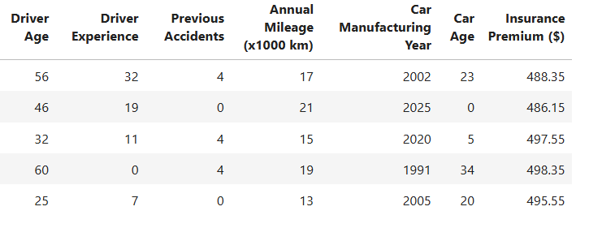
Data Overview
The dataset is from www.kaggle.com
Columns:
Driver Age
Driver Experience
Previous Accidents
Annual Mileage(x1000 km)
Car Manufacturing Year
Car Age
Insurance Premium($)

Slide 5
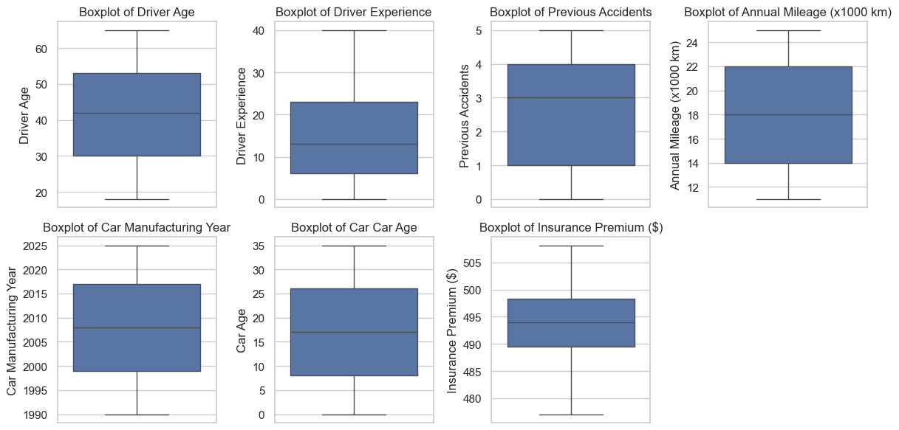
Data Wrangling & Cleaning
No NULL value
No duplicated rows
No outlier data

Slide 6
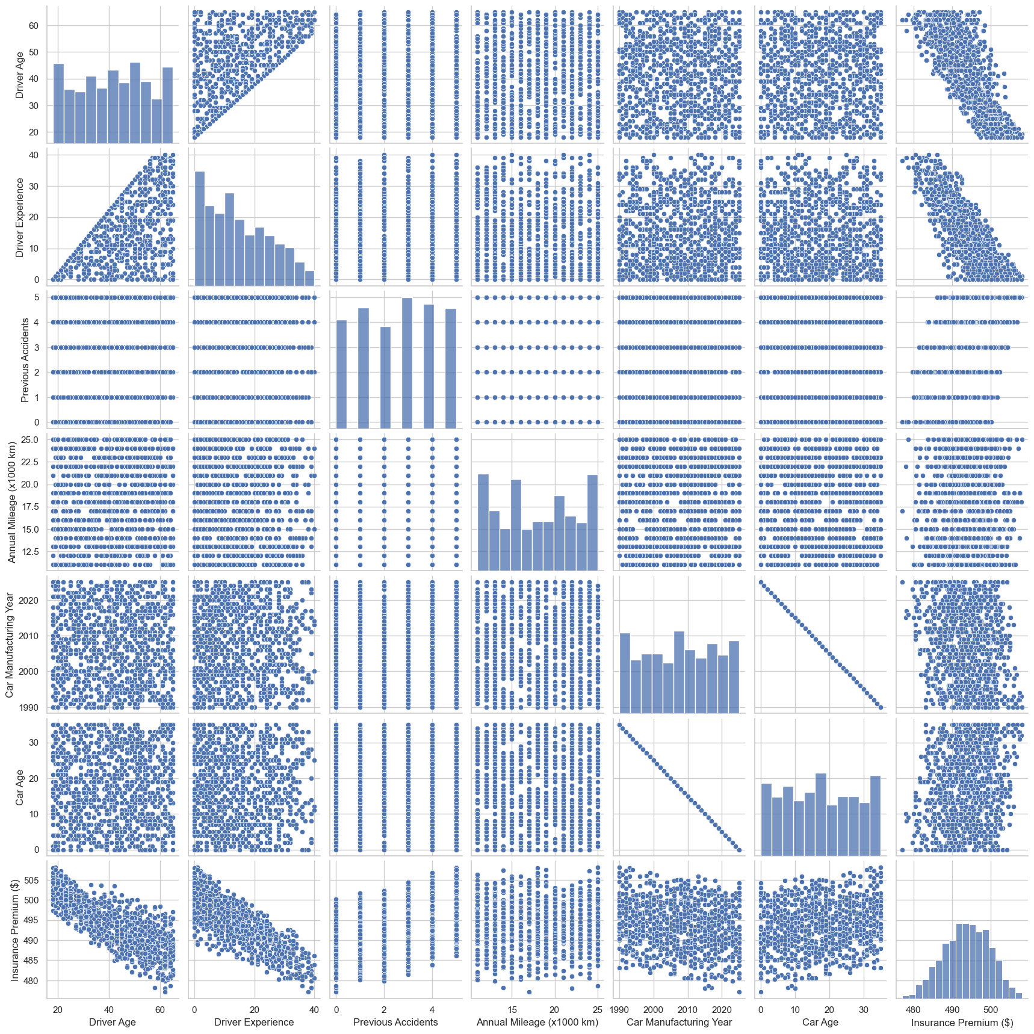
Exploratory Data Analysis (EDA)
Correlation:
Driver Experience -0.803323
Driver Age -0.776848
Car Manufacturing Year -0.171829
Annual Mileage (x1000 km) 0.022131
Car Age 0.171829
Previous Accidents 0.410786
Insurance Premium ($) 1.000000

Slide 7
Hypothesis Testing
Null Hypothesis (H₀):
"Driver Experience does not significantly affect car insurance premiums."
Alternative Hypothesis (H₁):
"Driver Experience significantly affects car insurance premiums."
Test Method:
A t-test was performed to check the significance of the relationship between Driver Experience and Premium.

Slide 8
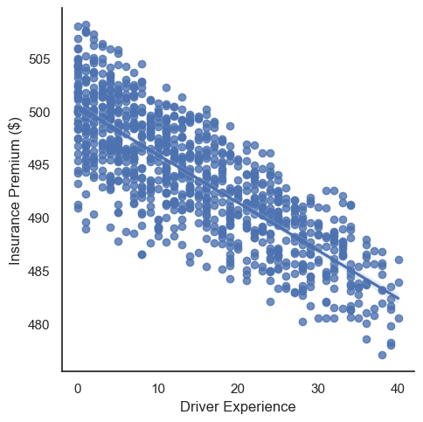
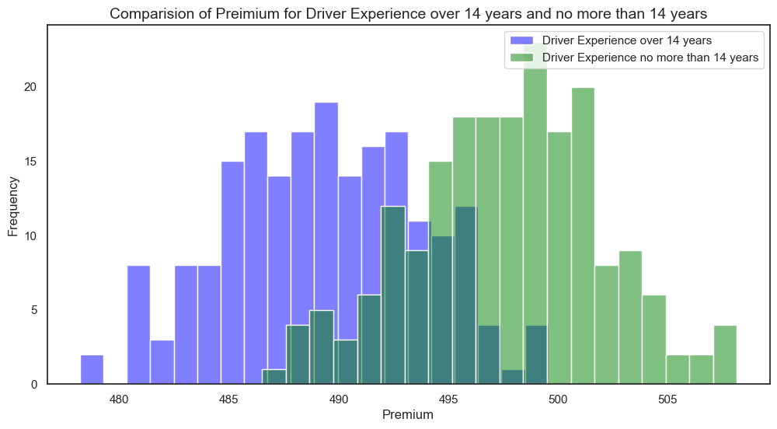
alpha = 0.05
t = -18.778445334825797
p = 8.541512483416088e-57
We reject our null hypothesis.
Driver Experience significantly affects car insurance premiums.

Slide 9
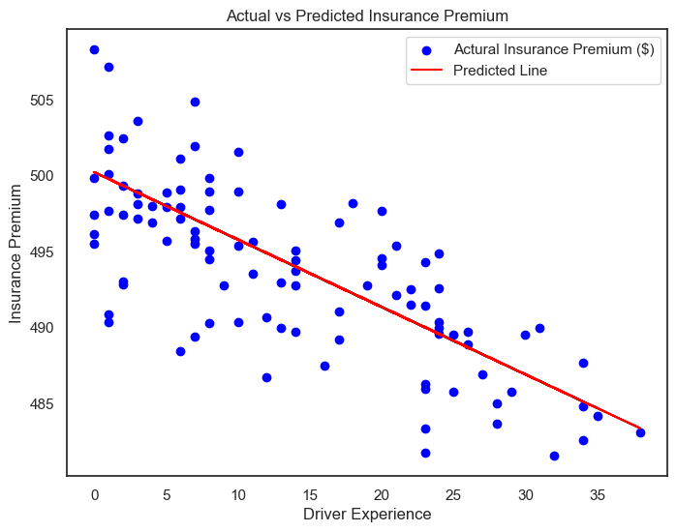
Linear Regression Model
Model:
Linear Regression was used to predict Insurance Premium based on Driver Experience.
Model Results:
Intercept: 1000
Coefficient: -0.44366

Slide 10
Model Performance
 | Training R2 | Test R2 | Training RMSE | Test RMSE
1 | 0.655881 | 0.601505 | 3.465519 | 3.719343
2 | 0.649873 | 0.624903 | 3.512102 | 3.540192
3 | 0.634097 | 0.683574 | 3.541980 | 3.424669
4 | 0.636770 | 0.676312 | 3.543693 | 3.415562
5 | 0.649701 | 0.626167 | 3.522816 | 3.497520
5-fold cross validation

Slide 11
Insights & Business Impact
Key Findings:
As driver experience increases, insurance premiums tend to decrease.
The model provides a good starting point for predicting insurance premiums based on driver experience.
Business Impact:
This model can help insurance companies set more accurate, fair premiums for drivers based on experience.
Better pricing strategies could lead to increased customer satisfaction and more competitive pricing.

Slide 12
Conclusion & Next Steps
Conclusion:
The linear regression model predicts car insurance premiums based on driver experience, with R² of 0.64. It is not perfect. There’s still significant room for improvement in capturing the relationship between Driver Experience and Premium.
Next Steps:
Try other machine learning models
Incorporate additional features like age or car type for improved accuracy.
Test the model on new data to ensure generalizability.

Slide 13

Q&A
Thank you!

