Slide 1
pm6A-CNN

Slide 2


Slide 3
Introduction
Methyladenosine (m6A) is the most frequently occurring RNA modiﬁcation among more than 160 RNA modiﬁcations. The m6A is associated with various biological processes including :
RNA structural dynamics
Cell differentiation
Reprogramming
Localization and degradation of RNA
Alternative splicing
Circadian clock regulation
Primary microRNA processing

Slide 4
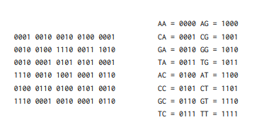
Most of the previous works relied on machine learning and hand-crafted features
Chen et al. proposed two SVM models for m6A identiﬁcation in S.cerevisiae using nucleotide chemical properties (NCP).
Liu et al. used physical-chemical properties with the SVM model for m6A identiﬁcation in S.cerevisiae
MethyRNA was proposed to ﬁnd m6A sites in H.sapiens and M.musculus using SVM and NCP.
iMethyl-STTNC utilized split-tetra-nucleotide composition with SVM for m6A sites identiﬁcation in H.sapiens and S.cerevisiae.
M6AMRFS used the dinucleotide binary encoding with the eXtreme Gradient Boosting algorithm for m6A identiﬁcation in H.sapiens,M.musculus,S.cerevisiae, and A.thalinia.
iMRM used the NCP with the eXtreme Gradient Boosting algorithm for m6A identiﬁcation in H.sapiens,M.musculus, and S.cerevisiae.
dinucleotide binary encoding:

Slide 5
Currently, the deep learning-based models achieve remarkable results in the ﬁeld of natural language processing
Nazari et al. proposed iN6-Methyl in which they utilized the deep learning-based CNN architecture for the prediction of m6A sites in the benchmark datasets of H.sapiens, M.musculus, and S.cerevisiae.
They extracted the feature using a word2vec model, which is a natural language processing model in which each sequence is manually divided into words having a length of k using a k-mer technique.
The k was set to 3 and each word was mapped into its corresponding feature representation.
The word2vec has to be trained on the whole-genome to produce a vector space, therefore, it is a computationally costly and time-consuming process.

Slide 6
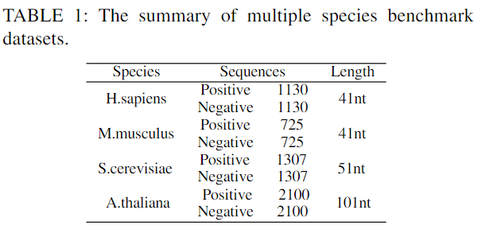
Benchmark dataset
In this paper, we used k-fold cross-validation in order to evaluate the performance of the proposed model.

Slide 7
The RNA sequence is represented by the combination of two commonly used encoding techniques one-hot encoding and nucleotide chemical properties (NCP)
In one-hot encoding:
A is represented as (1,0,0,0)
C is represented as (0,1,0,0)
G is represented as (0,0,1,0)
U is represented as (0,0,0,1)

Slide 8
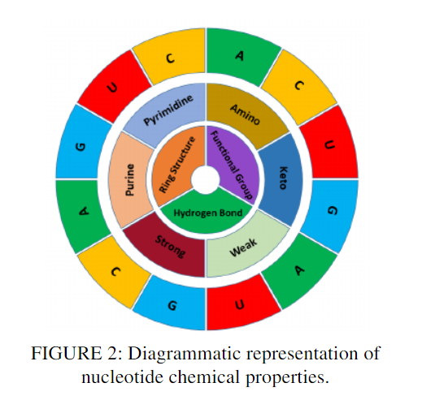
While NCP is the representation of each nucleotide in the RNA sequence based on their three chemical groups in the three-dimensional Cartesian coordinate system.
As each of the four nucleotides in the RNA sequences namely, Adenine(A), Cytosine (C), Guanine (G) and Uracil (U) consists of different chemical properties. Considering the ring structures , A and G are purines consisting of two rings. While C and U are pyrimidines consisting of one ring.
In terms of secondary structure formation, the bonds between A and U are weak hydrogen bonds whereas between C and G are strong hydrogen bonds. Also, regarding the chemical functionality , A and C can be grouped into an amino group, while G and U into a group called the keto group.
According to these three chemical properties, the four nucleotides can be categorized into three distinct groups which are represented in the three-dimensional Cartesian coordinate system by assigning the value of 1 or 0. Therefore,
A is denoted by coordinates (1, 1, 1),
C is represented by coordinates (0, 1, 0),
G is represented by coordinates (1, 0, 0),
U is denoted by coordinates (0, 0, 1).

Slide 9
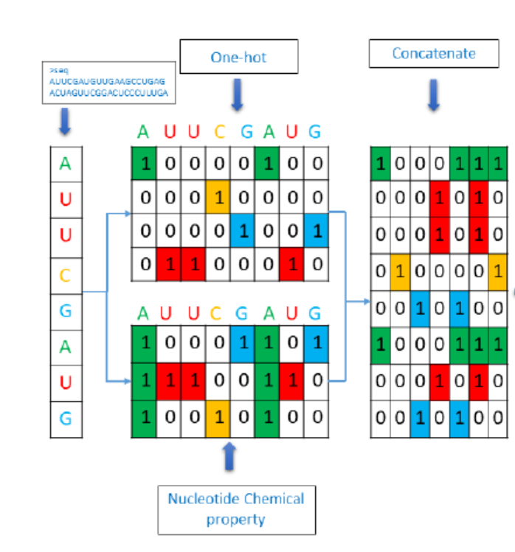

Slide 10
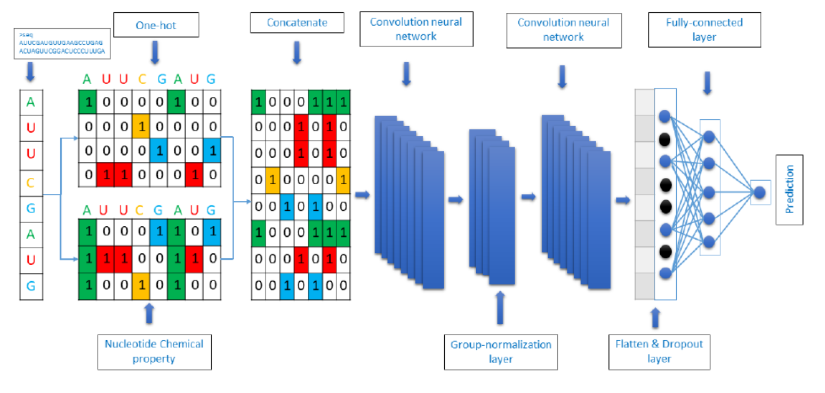
THE PROPOSED MODEL
We propose a deep learning-based CNN architecture that takes RNA sequence as an input as shown in Figure 1.

Slide 11
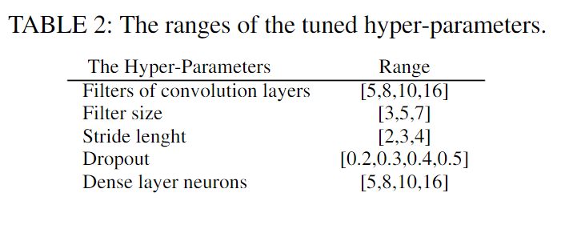
THE PROPOSED MODEL
The optimum hyper-parameters are found using a grid search method. The ranges of hyper-parameters are enlisted in Table 2.
Filter of conv layer | Filter size | Stride length | Dropout | Dense layer neurons
8 | 3 | 3 | 0.5 | 8

Slide 12
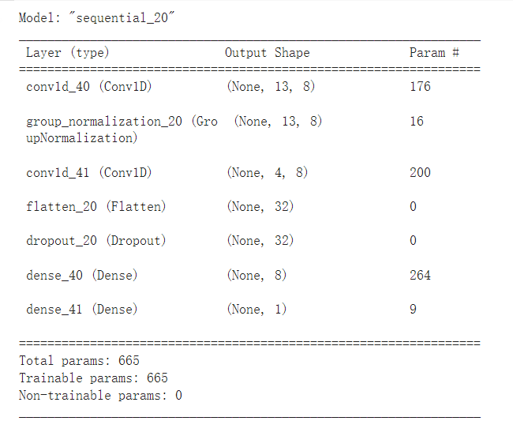
THE PROPOSED MODEL
The vectors produced by utilizing one hot-encoding and NCP are concatenated together resulting in representing the RNA sequence by a seven-channel vector.
The resulted vector is passed to a CNN model with two Conv1D layers and two fully connected layers. Each Conv1D layer is followed by a ReLU nonlinear activation function. In addition, the ﬁrst Conv1D is followed by a group normalization by setting the size of the group to four. The learned features using the two convolution layers are passed to the dropout layer with a dropout rate of 0.5 and then to two fully connected layers. The ﬁrst fully connected layer is followed by a ReLU activation function. The second fully connected layer is a one-node layer with a sigmoid activation function.

Slide 13
THE PROPOSED MODEL
L2 regularization method is used for weights and bias of the ﬁlters to avoid overﬁtting. Adam optimizer with the learning rate of 0.001 is utilized for model optimization. The binary cross-entropy is utilized as a loss function. The Batch size of 32 and early stopping based on validation loss is utilized for the maximum number of training iterations. Keras framework is utilized for the implementation of the proposed model pm6A-CNN

Slide 14
PERFORMANCE EVALUATION
To evaluate the performance of our proposed model we utilized the 10-fold cross-validation technique. The benchmark datasets were divided into ten mutually exclusive folds. Where one fold is reserved for testing of the proposed model,one fold for validation of the model, while the remaining folds were used for training of the proposed model. This is a recursive process which occurs ten times.
The ﬁnal approximation of the performance was taken into account by taking the average outcome of ten folds.
The common performance metrics used in this study and several existing computational models are Accuracy (ACC), Sensitivity(SN), Speciﬁcity (SP), and Mathew’s correlation coefﬁcient(MCC). These performance metrics are formulated as:

Slide 15
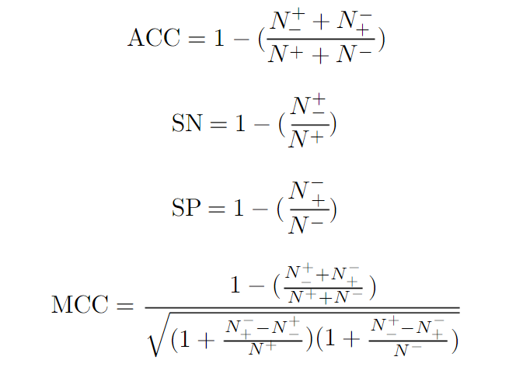
PERFORMANCE EVALUATION
where N+ is the representation of methyladenosine sties while non-methyladenosine sites are represented by N−. N−+ represents the methyladenosine sites incorrectly identiﬁed as non-methyladenosine. N+− states the number of non-methyladenosine site that was predicted as methyladenosinesties.

Slide 16
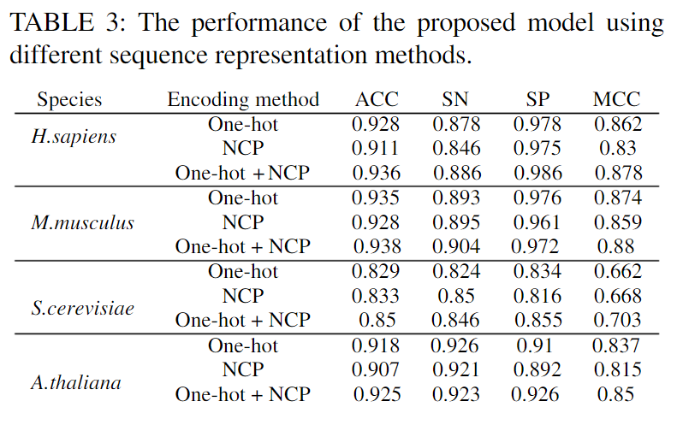
RESULTS AND DISCUSSION
The proposed model was evaluated using the 10-folds cross-validation on four species benchmark datasets. In order to study the effectiveness of incorporating nucleotide chemical properties, we conducted three experiments.
The ﬁrst experiment used only a one-hot encoding for RNA sequence representation. The second experiment used only nucleotide chemical properties encoding for RNA sequence representation.
The third experiment integrated the representation of both encoding methods (one-hot and nucleotide chemical properties). The results of these experiments are shown in Figure 3 and Table 3.
 | Encoding | ACC | SN | SP | MCC
H.sapaiens | One-hot+NCP | 0.906 | 0.825 | 0.998 | 0.827

Slide 17
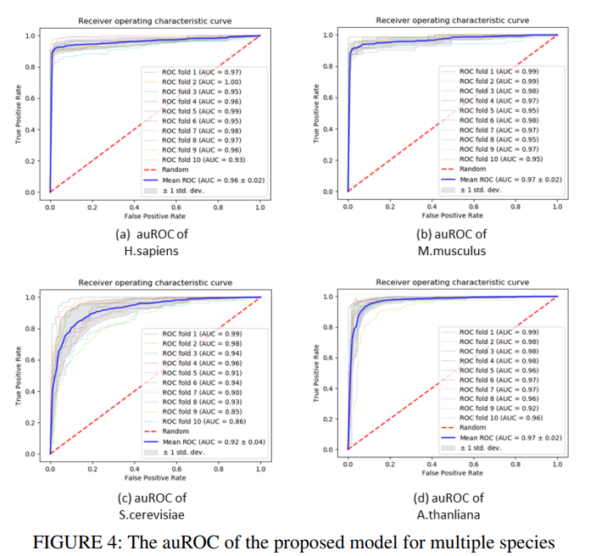
RESULTS AND DISCUSSION
Furthermore, Figure 4 shows the AUC of the proposed model along with standard deviation errors in 10 folds using the benchmark datasets of H.sapiens, M.musculus, S.cerevisiae, and A.thaliana.

Slide 18
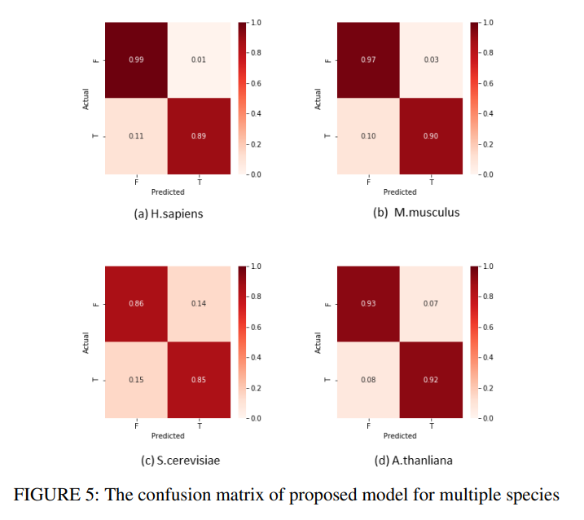
RESULTS AND DISCUSSION
The confusion matrix of the proposed model is also visualized in Figure 5.

Slide 19
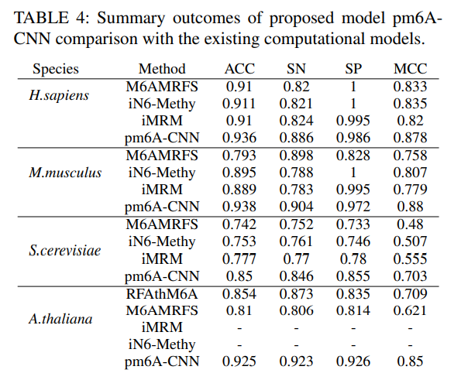
RESULTS AND DISCUSSION
We compared our model with the best known existing computational models including iMR, iN6-Methyl, M6AMRFS, and RFAthM6A.
The iMRM and iN6-Methyl used only three benchmark datasets including H.sapiens, M.musculus, and S.cerevisiae and outperformed the M6AMRFS.
Whereas the RFAthM6A showed a higher performance in comparison to M6AMRFS by utilizing only the fourth benchmark dataset i.e. A.thaliana.
The comparison between the computational models is illustrated in Table 4 and Figure 6.
The ’-’ sign in Table 4 means that it was not possible to obtain these metrics for the corresponding tools.

Slide 20
CONCLUSION
In this study, we proposed an efficient deep learning-based CNN architecture for the identification of m6A sites in multiple species.
The CNN based predictor extracts the most important features by utilizing the combination of one-hot encoding and nucleotide chemical properties for the representation of RNA sequences.
This combination helped the predictor to accomplish more effective and efficient outcomes for the identification of m6A sites.

