Slide 1
專題討論(二)
姓名:黃彥承 N26101185
指導教授:吳謂勝

Slide 2
DeepM6A
Elucidation of DNA methylation on N6-adenine with deep learning

Slide 3
Methods
Deep learning techniques
The deep convolutional neural network, one of most popular deep-learning architectures, has set many records in various fields due to its powerful feature representation learning. A typical architecture of deep convolutional learning is composed of alternate convolution, pooling and nonlinear activation layers that learn the intermediate feature representation hierarchically, followed by fully connected layers and one sigmoid output layer for fusing internal features learned by convolutional layers together and delivering the output probability. Our learning architecture mainly involves convolutional network layers (ConvNet), leaky rectified linear activation (LeakyReLU) unit, dropout regularization, a fully connected layer and a sigmoid activation layer (Supplementary Fig. 1).

Slide 4
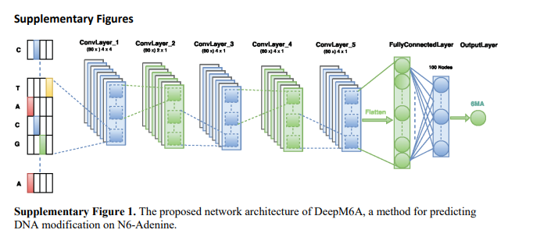
Altogether, our model has five convolutional neural networks, each with 80 filters (f=1, …, 80), one fully connected layer of 100 units and the final sigmoid classification layer. The dropout probability p is [0.2, 0.2, 0.2, 0.2, 0.5, 0.5] for the respective layers. The window size M of filters is set to be [4, 2, 4, 4, 4], respectively. The α of LeakyReLU is tuned to be 0.001 for all layers.

Slide 5
Data for DeepM6A development
The raw data of A. thaliana, D. melanogaster and E. coli were taken from the PacBio public database (https://github.com/ PacificBiosciences/DevNet/wiki/Arabidopsis-P5C3, https://github.com/ PacificBiosciences/DevNet/wiki/Drosophila-sequence-and-assembly and https:// s3.amazonaws.com/files.pacb.com/datasets/secondary-analysis/e-coli-k12-P 6C4/p6c4_ecoli_RSII_DDR2_with_15kb_cut_E01_1.tar.gz).
Raw reads were first filtered based on a minimum subread length (50), polymerase read quality (75) and polymerase read length (50). The left reads were mapped to their reference genome by pbalign (seed=1 --nproc 8 --minAccuracy=0.75 --minLength=50 --concordant --algorithmOptions="-useQuality" --algorithmOptions=‘ -minMatch 12 -bestn 10 -minPctIdentity 70.0’). Additional pulse metrics were loaded into the resulting cmp.h5 file to enable downstream use of the Quiver algorithm, which identifies haploid single nucleotide polymorphisms and indels by performing a local realignment of reads using the full range of sequence quality metrics.

Slide 6
Afterwards,the P_ModificationDetection module was applied to identify putative sites of base modification as well as common bacterial base modifications (6mA) using an in silico control consisting of expected kinetic signals.
The 6mA sites were further filtered if
there is any sequence variance located between the upstream 10bp and downstream 5bp of the identified modification site and
(2) the variation of estimated methylation level is greater than 30%.
For A. thaliana, D. melanogaster and E. coli there are 19,632, 10,653 and 33,700 profiled methylated adenine sites, respectively. These sites account for 0.025696% (76,401,454), 0.013418% (79,393,495) and 1.475402% (2,284,124) proportions of the whole-genome adenine sites.

Slide 7
To prepare for the model development, we sampled non-methylated adenine sites (negative samples) randomly from the whole-genome sequences by preserving a distance scale of at least 200 between sampled negative non-methylated sites and the positive methylated sites. For both positive and negative samples, contextual sequences around the adenine site at each side were also extracted as input features.
The above distance scale guarantees 200 non-overlapping nucleotides of contextual sequences. The length n of flanking sequences were set to be 3, 4, 5, 6, 7, 8, 9, 10, 20, 30, 40, 50, 100, 150 and 200, respectively. In this manner, each sample consisted of 2n+1 nucleotides paired with methylation labels. We sampled the same number of non-methylated adenines with their counterpart methylated sites.

Slide 8
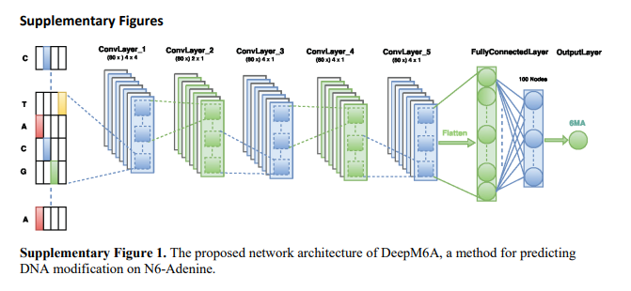
We utilized a one-hot encoding scheme(Supplementary Fig. 1) to represent each nucleotide and then fed the input sequences into the DeepM6A model. For example, given a sequence of 61 nucleotides (30 flanking nucleotides at each side and one middle adenine site), it can be represented by a 61×4 binary matrix (with the columns being A, C, G and T).

Slide 9
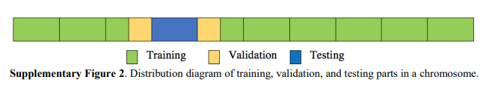
To facilitate efficient tuning of the model parameters and reasonable evaluation, we conducted a three-way data-splitting strategy. Specifically, for each chromosome of species, we split datasets into 10 different segments along the direction of 5′ to 3′, regardless of forward or reverse strands. We then picked one slice as the testing set, which is surrounded by two slices from both upstream and downstream sides. The validation dataset was set to be a combination of the nearest half upstream and half downstream segments accordingly (Supplementary Fig. 2).
The remainder of the sites were used for training. In this manner, we obtained a ratio of 8:1:1 for the training, validation and testing datasets, with training and testing parts strictly non-overlapping.

Slide 10
We used this spatial splitting to guarantee that the training and testing parts were strictly non-overlapping. Note that, for each 6mA site, we considered flanking sequences of length up to 200bp as input. If we simply chose the 8:1:1 proportion for the training, validation and testing datasets at random, their flanking sequences would be more likely to overlap with each other. In this context, the predictive performance and obtained motif patterns might be somewhat misleading. All hyper-parameters were tuned on the basis of binary cross-entropy error on the validation dataset, which was not used for training or testing.

Slide 11
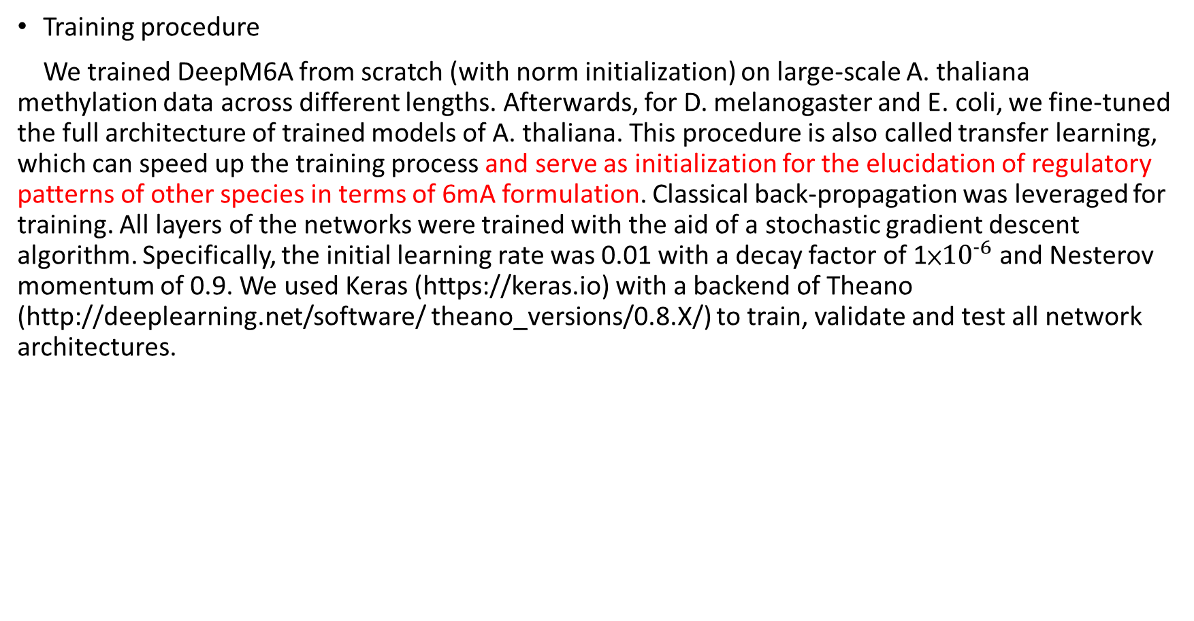
Training procedure
We trained DeepM6A from scratch (with norm initialization) on large-scale A. thaliana methylation data across different lengths. Afterwards, for D. melanogaster and E. coli, we fine-tuned the full architecture of trained models of A. thaliana. This procedure is also called transfer learning, which can speed up the training process and serve as initialization for the elucidation of regulatory patterns of other species in terms of 6mA formulation. Classical back-propagation was leveraged for training. All layers of the networks were trained with the aid of a stochastic gradient descent algorithm. Specifically, the initial learning rate was 0.01 with a decay factor of 1×${10}^{−6}$ and Nesterov momentum of 0.9. We used Keras (https://keras.io) with a backend of Theano (http://deeplearning.net/software/ theano_versions/0.8.X/) to train, validate and test all network architectures.

Slide 12
MLP network
MLP, here, is composed of five fully connected neural networks. The numbers of hidden nodes are 200, 200, 150 and 100 and the activation functions are also LeakyReLU of parameter 0.001 for all layers. The dropout probability is 0.5 for different layers. The activation of the output layer is also a sigmoid function. The training, validation and testing datasets and optimization settings are the same as for DeepM6A, if applicable.

Slide 13
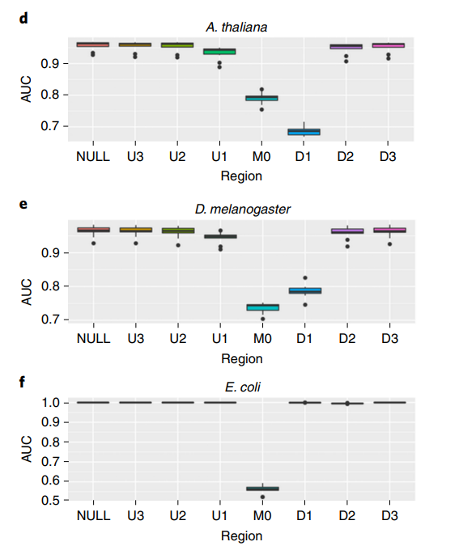
Perturbation procedure
For each testing sample, we partitioned the entire flanking sequences into seven regions: [−30, −13] (U3), [−12, −8] (U2), [−7, −3] (U1), [−2, +2] (M0), [+3, +7] (D1), [+8, +12] (D2) and [+13, +30] (D3), according to the normalized scoring maps (Fig. 4d–f). We then perturbed these regions alternately while keeping other regions fixed. With previously trained models, we then performed further prediction on testing data with different perturbed regions.

Slide 14
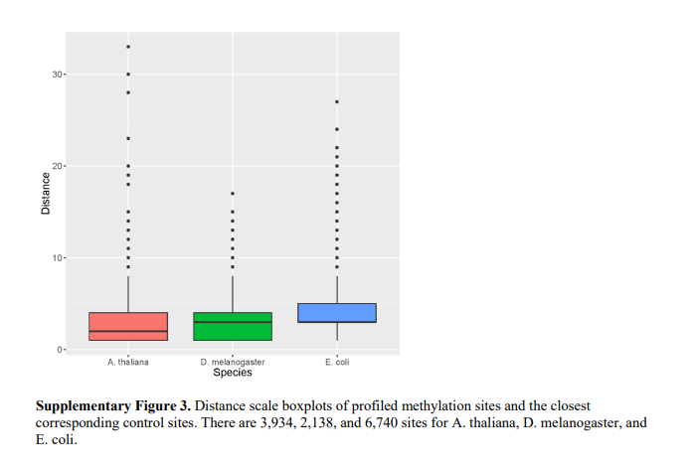
Data for closest non-methylated adenines prediction
Similarly, we also selected non-methylated adenine sites by minimizing the distance scale of case and control samples (Supplementary Fig. 3). In this case, the overlapped contextual sequences between two cohorts were maximized (they are more challenging to predict). They can thus further serve as alternative benchmarks to evaluate the predictive power of the proposed method.

Slide 15
Dataset of 6mA-DNA-IP-Seq of D. melanogaster
The 6mA-DNA-IP-Seq data are described in ref. 9 . We downloaded the raw sequencing data from https://trace. ddbj.nig.ac.jp/DRASearch/study?acc=SRP055483. We then selected IgG and DNA 6mA demethylase mutant samples to call peaks. Downloaded reads were mapped to the reference genome dm6 using the Torrent Mapping Alignment Program with parameters ‘-Y -u -o 2 stage1 map4’. The MACS2 callpeaks pipeline was used to filter out duplicated reads and identify enrichment peaks with an FDR cutoff of 0.05.
As a result, we obtained 801 6mA peaks (Supplementary Table 4). Because of the limitations of the 6mA-DNA-IP-Seq technology, we were not able to know the exact sites of adenine that are methylated in these 6mA peaks. To evaluate the prediction performance of our DeepM6A model on these 6mA sites identified by 6mA-DNA-IP-seq, we first selected all adenine sites around the 50bp flanking context (upstream and downstream) of both forward (Supplementary Table 5) and reverse strands (Supplementary Table 6) for each 6mA peak. Only eight out of all contextual adenine sites around peaks were covered by the dataset we used to develop our DeepM6A.

Slide 16
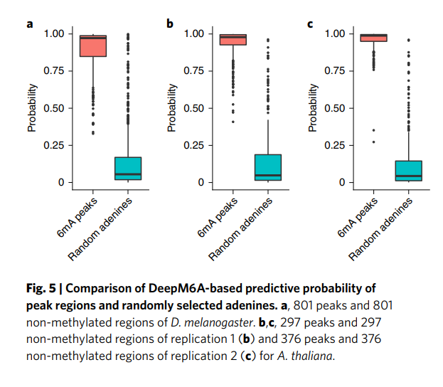
Next, we generated the contextual sequences with flanking length of 30bp for each selected adenine site. Thus, each 6mA peak will have multiple contextual sequences with adenine centred. For each 6mA peak, we applied our DeepM6A model to predict the contextual sequences from the same peak (Supplementary Tables 5 and 6) and assigned the maximum score to this peak (Supplementary Table 7). We summarize the prediction result of those 801 6mA peaks in Supplementary Table 7.
The high prediction scores (Fig. 5a) indicate that our DeepM6A model is able to capture the genomic patterns of the 6mA sequences found by 6mA-DNA-IP-Seq, even though the DeepM6A was trained based on 6mA sequences from the SMRT platform.

Slide 17
6mA-DNA-IP-Seq and sequencing of A. thaliana
Columbia-0 (Col-0) ecotype A. thaliana were vertically grown in 1/2 Murashige and Skoog medium (MS) salts (Phytotech) in chambers under long-day conditions (16-h photoperiods) at 22 °C. gDNA was extracted from nine-day-old seedlings and sonicated to ~300bp. Fragmented DNA was incubated with antibody against N6 -methyladenosine modifications of RNA and DNA (Synaptic Systems) in immunoprecipitation (IP) buffer (50mM Tris-HCl, 750mM NaCl and 0.5% IPEGAL) for 2h at 4 °C. Subsequently, the mixture was incubated with protein A beads (Thermo Fisher Scientific) that was pre-bound with acetylated bovine serum albumin (Sigma-Aldrich) at 4 °C for another 2h.
After washing four times, 6mA antibody-bound DNA was eluted from beads in elution buffer (90 µl 5X IP buffer, 30µl of 100mM antibody against 6mA, 330 µl H2O) at 50 °C for 45min. The eluted DNA was purified with a 2:1 ratio of AMPure SPRI beads (Beckman Coulter) and quantified with a Qubit High Sensitivity Kit (Thermo Fisher). Library synthesis was performed using the SMARTer ThruPLEX DNA-Seq Kit (Takara), library size was determined using a Bioanalyzer High Sensitivity Kit (Agilent) and quantification was performed with a KAPA Library Quantification Kit (Roche). Sequencing was performed on an Illumina NovaSeq 6000 sequencer using an SP 300 cycles flow cell in paired-end mode and the running parameters were 150×8×8×150.

Slide 18
The sequencing data are available on the GEO database under accession no. GSE149060. After sequencing, we applied Trim galore and FastQC for adapter trimming and quality control. The pair-ended reads were then aligned to the TAIR10 genome by Bowtie2 with default settings. The MACS2 callpeaks pipeline was used to filter out duplicate reads and identify enrichment peaks with an FDR cutoff of 0.05. As a result, we obtained 297 and 376 peaks for the two replications (Supplementary Tables 14 and 15), respectively.
Following the same analysis as for 6mA-DNA-IP-Seq of D. melanogaster, we selected all adenine sites in the 50-bp flanking context around the peaks and applied the corresponding trained DeepM6A model to predict scores of both forward (Supplementary Tables 16 and 18) and reverse strands (Supplementary Tables 17 and 19) for each 6mA peak. One peak could have many nearby adenines, and we picked the maximum score as the score for the peak (Supplementary Tables 20 and 21). The high prediction scores are described visually in Fig. 5b,c.
It is also noted that ~48% (143/297) and 21% (80/376) of peaks in two replications are covered by the SMRT dataset we use to develop our DeepM6A. The median probabilities for the uncovered parts in two replications both exceed 0.97. The above studies strongly indicate that our DeepM6A model is capable of capturing the genomic patterns of the 6mA sequences found by 6mA-DNA-IP-Seq although the DeepM6A was trained based on 6mA sequences from the SMRT platform.

Slide 19
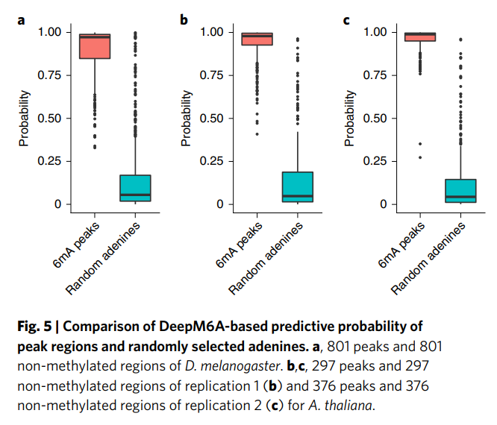

Slide 20
Data for different stages of D. melanogaster embryos
The data were downloaded from the GEO database under accession no. GSE86795. We downloaded BED files of 6mA peaks in 0.75, 3 and 6h. Because the 6mA peaks in this dataset were detected by 6mA-DNA-IP-seq, it is impossible to identify the precise adenine sites that were methylated. To generate training data for DeepM6A, we selected the middle points (it is noted that middle points are not necessarily adenine) of 6mA peaks and padded 200bp up- and downstream contexts (forward strand of the dm6 reference genome). The majority lengths of the 6mA peaks are less than 400bp (the third quartile of lengths is 385bp), so 200bp up- and down-contexts can cover most 6mA peaks. The numbers of 6mA peaks in the 0.75-, 3- and 6-h stages were 17,528, 4,363 and 2,447, respectively (Supplementary Fig. 6). The same number (24,338) of non-methylated regions were randomly selected as negative samples.
As a result, we have four different labels: 0.75h, 3h, 6h and non-methylation. We modified the last fully connected layer of DeepM6A to four sigmoid outputs, enabling DeepM6A to predict four different labels. The filter size of convolutional layers in DeepM6A was set to nine. For the MLP model, we also modified the last layer to four sigmoid outputs. For k-mer LR, we ran it four times to predict the four labels.

Slide 21
Whole-genome sequence prediction
To prioritize the whole-genome adenine sites, we extracted all adenine sites and their associated contextual sequences (30 flanking nucleotides at each side) for each species, giving a total of 76,401,454, 79,393,495 and 2,284,124 adenine sites of interest for A. thaliana, D. melanogaster and E. coli, respectively.

Slide 22
SM-CAP
The saliency map is a topographically arranged map that represents the visual saliency of a corresponding visual scene. To interpret the proposed DeepM6A and elucidate the regulatory motifs of 6mA for different species, we propose the following saliency maps-based context analysis protocol (SM-CAP).
(1) Given a methylated adenine site with contextual sequence, the corresponding first-order derivative with respect to the input sequence is first computed by utilizing back-propagation. In this manner, the protocol is able to highlight most of its signals and ignores irrelative contextual sequences. (2) The derivative is then multiplied by the encoding representation of the input sequence to obtain sequence-specific saliency maps.
(3) The derivatives of all sequence samples are averaged accordingly. This leads to the overall scoring maps with respect to both sequence loci and nucleotides.
(4) The scoring maps are finally normalized based on the min–max rule in the range from 0 to 1. SM-CAP can quantify the contribution of a single base in the modelling context of all other participating bases.

Slide 23
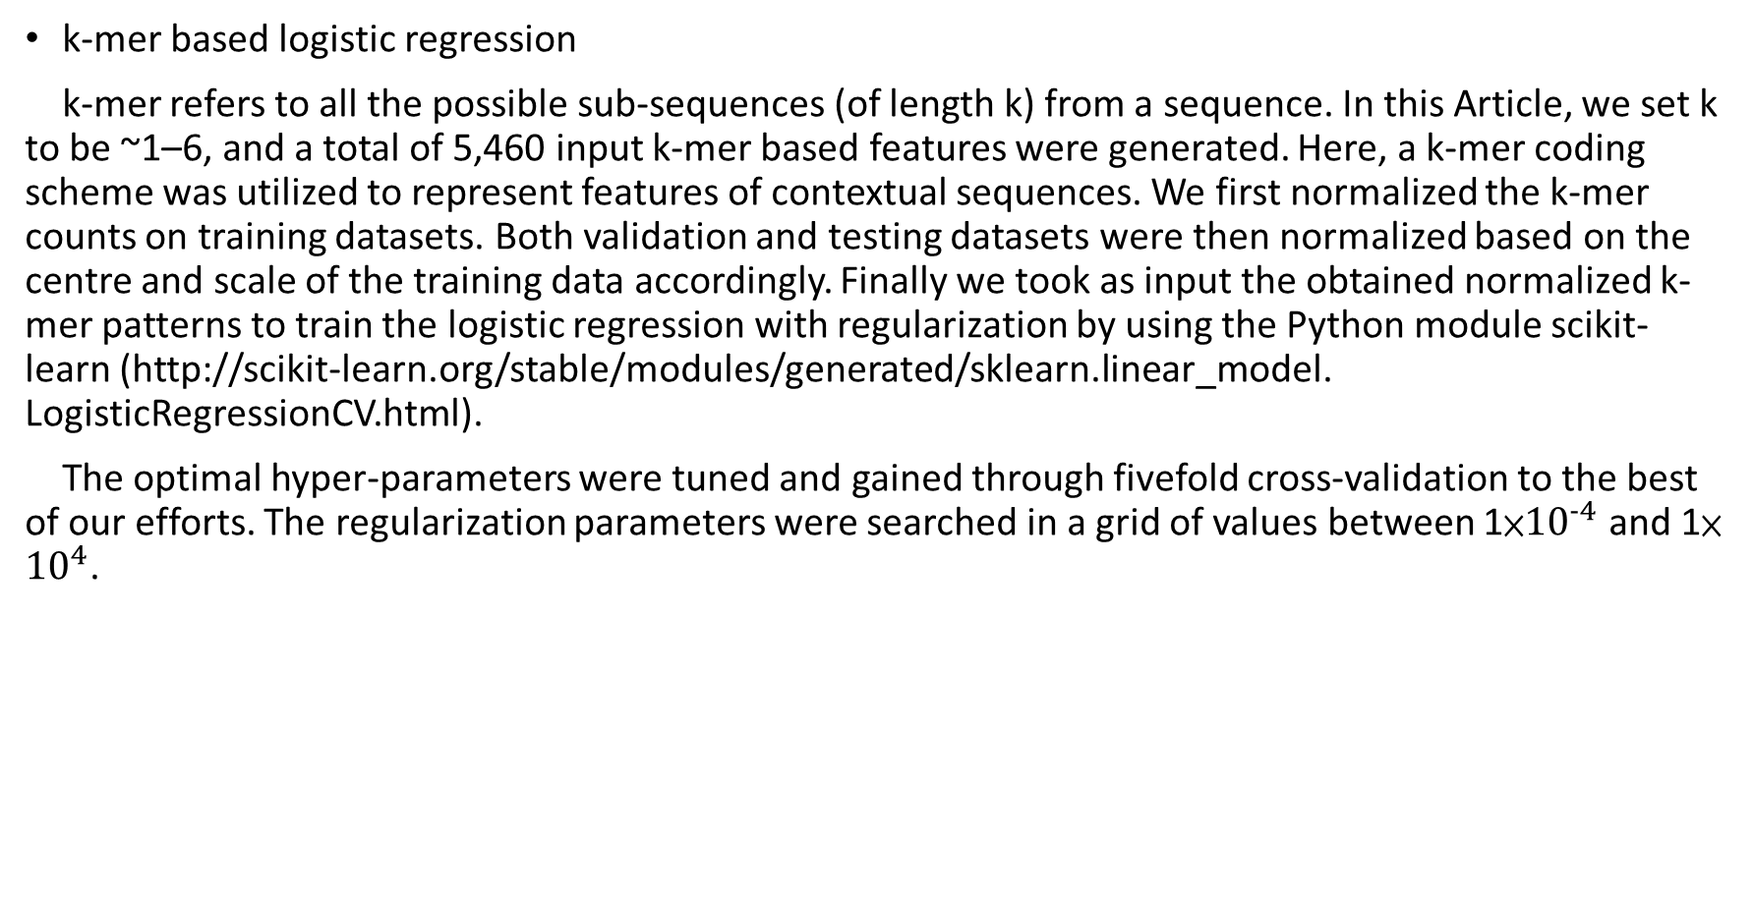
k-mer based logistic regression
k-mer refers to all the possible sub-sequences (of length k) from a sequence. In this Article, we set k to be ~1–6, and a total of 5,460 input k-mer based features were generated. Here, a k-mer coding scheme was utilized to represent features of contextual sequences. We first normalized the k-mer counts on training datasets. Both validation and testing datasets were then normalized based on the centre and scale of the training data accordingly. Finally we took as input the obtained normalized k-mer patterns to train the logistic regression with regularization by using the Python module scikit-learn (http://scikit-learn.org/stable/modules/generated/sklearn.linear_model. LogisticRegressionCV.html).
The optimal hyper-parameters were tuned and gained through fivefold cross-validation to the best of our efforts. The regularization parameters were searched in a grid of values between 1×${10}^{−4}$ and 1× ${10}^{4}$.

Slide 24
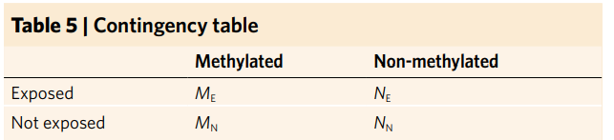
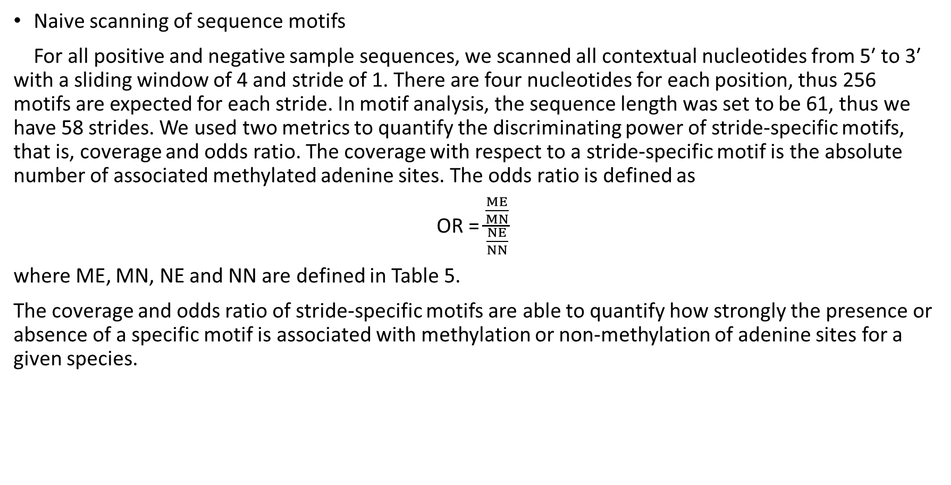
Naive scanning of sequence motifs
For all positive and negative sample sequences, we scanned all contextual nucleotides from 5′ to 3′ with a sliding window of 4 and stride of 1. There are four nucleotides for each position, thus 256 motifs are expected for each stride. In motif analysis, the sequence length was set to be 61, thus we have 58 strides. We used two metrics to quantify the discriminating power of stride-specific motifs, that is, coverage and odds ratio. The coverage with respect to a stride-specific motif is the absolute number of associated methylated adenine sites. The odds ratio is defined as
OR = $\frac{\frac{ME}{MN}}{\frac{NE}{NN}}$
where ME, MN, NE and NN are defined in Table 5.
The coverage and odds ratio of stride-specific motifs are able to quantify how strongly the presence or absence of a specific motif is associated with methylation or non-methylation of adenine sites for a given species.

Slide 25
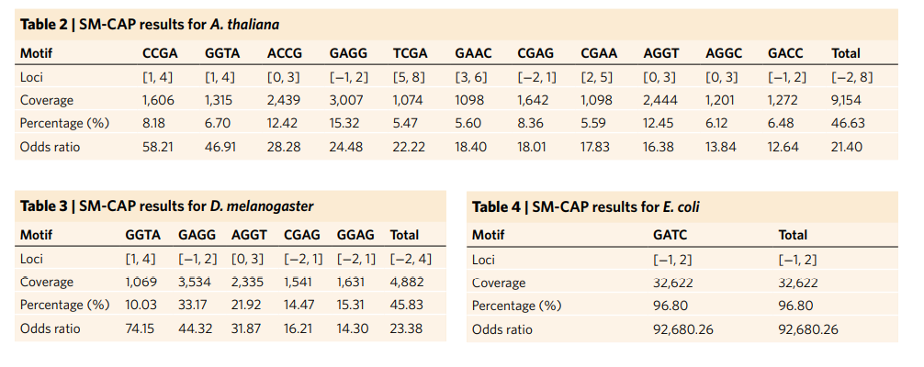
Examination of salient patterns revealed by SM-CAP
The motifs we identify summarize the aggregate importance of each base, which may be composed of the contribution of several individual patterns. To untangle their effects, we scrutinize the whole vital contextual sequences and examine each individual pattern. Specifically, we compute the coverage and odds ratio for all 4-mers at each position. As shown in Supplementary Tables 8–10, we observe around 10 powerful (high coverage) and discriminative (high odds ratio) patterns. For example, some major salient patterns, when combined together, account for 9,154 (46.63%) and 4,882 (45.83%) methylated sites, with odds ratios of 21.40 and 23.38 for A. thaliana and D. melanogaster, respectively (Tables 2 and 3). The well-known motif GATC [−1bp, +2bp] in E. coli is identified successfully by SM-CAP as well (Table 4).

Slide 26
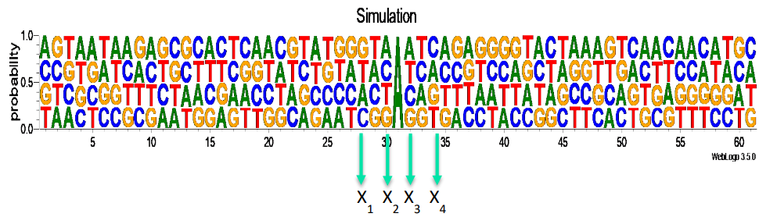
SM-CAP can reveal advanced cis-regulatory patterns
After identifying 6mA, the next step, typically, is to search for regulatory sequences in the surrounding regions. Unlike conventional motif analysis, we developed a saliency maps-based context analysis protocol (SM-CAP). SM-CAP works by quantifying the contribution of a single base in the modelling context of all other participating bases, such as the nonlinear models DeepM6A employs. In contrast, conventional motif analysis assumes simple independence and additive effects among regulatory bases.
Our current knowledge suggested that genomic 6mA may not be conserved. Such conservancy status is defined conventionally as traditional motif definition. Advanced nonlinear motif patterns can exist and exhibit unconventional conservancy status. If we consider simulated data, for example, as shown in Supplementary Fig. 7, there is supposed to be a 61-bp DNA segment with adenine in the centre, and A, C, G and T distributed evenly at the remaining loci.

Slide 27
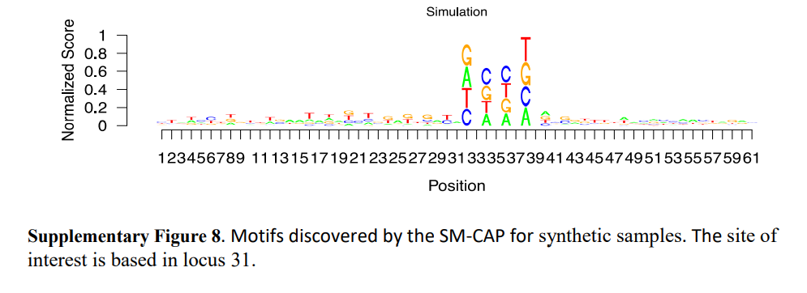
The central adenine will become methylated if and only if a combination of {A, C, G, T} shows at four specific loci X1, X2, X3 and X4. The order A, C, G and T does not matter, for example, ACGT, TCGA or GATC can all lead to the methylation of the central adenine. We can see that the motif pattern at the four loci {X1, X2, X3, X4} is not conserved according to the conventional conservancy status definition. Conventional motif search algorithms would fail to recognize this motif. As shown in Supplementary Fig. 8, our proposed SM-CAP can successfully identify the four loci and assign appropriate importance scores for the four bases, in comparison with other irrelevant loci. Our SM-CAP can thus capture advanced patterns that are missed by traditional analysis, as verified by simulation studies (see Supplementary Information).

Slide 28
cis-regulatory patterns of 6mA revealed by SM-CAP
We used SM-CAP to analyze and visualize the contextual region of 6mA for the three species (Fig. 4a–c). We can see that the central region is the most critical and that the eukaryotes exhibit more sophisticated patterns than the prokaryote. Interestingly, we observe asymmetrical contributions of the flanking contextual sequences, with the downstream more predominant than the upstream sequences in terms of both strength and length.
To further quantify and confirm their contributions, we perturbed nearby regions alternately and evaluate their impact on the prediction performance (Fig. 4d–f and Supplementary Fig. 9). We observed that the central M0 [±2bp] and downstream D1 [+3bp, +7bp] regions play the most important role in predicting 6mA across different species, which is in line with the cis-regulatory patterns elucidated by SM-CAP. We noticed that some patterns are shared by the two eukaryotes, for example, GAGG [−1bp, +2bp], as shown in Fig. 4a,b. The normalized scoring maps thus present a good summary of the underlying conventional conserved motifs, which might co-regulate 6mA.

Slide 29
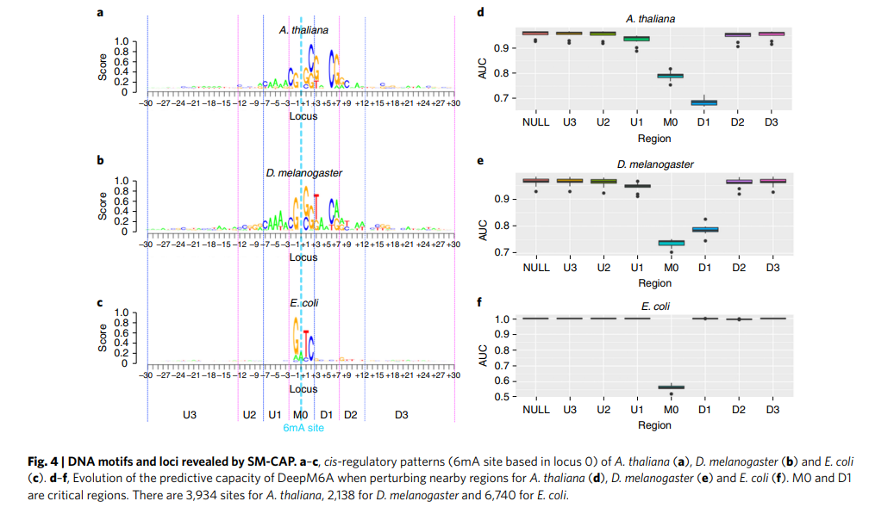

Slide 30
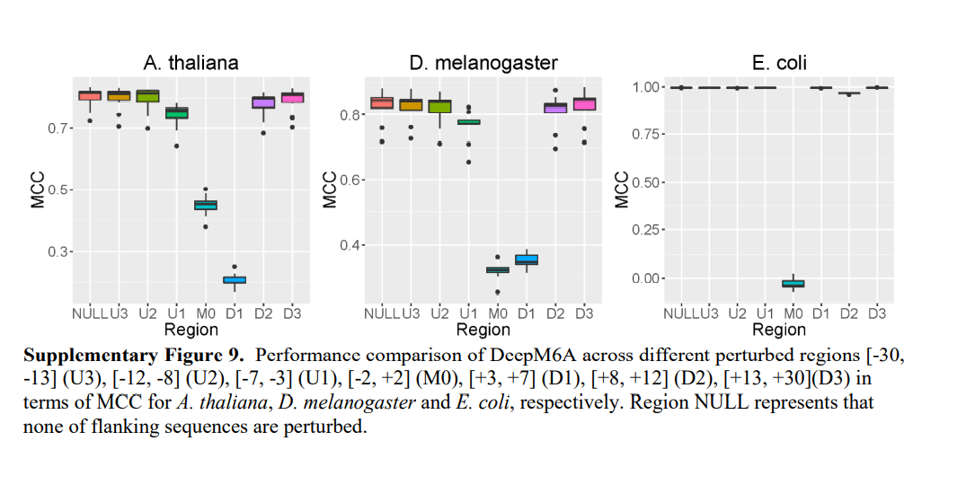

Slide 31
Further examination of the salient patterns revealed by SM-CAP shows that these patterns are more discriminative and account for more than 45% of the 6mA sites with an odds ratio of more than 20 for A. thaliana (Table 2) and D. melanogaster (Table 3), respectively (see Methods). As a comparison, we also tried to elucidate conventional motif patterns using HOMER(Supplementary Figs. 10–12) (all with odds ratios of less than 2 for the two eukaryotes). It is noted that conventional conserved motifs could be a special case of the patterns SM-CAP can capture. An example in point is the well-known motif GATC (−1bp, +2bp) in E. coli, as also identified successfully by SM-CAP (Table 4)

Slide 32
Experimental validation
We have used public data to demonstrate the robustness and prediction performance of DeepM6A. We also conducted our own experimental validation to strengthen the work. DNA immunoprecipitation-based genomic profiling of 6mA has proven to be accurate and robust in A. thaliana. We thus chose A. thaliana as the model organism and validated our prediction using DNA immunoprecipitation followed by a next-generation sequencing experiment (see Methods ‘6mA-DNA-IP-Seq and sequencing of A. thaliana’ for details).
Briefly, we grew the Columbia-0 ecotype of A. thaliana in a chamber under long-day conditions and extracted gDNA from nine-day-old seedlings. We produced two biological replicates and sonicated the gDNA into ~300-bp fragments. Following ref. 22, we then used the same 6mA antibody to pull down 6mA-methylated DNA fragments, followed by high-throughput next-generation sequencing. We mapped the sequencing data (GEO accession no. GSE149060) to the plant reference genome and used MACS2 to call peaks (enriched regions) that contained 6mA sites. Under a false discovery rate (FDR) cutoff of 0.05, MACS2 reported 297 and 376 peaks for the two replicates, respectively. As shown in Fig. 5b,c, DeepM6A predicted most of those DNA-IP-Seq validated 6mA sites with very high probability (>0.95), while as negative control, DeepM6A predicted most randomly selected adenines with very low probability (<0.05). This cross-platform independent experimental validation confirms the accuracy of DeepM6A.

Slide 33
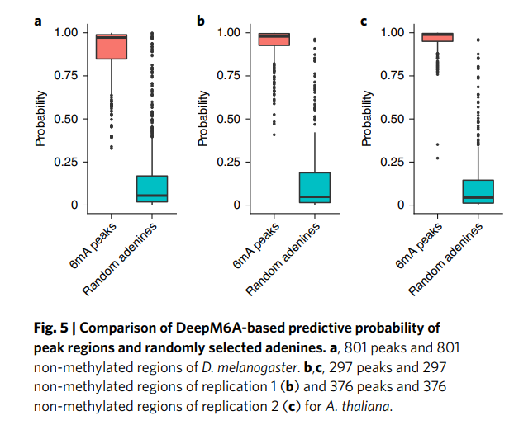

Slide 34
Discussion and conclusion
It is noted that our prediction is purely based on sequence information. In other words, only the cis effect has been captured. This means that what we predict is the candidacy or potential for being a 6mA site. Whether a candidate is 6mA-ed or not will also depend on many other exogenous trans effects. The origin of the trans effects has remained largely elusive so far for eukaryotes. Conventionally, epigenetic modifications on individual bases in DNA are regulated by certain methyltransferases and can encode heritable genetic information. In eukaryotes, only the DNA N6 adenine methyltransferase 1 (DAMT-1) in Caenorhabditis elegans has been reported to execute DNA adenine methyltransferase activities.
A recent study shows that the majority of DNA 6mA in mammalian cells, instead of originating from direct methylation, may be incorporated by DNA polymerases via a nucleotide-salvage pathway. This finding is interesting because it delineates another pathway of generating 6mA that results from an environmental effect instead of a heritable effect. Using only DNA sequence information, our prediction may not directly distinguish the origins of 6mA, for example nucleotide salvage or direct DNA methylation.

Slide 35
Nevertheless, the good prediction accuracy suggests that the presence of genomic 6mA is non-random and may have biological consequence. Even if the 6mA is incorporated into the genome during DNA replication, the frequency of the T base in DNA template strand pairing with adenine or 6mA may be affected by its flanking sequences. Regardless of whether this 6mA site originates from direct methylation by writer proteins or from DNA replication, its interaction with 6mA binding proteins (readers) can trigger downstream biological consequence. In the event 6mA is released from the microbiome or bacteria and is absorbed by the host cell and integrated into its own genome, this would be an interesting mechanism by which the microbiome or bacteria in the environment communicate with the host (via the releasing/recycling of bacterial DNA bases).
Our in silico 6mA candidacy map helps to provide a global view of 6mA candidacy (Supplementary Tables 1–3, Supplementary Fig. 16 and Supplementary Information) and may shed light on host–microbiome interactions. It is recognized that genomic 6mA methylation is dynamically regulated, with methylation status probably changed over time (developmental stages) or location (tissue-specific).

Slide 36
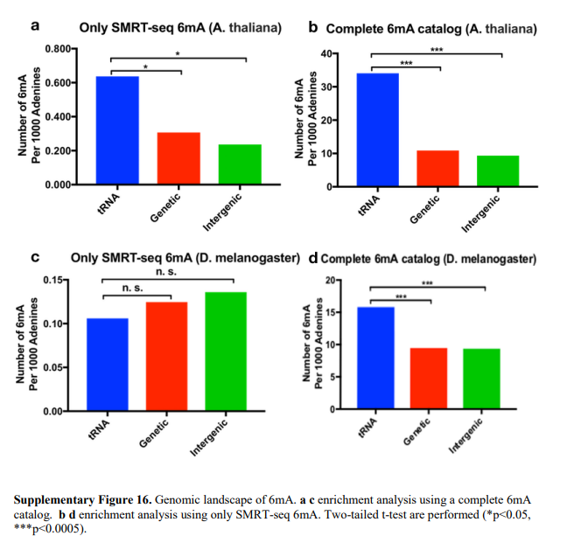

Slide 37
We note that DeepM6A is a general 6mA prediction algorithm, which is not limited to the conditions, time or tissues for which data are collected. If 6mA methylation data are collected and provided with development-stage and/or tissue information, our model can be trained over those data and make predictions of tissue- and/or development-stage-specific 6mA sites accordingly. For example, if trained on 6mA methylation data collected at the embryonic development stage, DeepM6A would be able to predict embryo-specific 6mA candidacy.
Although we have conducted a rigorous filtering protocol on the 6mA sites as determined by SMRT and have generated the final datasets for our research, some false-positive sites might still exist. It is therefore good to assess the impact of the error rate on our study. It is interesting to see whether DeepM6A is robust to false-positive samples and our results remain convincing. To this end, we performed twofold experiments. First, we used simulation studies to show the effectiveness even when the dataset for model training contained a significant proportion of false-positive samples. Second, we applied the models to 6mA regions generated using 6mA-DNA-IP-Seq. This is the current state-of-the-art sequencing technology, with a low error rate, but it could not pinpoint the exact methylation sites of 6mA. Interestingly—and impressively—our predictive models, trained on the SMRT 6mA data, captured almost all peaks with high probability. These two independent explorations indicate that our approaches are robust to false-positive samples and their outputs are reliable.

Slide 38
In conclusion, we have proposed a set of methodologies based on deep-learning techniques for elucidating DNA methylation on N6 -adenine. This work is a comprehensive study across three representative model organisms from a computational perspective. The proposed DeepM6A can identify 6mA sites at single-nucleotide resolution with high accuracy and reliability. Exploiting the predictive power of DeepM6A, we have constructed a whole-genome complete catalogue of 6mA sites. We have also developed SM-CAP in an attempt to elucidate the regulatory mechanisms of 6mA methylation. This has uncovered quite a few interesting regulatory patterns that are missed by conventional motif analysis. These unconventional motif patterns are worthy of further investigation in epigenetics. Taken together, these computational approaches (DeepM6A and SM-CAP) and their findings may shed new light on the functional effects of 6mA methylation.

