Slide 1
iM6A
Deep learning modeling m6A deposition reveals the importance of downstream cis-element sequences

Slide 2
Abstract
The N6-methyladenosine (m6A) modification is the most common internal modification in eukaryotic mRNA, and widely distributed in various tissues. It was first identified to be in mRNA during 1970s. m6A is involved in diverse biological processes including cell differentiation, cancer progression and neurological development. Due to its functional importance, m6A has been discovered to affect various aspects of RNA biology, including splicing, polyadenylation, export, degradation, and translation. Its major function is believed to regulate mRNA turnover.
The m6A modification on mRNA is catalyzed by the m6A methyltransferase complex (MTC), which is comprised of METTL3 and METTL14 as the catalytic core. Additional components including WTAP, VIRMA, ZC3H13, and HAKAI are also found to interact with METTL3-METTL14 and affect the complex activity. The m6A consensus sequence RRACH as a stringent motif or RAC as a more inclusive motif (R = A or G, H = A, C, or U) was first determined by biochemical experiments. Despite the wide prevalence of the m6A consensus motif in transcripts, very few of them are methylated, highlighting the site-specificity of m6A methylation.

Slide 3
To investigate the global m6A distribution at the transcriptomic level, the m6A-seq and MeRIP-seq were first developed to map the m6A peak regions (typically ~200 nt or longer) using commercially available m6A antibodies. To achieve single-nucleotide resolution mapping for m6A, m6A-CLIP/miCLIP/PA-m6A-seq crosslinked m6A-antibody to its m6A mRNA target by UV and achieved precise m6A mapping in transcripts by detecting the reverse transcription errors due to the residual peptide crosslinked to m6A (CIMS sites: crosslink induced mutational sites, CITS sites: crosslink induced truncation sites).
In addition, the reverse transcription errors by m6A modification itself also enabled the single-nucleotide resolution mapping (MITS sites: m6A induced truncation sites). Though a few new precise m6A mapping methods have recently been developed by exploring alternative ideas, the m6A-CLIP method has generated the major share of precise m6A sites in human and mouse transcripts. The m6A mapping studies showed that m6As were preferentially enriched in last exons, both their coding region and 3'UTR (untranslated region), as well as in long internal exons.

Slide 4
Based on the existing m6A sites precisely determined by experiments, computational methods have been developed to model the m6A sites in mRNA, including the machine learning based methods (WHISTLE, SRAMP, and MethyRNA) and the deep learning-based methods (TDm6A, DeepM6ASeq). These bioinformatics methods mostly focused on the gradually improvement for the m6A site modeling accuracy, but used the relatively small-scale data integration and contributed little to discovery of biological mechanisms.
Here we first described a new deep learning method, the ResNet (residual neural network), for modeling the m6A deposition in pre-mRNA. The ResNet avoids the vanishing gradient problem in deep neural networks by the skip connections. Skip connections allow to skip some layers in the neural network and feed the output of one layer as the input to the next layers, enabling us to build deeper neural networks (adding more layers) and improve the accuracy of classification. In addition, it can handle very large datasets to investigate more complex issues. This deep learning method has been successfully used to handle high-throughput sequencing data and model biological processes.

Slide 5
Our ResNet deep learning approach, the iM6A (intelligent m6A), models the m6A site-specific deposition in the genome with a state of art accuracy. Using saturated mutational analysis to generate input sequence, we systematically perturbed the input sequence to the iM6A deep learning model to see how it affects the m6A deposition output. We discovered surprisingly that the downstream 50 nt region of the m6A sites contained a high density of the cis-elements for the m6A deposition. This pattern was consistently true for both last exons and internal exons. We further characterized m6A enhancers and silencers by implementing linear regression to interpret the iM6A deep learning output.
The iM6A modeling as well as the identified functional cis-elements were validated by independent experimental data and evolutionary conservation. By a similar process of model perturbation, we found that synonymous codon mutations can affect m6A deposition and that the TGA stop codon may promote the adjacent m6A deposition. The iM6A approach enabled high-throughput and effective biological discovery which would be cost-prohibitive for traditional experimental methods, and uncovered a key cis-regulatory mechanism governing m6A site-specific deposition.

Slide 6
iM6A accurately models m6A deposition
As with any nucleotide-related biological process, the question arises whether the site-specificity of m6A deposition is determined in whole or part by a “code” in flanking primary nucleotide sequences. Is there an m6A cis-element code? To address this question directly, we developed the iM6A (intelligent m6A, Fig. 1a), a deep residual neural network (ResNet) to model the m6A site-specific deposition at genome-wide level. We first collected a highquality set of m6A sites that were precisely determined by the m6A-CLIP experiments in mouse transcriptome. We used pre-mRNA sequences as input: the m6A sites on pre-mRNA were served as positive sites, while the remained nucleotides were treated as negative sites.
The whole dataset was divided into training and test datasets. The training dataset contained all the transcripts on most chromosomes except chromosome 9 (Chr9), the transcripts of which were held out and reserved for the later independent test of iM6A modeling. iM6A evaluated the full length of transcripts, and the outputs of which were probabilities of each nucleotide position being an m6A site (see details in the Methods).

Slide 7
Methods - Model training and testing
We downloaded the gene annotation tables (vM7 for mouse, v19 for human) from GENCODE (https://www.gencodegenes.org/) and extracted the longest transcript for each gene. Both mouse and human m6A sites were collected from published data, which were determined by m6A-CLIP experiments. The consensus motif for an m6A site could be either RRACH as a high stringent set or RAC as a more inclusive set. We generated two separate iM6A models using either stringency: the RRACH dataset for RRACH iM6A model and the RAC dataset for RAC iM6A model.
The transcripts with its m6A sites were kept as input (mouse RRACH: 8475 genes, 41,551 m6A sites; mouse RAC: 8939 genes, 57,712 m6A sites; human RRACH: 8598 genes, 54,354 m6A sites; human RAC: 10,314 genes, 81,519 m6A sites). We used pre-mRNA sequences as input: the m6A sites on pre-mRNA were served as positive sites, while the remained nucleotides were treated as negative sites. The whole dataset was divided into training and test datasets. The training dataset contained all the transcripts on most chromosomes except chromosome 9, the transcripts of which were held out and reserved for the test later on.

Slide 8
Methods - Model training and testing
The iM6A were trained for 10 epochs with a batch size of 30 on NVIDIA GPU. By pulling singularity container (tensorflow-19.01-py2) from NVIDA official website, we created an environment for model training and testing. Extra packages (biopython: 1.76; scikit-learn: 0.20.3, matplotlib: 2.2.4, keras: 2.0.5) were installed into an external path by pip. For training, Adam optimizer was used to minimize the categorical cross-entropy loss between the target and modeled outputs. The learning rate of the optimizer was set as 0.001 for the first 6 epochs, and then reduced by a factor of 2 in every subsequent epoch. We trained the model for five times and obtained five trained models. For testing, each input was evaluated using all five trained models, while the average score of their outputs was used as the modeled value.

Slide 9
Methods - Model architecture.
The iM6A is based on a deep residual neural network. The basic unit of iM6A is the Residual Network (ResNet) block and we implemented the ResNet structure according to the CNN Architectures and implementations by MLT (https://github.com/Machine-Learning-Tokyo/CNN-Architectures), which is composed of batch-normalization (BatchNorm) layers, rectified linear units (Relu), and convolutional (Conv1D) layers organized in a specific manner (Fig. 1a).
In ResNet block, k, w, ar, and r are the number of convolutional kernels, window size, dilation rate of each convolutional kernel in the layer, and repetition numbers, respectively. The current combination of k, w, ar, and r-values are showed in Fig. 1a, which were obtained by hyperparameter search (Supplementary Data 1). iM6A starts with a Conv1D, then is followed by four ResNet blocks. The output of every ResNet block is added to the input of penultimate layer (Cropping1D), connected with a Cov1D layer with softmax activation.

Slide 10
Methods - Model architecture.
The training input of iM6A for each gene is the full length of the pre-mRNA sequence with 5000 nucleotides on each side, covering the transcript from 5 kb upstream of TSS (transcription start site) to 5 kb downstream of TES (transcription end site).The sequence is transformed by One-Hot-Encoding, which N, A, C, G, and T are encoded as [0,0,0,0], [1,0,0,0], [0,1,0,0], [0,0,1,0], and [0,0,0,1] respectively. Then, the one-hot-encoded nucleotide sequence was split into blocks of length 5000 + 5000 + 5000 in such a way that the i th block is consisted of the nucleotide sequence position from 5000(i−2) +1 to 5000i + 5000.
Along with the sequence input, the location for the positive training set of individual m6A sites was marked out, and the output label was also split into block of length 5000 in such a way that i th block consists of the positions from 5000(i−1) +1 to 5000i. Information of input and output was jointly feed into the ResNet deep learning network for training. A similar input strategy has been implemented in SpliceAI that implemented deep learning to model splice sites in pre-mRNA. The output of the model is the probability value of each position being an m6A site.

Slide 11
SpliceAI - SpliceAI architecture
The SpliceAI architectures only have normalization and non-linear activation units in addition to convolutional units. Consequently, the models can be used in a sequence-to-sequence mode with variable sequence length (van den Oord et al., 2016). For example, the input to the SpliceAI-10k model (S = 10,000) is a one-hot encoded nucleotide sequence of length S/2+l+S/2, and the output is an l×3 matrix, corresponding to the three scores of the l central positions in the input, i.e., the positions remaining after excluding the first and last S/2 nucleotides. This feature can be leveraged to obtain a tremendous amount of computational saving during training as well as testing. This is due to the fact that most of the computations for positions which are close to each other are common, and the shared computations need to be done only once by the models when they are used in a sequence-to-sequence mode.

Slide 12
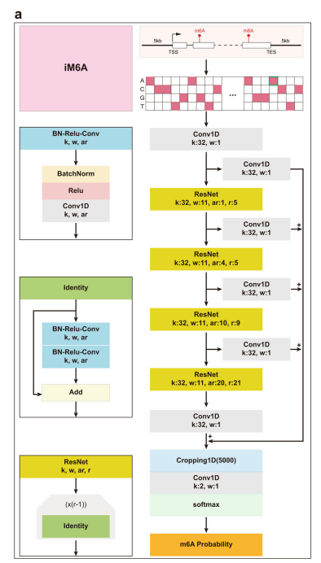

Slide 13
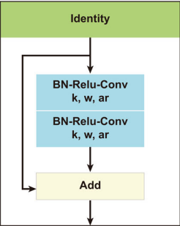
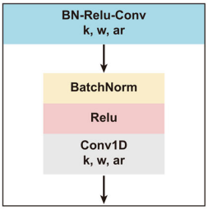
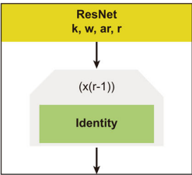

Slide 14
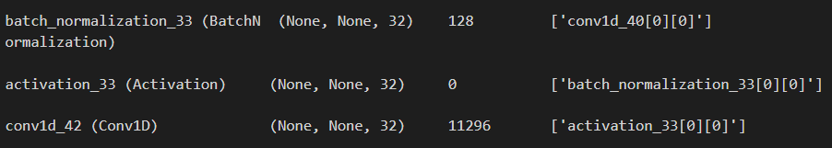

Slide 15
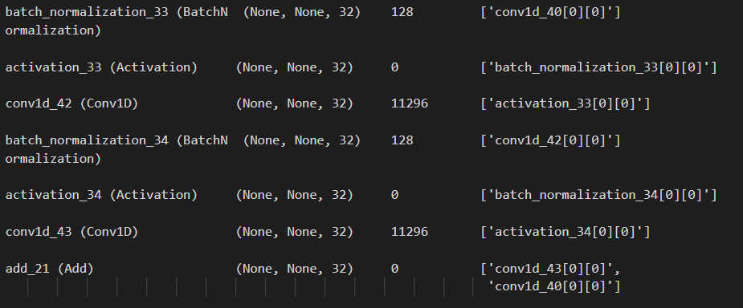

Slide 16
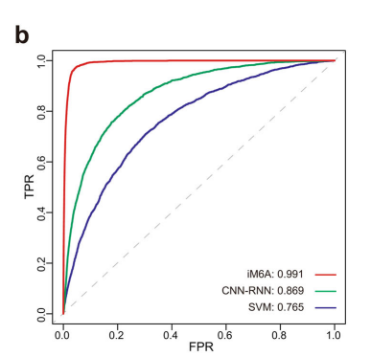
iM6A accurately models m6A deposition
iM6A modeled the m6A sites in the test set with an accuracy of 0.991 as measured by the AUROC score (area under receiver operator curves) (Fig. 1b). As the comparison, we also implemented a traditional machine learning method, SVM (Support Vector Machine) and an alternative deep learning method CNN-RNN (Convolutional Neural Network-Recurrent Neural Network) to modeling the m6A modification deposition for the same training and testing datasets (see Methods for more details). The comparisons showed that iM6A achieved better performance than both SVM and CNN-RNN (Fig. 1b).

Slide 17
Methods - Comparison of iM6A with other methods
We compared the modeling performance of iM6A with that of the machine learning-based SVM method and that of the deep learning-based CNN-RNN method. Both SVM and CNN-RNN models were trained on the same training samples used for iM6A, and the m6A and nonm6A sites were conformed to the RRACH motif in the same way as in Chen et al., 2019. For the positive training data, the input is the sequence centered on the m6A sites (39,138 sites). For the negative training data, the input is the sequence centered on the non-m6A sites, which were randomly selected from the non-m6A sites on the same full transcripts that contained the positive sites.
The sequence length for SVM model was 41 nt as described in Chen et al., 2019, while the sequence length for CNN-RNN model was 1001 nt as in Wang and Wang, 2020. Moreover, the positive-to-negative ratio was 1:1. For independent testing, the sequence centered on the m6A and non-m6A sites in chromosome 9 were used to quantify the modeling performance of the models, and ROC (receiver operator curves) curves and AUROC (area under receiver operator curves) scores were used as the performance evaluation metrics.

Slide 18
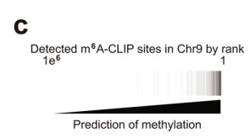
iM6A accurately models m6A deposition
Alternatively, the performance of iM6A measured by the AUPRC score (area under precision recall curves) showed iM6A was also better than those of SVM and CNN-RNN methods (Supplementary Fig. 1b). The m6A sites experimentally determined by m6A-CLIP were accurately identified from the nonmethylated sites by iM6A in the independent test (Fig. 1c). For comparison with mouse, we implemented the iM6A strategy to model the m6A site-specificity in human genome by using a high-quality set of human m6A sites that were precisely determined by the m6A-CLIP experiment and obtained the same high AUROC and AUPRC performances (Supplementary Fig. 1a, c, d).

Slide 19
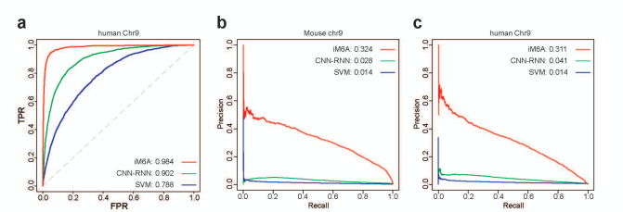
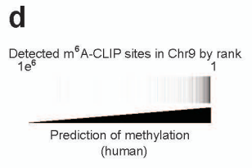
Supplementary figure

Slide 20
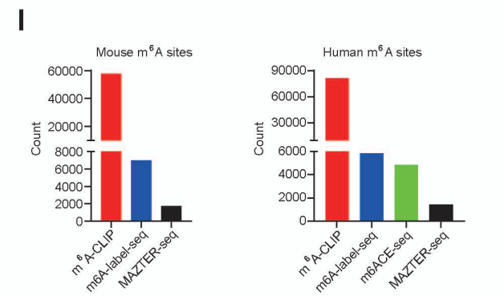
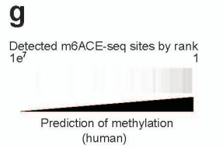
iM6A accurately models m6A deposition
Our iM6A training was using the experimentally determined m6A sites by the m6A-CLIP method which identified a major share of the single-nucleotide resolution m6A sites that had been mapped so far (Supplementary Fig. 1l). To make sure that the iM6A model was accurate for all m6A sites independent of the experimental methods that precisely mapped them, we examined whether iM6A could identify m6A sites mapped by alternative experimental methods (Supplementary Fig. 1g) including m6Alabel-seq, MAZTER-seq, m6ACE-seq, and miCLIP2.

Slide 21
iM6A accurately models m6A deposition
The m6A-label-seq method detected m6A sites by chemically substituting the m6A with a6A (N6-allyladenosine) at the m6A sites, MAZTER-seq identified a relatively small subset of m6A sites that were in the m6ACA motifs by a methyl-sensitive RNase, and m6ACE-seq detected m6A sites by its crosslinking to the m6A-antibody and followed with the exonuclease digest to achieve single-base resolution. In addition, miCLIP2 was an optimized CLIP method that combined miCLIP with machine learning to improve m6A detection. The precisely mapped m6A sites by all these alternative experimental methods were identified with high probability values by iM6A (Fig. 1d and Supplementary Fig. 1j, k for mouse, Supplementary Fig. 1e–i for human), indicating that iM6A modeling was accurate and supported by a variety of the m6A mapping experimental methods.

Slide 22
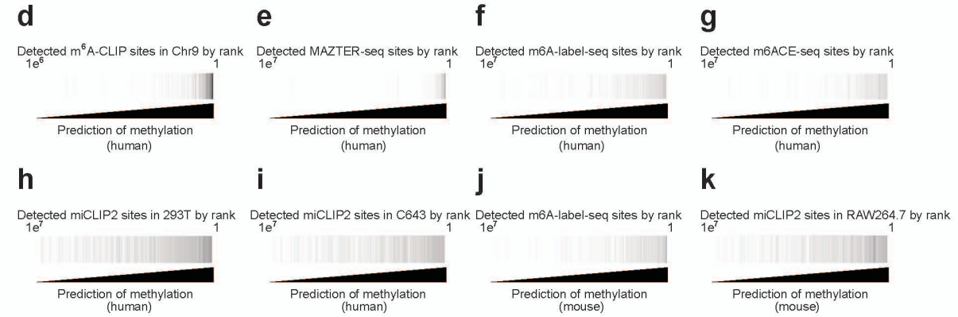

Slide 23
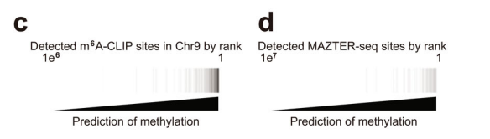
Method - Validation of iM6A modeling by experimentally detected m6A sites.
We downloaded the gene annotation tables (vM7 for mouse, v19 for human) from GENCODE (https://www.gencodegenes.org/) and extracted the longest transcript for each coding gene (mouse: 22,357 genes, human: 20,536 genes). The probability value of each nucleotide being an m6A site in the pre-mRNA of the transcripts were modeled by iM6A, and the sites selected were those conforming to the RRACH (the iM6A RRACH model) or the RAC (the iM6A RAC model). We collected the m6A sites detected by the experimental methods including m6A-CLIP, m6A-label-seq, MAZTER-seq, and m6ACE-seq.
The heatmap was used to visualize the experimentally detected sites in all modeled sites. The modeled sites were ranked by its probability value, and the black line denoted whether methylation was identified by the experimental method at the site (Fig. 1c, d).

Slide 24
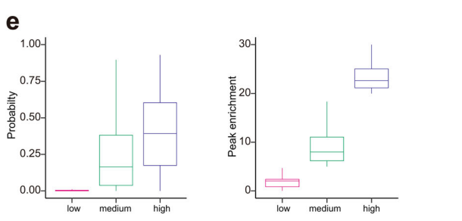
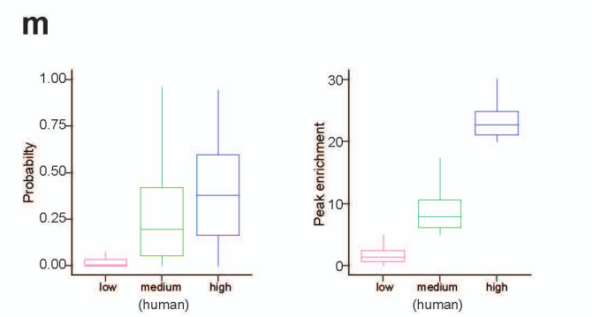
iM6A accurately models m6A deposition
Furthermore, we investigated if the modeled m6A probability by iM6A for an m6A site was quantitatively associated with its methylation level. The m6A peak enrichment value quantifies its methylation level by normalizing the m6A-IP read count to the input read count for an m6A peak region. We categorized the m6A sites into three groups based on their m6A peak enrichment value as the low, medium, and high groups, and found that the modeled m6A probability by iM6A associated with the quantitative distribution of the peak enrichment value across the three groups (Fig. 1e for mouse, and Supplementary Fig. 1m for human).

Slide 25
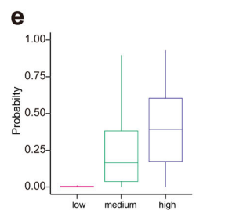
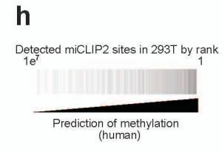
Method - Calculation of the m6A probability and the enrichment score for the m6A sites derived from m6A-CLIP.
The peak enrichment value for the m6A sites in mouse (mouse embryonic stem cell, mESC) and human (the A549 cell line) were quantified by the m6A-CLIP. Based on the enrichment score, the m6A were categorized into three groups (low: score < 5, medium: 5 ≤ score < 20, high: score ≥ 20). The probability of the site being an m6A site was modeled by the iM6A, and the box plot was used to visualize the peak enrichment value and the modeled m6A probability (Fig. 1e and Supplementary Fig. 1h)

Slide 26
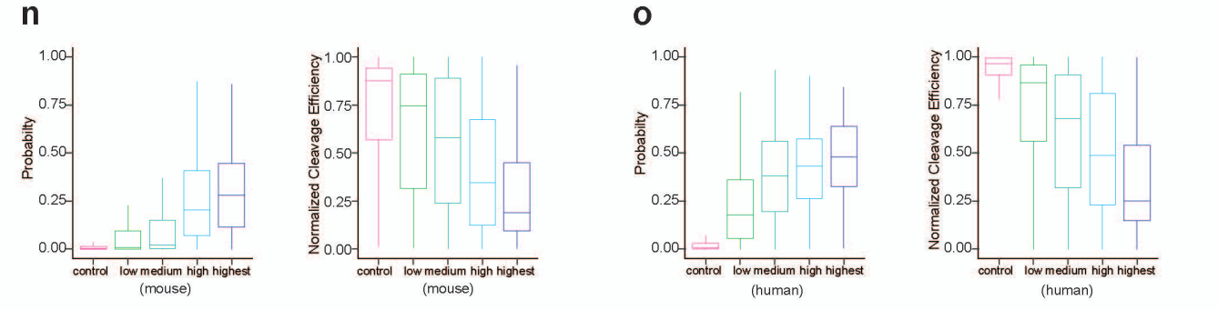
iM6A accurately models m6A deposition
MAZTER-seq is another method that could experimentally quantify m6A methylation level for a small subset of m6A sites that were in RRACA (R = A or G) motif, with the higher m6A methylation level associated with the lower cleavage efficiency by a methylation-sensitive RNase. The modeled m6A probability by iM6A also associated with the quantitative distributions across the different cleavage efficiencies groups (Supplementary Fig. 1n for mouse data, and Supplementary Fig. 1o for human data). All the results above supported that the m6A probability score generated by iM6A reflected quantitatively the methylation level at the m6A site.

Slide 27
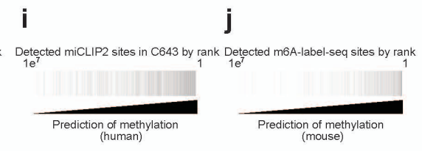
Methods - Calculation of the m6A probability and the cleavage efficiencies for the m6A sites derived from MAZTER-seq.
The m6A sites identified by MAZTER-seq were downloaded. According to their supplemental tables, the m6A sites were categorized into the groups of control, low, intermediate, high, and highest confidence. We filtered the dataset to retain the sites conforming to the RRACA motif and extracted the normalized cleavage efficiency of the sites from the table. Box plot was used to visualize the normalized cleavage efficiency and the modeled m6A probability (Supplementary Fig. 1i, j).

Slide 28
iM6A accurately models m6A deposition
It is known that the m6A site consensus could be either RRACH (H = A, C, or U) as a high stringent set or RAC as a more inclusive set. Accordingly, to be comprehensive, we independently trained the RAC iM6A model and the RRACH iM6A model using either the RAC or the RRACH experimentally determined m6A sites in most genes on chromosomes except chromosome 9 (Chr9) as the training dataset, and tested the performance of the RAC and the RRACH iM6A models on genes from chromosome 9 (Chr9).
The RAC iM6A model performed very similarly to the RRACH iM6A model (Fig. 1f for mouse data, and Supplementary Fig. 1p for human data). In addition, we trained the iM6A model with 80, 400, 2 K, and 10 K sequence on both sides, and the performance increased along with sequence length (Supplementary Fig. 1q). For all the analysis in the remaining result section, we implemented the RAC iM6A-10K model to generate all the data.

Slide 29
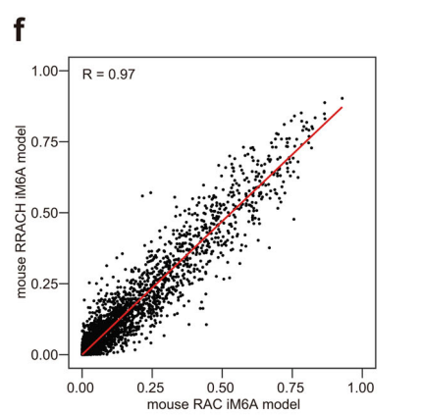
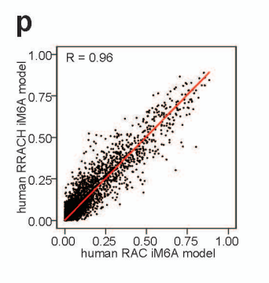
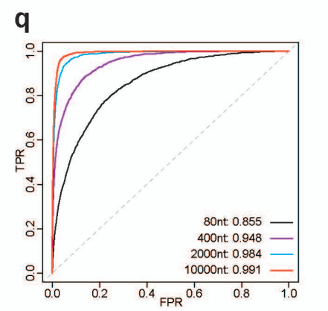

Slide 30
Methods - Comparison of the RRACH model with the RAC model. Both RRACH and RAC of the iM6A models for mouse
(Fig. 1f) were trained independently on the genes of all the other chromosomes except those of the chromosome 9 (Chr9). The m6A sites in Chr9 were modeled by either the RRACH iM6A model or the RAC iM6A model, and the scatter plot was used to visualize the modeled probability of the m6A sites between the RRACH model and the RAC model. Each dot represented one site in Chr9 discovered by both models, and the labeled axes provided the probability estimate for that site by the two models. The R-value was calculated by Pearson Correlation Coefficient. The same analysis was performed for human (Supplementary Fig. 1P).

Slide 31
Cis-elements that govern the m6A deposition locate largely within 50 nt downstream of the m6A sites
Though iM6A as a deep learning approach was powerful in accurately modeling the m6A sites in the genome, this deep learning black box did not aid understanding of the underlying cis-element rules, i.e., the m6A cis-element code. To systematically identify the cis-elements that determine m6A modification, we performed single nucleotide saturation mutagenesis (Fig. 2a) to the sequences flanking the m6A sites in last exon which contains about 70% of all m6A sites in the transcripts and calculated the positional mutational effects for the m6A deposition by iM6A.
We found that the mutations that either increased or decreased m6A probability significantly (|ΔProbability | > 0.1) were largely enriched in the downstream region of the m6A sites, especially within the 50 nt downstream of m6A sites (Fig. 2b for mouse; and Supplementary Fig. 2a for human), suggesting cis-elements that influence m6A deposition locate largely in this region.

Slide 32
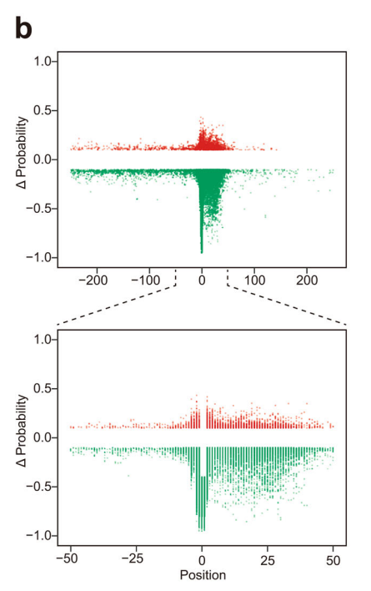
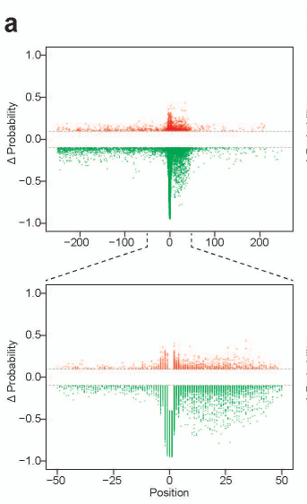
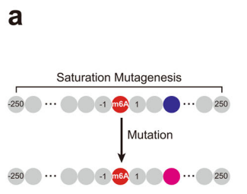

Slide 33
Method - Positional mutational effects on m6A deposition implemented by single nucleotide saturation mutagenesis
For the m6A sites in last exon, we modeled its probability by iM6A. The sites were sorted based on probability value, and a single m6A site with the highest probability value were kept for each gene. In addition, the probability should be ≥0.4. Then, we selected the sites which located at least 250 nt away from both last exon start and last exon end. We obtained 2048 sites for mouse and 2724 sites for human in the last exon region. The same strategy was applied to the m6A sites in long internal exon, and we obtained 893 sites for mouse (the m6A sites in Plekhm3 gene was excluded for its unusual sequence property) and 806 sites for human. For each position in the sequence (−250 to 250) flanking the m6A site, the nucleotide was substituted by each of the three other nucleotides (Fig. 2a). The delta changes of m6A probability value (ΔProbability) after mutation was calculated by iM6A (Fig. 2a).

Slide 34
Cis-elements that govern the m6A deposition locate largely within 50 nt downstream of the m6A sites
While the last exon hosts a majority of m6A sites, the long internal exon also contains many m6A sites. We applied the same strategy to investigate the cis-elements flanking the m6A sites in the long internal exon, and found that the downstream 50 nt region of the m6A sites again contained largely of the ciselements that regulate the m6A deposition (Fig. 2c for mouse; and Supplementary Fig. 3b for human), suggesting that the m6A deposition in both the last exon and the long internal exon may follow a similar mechanism.

Slide 35
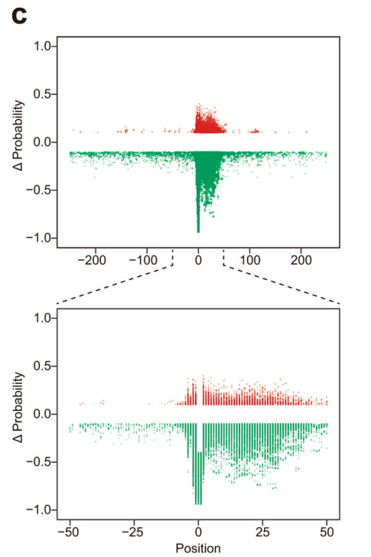
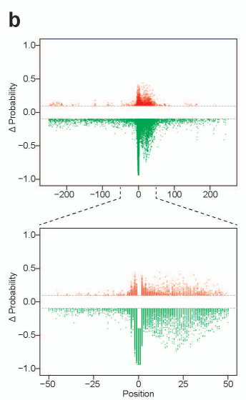

Slide 36
Cis-elements that govern the m6A deposition locate largely within 50 nt downstream of the m6A sites
To systematically and quantitatively analyze the cis-element effect on m6A deposition in the 50 nt downstream region, we implemented a linear regression approach (Fig. 2d) which had been demonstrated to be effective in identifying functional motifs for microRNA targeting and pre-mRNA splicing regulation: a substitution was made which created and disrupted five overlapping 5-mers simultaneously and the net effect for each pentamer motif was determined by the slope of the linear regression equation when pooling all the data (see details in the Methods).

Slide 37
Methods - Quantify the effect of all cis-element pentamers by linear regression.
To prepare the m6A sites in last exon for the systematic effect analysis of all pentamers, we first modeled the m6A probability by iM6A for all m6A sites in last exons. In addition, the probability should be ≥0.4. All of these sites were sorted based on their m6A probability value, and only a single m6A site with the highest probability value was kept for each gene.
We further selected the m6A sites which located at least 50 nt away from both last exon start and last exon end. We obtained 5292 sites for mouse and 4772 sites for human from which we randomly selected 1500 sites for both mouse and human, as 1500 sites was sufficient for our analysis. The same strategy is applied to the m6A sites in long internal exon (length > 100 nt), and we got 1460 sites for mouse and 1416 sites for human.
For each position in the downstream region of an m6A site (i.e., from position 3 to position 46), the nucleotide was substituted by each of three other nucleotides. The resulted probability change (ΔProbability) of this m6A site is calculated by iM6A. Each substitution created and broke 5 overlapping 5-mers simultaneously, and −1 or 1 was assigned to each of the five created or broke 5-mers. Linear regression was implemented to each 5-mers (total 1024 pentamers) when pooling all the data, then the effect of each motif was ranked based on the slope of linear regression equation and the statistical significance was quantified by p-value (Fig. 2d)

Slide 38
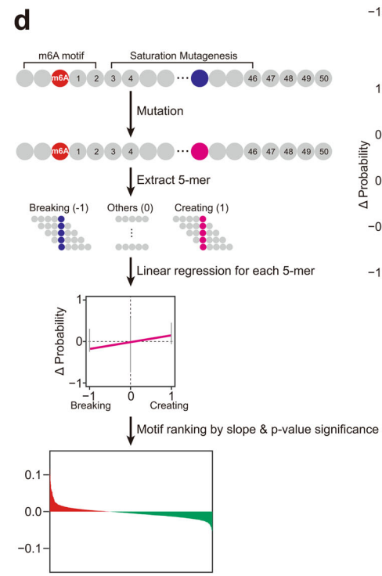

Slide 39
Cis-elements that govern the m6A deposition locate largely within 50 nt downstream of the m6A sites
Based on their effect value and the statistical significance, pentamer motifs were ranked, Top 20 enhancers and silencers were showed. For the last exon, the m6A enhancers included mostly part of the RRACH motif; the m6A silencers mostly contained the CG/GT/CT dinucleotides (Fig. 2e, f for mouse, and the virtually the same motif set for human, Supplementary Fig. 2c, d). Almost the same set of the m6A enhancers and the m6A silencers were obtained for the long internal exon (Supplementary Fig. 2f, g).
We also observed a strong effect value correlation for all pentamers between the study in the last exon and the study in the long internal exon (Fig. 2g for mouse, and Supplementary Fig. 2e for human), supporting that the same cis-element code governed m6A site-specific deposition in both locations. Moreover, the strong effect correlation was obtained for all pentamers between the study in mouse and the study in human (Supplementary Fig. 2h for the last exon, and Supplementary Fig. 2i for the long internal exon), supporting that both mouse and human had the same cis-element code in regulating m6A deposition for both the last exon and the long internal exon.

Slide 40
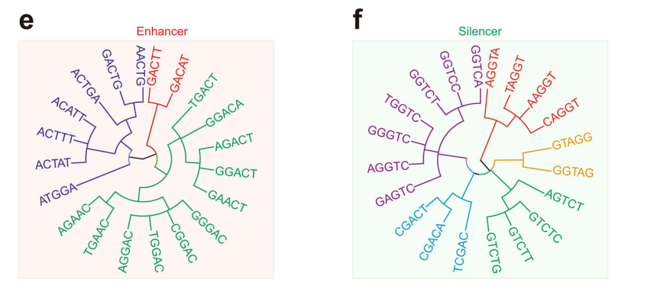
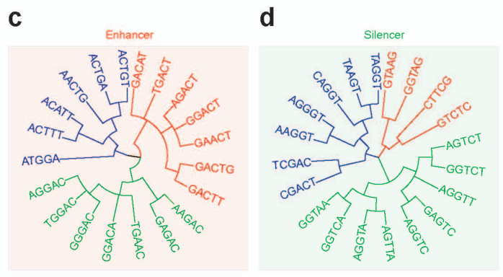

Slide 41
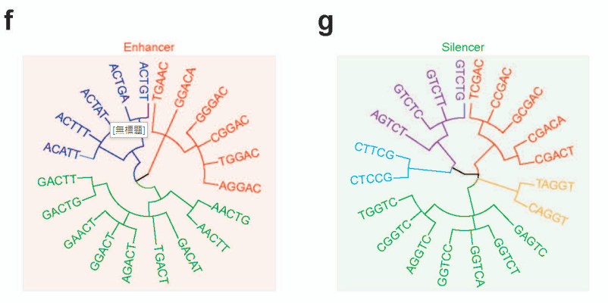
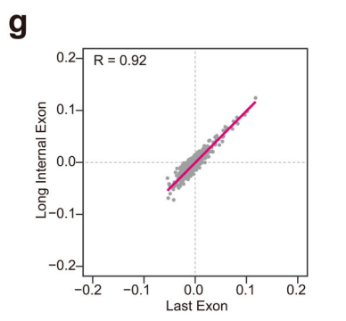
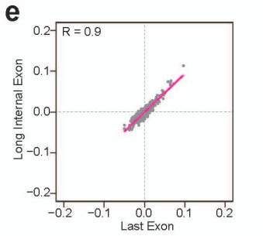

Slide 42
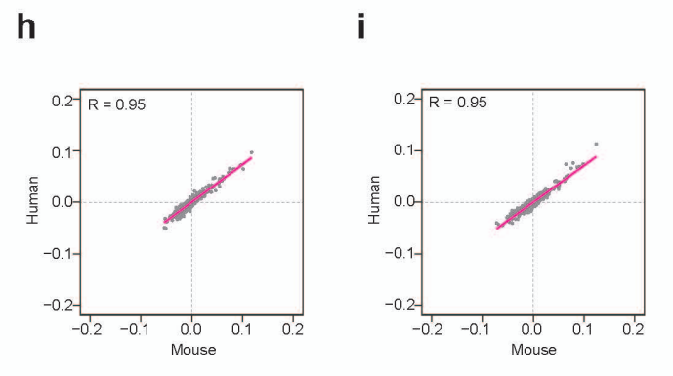

Slide 43
Cis-elements that govern the m6A deposition locate largely within 50 nt downstream of the m6A sites
We further investigated the m6A enhancer and silencer motif distribution in the region flanking the m6A sites. The m6A enhancers had a higher frequency around the m6A sites than the control that had the exact RAC motif matched (Supplementary Fig. 2h for mouse, and Supplementary Fig. 2j for human).
In contrast, the m6A silencers had a lower frequency around the m6A sites than the control that had the exact RAC motif matched (Fig. 2i for mouse, and Supplementary Fig. 2k for human). The difference in the downstream region of the m6A sites was more evident than upstream region (Fig. 2h, i for mouse, Supplementary Fig. 2j, k for human), supporting the hypothesis that the functional cis-elements largely resided in the 50 nt downstream of the m6A sites.

Slide 44
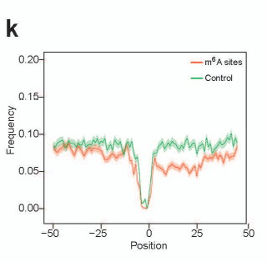
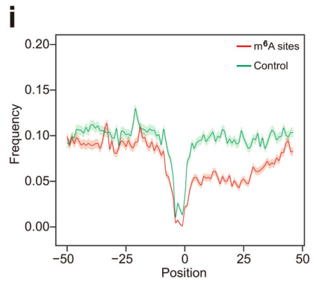

Slide 45
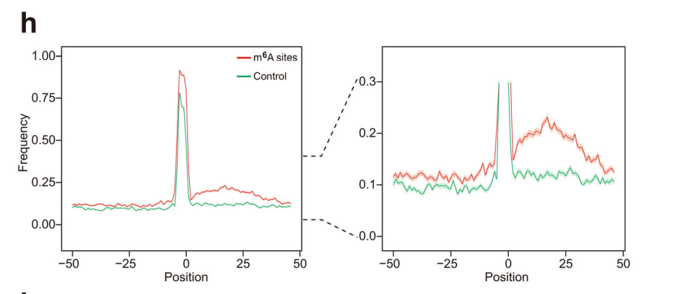
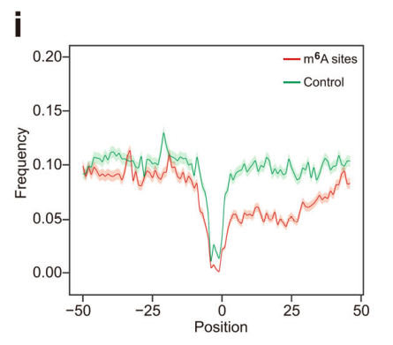
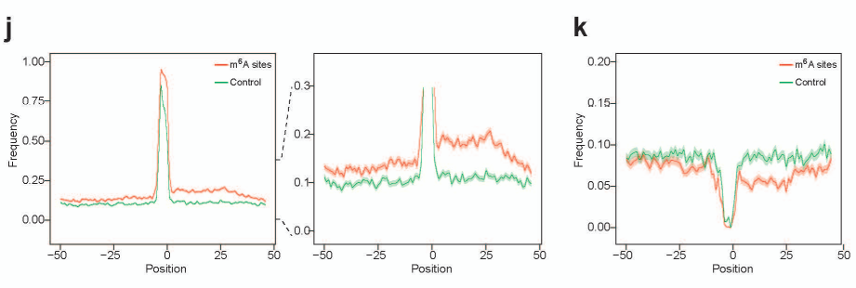
mouse
human

Slide 46
Method - Positional plot of pentamers in sequences flanking m6A sites
For the potential m6A sites in the RAC consensus at the last exons of each gene, we calculated their m6A probability values by iM6A. The m6A sites were sorted based on their m6A probability value, and a single m6A site with the m6A highest probability value were kept for each gene. We selected the m6A sites with the higher m6A probability values (probability ≥ 0.7) as the positive sites, while the control was the exact RAC motif matched site with a lower m6A probability value (probability < 0.1). For the m6A enhancer and silencer positional plot, we randomly selected 1000 positive sites or control sites located in the last exon, and extracted the 50 nt upstream and downstream sequence flanking the m6A site.
The pentamers were enumerated from the 5' end to the 3' end of the 101 nt sequence. For the positional plot, we counted the numbers of top 100 enhancers and top 100 silencers at each position of the 101 nt sequence (see details in the section for quantifying the effect of all cis-element pentamers). The frequency of the enhancers or silencers were also calculated. The plots were compared between the positive sites and the control, and the data were presented as mean ± S.E.M. standard error of the mean (Fig. 2h, i).

Slide 47
Cis-elements that govern the m6A deposition locate largely within 50 nt downstream of the m6A sites
Next, we examined the m6A enhancer and silencer motif distribution on several sets of the experimentally mapped m6A sites by different methods, including m6A-CLIP, m6A-labelseq, m6ACE-seq, and MAZTER-seq. The m6A enhancers showed consistently higher frequency in the positive m6A sites than the control (Supplementary Fig. 3a, c, e, g, i, k, m) for both human and mouse dataset, while the m6A silencers exhibited lower frequency (Supplementary Fig. 3b, d, f, h, j, l, n). All of these positional distribution investigations confirmed that the frequency difference for the m6A enhancers and silencers was more evident in the downstream region of m6A sites than the upstream region, and generally true regardless of the experimental approaches that mapped the m6A sites.

Slide 48
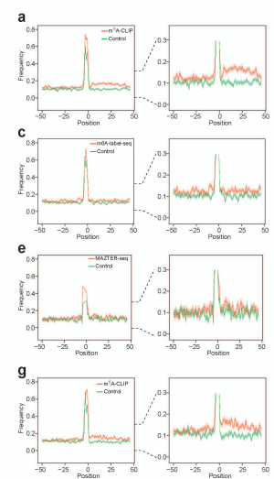
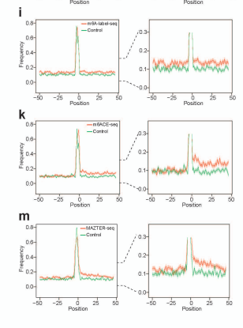

Slide 49
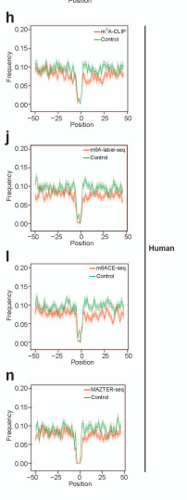
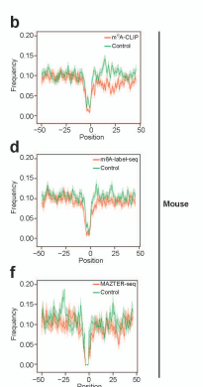

Slide 50
Method - Positional plot of pentamers in sequences flanking m6A sites
In parallel, we collected the m6A sites detected by different experimental methods, including m6A-CLIP, m6A-label-seq, m6ACE-seq, and MAZTER-seq. The experimentally determined m6A sites (m6A-CLIP, m6A-label-seq, m6ACE-seq, and MAZTER-seq) served as the positive sites while the control was the exact RAC motif matched site which was not determined by the experimental methods. Moreover, those control sites did not overlap with the m6A peak regions and came from the transcripts that also contained the positive sites. For the sites detected by MAZTER-seq, we intersected it with the sites determined by other methods (m6A-label-seq, m6ACE-seq, and m6A-CLIP) to get the high-quality sites as to lower the multiple technical noises of MAZTER-seq as discussed in Garcia-Campos et al. 2019.

Slide 51
Cis-elements that govern the m6A deposition locate largely within 50 nt downstream of the m6A sites
Furthermore, we conducted the study for the sequence conservation flanking the m6A sites and found that the flanking sequences of the m6A sites were more conserved than that of the control (Fig. 2j for mouse, and Supplementary Fig. 2l for human).
Moreover, the functionally greater importance of the downstream sequences flanking m6A sites compared with upstream sequences was supported by their being more conserved cross species and the fact that such conservation did not exist in the control. (Fig. 2j for mouse, and Supplementary Fig. 2l for human).

Slide 52
Cis-elements that govern the m6A deposition locate largely within 50 nt downstream of the m6A sites
At last, given that the enhancers surrounding the m6A sites include mostly part of RRACH motif, which are potential motif for methylation, we examined the distribution of methylated sites flanking the m6A sites. We found that the RAC sites adjacent to m6A sites have a higher frequency to be m6A sites (Supplementary Fig. 2m), indicating it’s more likely to be methylated.
The RAC sites adjacent to non-m6A sites have lower frequency to be m6A sites (Extended Data Fig. 2n), indicating it’s unlikely to be methylated. Moreover, both methylated and non-methylated RAC sites are enriched in the downstream 50 nt region of m6A site (Extended Data Fig. 2m), suggesting both could enhance m6A deposition.

Slide 53
Cis-elements that govern the m6A deposition locate largely within 50 nt downstream of the m6A sites
Taken together, our data strongly supported that the ciselements regulating m6A deposition largely reside within the 50 nt downstream of the m6A sites, with additional functional subsequences being less concentrated in other regions (Fig. 2b, c, and Supplementary Fig. 1q). Enhancers include mostly part of RRACH motif, while silencers generally contain CG/GT/CT motifs.

