Slide 1
DNA6mA-MINT: DNA-6mA Modification Identification Neural Tool

Slide 2
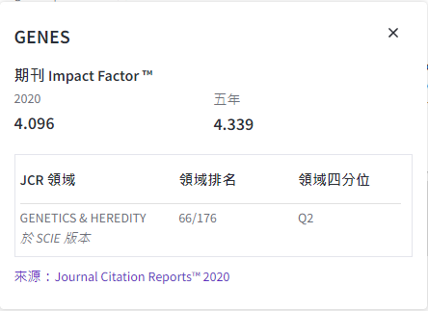
Impact factor

Slide 3
Outline
Introduction
Datasets
Model
Evaluate
Result

Slide 4
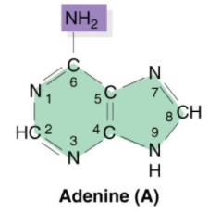
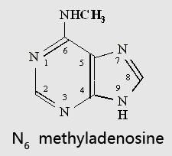
INTRODUCTION
In genomes of distinct species, DNA N6 -methyladenine (6mA) illustrates a crucial epigenetic transformation. DNA 6mA is a non-canonical process that modifies the catalyzed adenine ring of DNA methyltransferases.

Slide 5

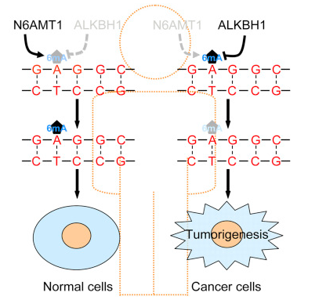

INTRODUCTION
Recent research established that uneven 6mA modification has a role in different diseases such as cancer, immune systems, and others.
Therefore, this makes it necessary to identify a 6mA position in the genome sites.

Slide 6

INTRODUCTION
For the identification of 6mA, diversified techniques can be found in the literature
ultraviolet absorption spectra(紫外線吸收光譜)
paper chromatographic movement(紙色譜法)
electrophoretic mobility(電泳遷移率)
Although this method was not efficacious enough to be used for detecting 6mA transformations in animals, this led to an introduction of another technique for identifying 6mA modification using a restriction enzyme, but this approach was only capable of identifying transformed adenines that are present in the target motifs.

Slide 7
INTRODUCTION
For the detection of 6mA sites in prokaryotes and eukaryotes, numerous techniques were proposed such as
single molecule real-time (SMRT定序)
methylated DNA immunoprecipitation(甲基化DNA免疫沉澱定序)
ultra-high performance liquid chromatography with mass spectrometry(高效液相層析 + 質譜法)
metabolically generated stable isotope-labeled deoxynucleoside code(代謝產生的穩定同位素標記的脫氧核苷密碼)
Chlamydomonas genes carry 84% N6 -methyladenine modifications, which was identified after 6mA an immunoprecipitation sequencing experiment .
SMRT sequencing found out that adenines of methylated sites carry 2.8% of initial-diverged fungi .
Utilization of SMRT, 6mA immunoprecipitation, and mass spectrometry result in 0.2% of adenines being methylated.

Slide 8
INTRODUCTION
The experimental techniques proved to be expensive and prolonged processes, therefore researchers tried to come up with computational techniques for prediction of DNA 6mA modifications.
iDNA6mA-PseKNC was the first ever N6 -methyladenine modification prediction tool for the Mus musculus genome. iDNA6mA-PseKNC proposed sequence sample formulation for feature extraction and employed six different classifiers to identify the modification.
csDMA is another reported tool that predicts the modification in N6 -adenine methylation, which used K-mer pattern, KSNPF frequency, nucleic shift density, binary code, and motif score matrix for extraction of the feature vector of the sequence. Further, they deployed 5 different classifiers to evaluate the performance of the extracted feature set.
6mA-Finder was introduced as an online tool for predicting 6mA modification. 6mA-Finder engaged seven sequence encoding schemes to get three types of physico-chemical features encoded. These encoded features were then embedded in seven different classifiers to evaluate the performance of encoded features.
i6mA-Pred is an identification tool for N6 -methyladenine modification in the rice genome

Slide 9
INTRODUCTION
In recent years, Neural Network (NN)-based techniques, especially Convolution Neural Network (CNN), have shown tremendous improvement in many different research problems, e.g., in medical imaging and bio-informatics , while the use of CNN for DNA-6mA modification identification is still in the infancy.
Recently, a technique called iIM-CNN was reported by Wahab et al., which uses a CNN-based model for the N6-adenine methylation modification identification in genomes of different species.
The proposed CNN model in iIM-CNN carries two convolution layers with two max-pooling layers and a set of fully connected layers. iIM-CN showed high performance in prediction of N6 -methyladenine modification, somehow still, a research space is available where many aspects of CNN can be explored more.

Slide 10
INTRODUCTION
This article aims to provide a CNN and Long Short-Term Memory (LSTM)-based efficient tool named DNA6mA-MINT, for DNA 6mA modification identification. The proposed model uses CNN for feature extraction while LSTM gives optimal interpretation to those features.
The proposed architecture demonstrates higher performance than the existing state-of-the-art techniques on the “combined-species”, M. musculus genome, and rice genome benchmark datasets.
When compared with respective models available in the literature, Matthews Correlation Coefficient (MCC) for the “combined-species” benchmark dataset is noted with an increase of 20.83% for 5-fold cross-validation

Slide 11
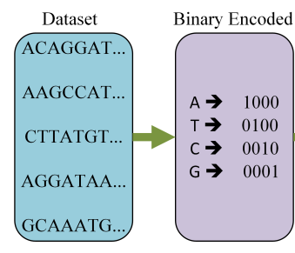
Datasets
Species | Positive data | Negative data
M. musculus (41bp) | 1934 | 1934
Rice (41bp) | 880 | 880
Combined-species (41bp) | 2768 | 2716
The M. musculus genome database for DNA 6mA was proposed in 2018 by Feng et al. The 6mA sites available in the mouse genome were collected from MethSMRT database with Gene Expression Omnibus (GEO) accession number GSE71866.
Another dataset was on the rice genome, which was presented in 2019 by Chen et al.. This dataset consists of 880 samples for each positive and negative case. The 6mA sites in rice genomes were provided by Zhou et al. with GEO accession number GSE103145.
While the “combined-species” dataset did not contain sequence redundancy, which is eliminated by CD-HIT software, the rigorous sequence identity threshold was 0.80.
The length of all sequences in the datasets are 41 bp centered with the 6mA and non-6mA site.

Slide 12
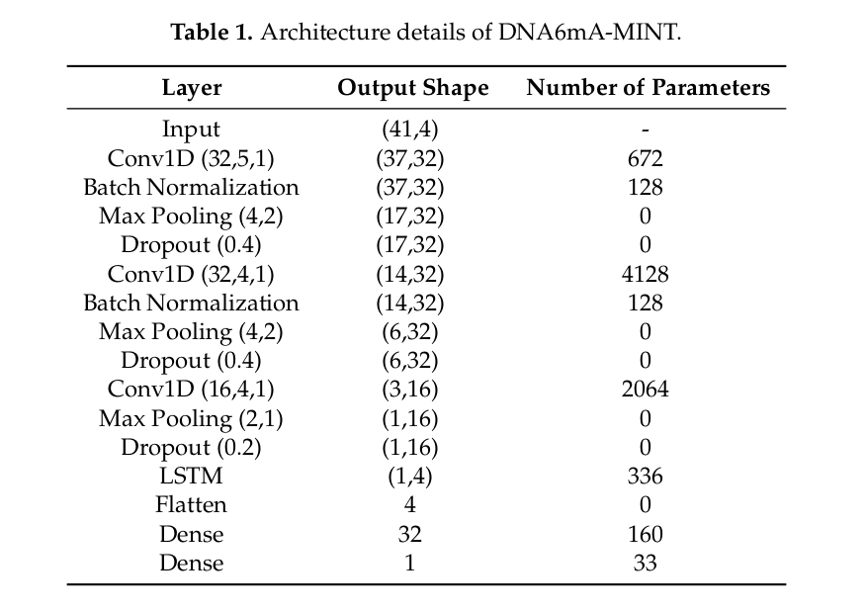
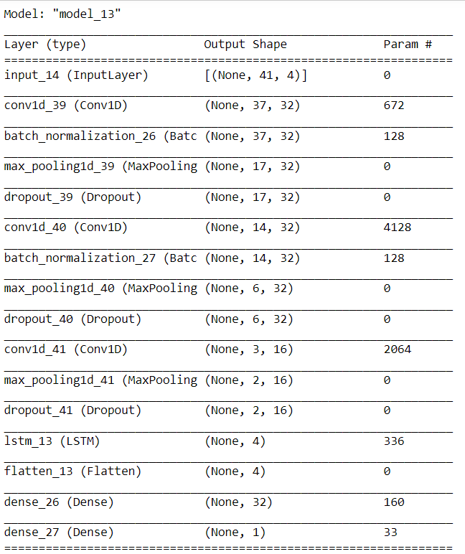
Model

Slide 13
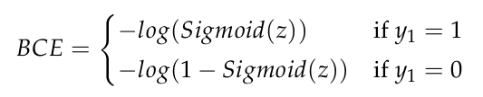
Model
DNA6mA-MINT is implemented on the Keras framework. The output of the sigmoid activation function will be an input to the objective function. Binary cross-entropy is used as an objective function and its equation is as follows,
where y 1 is the label for class sample.
Stochastic gradient descent reduces the computational complexity by achieving faster iterations. In the optimization process, the learning rate and momentum were set to 0.004 and 0.9 respectively.

Slide 14
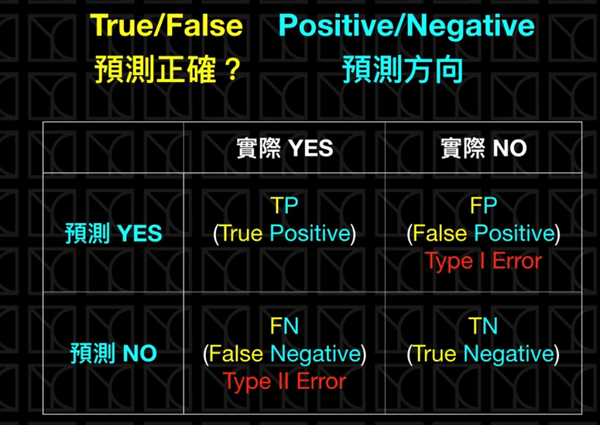

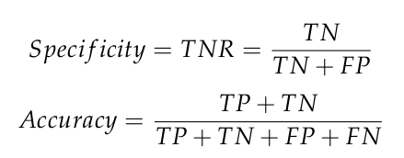

Evaluate

Slide 15
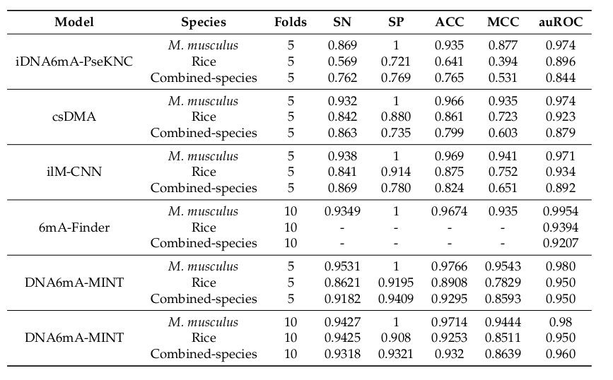
result
In the case of M. musculus genomes, compared on 10-fold cross-validation, the 6mA-Finder exhibits higher auROC then the proposed model.
In the case of Rice genomes, 6mA-Finder has not reported results for all figures of merit, but the reported auROC achieved by 6mA-Finder is lower than that achieved by the proposed model in 10-fold cross-validation.
In the cross species, for 10-fold cross-validation, the proposed model illustrated an increase of 3.93% in auROC when compared with 6mA-Finder. The sharp increase in MCC depicts the higher quality of the DNA6mA-MINT in comparison to existing state-of-the-art tools.

Slide 16
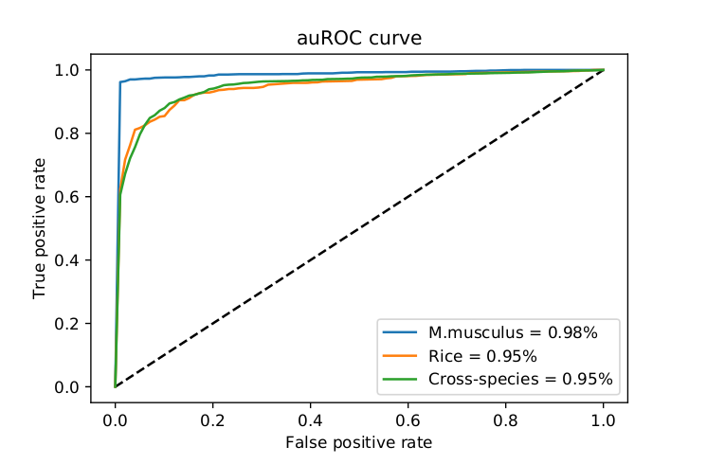
result
Especially in the case of M. musculus, which is almost near to ideal. Upon evaluation of DNA6mA-MINT on the “combined species” independent dataset with 10-fold cross-validation, a massive increase of 8.99% is observed in auROC.
The 6mA Finder has reported 92.07% auROC while the proposed model has achieved 96% auROC for “combined-species” independent dataset. The high performance shown by the DNA6mA-MINT depicts the reliability of the proposed tool.

Slide 17
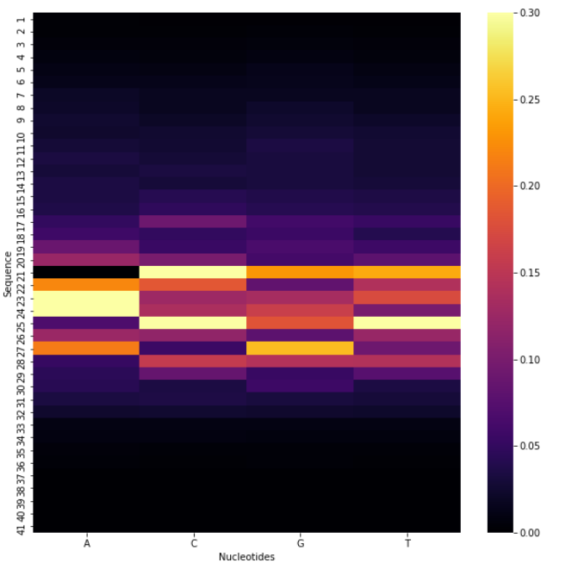
result
Last, the averaged predicted score for all the mutations over all the sequences in the benchmark dataset is computed to construct the heat map.
Figure represents the constructed heat map illustrating the important position of the input sequence.
As can be seen, the final prediction is more affected by the mutations occurring at the center of the sequence than the mutations happening on both sides of the sequence.

Slide 18
result
In order to study the generalization of DNA6mA-MINT we have prepared additional dataset for Rice genome (which is a part of our future work) from the NCBI Gene Expression Omnibus (https://www.ncbi.nlm.nih.gov/geo/) under the accession number GSE103145. We have prepared from this repository 10,000 positive sequences and 10,000 negative sequences that are not 6mA.
Obtained values for sensitivity, specificity, and accuracy are 84.77, 82.78, and 83.76, respectively. The obtained results show that proposed model generalizes well to the new sequences.

Slide 19
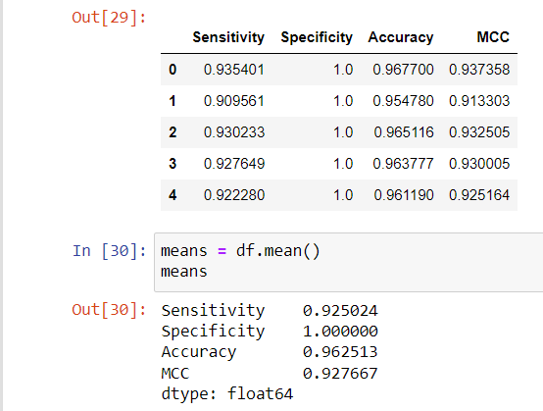
M. musculus

Slide 20
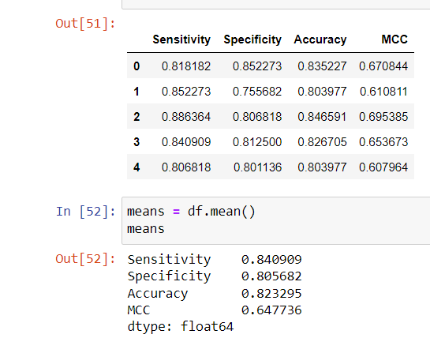
Rice

Slide 21
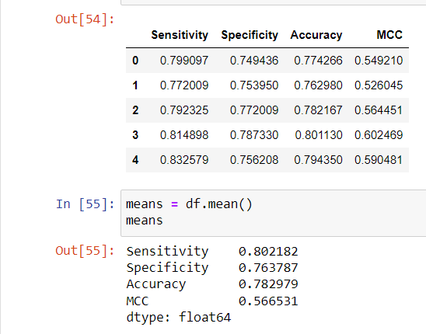
Combined-species

